Slide 1
White Wine Quality Prediction using Machine Learning
Andy de Wind & Karin Ferrada

Slide 2
PROJECT OBJECTIVE
This project will use a Machine Learning technique to predict the quality of white wine and is completed in the following steps:
Collect data
Load the data
Clean and Transform the data
Select wine characteristics to train the data on
Scale and Normalise the data
Choose a machine learning model
Fit the Model to the scaled training data
Quantify the model and compare the fit of trained to test data
Save the model to enable predictions using the scaled test data

Slide 3

DATA PREPARATION Clean and Transform
The csv file was read into a Pandas data frame and the following done to the data frame:
# Drop the null columns where all values are null
white_wine_df = white_wine_df.dropna(axis='columns', how='all')
# Drop the null rows
white_wine_df = white_wine_df.dropna()
Columns were renamed to remove spaces in the column names
white_wine_df.rename(columns={'fixed acidity’:'fixed_acidity’,
'volatile acidity': 'volatile_acidity’,
'citric acid': 'citric_acid’,
'residual sugar': 'residual_sugar’,
'free sulfur dioxide': 'free_sulfur_dioxide’,
'total sulfur dioxide': 'total_sulfur_dioxide' }, inplace=True)
Min and Max values for each characteristic were extracted using the describe() function and written to a file. This was to be used later in the prediction web page.

Slide 4


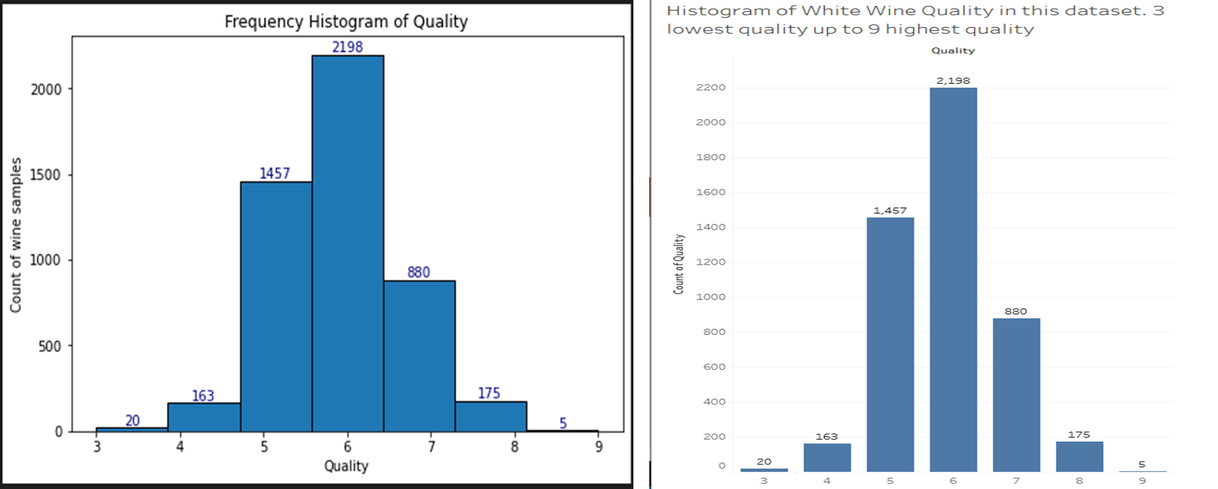
DATA PREPARATION Explore the data
Using Matplotlib and Tableau a Frequency histogram was drawn to see the range of quality: Most of the wine samples were in the 5-7 quality range

Slide 5

DATA PREPARATION Tableau Visualisations
Using Tableau bar charts were created by plotting quality against each of the 11 characteristics to better understand the data visually.
On the next slide are samples of the bar charts of quality plotted against the various characteristics within the dataset

Slide 6
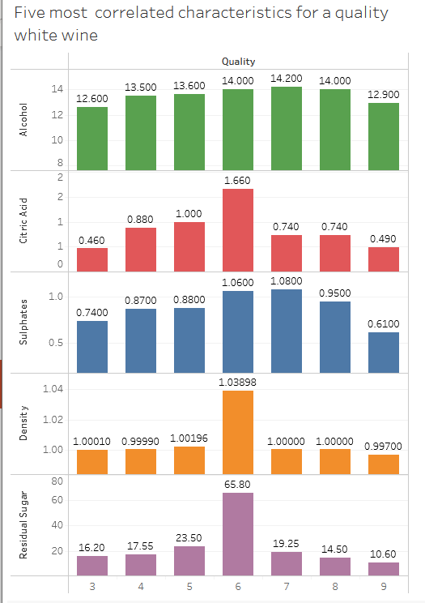
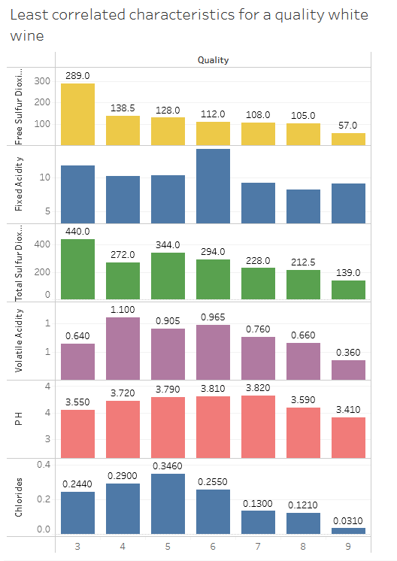
DATA PREPARATION Tableau Visualisations
What was uncovered was that : Alcohol, Citric Acid , Sulphates, Density and Residual Sugar were highest in the most common quality wines i.e. the 5-7 bracket
The lowest rating characteristics in this quality bracket are : Fixed Acidity, Volatile Acidity, Chlorides, Free Sulfur Dioxide, Total Sulfur Dioxide and pH

Slide 7

DATA PREPARATION Scale and Normalise the Data
It was decided that all 11 characteristics would be used to train the model (X_train and X_test) and quality would be the y value
sklearn’s train_test_split was used on the X and y data to train the data. A random percentage of the dataset would be used for training and the rest for testing.
A StandardScaler was used to normalise and transform the data so that all X characteristics values would be scaled to have similar means and standard deviations.

Slide 8
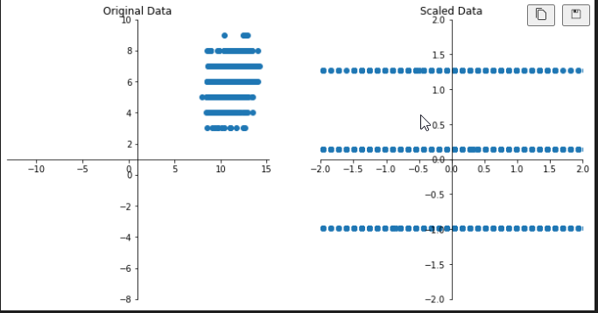
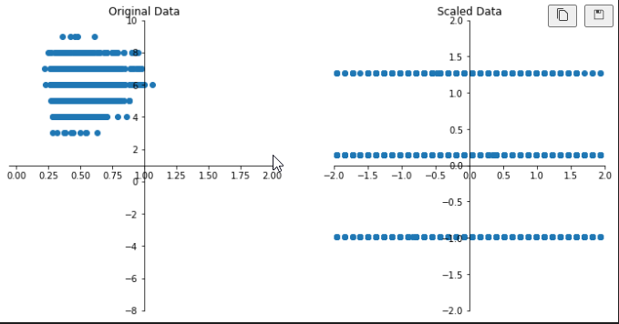
DATA PREPARATION Scale and Normalise the Data
Alcohol values before and after Scaling and Normalisation
Sulphates values before and after Scaling and Normalisation

Slide 9

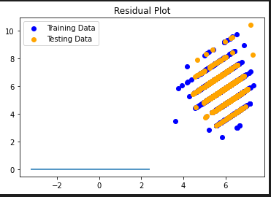
DATA PREPARATION Train & fit the model
Next step was to fit the Model to the scaled training data and make predictions using the scaled test data
The model chosen was the LinearRegression supervised model. It was chosen because the data had independent values (characteristics) which led to a single discrete value (quality)
Each of the characteristics were independent but together they resulted in a single value. Below is a plot of the model comparing the fit between the training and test data. Pretty good fit!
The model and the X_scaler were then saved for future use using the python library joblib

Slide 10

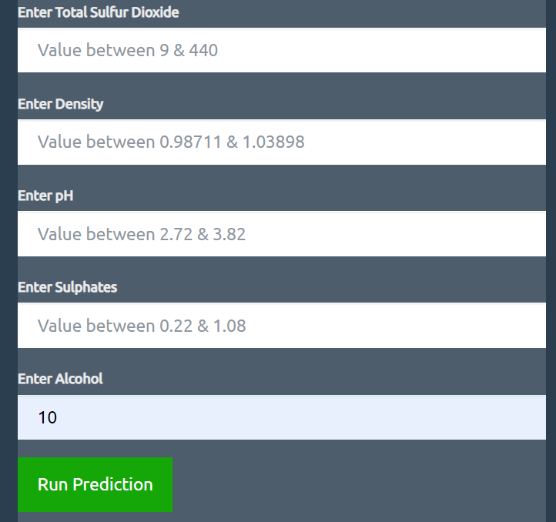
Model Deployment Flask app
The Joblib saved model and X_scaler were utilised in the flask app to allow a wine maker to predict the quality of their wine using values for the 11 (X value) characteristics.
Flask “app.py” renders all our HTML templates and guides the wine maker to the “predict_new_wine.html”
On this page the wine maker enters the 11 characteristics on the form

Slide 11



Deployment HTML & Heroku
The prediction is run by obtaining the inputs via the “POST” method
Inputs put into a dictionary which the model is then run to predict the quality of wine and rendered to the HTML page
Gunicorn was utilised to serve the Flask application at Heroku
The Heroku platform was utilised as it allows the applications to run directly in the cloud and allow any user to submit a request

Slide 12
Conclusion Findings/Limitations
Model successfully created via Machine Learning to predict the quality of wine
The characteristics that were utilised in this model are an objective measure whilst the quality of wine is a subjective measure and is an established by an individual
Utilise other models to predict a quality of wine
Obtain further data from different wine regions around the world
Flask deployment and utilising the “POST” method
Heroku deployment and it being fully functional
More time on HTML & CSS

