Slide 1


Slide 2

Table of content
History
About MySQL
Graphical user interfaces
MySQL Workbench
Demo
Exercise

Slide 3
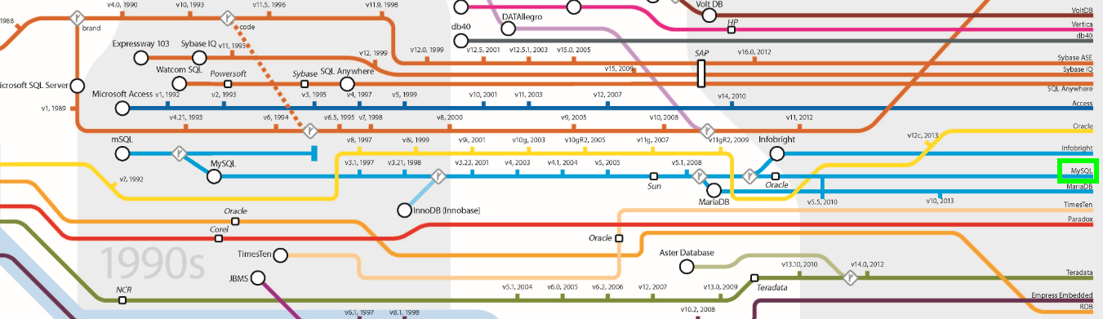
History
Notes:
Created by Swedish company MySQL AB
First version appeared in 1995
2009 Sun Microsystems acquired MySQL AB
2010 Oracle aquired Sun Microsystems

Slide 4
About MySQL
Name from daugther „My“ and the language „SQL“
Open-source relational database management system (RDBMS)
World‘s second most widly used RDBMS
Used for example in WordPress, Google, Twitter
Notes:
Name compound from the daugther‘s name of the co-founder, called „My“ and the Structured Query Language used for the database
Open-source → it‘s free

Slide 5










Graphical user interfaces
Notes:
HeidiSQL
LibreOffice

Slide 6
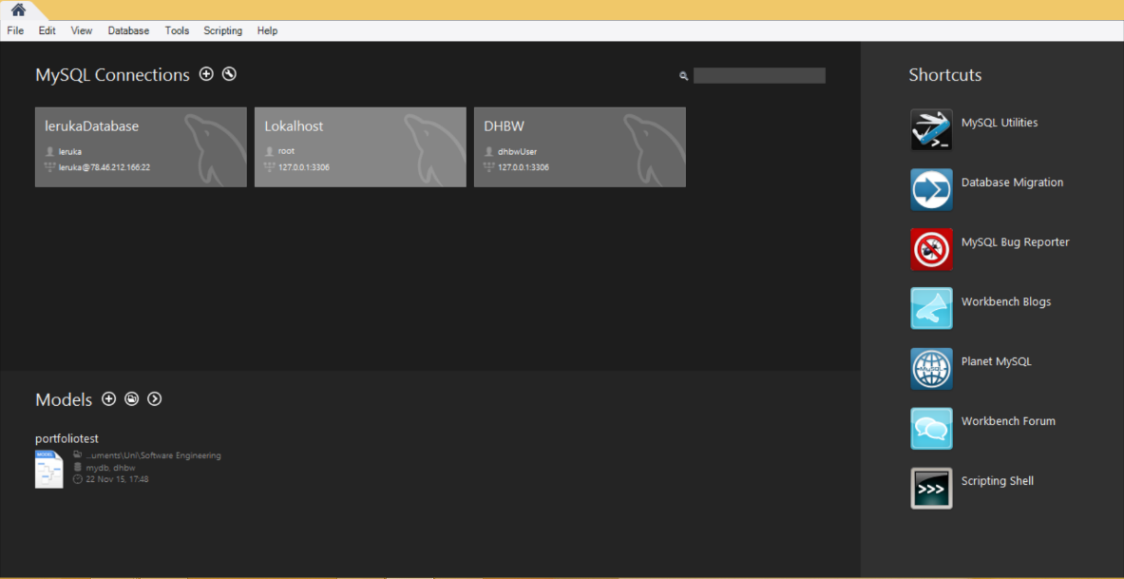
MySQL Workbench
official integrated environment of MySQL
Integrates SQL developement, administration, database design, creation and maintance

Slide 7
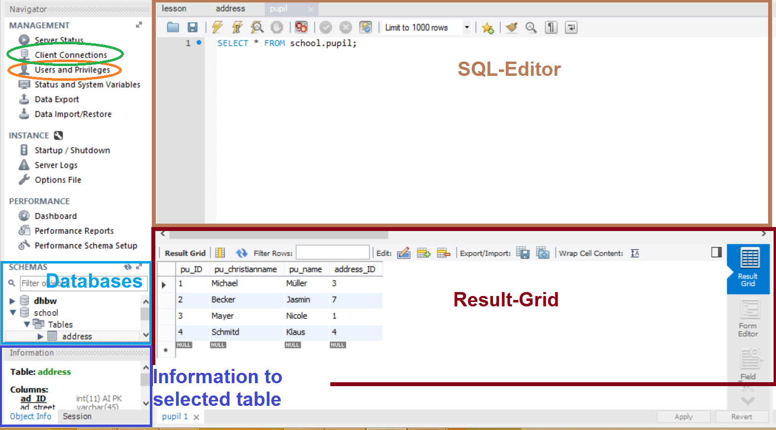
What is what?

Slide 8
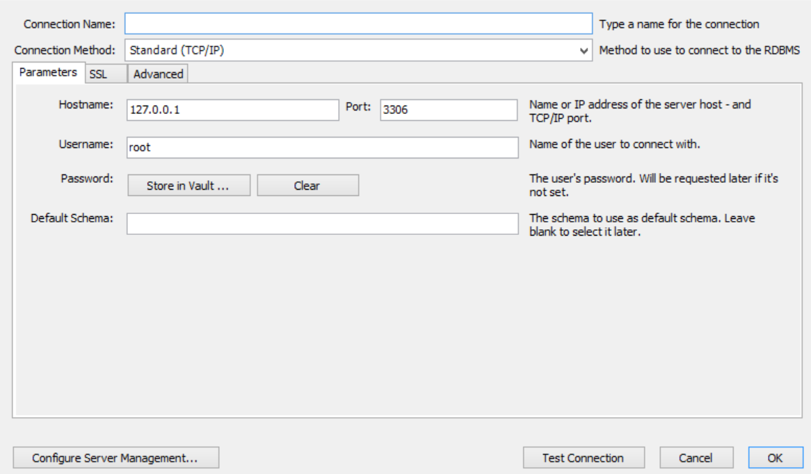
connection
TCP/IP; TCP/IP over SSH; socket
Give a connection name
IP and port where server is hosted
Special user with password
Notes:
TCP/IP (over SSH) with the IP and the port
Socket only if server is on the same computer as you
Connection name will be displayed in the home screen
User have to be created

Slide 9
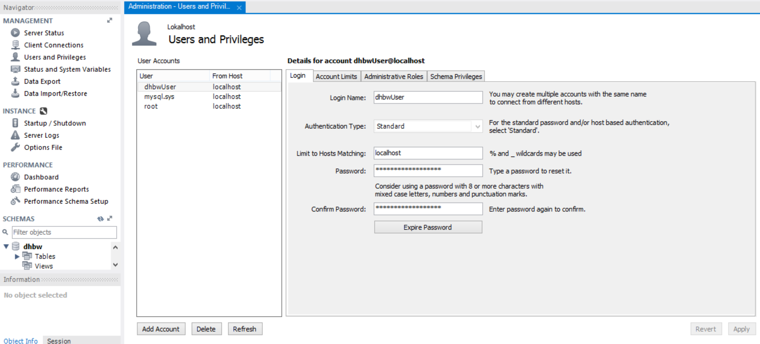
users and roles
username, hosts and password
administrative role
schema priviliges
(create, insert, delete,…)
Notes:
Username and password
Hosts which are allowed for the user
Administrative role: DBManager, UserAdmin(creates user logins, reset password)
Schema privileges: create database/table, alter, drop, insert/update/delete data, etc.

Slide 10
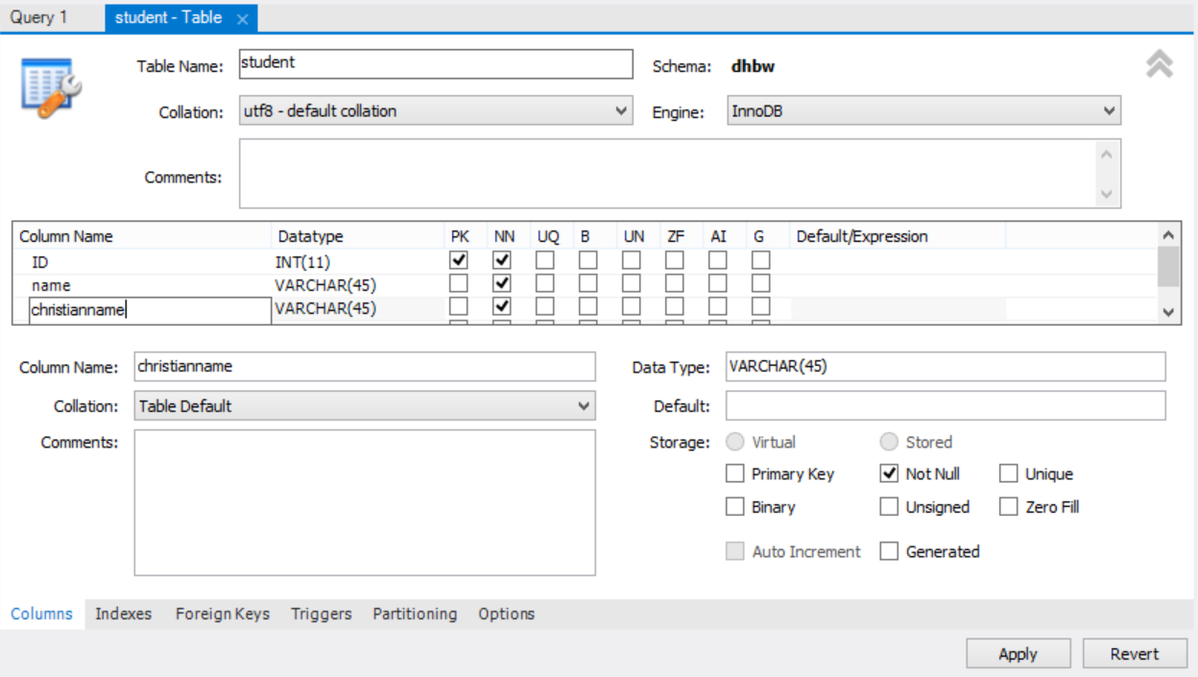
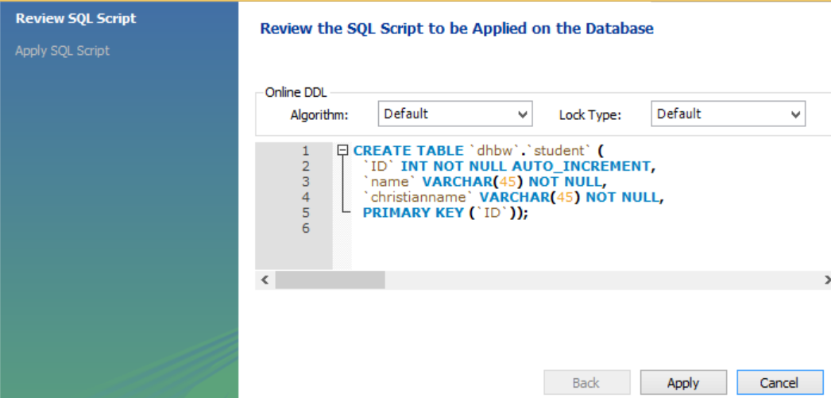
create table
table name
choose column name, datataype and properties
foreign key
indexes
generates the SQL command
Notes:
datatype: int, varchar, decimal, datetime, char, …
Foreign key: reference from a column to another column of another table

Slide 11
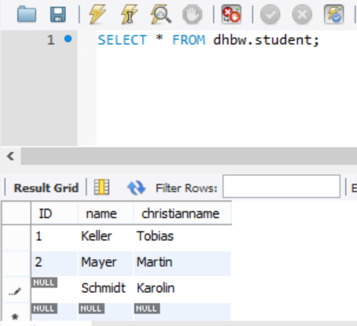
insert, change, delete data
in result grid change, add or delete columns
all SQL commands are possible in SQL Editor too

Slide 12
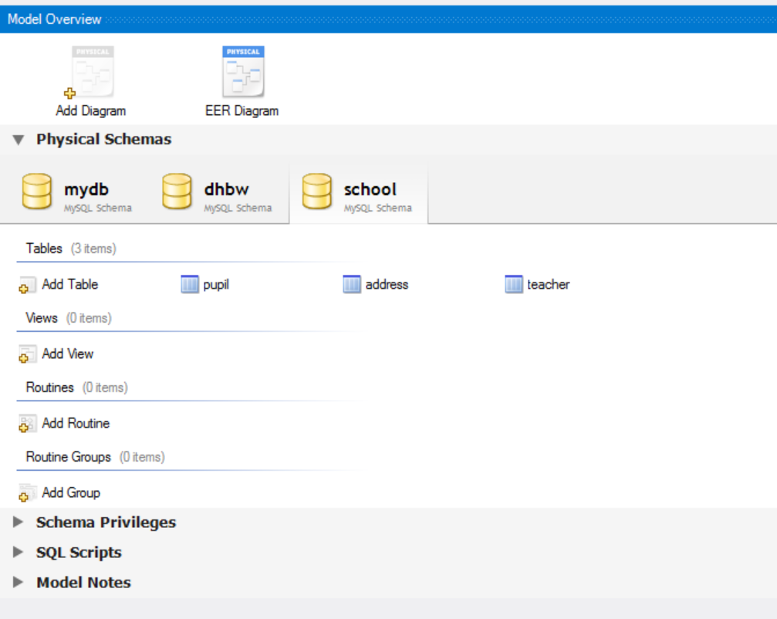
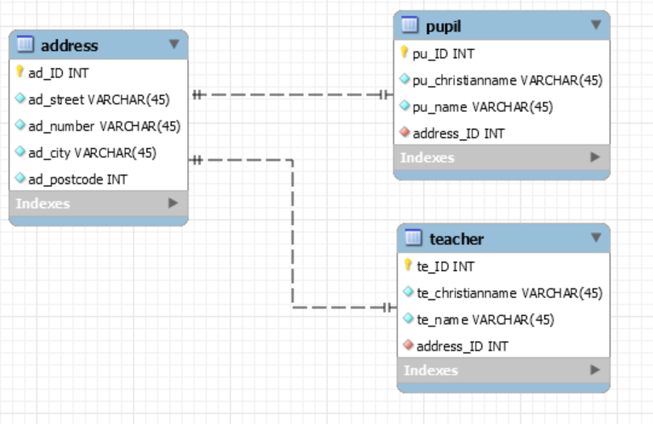
ER-diagram
press „Reverse Engineer“
choose a connection and schema
you can see the ER-Diagramm of the schema
you can create a new schema with tables
change things in tables or relations
press „Forward Engineer“ and choose connection
so it will create or update the schema

Slide 13
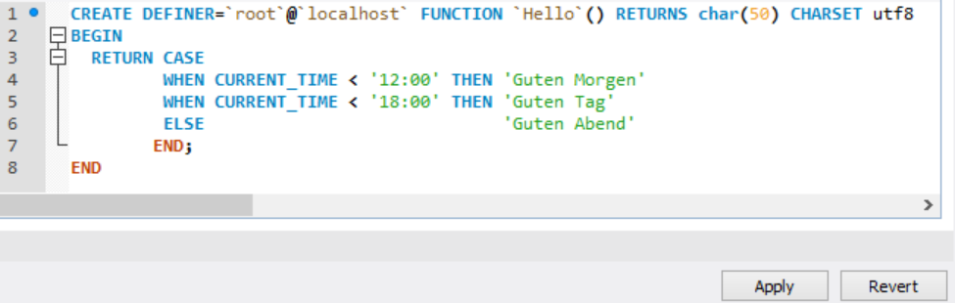
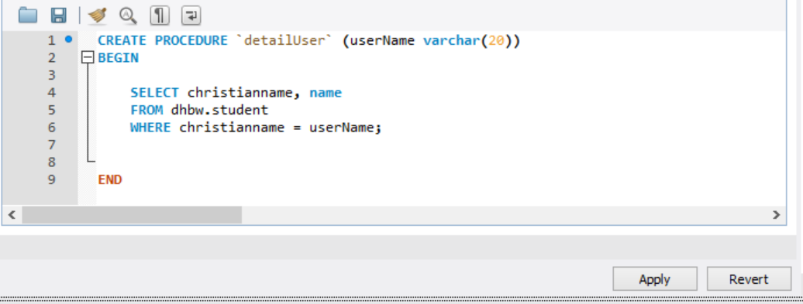
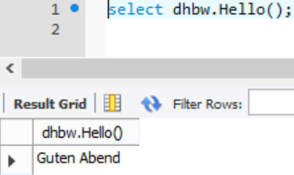
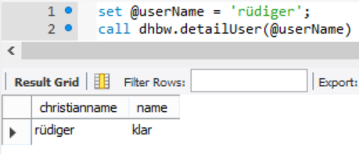
functions and stored procedures
Notes:
Function returns a value
Function can be called from a SQL Statement
Procedures don‘t return value
You can declare outputs with OUT → multiple values to return
Procedure cannot be called from SQL-Statement! Use the CALL statement

Slide 14
DEMO

Slide 15
exercise
open the connection to your server as root
execute the school.sql script available at https://github.com/KFrank12/MySQL
create a user „erwin“ which has only the right to change, add or delete data in the tables and create a new table in the database „school“
create connection for user „erwin“ and connect
create new table „class“ with columns for classname and the class teacher
add relation between „class“, „teacher“ and „pupil“

