Slide 1
Aspire: Onboarding and dev experience of the future?

Slide 2

The brownfields onboarding process
Install Dependencies
Oops wrong connection string in dbup, wiped wrong database
Figure out which app you need to run
Wrong node version
Database setup?
Build everything
Debug the things
Where does logging go?
Also which apps need to run to support the one you want
Sort out auth, secrets, and config
Run the things

Slide 3
Some other brownfields onboarding tropes
Running api and ui separately?
Is database locally creatable and seedable, or need real backup?
Overriding shared vars like connection strings in all the different projects
How to run just one out of 50 functions in Azure function?
Notes:
Running together vs running separate

Slide 4
Onboarding: Past and future?
How we solve these now
ResetTheWorld.ps1
Detailed Readme
Startup profiles in VS/Rider
How we could be solving them
Aspire ✨
And a good readme ☺

Slide 5
Fixing all that with Aspire!
Central configuration to override all projects
Define project relations and have a button to run several projects at once
How to run just one out of 50 functions in Azure function?
Have a picker!
Local logging built in

Slide 6
And moar!
Automatic OTEL
Metrics
Logs
Traces
“Infra” graph
What more could you want!
Config management
Infra export

Slide 7
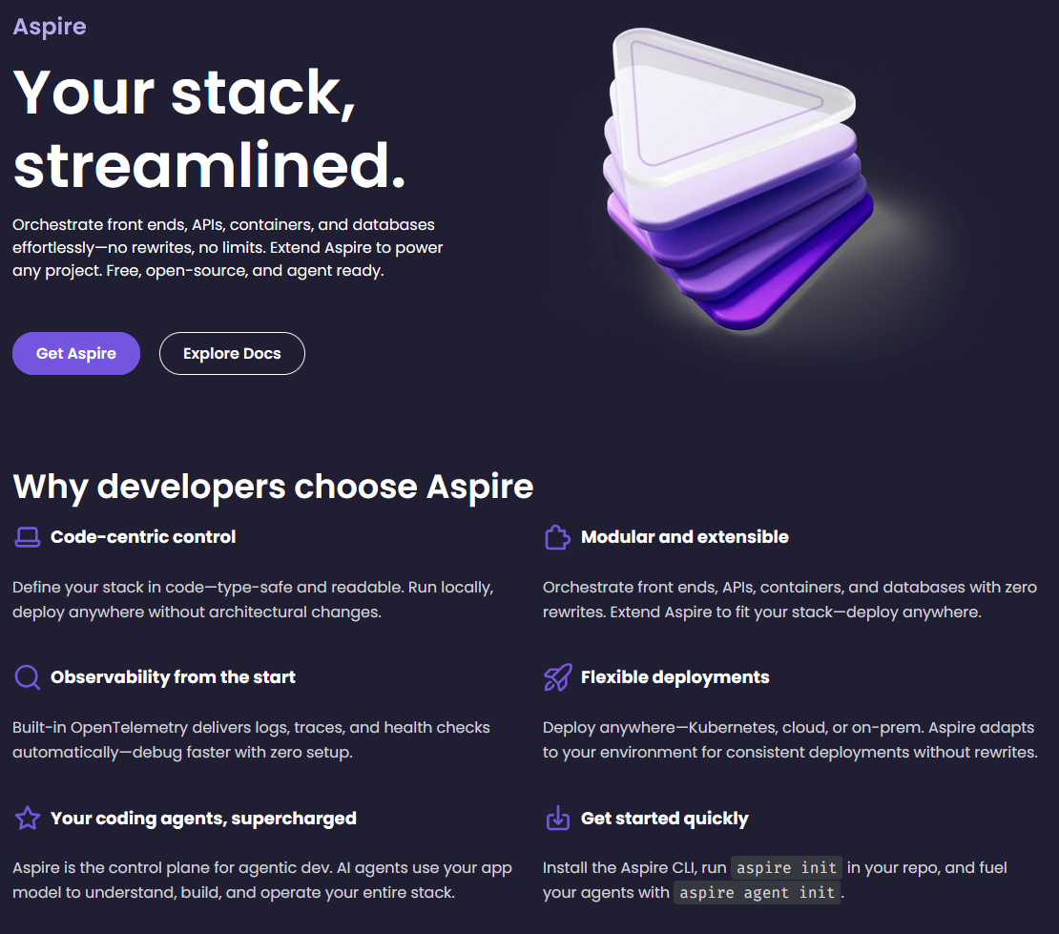
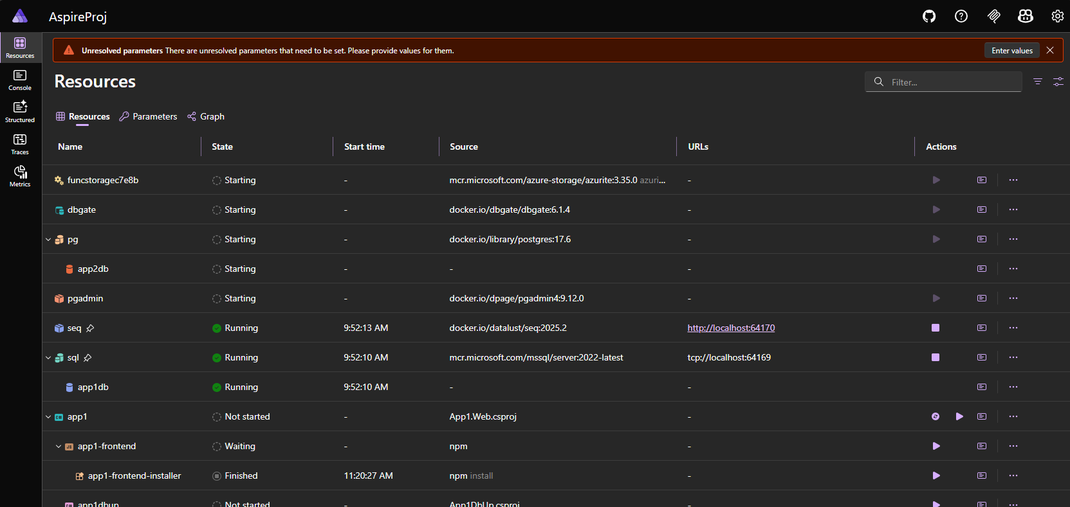
Hold up, what actually is this Aspire thing?

Slide 8
Demo setup
Several aspnetcore apps
React UIs
Azure function for funsies
SQL server database and Postgres DB
Seq (could be any others OR even none)
Database managers (pg4admin, SQL???)
User Secrets for local overrides

Slide 9
DEMO
Notes:
Specific scenarios to run through:
Unresolved parameters solves “go get variables from lastpass”
Which project seeds dbs?
How do I just run everything up? Grouped start parameter
How do I change shared config? Just one place!

Slide 10
Sounds too good to be true…
Friction for running day to day
Still a decent amount of work to get running
Don't forget to actually setup your infra correctly so when you deploy there are things to override...
Harder to understand the flow?
Sometimes, people just don't like it ¯\_(ツ)_/¯

Slide 11
Give it a go ☺
Notes:
Specific scenarios to run through:
Unresolved parameters solves “go get variables from lastpass”
Which project seeds dbs?
How do I just run everything up? Grouped start parameter
How do I change shared config? Just one place!

