Slide 1

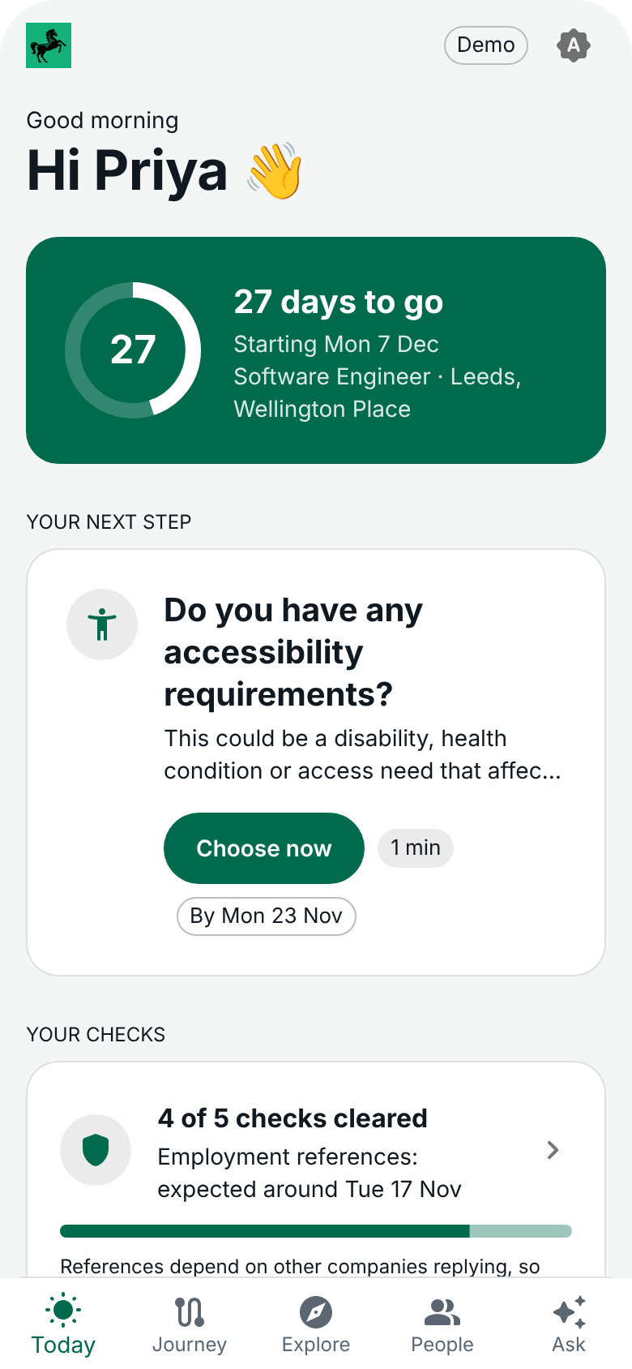
LBG Joiner Companion
From offer accepted to connected and confident by Day 30
Team 04 · Launchpad '26
Notes:
[15 sec] We're Team 04. This is a phone companion for people joining the bank, from the day they accept the offer to Day 30. Our measure of success is not tasks ticked off. It is whether the joiner feels connected and confident by Day 30.

Slide 2
The silence before Day 1 is the risk
Joiners do not need more content. They need a guided journey through weeks of vetting.
+22%
45%
6 weeks
higher odds of a no-show for every extra week between offer and start
of new-hire ghosting happens between the offer and Day 1
is how long a regulatory reference can take for a senior (SM&CR) hire
Speer, 2026 (peer reviewed)
Click Boarding (vendor survey)
FCA Handbook, SYSC 22
Notes:
[30 sec] The riskiest stretch is the long quiet wait while checks run. Each extra week between offer and start raises the odds of a no-show by about 22 percent. Nearly half of ghosting happens in exactly this gap. And for senior regulated roles a reference alone can take six weeks. Today the joiner hears very little in that time. That is the gap we fill. (The 45% figure is from a vendor survey, so treat it as indicative.)

Slide 3
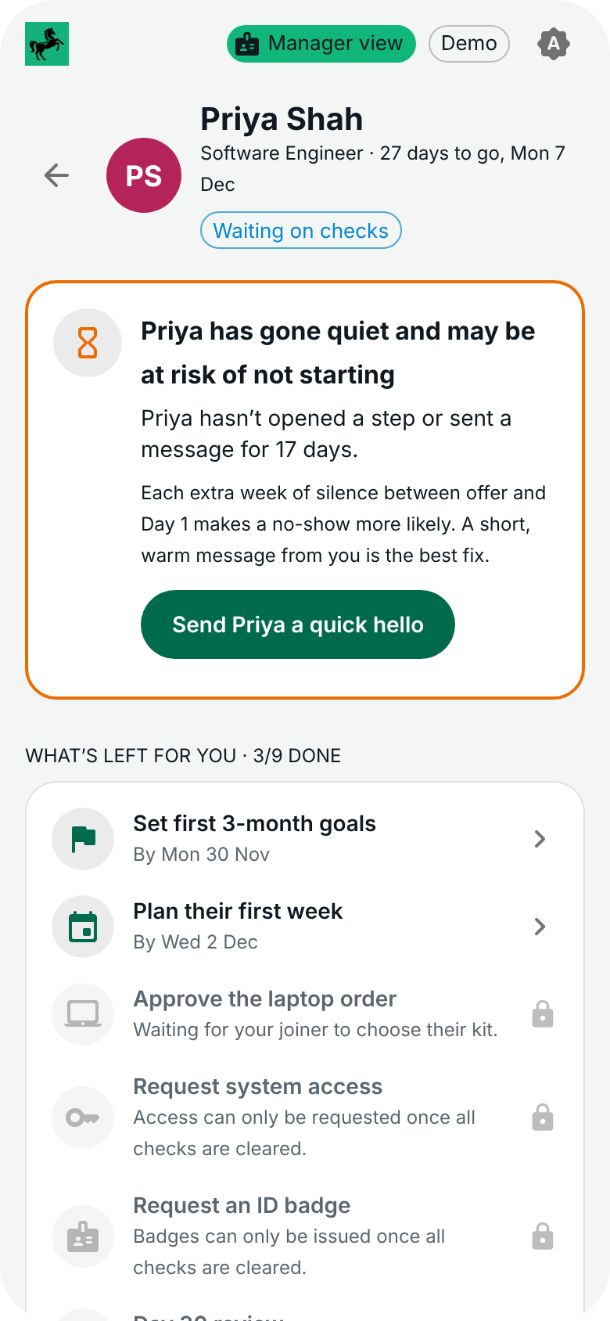

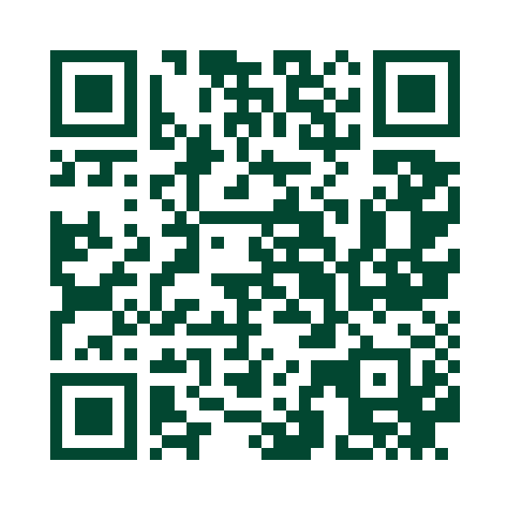




One journey engine, four views
Joiner
One next step at a time, an honest vetting tracker and a Day 1 plan.
Manager
What's left for each joiner, timely nudges and a 'gone quiet' alert.
Buddy
Why they were matched, a meetup tracker and step-in alerts.
Try it on your phone
Live on Azure. All people and data are fictional.
People team
Anonymous trends and the questions joiners chose to send on.
Assistant
Answers from policy, shows its source and hands over to a person.
Notes:
[20 sec, then about 6 minutes of DEMO] One engine drives four views, so when a manager does something the joiner sees it straight away. Scan the code if you want to follow along on your own phone.
SWITCH TO THE LIVE DEMO HERE. Suggested path: the slow check and the date slip, two joiners getting different packs, the manager sending the welcome pack, the assistant declining a salary question and offering a person, then the Day 30 check-in.

Slide 4







Behind the demo: how it plugs in
One front door on systems the bank already runs. This is the proposed design: in the demo these links are simulated.
THE COMPANION LISTENS FOR
THE COMPANION SENDS
Workday
New hire, start date, manager and team. A changed date reflows the journey.
ID badge photo, bank and pension details, 3‑month goals.
HR system of record
ServiceNow
Request status: approved, built, shipped, ready.
Laptop and headset orders, app access requests, HR Direct cases.
Requests and service desk
Entra ID
Work account created, and which access is live.
Access requests from the role profile. Single sign-on from Day 1.
Identity and access
Screening provider
The status of each check only. Never the result.
Nothing. The companion only reads.
Vetting checks
Microsoft 365
Free slots for intro meetings.
Nudges in Teams, Day 1 and first-week calendar invites.
Teams and Outlook
Notes:
[45 sec] What you just saw is the front end. Here is what sits behind it. We do not replace any of these systems or their approvals. We put one front door on them.
Workday stays the source of truth for the hire. A new hire record starts the journey, and if the start date changes there, the whole journey moves.
ServiceNow does the fulfilment: kit orders, access requests to application owners, and HR Direct cases when the assistant hands over.
Entra ID grants group access from the role profile, and gives the joiner one sign-in on Day 1. Before Day 1 they come in by a personal invite link, so there is no new password.
From the screening provider we take the status of each check and never the result.
Be clear if asked: none of this is connected in the demo. It runs on seed data. This is the design for going live.

Slide 5


One tap, a chain reaction
1
Joiner takes a photo
2
Sent to Workday
3
Badge is printed
4
Everyone sees it
Camera or upload, two weeks before Day 1.
Saved to their worker profile through Workday's photo API. The app keeps no copy.
The pass system reads the photo from Workday and prints the badge.
The manager's badge task ticks itself. The joiner sees it is waiting at reception.
ID badge photo
via Workday
1
Manager sets the options
2
Joiner picks, manager approves
3
ServiceNow request raised
4
Status flows back
Picks which laptops the joiner may choose and recommends one.
The choice lands as an approval task for the manager.
A catalogue order with the model, where to deliver and a needed-by date.
Ordered, built, shipped. If Day 1 slips, the needed-by date moves too.
Laptop order
via ServiceNow
Working in the demo today
Integration, designed but not built
Notes:
[45 sec] Two examples of what happens after the tap you saw in the demo. Solid steps work today. Dashed steps are the integration.
Photo: the joiner takes the photo in the app. We would send it to their Workday worker profile using the Workday photo web service, and keep no copy ourselves. The building pass system takes it from Workday, prints the badge, and the manager task closes on its own.
Laptop: the manager chooses what is allowed, the joiner picks, the manager approves. All of that works today. The approval would raise a ServiceNow catalogue request, and ServiceNow status updates would flow back onto the joiner timeline. Because the journey is date-driven, a slipped start date moves the needed-by date on the order as well.
If asked how: both use the standard APIs of those products (Workday web services, the ServiceNow Service Catalog API). The exact routes would need confirming with the teams that own them.

Slide 6


Real today, and what comes next
Real today
To take it live
Journey engine, unlock rules and date reflow, with 250+ automated tests
1
Connect Workday, so real hires and start dates replace the seed data
Claude assistant grounded in policy, with sources and a handover to a person
2
Connect ServiceNow and Entra ID for kit, access and HR cases
Live on Azure as an installable phone app
3
Pilot with one cohort: track time to productivity, early attrition and Day 30 confidence
Every tap in the demo already records an event. Going live means wiring those events to the systems that own them. The screens do not change.
Notes:
[40 sec] To be straight about where we are. The journey logic is real and tested, the assistant is real, and it is live on Azure. The people, checks and system links are simulated.
The reason going live is a short step: everything in the app is an event, like kit chosen or start date changed, and the screens read from one data layer. Today that layer is seed data. Swap it for Workday and ServiceNow and the screens stay the same.
Safeguards worth mentioning if there is time: we show check status and never results, the badge photo is not stored in the app, managers see trends and not individual answers, and the AI key never reaches the phone.
If asked what we rejected: a fixed checklist per role (it breaks when a date slips), and a database for the demo (an event log keeps two phones in step and is simpler to replace later).
Close: thank you, we would love your questions. Slide 7 is a backup for the questions.

Slide 7





Our evidence for the five categories
Best Demo
Technical Approach
Best UX
Feature Fit
Most Innovative
A working journey, clearly demonstrated
Architecture, testing and a production path
An intuitive mobile journey with useful feedback
Deliberate choices that address the problem
An unexpected approach with user value
Offer to Day 30 on a real phone, with a second phone following live. We say what is simulated.
A tested journey engine, an event log and one data layer that Workday and ServiceNow slot into.
One next step, not a checklist. Locked steps say what unlocks them. Jargon is explained in place.
Built for the silent wait before Day 1. Each role gets its own journey. No login for the joiner.
The journey reflows when a date slips. 'Gone quiet' alerts. An assistant that hands over to a person.
Notes:
[Backup for the 5 minutes of questions. Do not present unless useful.] The grey line under each heading is the wording from the judging page. Questions to expect, from the same page:
Demo: what can a joiner complete now, and what is simulated or unfinished? (Slides 5 and 6.)
Technical: why this approach, what did you reject, and how have you checked it? (Event log and tested engine; see slide 6 notes.)
UX: where could a joiner become confused, and what did you change? (Example: joiners see access progress only, not the system names behind it.)
Feature fit: what matters most for the joiner, and what did you leave out? (We left out real integrations and sign-in to make the journey itself complete.)
Innovative: what is different and how does it help? (Date-slip reflow and the gone-quiet alert both target drop-out before Day 1.)

