Slide 1
The silence before Day 1 is the risk
LBG JOINER COMPANION · TEAM 04 · LAUNCHPAD '26
Workday records joining but does not guide anyone through it. Joiners want a guided journey, not more content.
+22%
45%
6 weeks
higher odds of a no-show for every extra week between offer and start
of new-hire ghosting happens between the offer and Day 1
is how long a regulatory reference can take for a senior (SM&CR) hire
Speer, 2026 (peer reviewed)
Click Boarding (vendor survey)
FCA Handbook, SYSC 22
Our answer: a phone companion that takes a joiner from offer accepted to connected and confident by Day 30.
Notes:
[45 sec] We're Team 04, and this is the LBG Joiner Companion.
Joining a bank takes weeks of vetting, and the riskiest stretch is the long quiet wait before Day 1. Each extra week between offer and start raises the odds of a no-show by about 22 percent. Nearly half of ghosting happens in exactly this gap. For senior regulated roles, a single reference can take six weeks.
The onboarding work already under way says the same thing from the inside: new joiners are not asking for more content, they want a guided journey, and managers need the admin made simpler so they can spend their time on connection. An onboarding app is the next step on that roadmap. This is our take on it.
(The 45% figure is from a vendor survey, so treat it as indicative. Internal figures are deliberately not on the slide: say them aloud if you want them.)

Slide 2
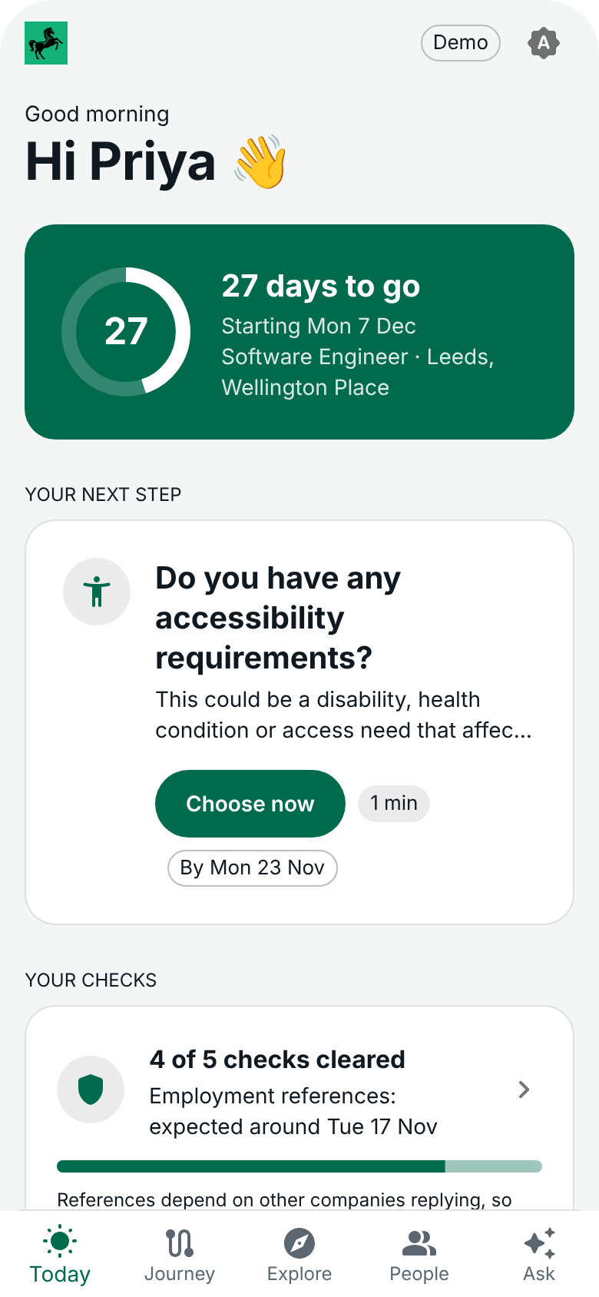

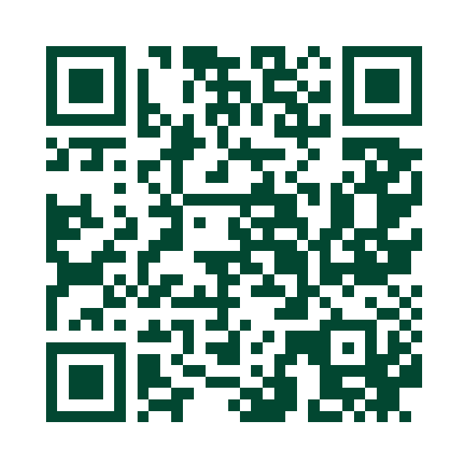




Demo: one journey engine, four views
LBG JOINER COMPANION · TEAM 04 · LAUNCHPAD '26
Joiner
One next step at a time, an honest vetting tracker and a Day 1 plan.
Manager
What's left for each joiner, timely nudges and a 'gone quiet' alert.
Buddy
Why they were matched, a meetup tracker and step-in alerts.
Try it on your phone
Live on Azure. All people and data are fictional.
People team
Anonymous trends and the questions joiners chose to send on.
Assistant
Answers from policy, shows its source and hands over to a person.
Notes:
[20 sec, then about 6 minutes of DEMO on the phone] One engine drives four views, so when a manager does something the joiner sees it straight away.
The script from docs/plan.md:
1. Margaret gets her offer: warm handover, Today card.
2. Vetting tracker: the regulatory reference is slow and the app says why. Slip the date and the journey reshapes.
3. Priya then Rhys: different packs for the same day (laptop choice vs shift pattern).
4. Manager view: Daniel chooses the laptops and sends the welcome pack, and it lands in the joiner app. He sets goals and they appear in the pack.
5. Ask: working from home in week one gets a sourced answer. The manager salary question is declined and a person is offered.
6. Buddy view: a step-in alert and the meetup tracker.
7. Day 30: check-in, celebration, and the manager sees the trend.
Tips: long-press the logo for the demo controls. Use two phones for step 4 if you can. The QR code is the plain link, so the Ask tab on a scanned phone shows Offline mode. Use the phone opened from the access link for the live assistant.

Slide 3



How it works, and how it would plug in
LBG JOINER COMPANION · TEAM 04 · LAUNCHPAD '26
Joiner
Manager
Buddy
People team
THE PHONE APP
Everything is an event
Dates reflow
Grounded assistant
THE ENGINE
Each tap is recorded. Rules over events decide what unlocks and what is next.
Move Day 1 and every due date, task and message moves with it.
Claude answers from eight policy documents, cites them, or offers a person.
Workday
ServiceNow
Entra ID and tools
Screening provider
Microsoft 365
BANK SYSTEMS
New hires and start dates in. ID badge photo and goals out.
Laptop orders and access tickets out. Status back.
One access request, split to each owner.
Status of each check in. Never the result.
Teams nudges and calendar invites out.
Built and tested today (250+ automated tests, live on Azure)
Designed, simulated in the demo
Notes:
[75 sec] Three layers. On top, the four views you just saw. In the middle, one journey engine. At the bottom, the systems the bank already runs.
The engine: everything in the app is an event, like kit chosen, goals set or start date changed. Rules over those events decide what unlocks and what comes next, so a manager action shows up for the joiner straight away, and moving Day 1 moves everything. That logic is real and covered by more than 250 automated tests. The assistant is real too: Claude answers from eight short policy documents, shows the passage it used, and hands over to a person when it should.
The dashed row is not connected today. The demo runs on fictional seed data. We do not replace these systems or their approvals, we put one front door on them.
Two examples of what a tap would set off:
ID badge photo: the joiner takes it in the app, we save it to their Workday worker profile through the Workday photo web service and keep no copy, the pass system prints the badge, and the manager task closes itself.
Laptop: the manager sets the options, the joiner picks, the manager approves (all working today). That approval would raise a ServiceNow catalogue request, and its status (ordered, built, shipped) flows back to the joiner. If Day 1 slips, the needed-by date moves too.
System access is one request with many owners: the manager asks once from a role profile, Entra groups are automatic, team and project owners approve theirs, applications go through the service desk.
If asked: the plan was Azure Static Web Apps, but it is not offered in our allowed regions, so one small Node server on App Service hosts the app and the assistant. The Workday and ServiceNow routes are our assumption and would need confirming with the teams that own them.

Slide 4




Team 04: how we built it
LBG JOINER COMPANION · TEAM 04 · LAUNCHPAD '26
Research first
A plan agreed on day one
One build stream
Honest about the edges
We looked at how leading products handle offer to Day 30 and borrowed only what has evidence behind it.
Scope, six joiners, a demo script and a list of what to cut if we fell behind.
Built with Claude Code in a single stream. The team steered, reviewed and tested on real phones.
The README says what is real and what is simulated. All people and data are fictional.
6
demo joiners, each with their own journey
4
views on one engine
250+
automated tests
2 days
from brief to a live phone app
Notes:
[45 sec] Introduce each person by name and say in one line what they did. Let quieter team members speak for their own part.
How we worked: we started with research, not code. The market research is in the repo, and we were strict about which numbers we trust. We agreed the plan, the six joiners and the demo script on day one, with a cut list in case we fell behind. We built in one stream with Claude Code, while the team steered, reviewed and tested on real phones at each checkpoint. And we have been straight about the edges: the README lists what is real and what is simulated.
(Add your names and roles to this slide if you would like them shown.)

Slide 5



What's next
LBG JOINER COMPANION · TEAM 04 · LAUNCHPAD '26
1
Connect Workday
2
Connect ServiceNow and Entra ID
3
Pilot with one cohort
Real hires and start dates replace the seed data. The screens do not change.
Kit orders, access requests and HR cases flow out, and status flows back.
Run it with real joiners and their managers, then extend from Day 30 to Day 90.
WHAT WE WOULD MEASURE
Earlier productivity
Fewer early leavers
A better preboarding experience
Less admin for managers
Every tap in the demo already records an event. Going live means wiring those events to the systems that own them.
Notes:
[45 sec] Three steps to take this live. First, connect Workday so real hires and start dates replace our seed data. Because the screens read from one data layer, they do not change. Second, connect ServiceNow and Entra ID so kit, access and HR cases actually flow. Third, pilot with one cohort and their managers, then stretch the journey from Day 30 to Day 90.
What we would measure lines up with what the wider onboarding work is already aiming for: people productive sooner, fewer regrettable early leavers, a better preboarding experience, and less admin for line managers. Our own headline measure stays the same: connected and confident by Day 30.
Safeguards if asked: we show check status and never results, the badge photo is not stored in the app, managers see trends and not individual answers, and the AI key never reaches the phone.
Close: thank you. We would love your questions.

