Slide 1
Student Alcohol Consumption
（From Kaggle）
-group 11(Katherine Guo, Katherine Wei, Ziyu Lin,
Bonnie Chen, Yingchen Yang)

Slide 2
Dataset
INFO:
students ages, genders, family sizes, and parent education level, etc
daily or weekly alcohol consumption patterns
GOAL:
what influences students’ alcohol use?
any associations between their characteristics and drinking patterns?
in a long term, how these factors influence student academic grades (or alcohol use)?
how to deal with related issues?

Slide 3
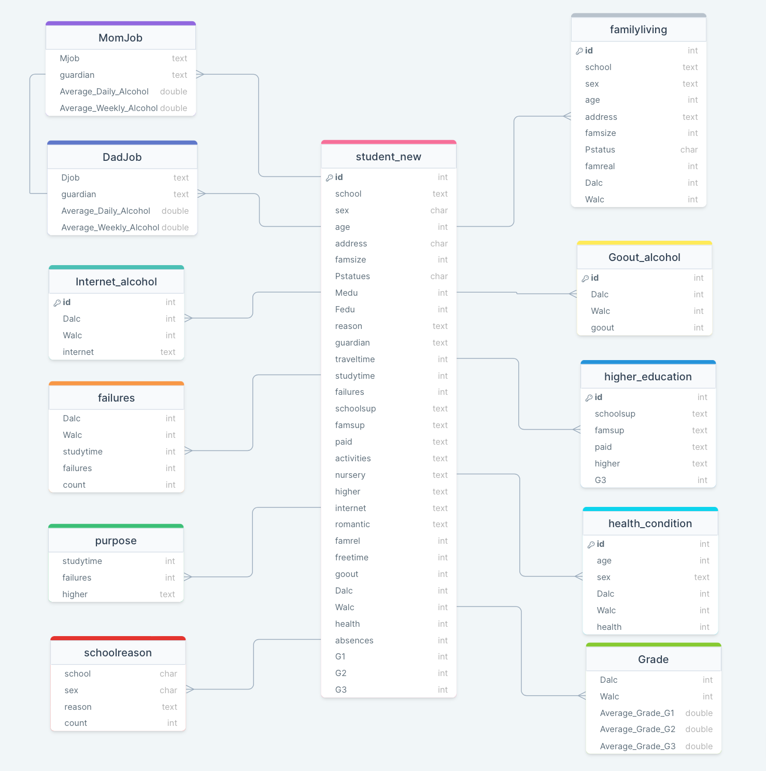
Data Model & ERD
The ERD model provides a more macroscopic understanding of the overall data. We set the id as the primary key to extend the eleven charts. The relationship between them can also be clearly shown in the diagram. We will analyze and interpret the chart content and queries in more detail in the next section.

Slide 4
Katherine Guo- 2 queries
--Exploring the relationship between the extra educational support and the student who wants to take higher education
– a higher grades can represent those students who tend to take higher education in the future.
CREATE TABLE higher_eudcation AS SELECT id, schoolsup, famsup, paid, higher, G3 FROM student_new;
--This query aim to analyze the relationship between health conditions and the levels of alcohol consumption among students by different age groups and sexes.
– whether there is a difference in health status between male and female students?
The overall trends of alcohol affection among different age group
CREATE TABLE health_condition AS SELECT id, age, sex, Dalc, Walc, health FROM student_new;

Slide 5
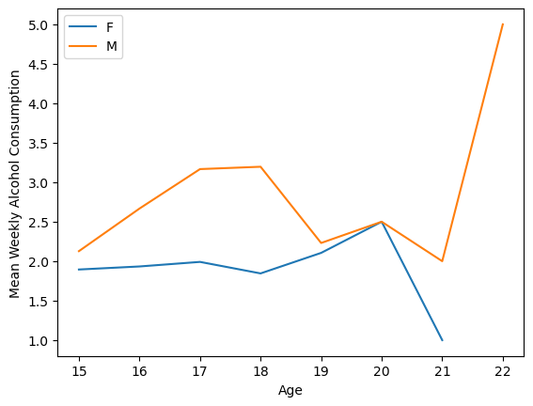
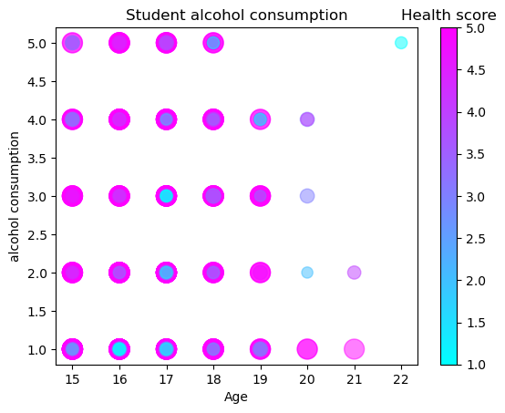
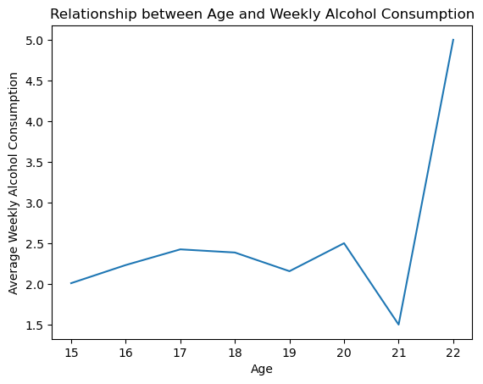
Health Condition & alcohol consumption
- Group by ‘age’ and ‘sex’
- Calculate the mean of alcohol consumption
- show the mean weekly alcohol consumption for different age groups and sexes
- A line graph that shows the relationship between age and weekly and alcohol consumption
- Showing the trends in alcohol consumption, and age-related alcohol consumption
-a scatterplot that visualize the relationship between age, alcohol consumption, and health level for students

Slide 6
Query - Bonnie Chen
How does alcohol consumption affect students’ Math or Portuguese grade (over time)
first period grade (G1), second period grade (G2), and final grade (G3), the variables of workday alcohol consumption (Dalc) , and weekend alcohol consumption (Walc)
emphasize the importance of promoting responsible drinking habits
creating awareness of the potential impact of alcohol on academic performance in specific subjects
How does if parents’ jobs and guardian related to alcohol consumption)
parent's cohabitation status (pstatues), mother's job (Malc), father's job (Dalc)
identify potential risk factors or protective factors related to alcohol consumption
address any negative consequences of alcohol consumption and promote healthier behaviors within families.
CREATE TABLE Grade

Slide 7
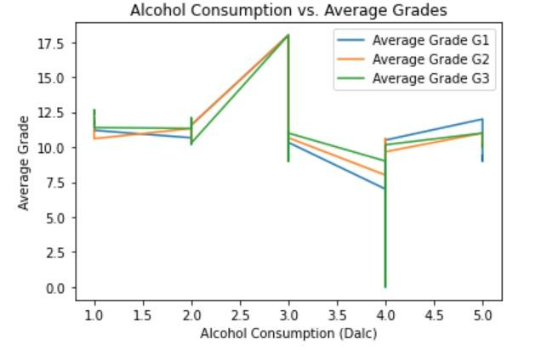
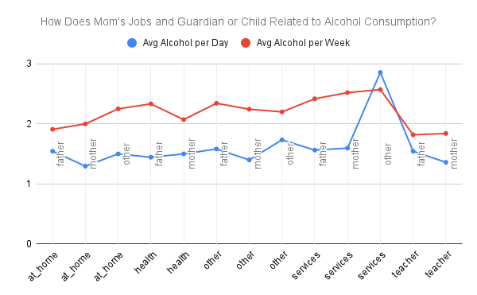
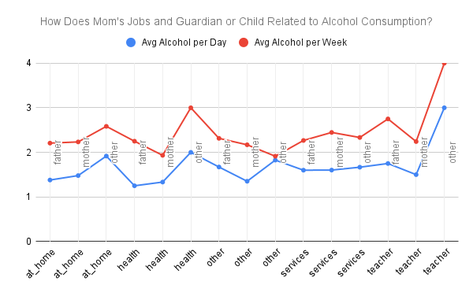
1
2
3

Slide 8
Katherine Wei - 2 queries
Dalc & Walc & studytime & failures
This query shows the relationship between alcohol consumption (both daily and weekend) and two crucial academic factors: study time and past class failures.
higher & studytime & failures
This query analyzes the potential impact of study time and the number of failed courses on students' intentions to pursue higher education.

Slide 9
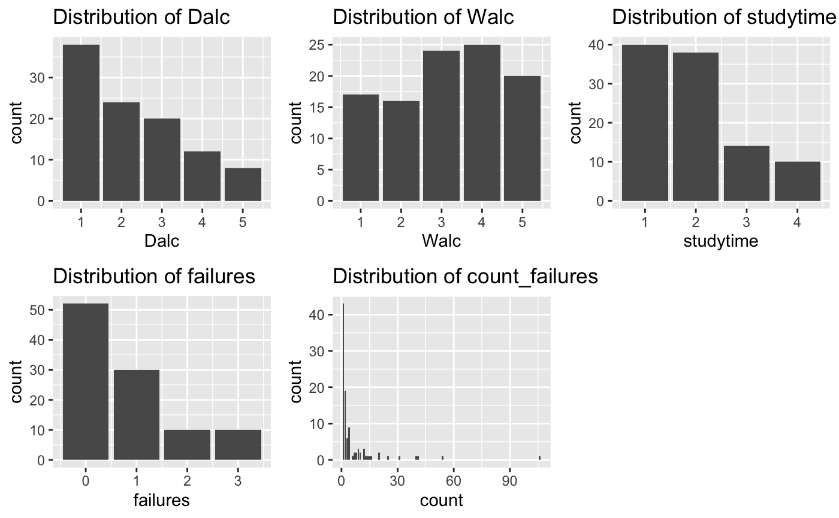
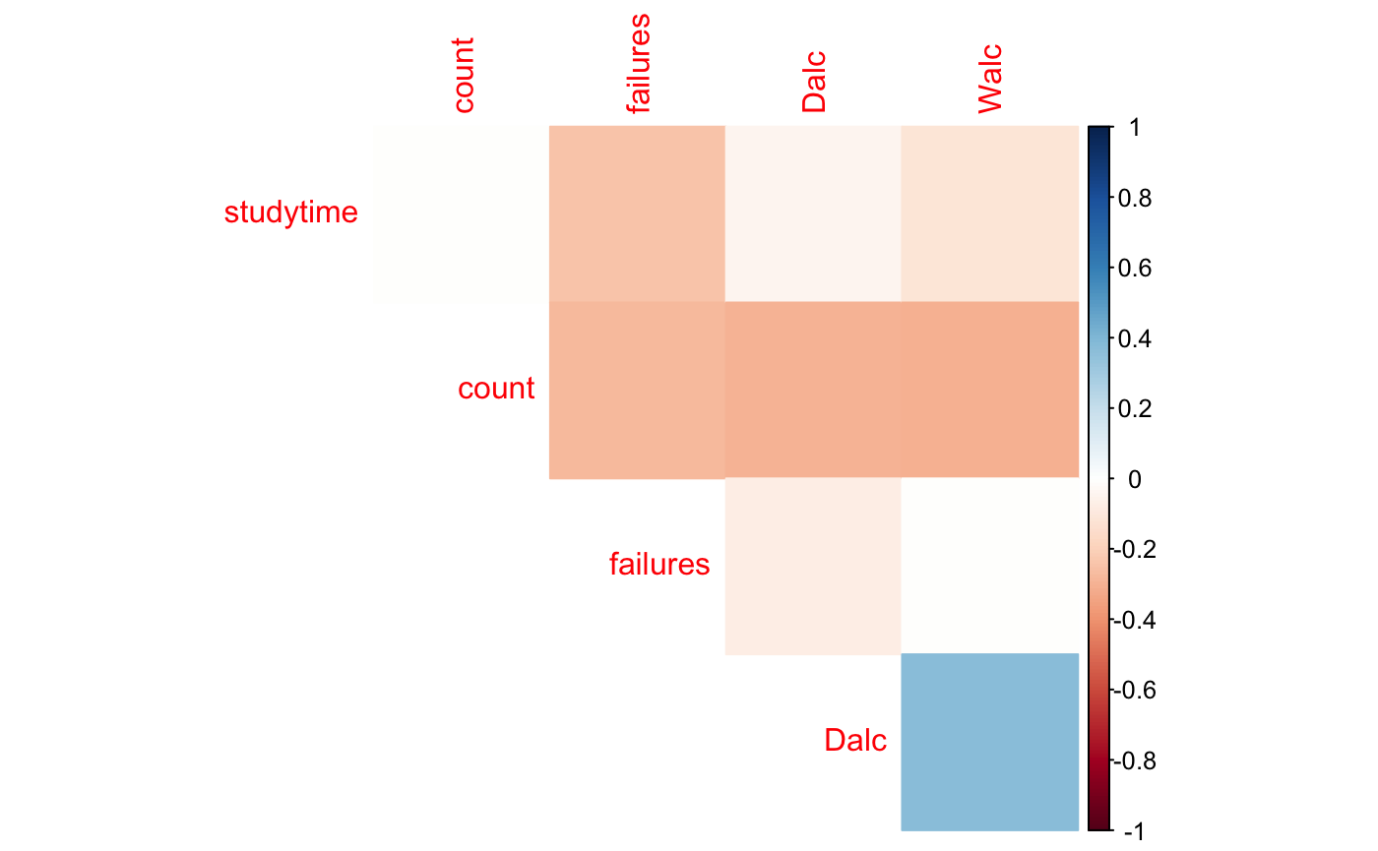
Distribution of each factors
Correlation between factors

Slide 10
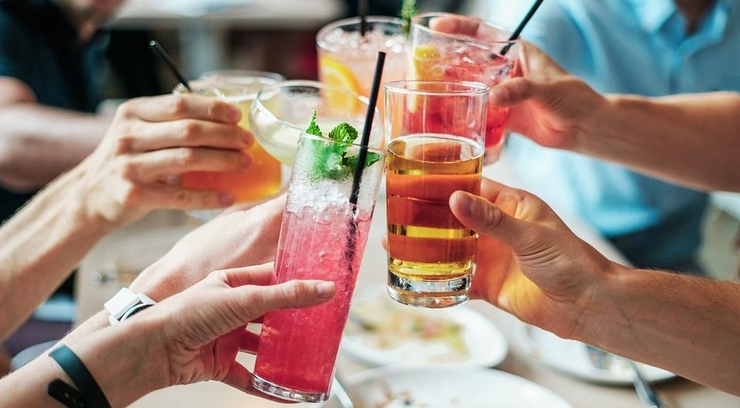
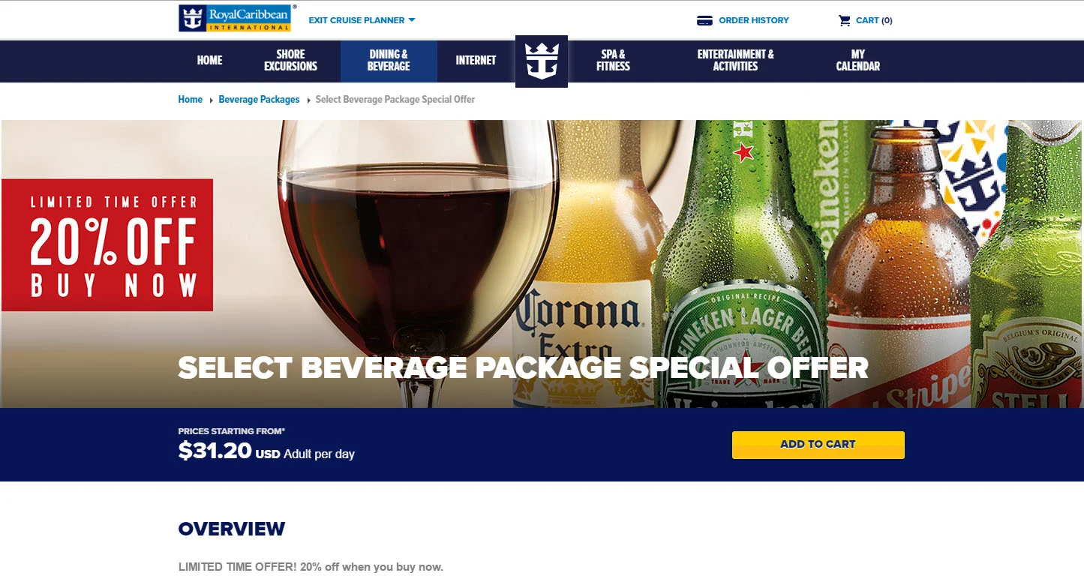
Yingchen Yang- 2 queries
27. Dalc & 28.Walc - 22. internet: will the use of internet affect the consumption of alcohol
27. Dalc & 28. Walc - 26. goout : will the frequency of going out with friends affect alcohol consumption

Slide 11
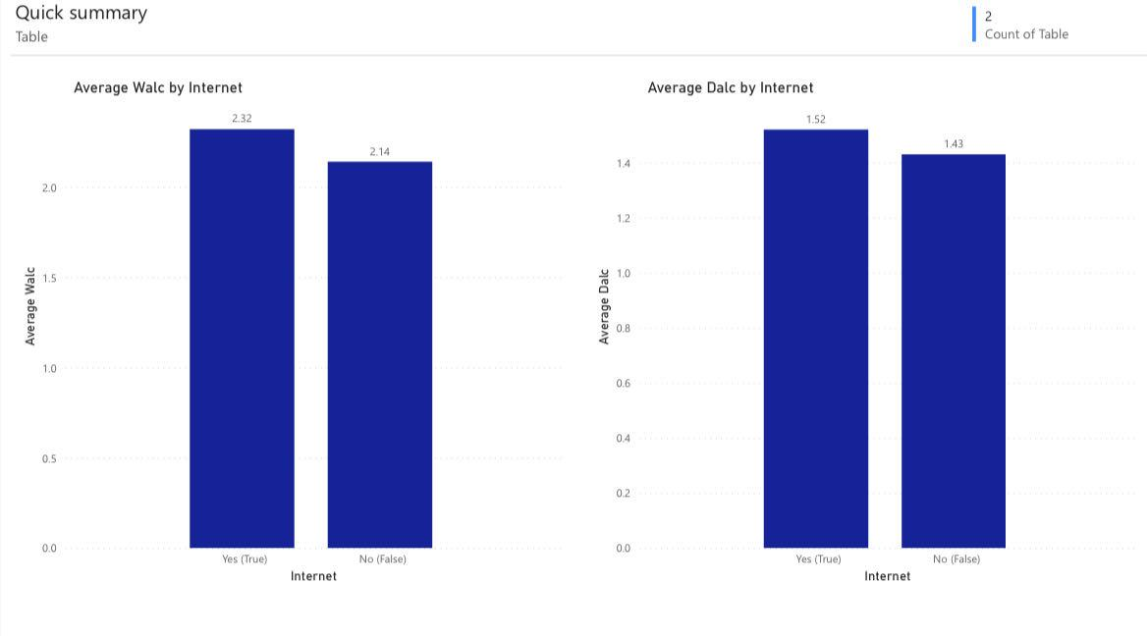
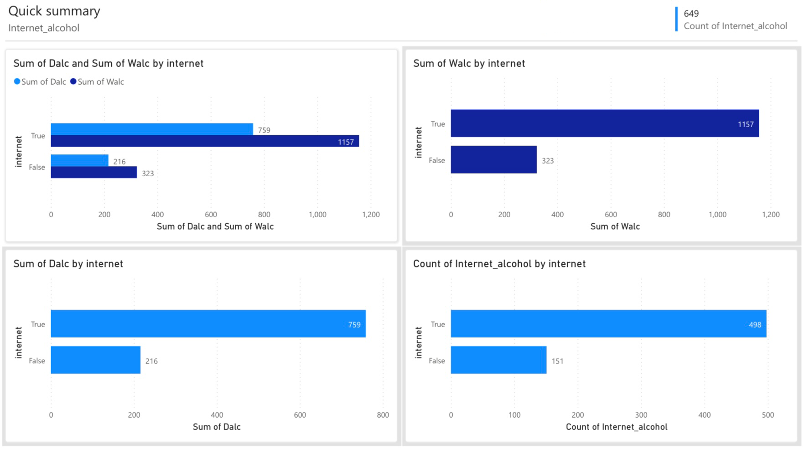
By selecting the query of Dalc (daily alcohol consumption), Walc (weekly alcohol consumption) and Internet. We can get the visualization for the sum of each and the count of different choice of internet use.
Then, we can get the average Walc and Dalc based on the choice of internet use.
[Sum of Dalc (or Walc) / Count of Internet (yes or no) = Average Dalc (or Walc) by internet]
Comparing the average, we can find that Internet use has a slight negative impact on student alcohol consumption.

Slide 12
Ziyu Lin - 2 queries
Since the database analyzes the amount of alcohol used by students at two schools, the reasons for students for choose this school may also be a reason for their alcohol use.To create this query, I select school, sex, reason and also use group by function to count different groups.
Family factors are often an important component in shaping students' character. The amount of alcohol abuse among students will be explored by looking at variables such as the general geographic location of the family, the size of the family, whether the parents live together, and the quality of the family relationship to find out if there is a correlation.
I pick school, sex, and age (these three will be the location of the basic information about the student) And also select of address, famsize, pstatus, and famrel will be used to study the effect of these factors on alcohol abuse in the future. While Dalc and Walc were counted by the amount of alcohol abuse among students on weekdays and days off.

Slide 13
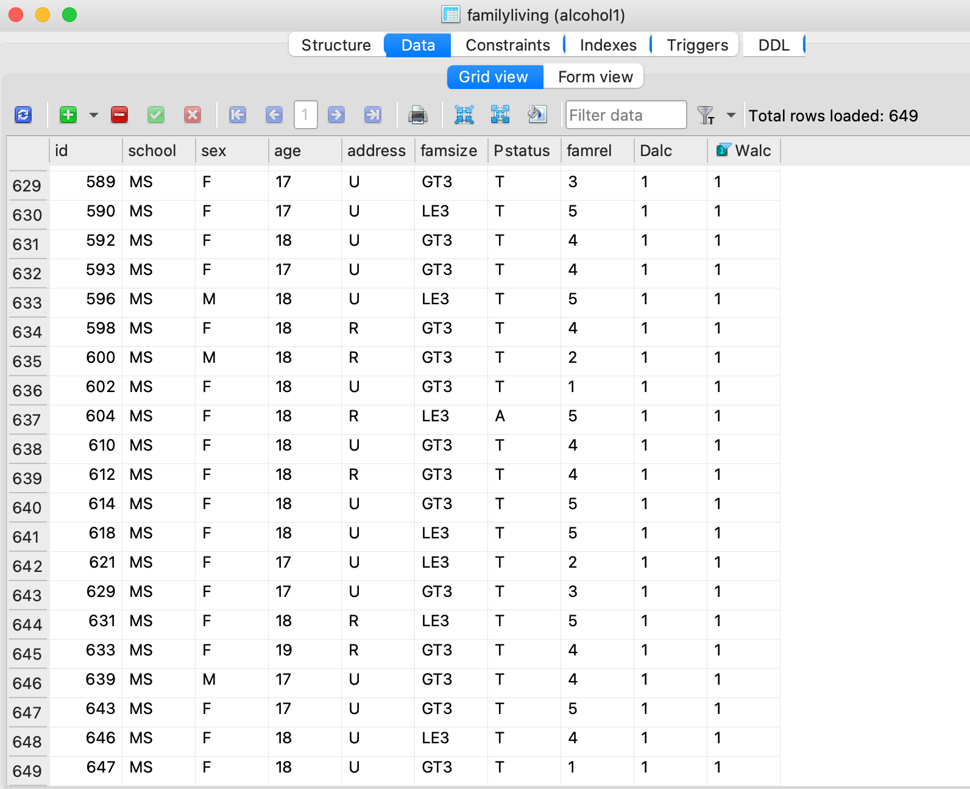
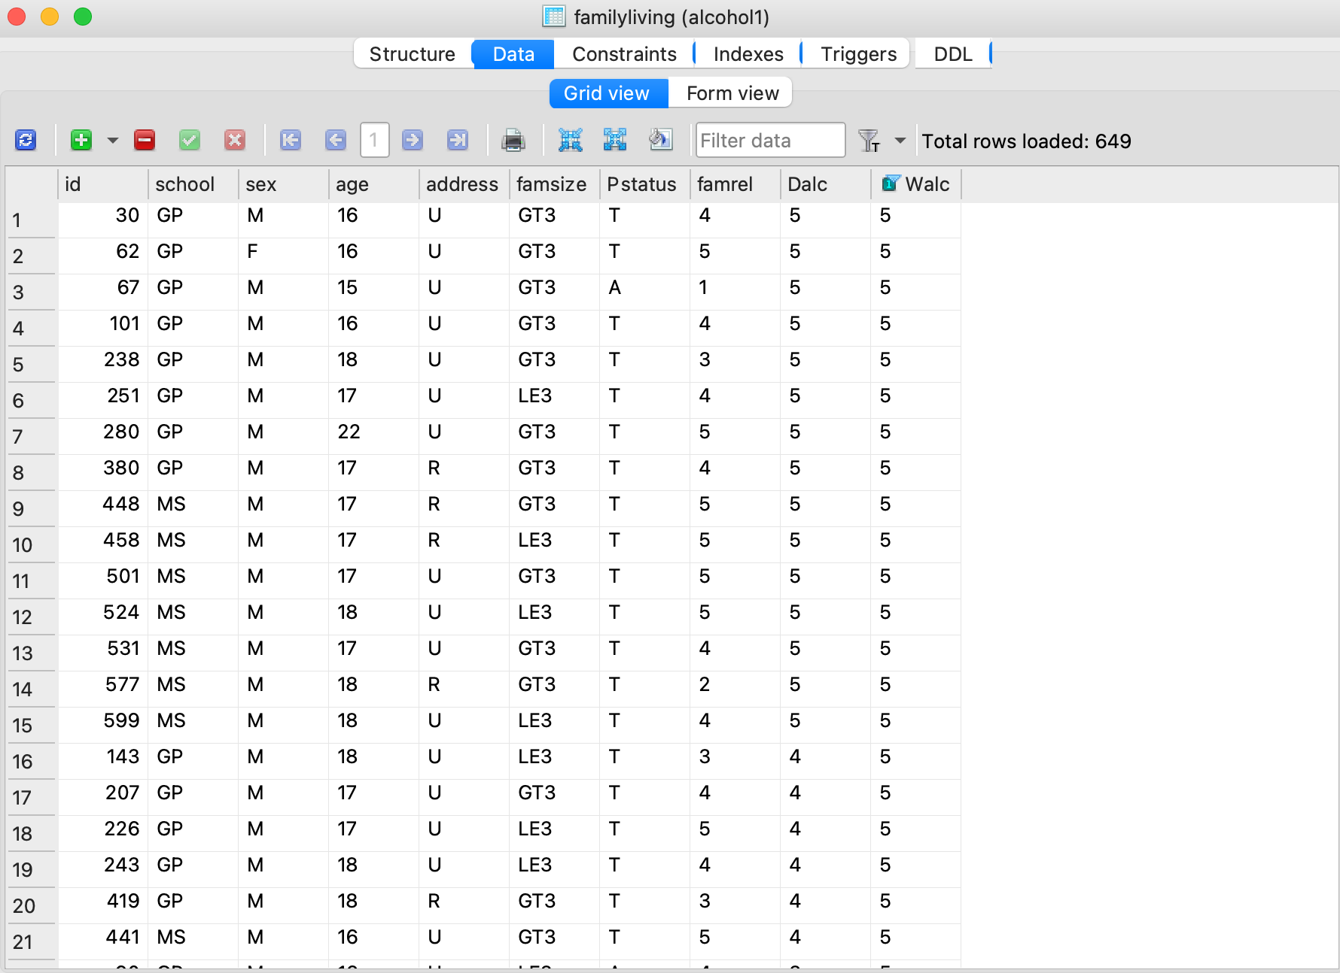
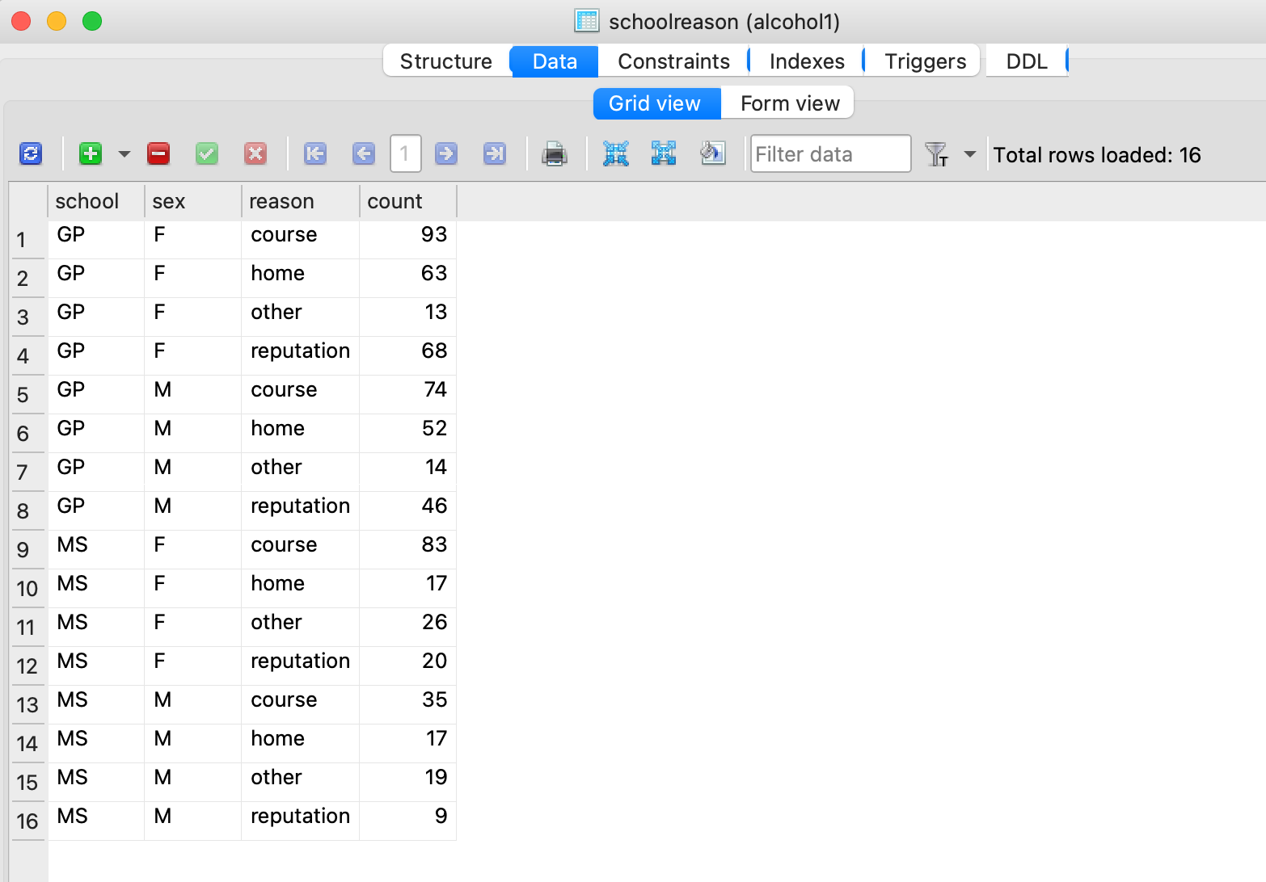
Based on that table, the reason people choose these schools are more dependent on the courses.

Slide 14
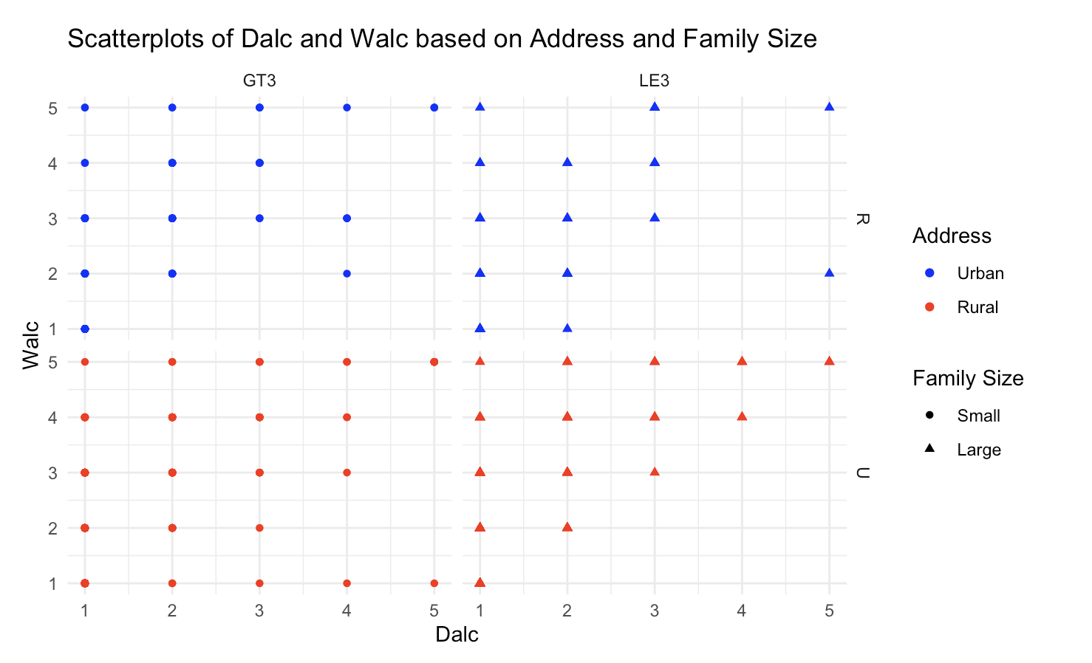
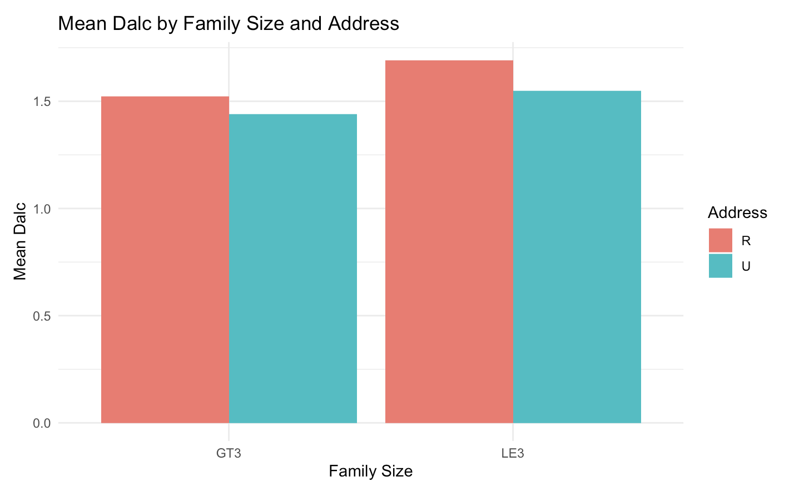
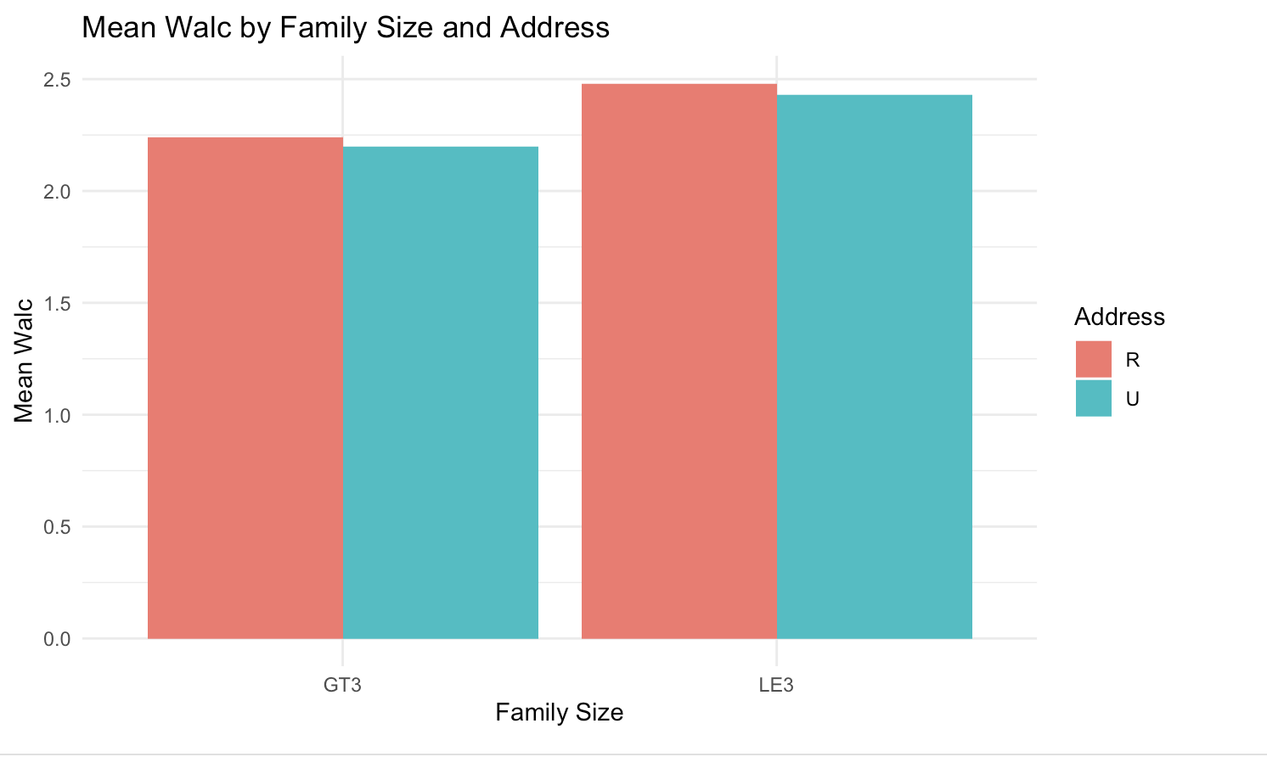
1. Male are more than female population
2. Pstatus and famrel did not show some outstanding relationship
3. Foucs on famsize and address:
By viewing the distribution of Mean Dacl and Walc, we can easily figure out that student live in rural are more likely to addicted in alcohol. And smaller family size may be also make student drink more.

Slide 15
Conclusions
There are various factors that influence student alcohol consumption
In a long term, it can bring bad effects on health and study
There are strict regulations on teenagers’ alcohol consumption
We need to develop effective prevention and intervention strategies to promote responsible drinking habits and minimize associated risks.
Thank you for listening!

Slide 16
References:
UCI Machine Learning. “Student Alcohol Consumption.” Kaggle, 19 Oct. 2016, www.kaggle.com/datasets/uciml/student-alcohol-consumption?select=student-por.csv.
https://www.royalcaribbeanblog.com/sites/default/files/blog-images/select-package-discount.jpg
https://guidable.co/wp-content/uploads/2019/07/drinks-2578446_960_720.jpg

