Slide 1

BIG DATA ANALYTICS | MINI-PROJECT
GitPulse
Big Data Analytics on Open Source GitHub Activity
Ayaan Memon (A-759)
Tanmay Meshram (A-761)
Kshitij Desai (A-772)
Guided by
Prof. Bhavesh Panchal
Department of Computer Engineering, University of Mumbai | October 2026
Notes:
Good morning. Our project is GitPulse. We took real public activity from GitHub, about 2.4 million events, and analysed it with twelve tools from the Hadoop ecosystem, all running on one laptop. The green squares on the right are a nod to GitHub's own contribution graph.

Slide 2
What is GitPulse?
Every action on GitHub, such as a push, a star, a pull request or a comment, is recorded as an event.
GitPulse collects millions of these events and turns them into answers: which projects are trending, how much work bots do, and which repositories a developer might like next.
It does this with a full big data stack: batch processing, a data warehouse, machine learning and a real-time stream.
2.4 M
12
real GitHub events processed
Hadoop-ecosystem tools, each doing one job
10
1 laptop
analytical questions answered
whole cluster in Docker, 16 GB RAM
Notes:
In one line: GitPulse is an analytics platform for GitHub activity. Four numbers sum it up: 2.4 million events, 12 tools, 10 questions, and it all runs on one laptop.

Slide 3
The data we used
GH Archive
What one event looks like
A public record of every GitHub event, published as one compressed JSON file per hour. About 167,000 events per hour. We used September 2025, before GitHub trimmed event details.
type
WatchEvent (someone starred a repo)
actor
the user, for example octocat
repo
owner/name of the repository
GitHub REST API
created_at
2025-09-01 12:04:31 UTC
Details for each repository: language, stars, forks, topics and creation date. Responses are cached so we stay inside the API rate limit.
payload
details: commits, PR number, comment
15 hours loaded: 2,397,993 events
Notes:
We used two sources. GH Archive gives us the raw events, one file per hour. The GitHub API gives us information about each repository, like its language and star count. On the right is a simplified event: what happened, who did it, on which repository, and when.

Slide 4
Ten questions the project answers
# | Question | Tools used
Q1 | Which repositories are trending each day? | MapReduce, Hive, Sqoop
Q2 | Which languages and topics are growing? | Sqoop, Hive, Impala
Q3 | When is GitHub busiest (UTC vs IST)? | Hive, Impala
Q4 | How much activity comes from bots? | Pig, Hive
Q5 | How healthy are maintainers (PR merge time)? | Hive
Q6 | Solo projects or community projects? | Spark
Q7 | Starred X? You may like Y | Mahout, Spark ALS, HBase
Q8 | Will a new repository go viral? | Spark MLlib
Q9 | Live events per minute and spike alerts | Kafka, Storm, HBase
Q10 | Which groups of similar repositories exist? | Mahout k-means
Notes:
These are the ten questions that drive the whole design. Each one is answered by the tool best suited to it, which is why we use so many tools.

Slide 5
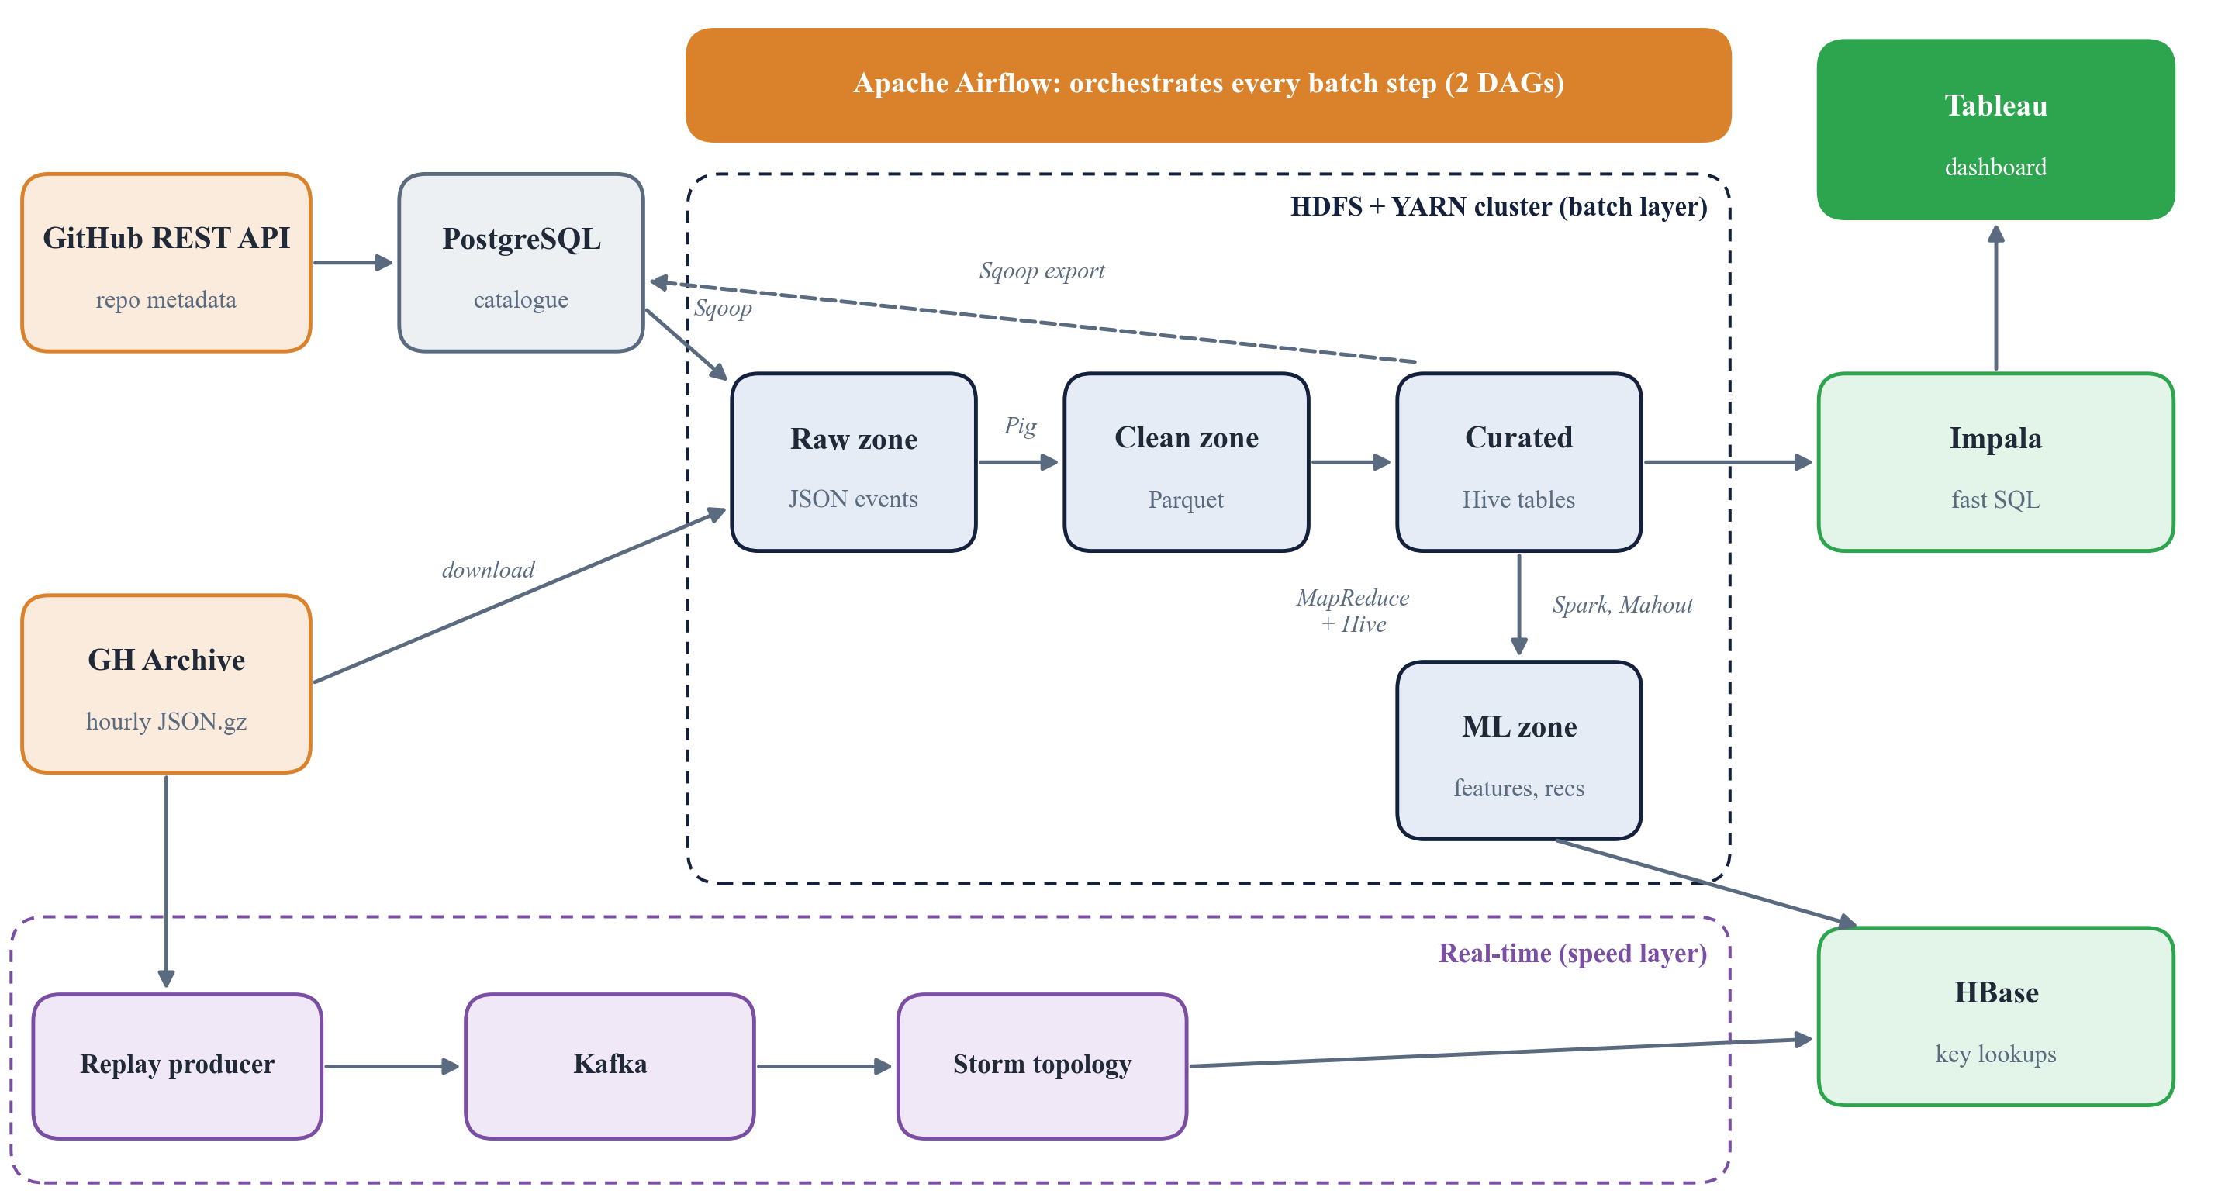
Architecture at a glance
Notes:
This is the full picture. Data comes in on the left. The dashed box in the middle is the Hadoop cluster, where data moves from raw, to clean, to curated, to machine learning. On the right, Impala and HBase serve the results, and Tableau shows them. The purple strip at the bottom is the real-time path. Airflow at the top runs the batch steps in order.

Slide 6
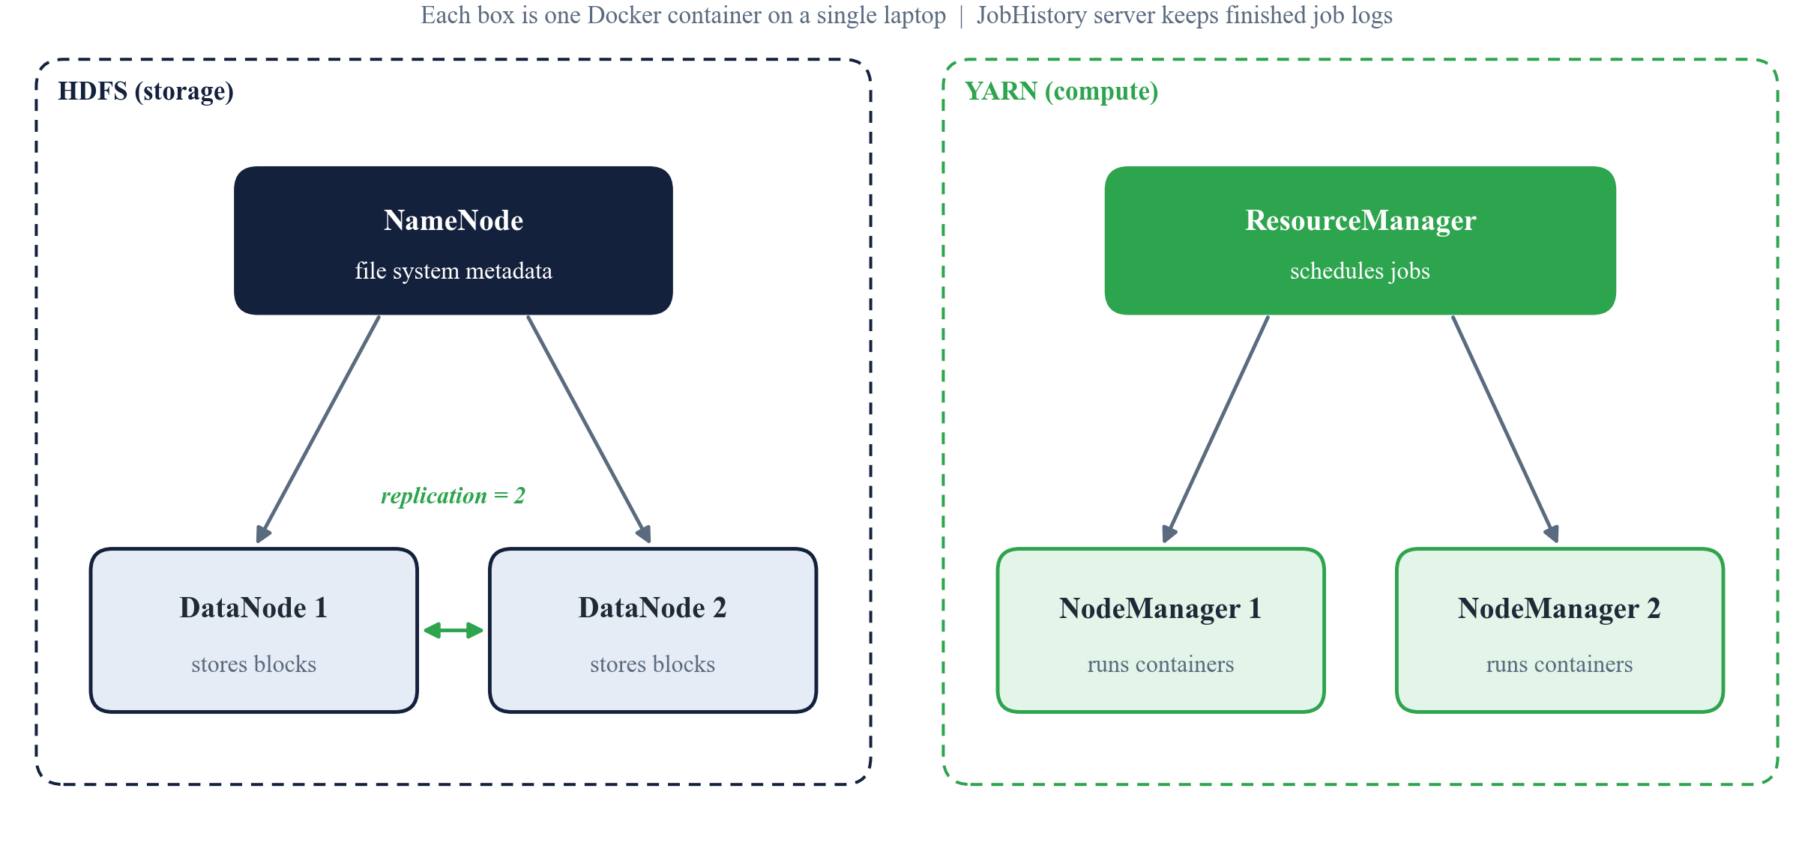
The cluster: many machines on one laptop
1
HDFS
splits files into blocks and keeps 2 copies on different DataNodes, so losing one copy loses no data.
2
YARN
hands out CPU and memory to jobs. MapReduce, Pig, Hive and Spark all run on it.
3
Docker
runs each node as a container, so the whole cluster starts with one command.
Notes:
Hadoop normally runs on many computers. We simulate that with Docker: one NameNode, two DataNodes, one ResourceManager and two NodeManagers. Because the replication factor is 2, every file block is stored twice.

Slide 7
Every tool and the job it does
HDFS
MapReduce
Pig
Hive
Stores all data across the DataNodes
Our Java job: daily top-N repositories
Cleans raw JSON, removes duplicates, tags bots
SQL warehouse for curated tables
Sqoop
Spark
Mahout
Impala
Moves tables between Postgres and Hadoop
Features, viral model, ALS recommendations
Item-based recommendations and k-means
Answers dashboard SQL in about 1 second
HBase
Kafka
Storm
Airflow
Millisecond lookups by repository key
Queue that carries the live event stream
Counts events per minute, detects spikes
Runs every batch step in the right order
Also used: PostgreSQL (catalogue), ZooKeeper (coordination), Docker Compose (cluster), Tableau (dashboard)
Notes:
Here is every tool and its single job. Blue is batch processing, green is analytics and machine learning, orange is serving and orchestration, and purple is the real-time path.

Slide 8
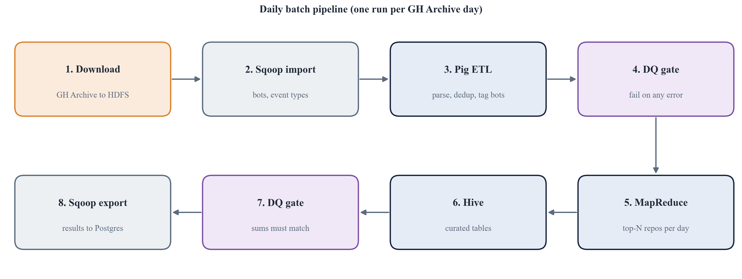
The batch pipeline, step by step
Each step overwrites only its own day, so any step can be re-run safely. A failed data-quality gate stops the pipeline.
Notes:
This is one day of batch processing. We download the raw files, bring in lookup tables with Sqoop, clean the data with Pig, check it, compute the top repositories with MapReduce, build curated Hive tables, check again, and export the results to Postgres for the dashboard.

Slide 9
Data quality: nothing slips through
0
malformed lines out of 2.4 million
1
duplicate event found and removed
2
real data bugs caught by the gates
Notes:
Every step is checked. Hive's assert_true fails the run if counts do not match. Out of 2.4 million lines, none were malformed and only one was a duplicate. The gates also caught two real problems: a file with no final newline, and 140 events already in GitHub's newer trimmed format.

Slide 10
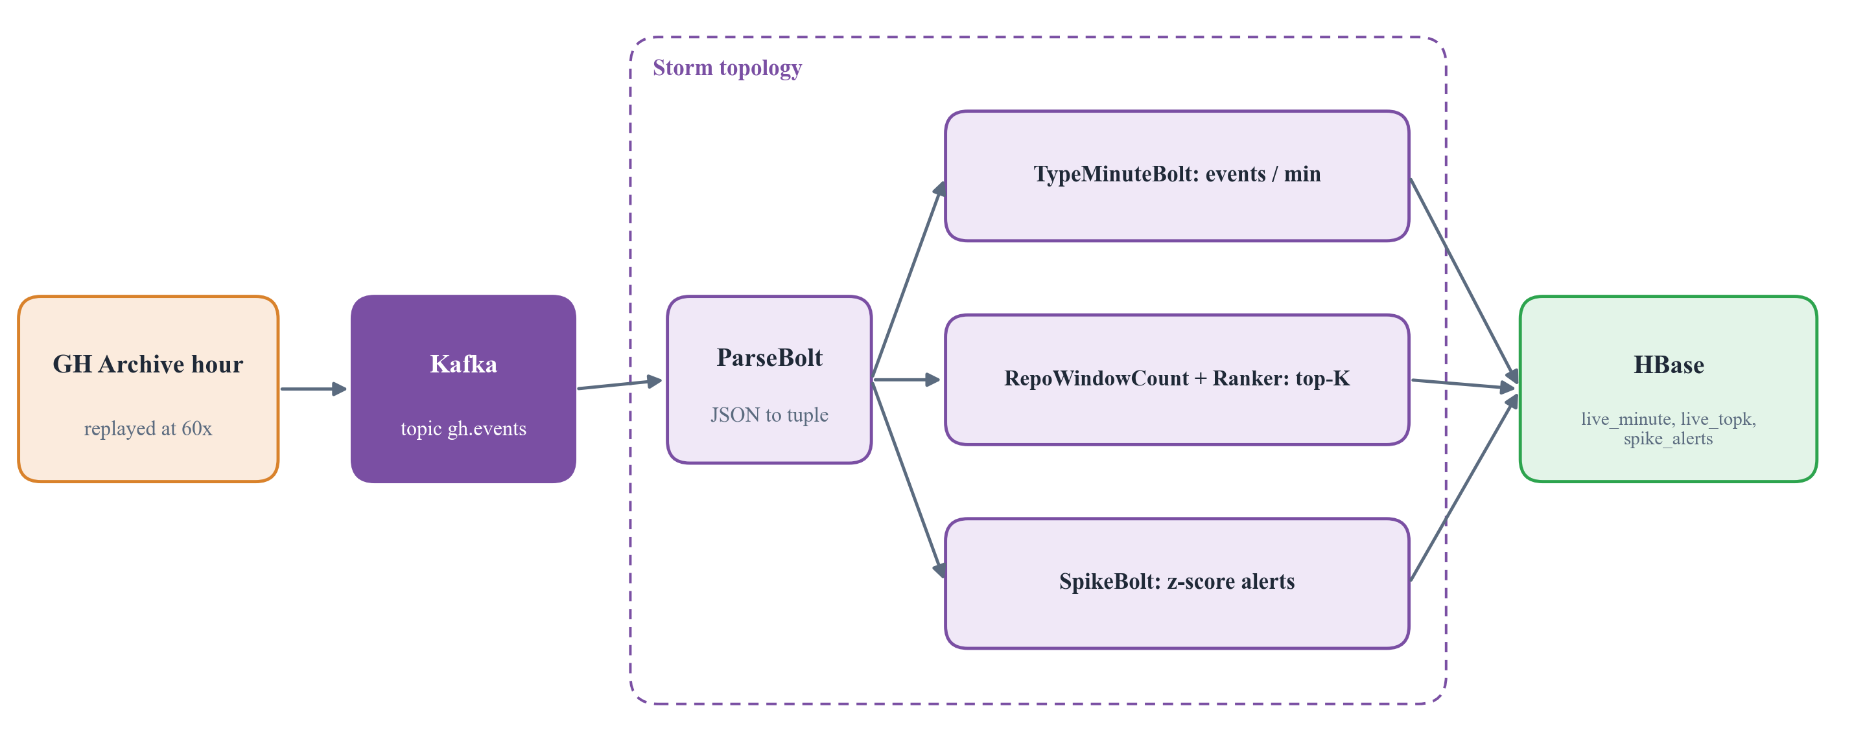
Real time: Kafka to Storm to HBase
60x
0
z = 12.8
replay speed: 1 hour in about 65 s
failed tuples across 167k events
spike: 18 events vs a mean of 0.41
Notes:
For the live path we replay a real GitHub hour into Kafka sixty times faster. Storm parses each event and, in parallel, counts events per minute, keeps a rolling top list of repositories, and raises an alert when a repository suddenly spikes. Everything is written to HBase.

Slide 11
Machine learning: "You may also like"
6x
better recall than just recommending the most popular repositories
Item CF: "people who starred X also starred Y"
Mahout also covers 53% of the catalogue, ALS only 24%
Notes:
To test recommendations we hid each user's most recent stars and checked whether we could predict them. Mahout item-based filtering wins on every metric and covers over half the catalogue, while recommending only popular repositories almost never works.

Slide 12
Machine learning: viral repos and clusters
Q8. Will a brand-new repository go viral?
Q10. Six kinds of repositories (Mahout k-means)
0.73
2.7x
Push-only, solo
Bot-driven pushes
AUC-ROC, logistic regression
better than random guessing (lift)
PR + push teamwork
Discussion-heavy
Trained on 67,585 new repositories using their first hour of activity. Gradient-boosted trees reached only 0.55, so the simpler model won.
Star magnets
Issue magnets
Notes:
Two more models. The viral model looks at a repository's first hour and predicts whether it will take off. AUC of 0.73 is a weak but real signal. K-means grouped repositories into six behaviour types, from solo push projects to repositories that mostly attract stars or issues.

Slide 13
Who does the work on GitHub? Often, bots
28 to 32%
of all GitHub events come from bots, such as dependabot and CI tools
How Pig tags a bot
login ends in [bot]
login is in the known-bots list
name ends in -bot or _bot
Notes:
One of our clearest findings: almost a third of GitHub activity is automated, and bots write more than half of all commit comments and issue comments. In our own test run the figure was 31.6 percent. Pig tags bots using three rules.

Slide 14
What the data tells us
93%
of closed PRs merged by NixOS/nixpkgs, median 38 h open (Q5)
3%
less activity on Sunday than on Monday (Q3)
4,138
pushes in 3 h by one automated repo, so we rank by humans (Q1)
Notes:
A few answers. Q1: by human stars, dockur/windows led the sample hours. Q6: most active repositories are solo projects, and only 407 are true community projects. Q5: the NixOS package repository merges 93 percent of its pull requests. Q3: Sunday is only about 3 percent quieter than Monday.

Slide 15
Which engine is fastest?
Impala: under 2 s
Long-running C++ daemons answer instantly. JVM engines need 20 to 40 s just to start.
1
MapReduce is slowest
one map task per small Parquet file (the small-files problem)
2
Pig beats MapReduce 4x
it combines small files into larger splits
3
2 workers help 1.0 to 1.9x
both share the same laptop CPU
Notes:
We ran the same three queries on five engines. Impala answers in about a second because its daemons are always running. The others spend most of their time starting up. MapReduce is slowest because our partitions create many small files, and it starts one task per file.

Slide 16
Fitting a 23-container cluster on a laptop
core
Postgres, NameNode, 2 DataNodes, YARN, JobHistory
16 GB
batch
core + edge client
enough for every stage
warehouse
core + Hive metastore + HiveServer2
ml
core + Hive metastore (Spark, Mahout)
8 GB
serving
core + ZooKeeper + HBase
works too, with LITE=1 mode
streaming
HDFS + HBase + Kafka + Storm
1 stage
impala
HDFS + metastores + Impala daemons
orchestrate
core + Airflow
runs at a time; switching takes under 1 min
Notes:
Running every service at once would need far more memory than a laptop has. So we split the services into stages. A script starts only what the current step needs and stops everything else. Airflow switches stages automatically as the pipeline runs.

Slide 17
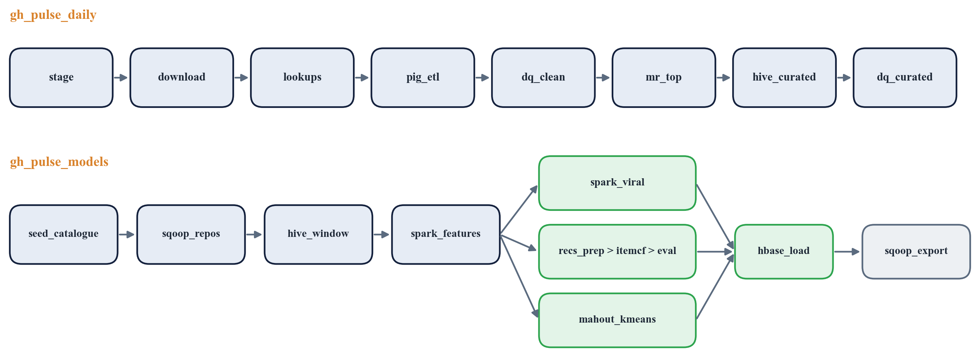
Automation with Apache Airflow
Daily DAG
Models DAG
Safe re-runs
one run per day of data: download to curated tables
once per window: catalogue, ML and serving
retries with backoff; every task can be repeated
Notes:
Airflow runs the pipeline as two DAGs, which are graphs of tasks. The daily DAG processes one day at a time. The models DAG runs the machine learning once the data is loaded. Each task is a single command, so anything can be retried.

Slide 18
We ran everything end to end
25 / 25
497,262
pipeline steps passed
events in our test run
31.6%
10 / 10
bot share, matches 28 to 32%
JUnit tests passed
E2E
58 min
Postgres, HBase and Storm checks passed
for the whole pipeline
Notes:
We ran the full system on a Windows laptop with 16 GB for Docker: 3 hours of real data, both pipelines, and the streaming test. All 25 steps passed, the data-quality gates passed, and the end-to-end checks passed. The slowest step was building the curated Hive tables.

Slide 19
Challenges and how we solved them
1
Not enough memory
2
Bot noise in rankings
3
Small-files problem
Memory-aware stages: one stage of services at a time
Rank repositories by distinct human users, not raw events
Pig combined splits; Impala for interactive queries
4
Late streaming events
5
Bad input data
6
Windows line endings
Event-time windows and a clean Kafka offset reset
DQ gates with assert_true stop the pipeline on any error
Convert scripts to LF; disable Git Bash path conversion
Notes:
Every big data project hits practical problems. Ours were memory, noisy bot data, the small-files problem, late events in the stream, bad input, and even line endings when running on Windows. Each one has a concrete fix in the code.

Slide 20
Conclusion and future work
1
Complete
Next steps
From raw files to dashboard and live alerts, with 12 tools on one laptop.
Run on the full 8-day dataset
Live GitHub API feed instead of replay
Spark Structured Streaming comparison
Deploy on a real multi-node cluster
Publish the Tableau dashboard
2
Trustworthy
Quality gates on every step: 0 malformed lines, all checks passed.
3
Insightful
Bots make about 30% of activity; Mahout recommends 6x better than popularity.
Notes:
To conclude: GitPulse is a complete, tested big data pipeline that answers real questions about open source. Next, we would scale to the full eight-day dataset, use the live GitHub feed, and deploy on a real cluster.

Slide 21
Thank you
Questions?
Ayaan Memon (A-759) | Tanmay Meshram (A-761) | Kshitij Desai (A-772)
Guided by Prof. Bhavesh Panchal
Notes:
Thank you. We are happy to take questions, and we can show the cluster running live.

