Slide 1


Slide 2
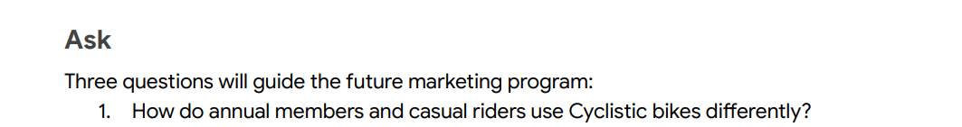
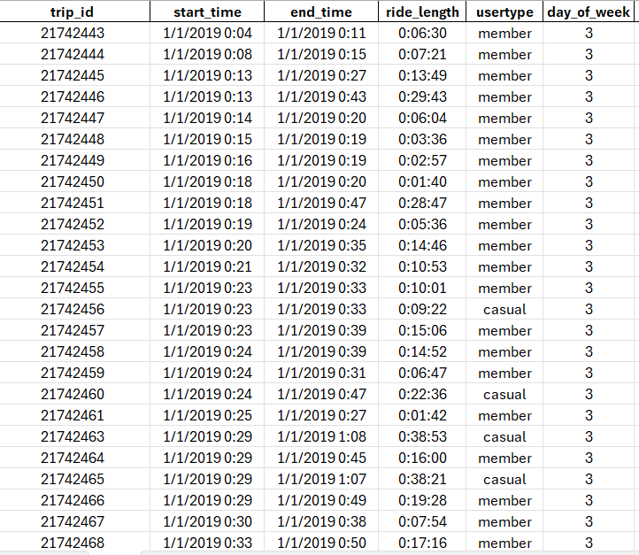
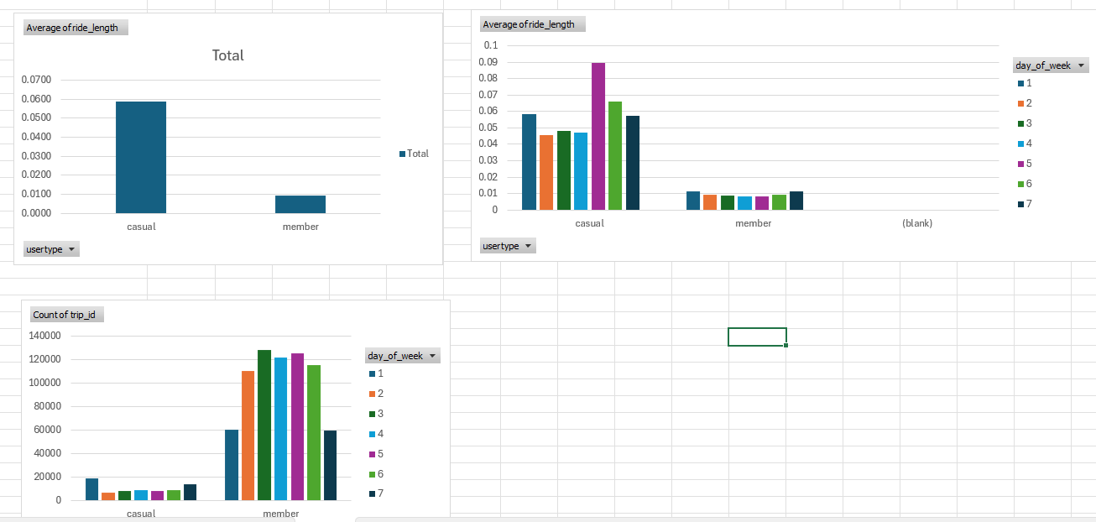
CYCLIST DATASET- Using Excel
Using pivot table and pivot chart

Slide 3
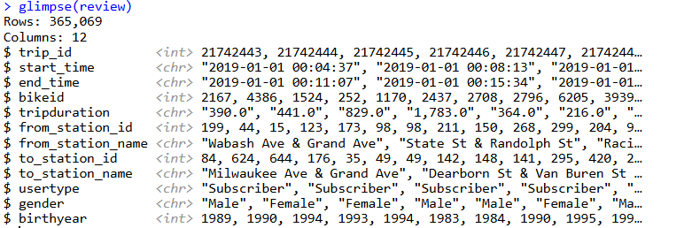
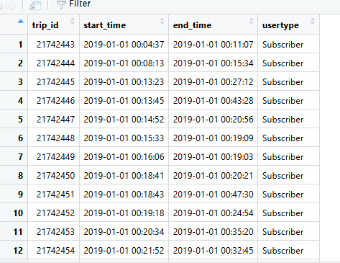
CYCLIST DATASET- Using R
Cleaning Data
review=read_csv("Divvy_Trips_2019_Q1.csv")
We can see from glimpse command , different type of variables or col names and type of data.
Closer inspection we can see start time , end time was used as character data type which should be converted to date type .
Trip duration was also saved as character, but it should be shown as time .
review_sorted_1<-review [, c("trip_id","start_time","end_time","usertype")]
Organizing the data to the columns which are needed and creating a new dataset out of it .

Slide 4
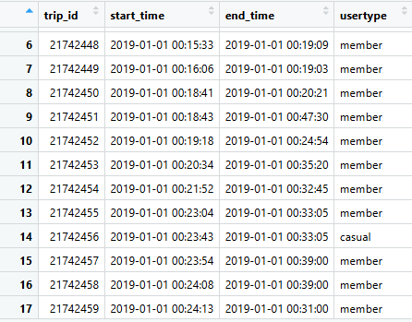
Process Data
review_sorted_2$usertype[review_sorted_2$usertype=="Subscriber"]<-"member“
review_sorted_2$usertype[review_sorted_2$usertype=="Customer"]<-"casual“
View(review_sorted_2)
Renaming usertype name with replace function.
review_sorted_2$ride_length<-(review_sorted_2$end_time-review_sorted_2$start_time)
review_sorted_2$end_time<-ymd_hms(review_sorted_2$ride_length)
Creating ride length column and converting into date time format

Slide 5
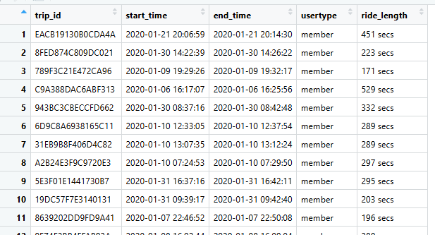
Process Data
Creating another dataframe
review_3<-read_csv("Divvy_Trips_2020_Q1.csv")
review_sorted_3<- review_3[,c("ride_id" ,"started_at","ended_at","member_casual")]
review_sorted_4<- review_sorted_3 %>% rename(trip_id=ride_id,start_time=started_at,end_time=ended_at,usertype=member_casual)
review_sorted_4$start_time<-ymd_hms(review_sorted_4$start_time)
review_sorted_4$end_time<-ymd_hms(review_sorted_4$end_time)
review_sorted_4$ride_length<-(review_sorted_4$end_time-review_sorted_4$start_time)
review_final<- merge(review_sorted_2,review_sorted_4, by = c("trip_id" ,"start_time","end_time","usertype","ride_length"))
review_final<-rbind(review_sorted_2,review_sorted_4)
Merging both dataframe
Analyze Data

Slide 6
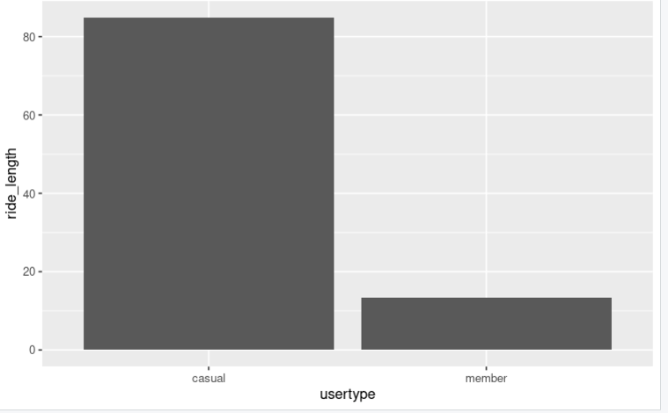
Creating Graph
ggplot(data=review_final)+geom_bar(mapping=aes(x=usertype ,ride_length) , stat = "summary", fun.y = "mean")

Slide 7
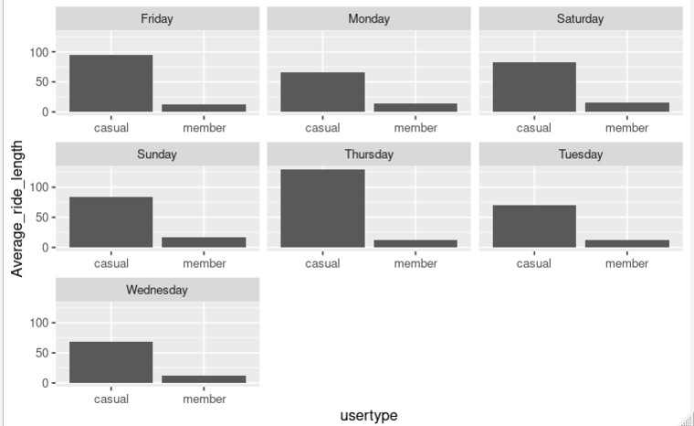
Creating Graph
ggplot(data=review_final)+geom_bar(mapping=aes(x=usertype ,ride_length), stat = "summary", fun.y = "mean")+ facet_wrap(~day_of_week ,scales= 'free_x')+ ylab("Average_ride_length")

Slide 8
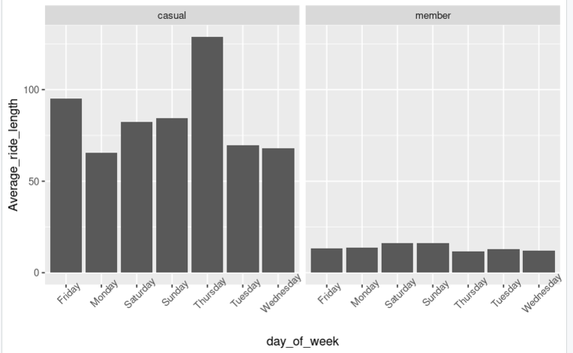
Creating Graph
ggplot(data=review_final)+geom_bar(mapping=aes(x=day_of_week ,ride_length), stat = "summary", fun.y = "mean")+ facet_wrap(~usertype ,scales= 'free_x')+ ylab("Average_ride_length")+theme(axis.text.x = element_text(angle = 45))

Slide 9
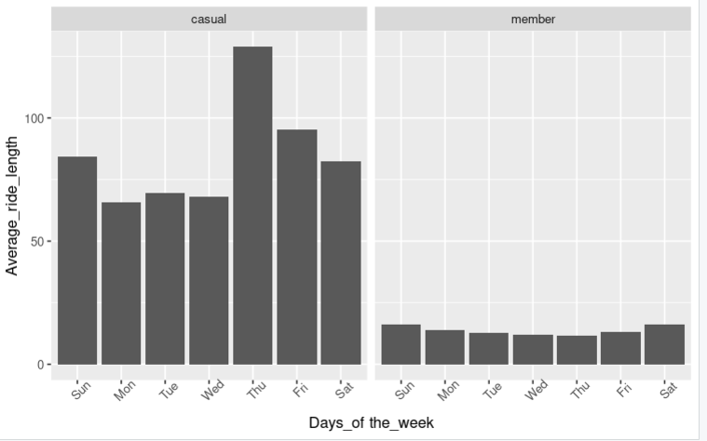
Creating Graph
days_of_the_week <- c("Sun", "Mon", "Tue", "Wed", "Thu""Fri "Sat")
ggplot(data=review_final)+geom_bar(aes(factor(x=day_of_week,days_of_the_week), y=ride_length) ,stat = "summary" ,show.legend = FALSE )+ facet_wrap(~usertype ,scales= 'free_x')+ xlab("Days_of the_week")+ylab("Average_ride_length")+theme(axis.text.x = element_text(angle = 45))

Slide 10
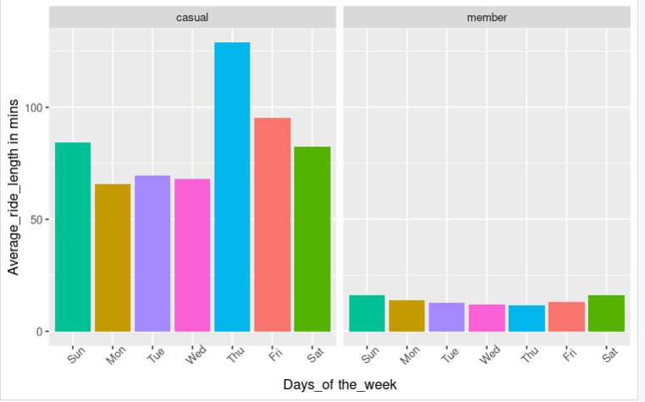
Creating Graph
days_of_the_week <- c("Sun", "Mon", "Tue", "Wed", "Thu", "Fri", "Sat")
ggplot(data=review_final)+geom_bar(aes(factor(x=day_of_week,days_of_the_week), y=ride_length ,fill=day_of_week) ,stat = "summary" ,show.legend = FALSE )+ facet_wrap(~usertype ,scales= 'free_x')+ xlab("Days_of the_week")+ylab("Average_ride_length in mins")+theme(axis.text.x = element_text(angle = 45))

Slide 11
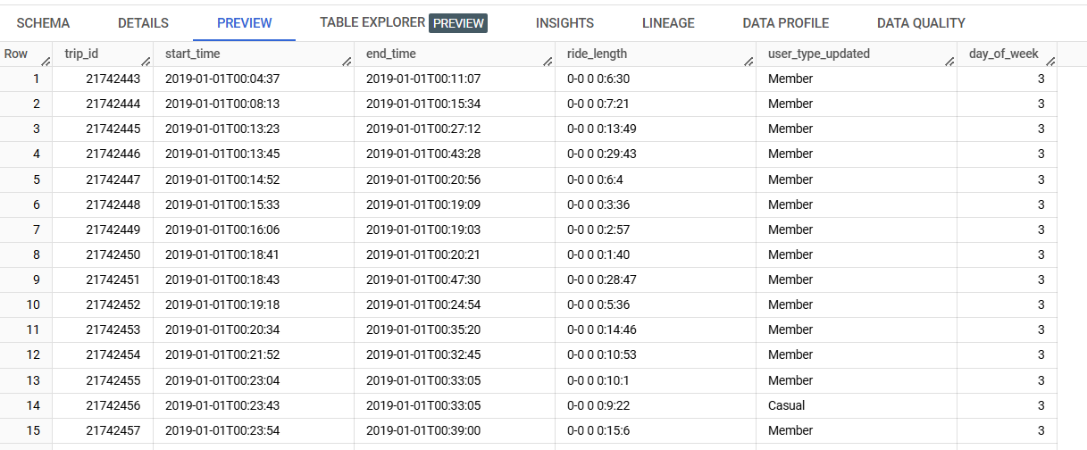
CYCLIST DATASET- Using SQL
SELECT
trip_id,
cast(start_time as datetime) AS start_time,
cast(end_time as datetime) AS end_time,
usertype
FROM `cyclist-444111.Divycycle_2019_2020.Divycycle2019`
ORDER BY
trip_id ASC
SELECT
trip_id,
start_time,
end_time,
( end_time - start_time) AS ride_length,
usertype,
day_of_week,
REPLACE(REPLACE(usertype,"Subscriber","Member"),"Customer","Casual") as user_type_updated
FROM cyclist-444111.Divycycle_2019_2020.Divycycle2019_filtered2
ORDER BY
trip_id ASC
SELECT
trip_id,
start_time,
end_time,
( end_time - start_time) AS ride_length,
usertype,
EXTRACT(DAYOFWEEK FROM start_time) as day_of_week
FROM `cyclist-444111.Divycycle_2019_2020.Divycycle2019_Filtered`
ORDER BY
trip_id ASC

Slide 12
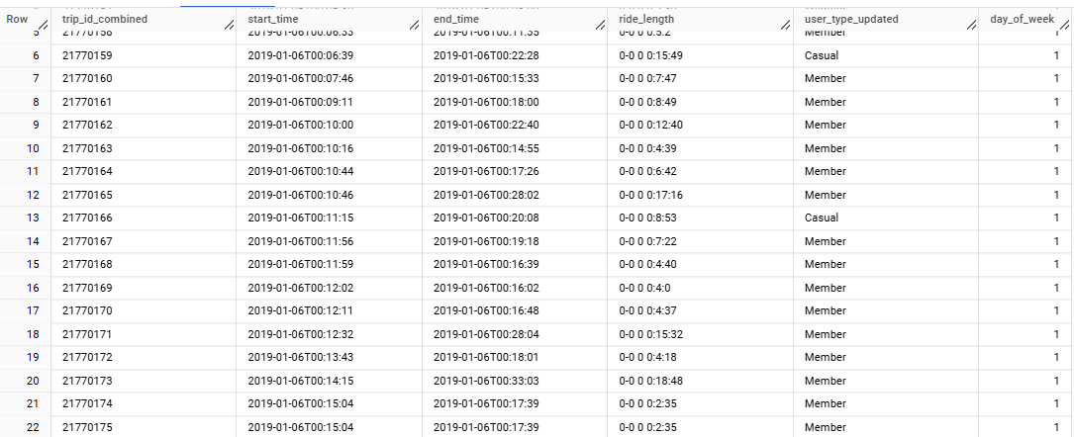
(
SELECT
trip_id_combined,start_time,end_time,ride_length,user_type_updated,day_of_week
FROM cyclist-444111.Divycycle_2019_2020.Divycycle2019_Filtered_6
)
union all
(
SELECT
trip_id_combined,start_time,end_time,ride_length,user_type_updated,day_of_week
FROM cyclist-444111.Divycycle_2019_2020.DivyCycle2020_Filtered_2
)

