Slide 1

Forecast Sales Prediction Using ML Model
Businesses struggle to predict future sales accurately, affecting inventory planning and decision-making.
Problem statement
……By Bhaskar Mandal, M.Tech, IIT KGP

Slide 2
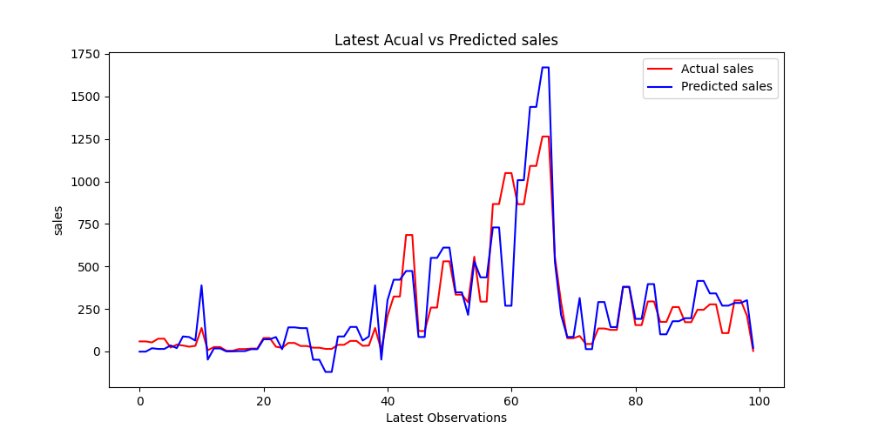
Forecast Sales Prediction Using ML Model
Predicted sales closely follow actual sales trends with good accuracy.
2. Prediction errors increase during sudden high sales peaks.
Add seasonal and promotional factors to improve forecast accuracy.
Insights
Recommend

Slide 3
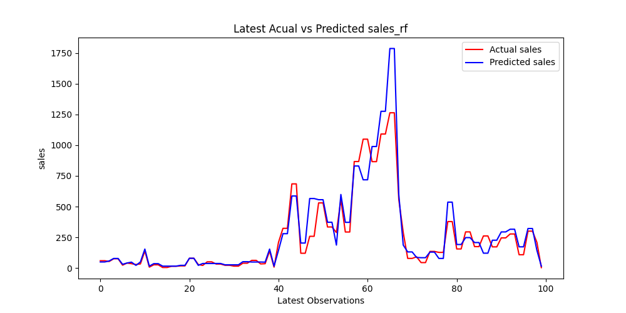
Forecast Sales Prediction Using ML Model
1.Random Forest closely captures actual sales patterns with higher prediction accuracy.
2. The model effectively follows major sales peaks and fluctuations.
Use Random Forest for reliable future forecasting.
Insights
Recommend

Slide 4
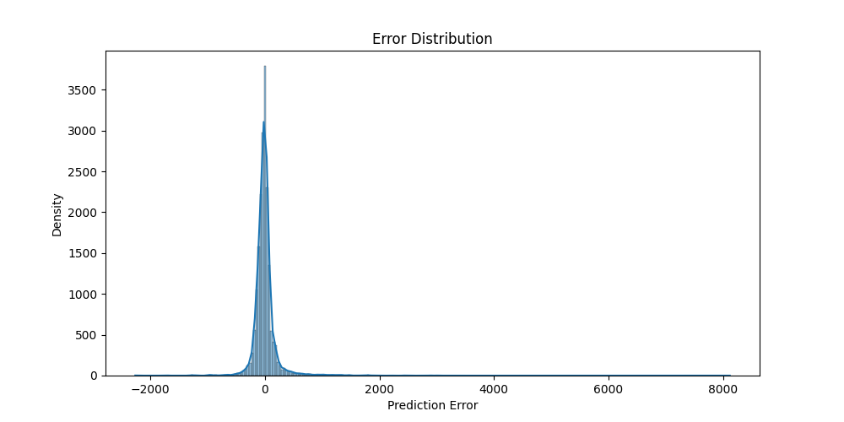
Forecast Sales Prediction Using ML Model
1. Most errors are close to zero.
2. Large sales values create higher prediction errors.
Use Random Forest for better accuracy.
Insights
Recommend

Slide 5
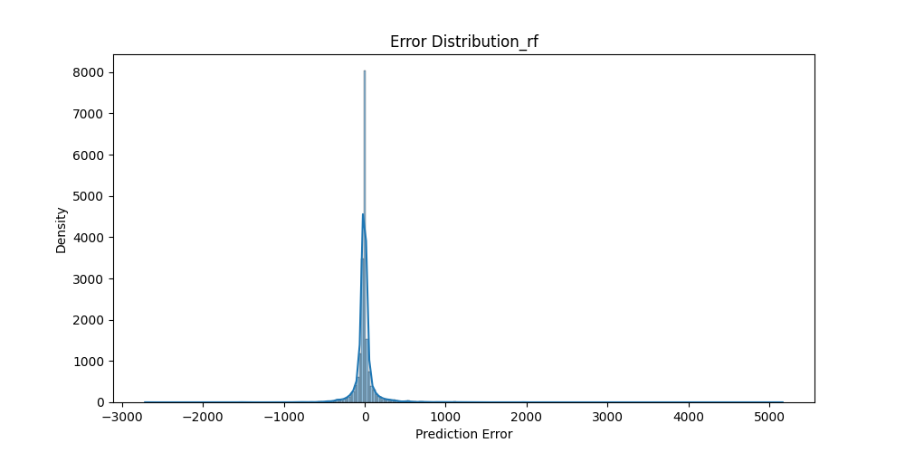
Forecast Sales Prediction Using ML Model
1. Errors are highly concentrated near zero, indicating strong prediction accuracy.
2. Random Forest produces fewer large prediction errors.
Use Random Forest as the final forecasting model.
Insights
Recommend

Slide 6
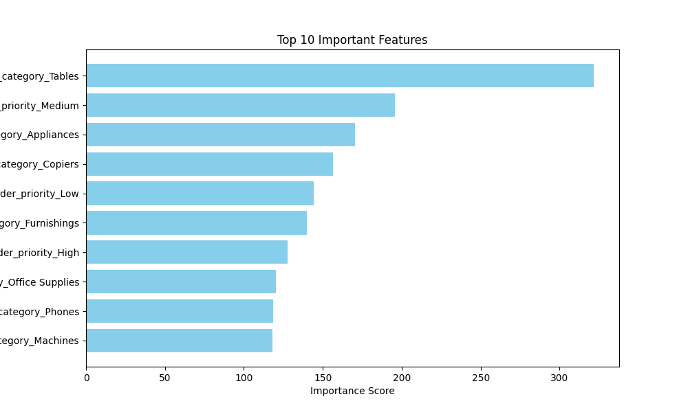
Forecast Sales Prediction Using ML Model
1. Product category has the strongest influence on sales prediction.
2. Priority and product type significantly affect sales patterns.
Focus marketing and inventory planning on high-impact features.
Insights
Recommend

Slide 7
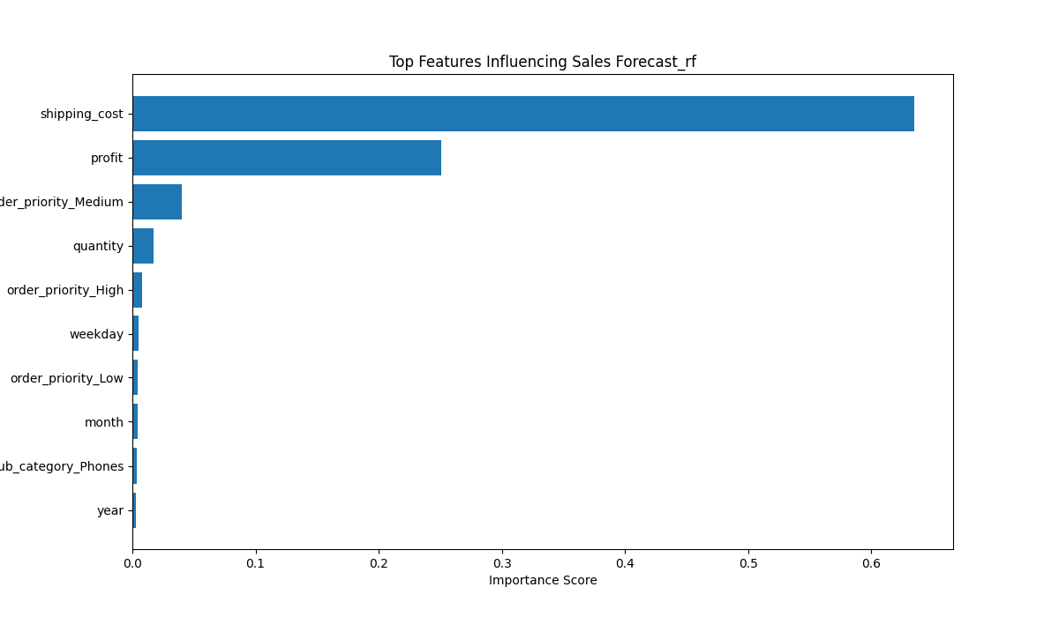
Forecast Sales Prediction Using ML Model
1. Shipping cost has the strongest impact on sales prediction.
2. Profit and quantity also contribute significantly to forecasting.
Focus on optimizing shipping cost and profit strategies to improve sales performance.
Insights
Recommend

Slide 8
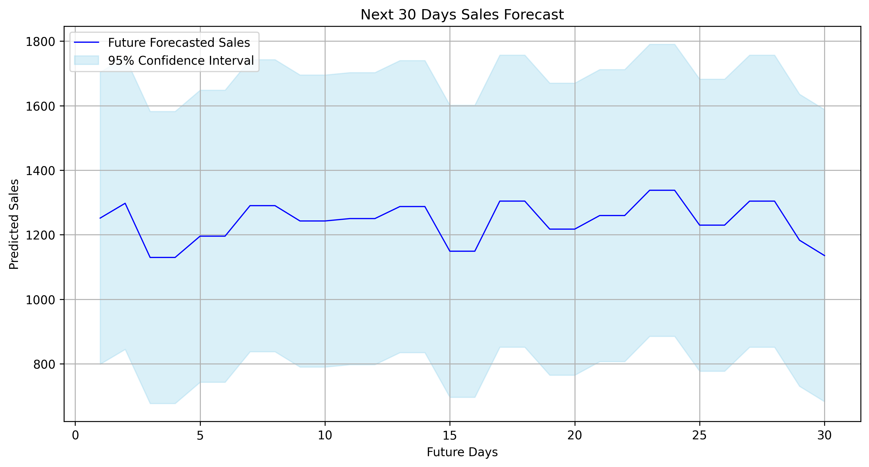
Forecast Sales Prediction Using ML Model
Future sales are expected to remain relatively stable over the next 30 days.
Minor fluctuations indicate moderate variation in demand.
Use forecast trends for inventory and resource planning.

Slide 9
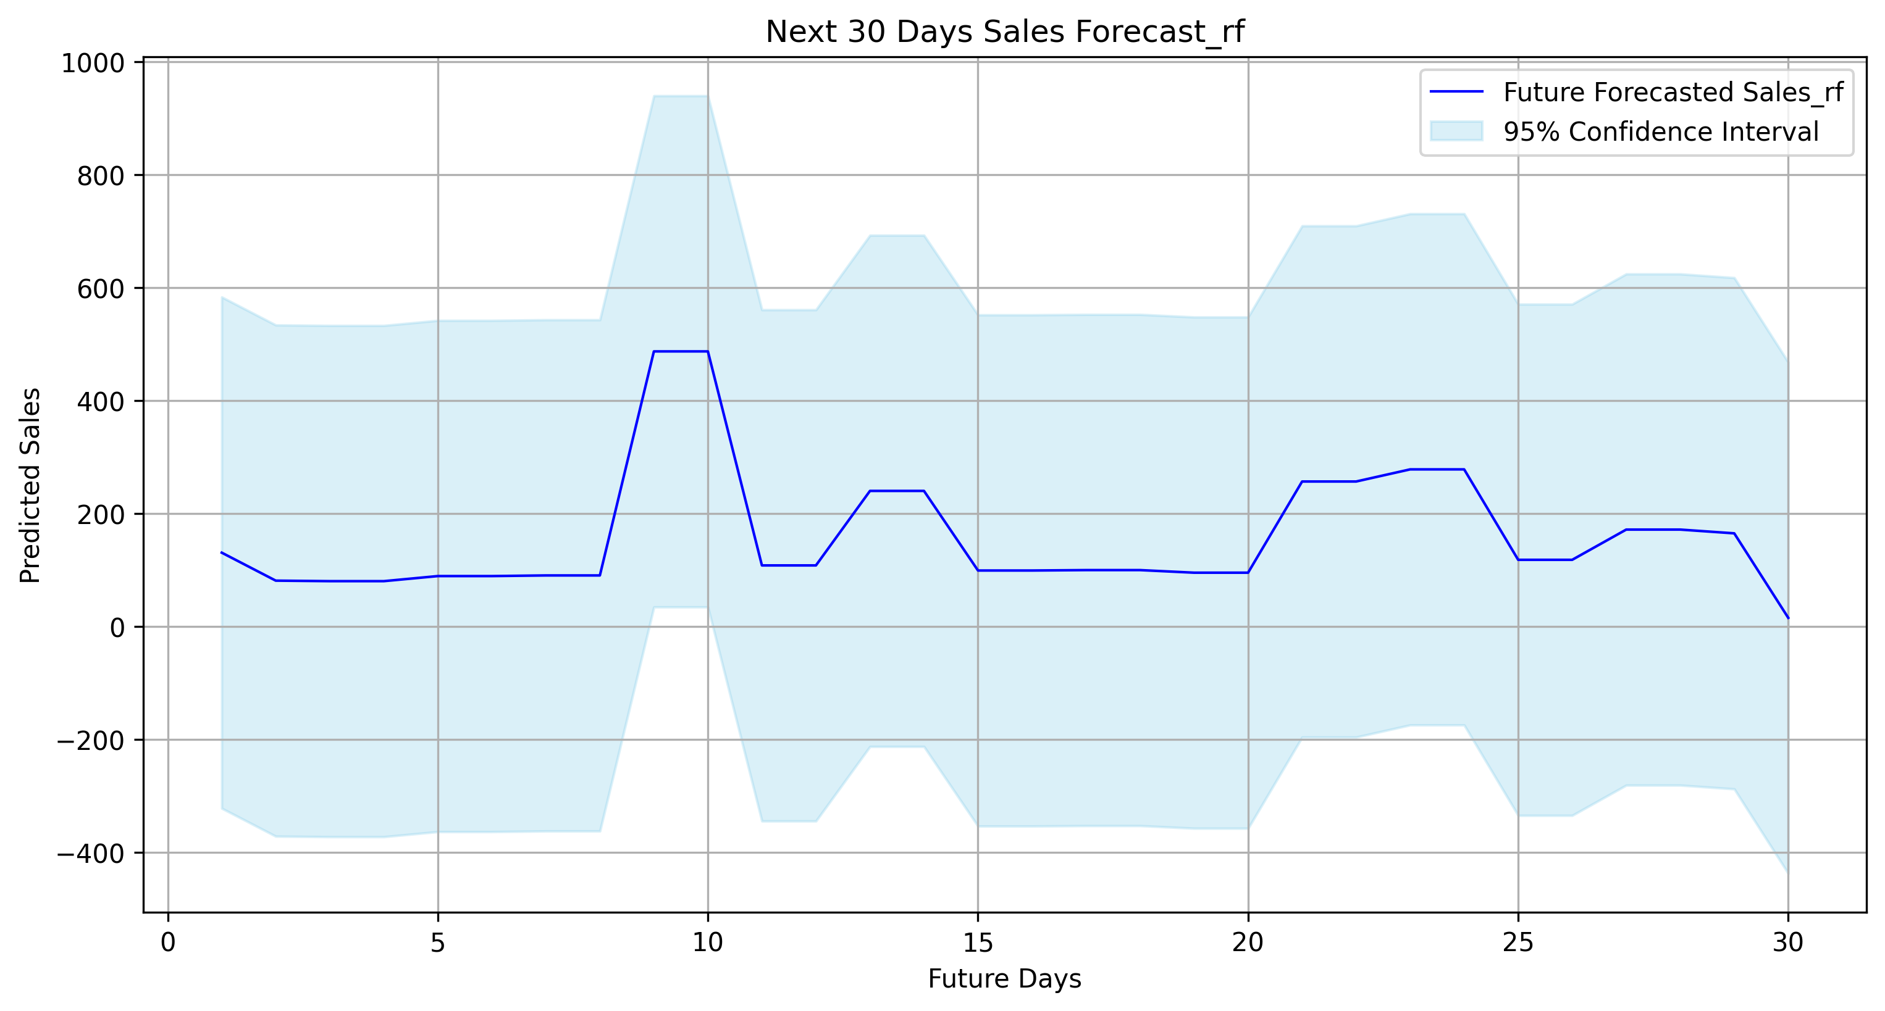
Forecast Sales Prediction Using ML Model
Random Forest predicts fluctuating future sales patterns effectively.
Sales spikes indicate changing demand behavior over time.
Use Random Forest forecasts for inventory and demand planning.

Slide 10
Conclusion
• Linear Regression performed well for simple and linear sales relationships (R² ≈ 0.76).
• Random Forest achieved better accuracy and lower prediction error (R² ≈ 0.87).
• Linear Regression is suitable for simple, stable, and linear data patterns.
• Random Forest is suitable for complex, nonlinear, and fluctuating sales patterns.
• Random Forest was selected as the final model for future forecasting due to stronger predictive performance.

Slide 11
Thank You

