Slide 1






Model Context Protocol & Langchain
Decoupling Agent Tools for Framework Independence
Technical Demo Presentation
June 2025
MCP Integration Demo
Have to check this

Slide 2



Agenda
1
The Challenge: Tool & Framework Coupling
5
After MCP: Tool Server Architecture
2
Introducing Model Context Protocol
6
Key Benefits: Framework Independence
3
HR Information Agent Scenario
7
Summary and Takeaways
4
Before MCP: Native Tool Integration
8
QNA
This presentation demonstrates how Model Context Protocol enables framework-agnostic tool handling, allowing seamless switching between frameworks like LangGraph and PhiData.
MCP Integration Demo
2/17

Slide 3

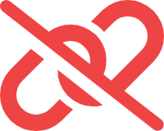



The Challenge: Tool & Framework Coupling
Framework-Specific Tools
Current Challenges
# Langchain-specific tool definition
@tool
def get_employee_info(employee_id: str) -> str:
"""Get employee information"""
# Langchain-specific implementation
return employee_data[employee_id]
# Different implementation for another framework
from crewai.tools import BaseTool
class get_employee_info(BaseTool): name: str = " get_employee_info " description: str = ”This tool helps in extracting the employee info." args_schema: BaseModel = MyToolInput def _run(self, argument: str) -> str: return employee_data[employee_id]
Tools are tightly coupled to specific agent frameworks
Switching frameworks requires rewriting tool definitions
No standardized way to share tools across frameworks
Difficult to maintain consistency across implementations
Duplicated code, inconsistent behavior, and maintenance overhead across frameworks
MCP Integration Demo
3/17

Slide 4











Introducing Model Context Protocol (MCP)
What is MCP?
MCP Tool Servers
Model Context Protocol (MCP)
is a standardized protocol that:
MCP Tool Servers
are standalone services that:
Host tool implementations independently
Defines a common interface for tool definitions
Expose tools via standardized API endpoints
Enables framework-agnostic tool implementations
Can be consumed by any MCP-compatible framework
Allows tools to be hosted separately from agents
Support tool discovery and metadata
Provides standardized evaluation capabilities
Tool Servers enable centralized tool management and consistent behavior across frameworks
MCP decouples tools from specific agent frameworks, enabling true interoperability
MCP Architecture Overview
Agent Frameworks
Agent Frameworks
MCP Tool Server
Independent tools with their corresponding tool servers
MCP
MCP Integration Demo
10/17

Slide 5






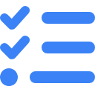
Demo Scenario: HR Information Agent
HR Agent Overview
Required HR Tools
An intelligent agent that answers questions about employees:
get_employee_info
Retrieves basic employee information by ID
Employee location and department
Skills and expertise
get_employee_skills
Lists skills and expertise of an employee
Reporting structure and supervisors
Project assignments and availability
get_reporting_structure
Returns manager and direct reports
get_project_assignments
Lists current projects and availability
Demo Scenario
We'll implement these HR tools in two ways:
1. Before MCP:
Tools defined directly within Langchain
2. After MCP:
Tools in a separate MCP Tool Server
MCP Integration Demo
5/17

Slide 6


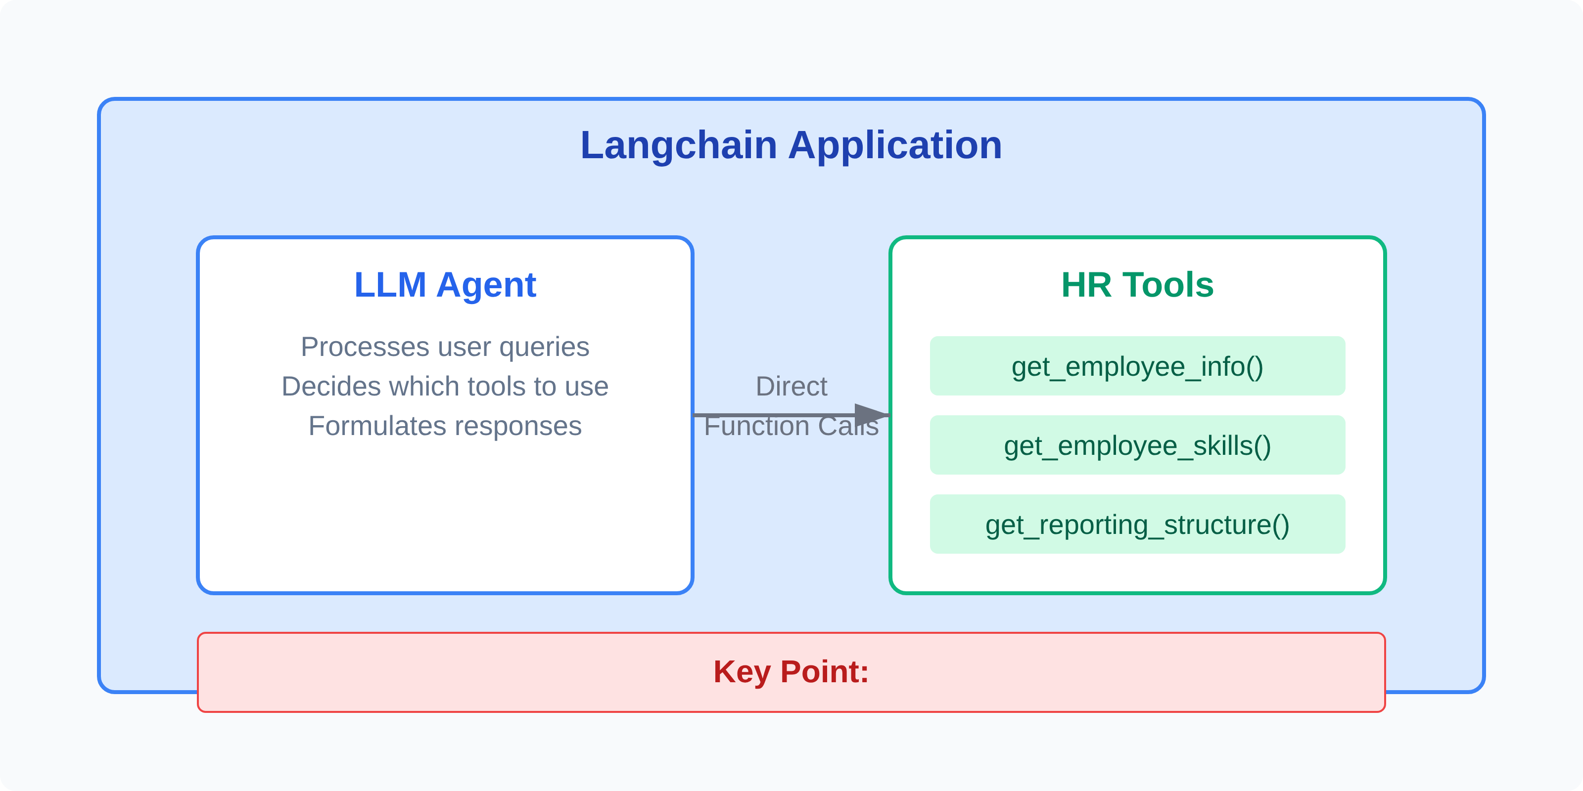


Approach 1: Before MCP (Native Tools)
Architecture: Native Langchain Tools
Architecture Notes
In the traditional approach, HR tools are:
Defined as Langchain-specific tool classes
Implemented directly within the agent application
Tightly coupled to the Langchain framework
MCP Integration Demo
6/17

Slide 7












Before MCP: Limitations
Technical Limitations
Business Impact
Framework Lock-in
Development Time
Tools are tightly coupled to Langchain's specific implementation patterns
Increased time to support multiple frameworks
Inconsistency Risk
Duplication of Effort
Different implementations may behave differently
Need to reimplement the same tools for different frameworks (LangGraph, PhiData)
Vendor Lock-in
Difficult to switch frameworks as needs evolve
Maintenance Overhead
Changes to tool logic must be replicated across all implementations
Limited Interoperability
Tools can't be easily shared across different systems
Architectural Constraints
Tools must run in the same environment as the agent
The Key Question
How can we decouple tools from specific frameworks while maintaining functionality?
MCP Integration Demo
9/17

Slide 8

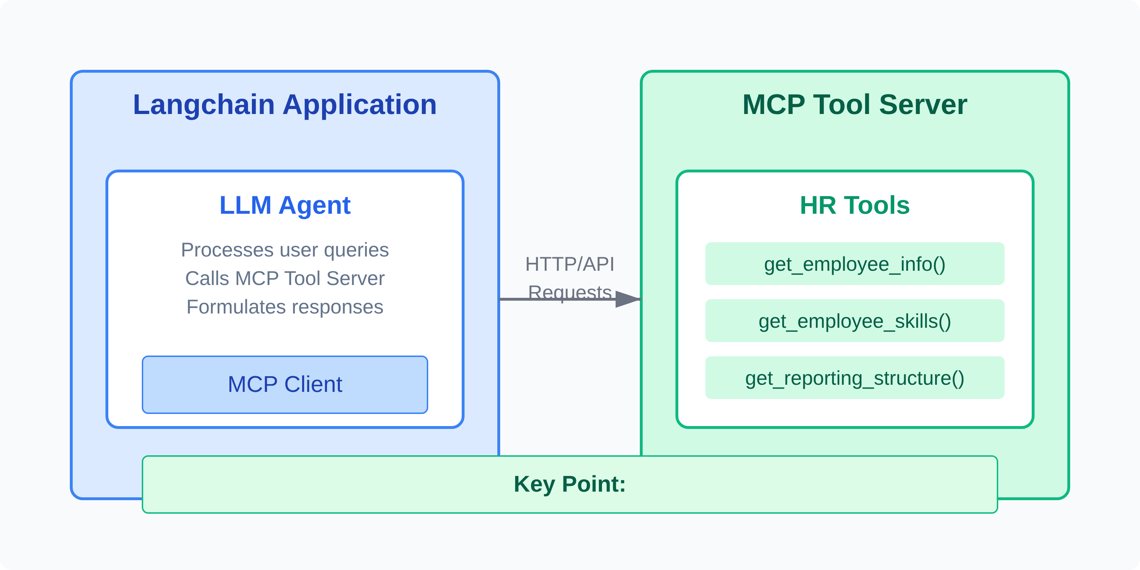

Approach 2: After MCP (MCP Tool Server)
Architecture: MCP Tool Server
Architecture Benefits
Clear separation between agent logic and tool implementation
Tools can be consumed by any MCP-compatible framework
Centralized tool management and versioning
MCP Integration Demo
11/17

Slide 9










Benefit 1: Framework Independence
Same Tools, Different Frameworks
Key Benefits
With MCP Tool Server, the same HR tools can be used by:
Framework Flexibility
Switch between agent frameworks without rewriting tools
Langchain
Single Source of Truth
from mcp.langchain import MCPToolClient
mcp_client = MCPToolClient("http://localhost:8000")
hr_tools = mcp_client.get_tools()
One implementation, consistent behavior across frameworks
LangGraph
Centralized Management
Update tools in one place, all frameworks benefit
from mcp.langgraph import MCPToolClient
mcp_client = MCPToolClient("http://localhost:8000")
hr_tools = mcp_client.get_tools()
Future-Proofing
New frameworks can integrate with existing tools
PhiData
from mcp.phidata import MCPToolClient
mcp_client = MCPToolClient("http://localhost:8000")
hr_tools = mcp_client.get_tools()
Technical Insight
MCP adapters translate between framework-specific formats and the standardized MCP protocol, enabling seamless interoperability without modifying the core tool implementations.
MCP Integration Demo
14/17

Slide 10





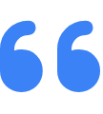
Summary & Key Takeaways
Before vs After MCP
Key Benefits
Before MCP
Framework Independence
• Tools tightly coupled to Langchain
Use the same tools across Langchain, LangGraph, PhiData, and future frameworks
• Framework-specific implementation
• Duplication across frameworks
• Inconsistent behavior possible
• Limited reusability
Reduced Development Effort
Implement tools once, use everywhere
After MCP
• Framework-agnostic tools
• Single implementation
Standardized Evaluation
• Consistent behavior
Consistent metrics across different agent implementations
• Centralized management
• Built-in evaluation
Future-Proof Architecture
Easily adapt to new frameworks and technologies
"MCP enables true separation of concerns between agent frameworks and tool implementations, creating a more maintainable and flexible architecture for AI systems."
MCP Integration Demo
16/17

Slide 11





Q&A / Thank You
Questions?
Resources
MCP Documentation:
https://mcp.example.org/docs
GitHub Repository:
https://github.com/example/mcp
Tutorials:
https://mcp.example.org/tutorials
Contact
For more information or assistance with MCP integration:
support@mcp.example.org
Thank you for your attention!
MCP Integration Demo
17/17

