Slide 1
Fall 2023
University of Houston
EDS 6340 Introduction to Data Science
Group 6
2311362 Suguna Chandana Sibbena
2279917 Goutham Reddy Kasireddy
2310127 Prudhvi Kolla
2202760 Naga Venkata Siva Tejaswini Anguluri
2295647 Sameer Shaik

Slide 2
Overview
In this project, we have chosen the dataset about credit card clients and we need to classify whether a given client will default the payment or not. This dataset contains information on default payments, credit data, history of payment, demographic factors( like age, sex, etc..), and bill statements of credit card clients in Taiwan from April 2005 to September 2005.
We collected the dataset from the UCI Machine Learning Repository.
Irregular entries in the dataset are handled by deleting the entries.
Outliers are handled using the winsorization technique.
One hot encoding is used to remove the ordinal relationship in between categorical variables.
During data reduction and feature selection, we dropped the unwanted columns that are not useful for current project goals.
The dataset is imbalanced data. So to handle imbalanced data Synthetic Minority Oversampling Technique (SMOTE) is used.
Exploratory data analysis and visualization.

Slide 3
Data Cleaning and Preprocessing
Data Collection: Data Collection is the process of gathering data that is required for the project from the source.
Duplicates: Duplicate records can bias our analysis and lead to incorrect conclusions. However, in the collected dataset, does not contain any duplicate values.
Missing Data: Missing Data can introduce bias or inaccuracies into analysis. However, there are no missing entries in the dataset.
The attributes Limit_Balance, Sex, and Age are consistent with the description while Education and Marriage have some irregular entries.
Since irregular entries are relatively few (1.33%) of the total number, deleting the records that contain the irregular entries.
On visualizing the dataset using boxplot, shows the presence of outliers in some columns.
The outliers are handled using the winsorization technique and the output from the winsorization technique is a numpy array. So, converted the numpy array into a data frame and named it df1.
Using the group by method, grouped the columns Education and Marriage with the bill amounts of credit card clients from April 2005 to September 2005 and the analysis is made by computing mean, standard deviation, and sum. We observed that the clients whose Education level is in Univeristy and their marriage status is single made higher bill amount than any other client.

Slide 4
Data reduction and Feature selection
Data Normalization is a method to change the values of numeric columns in a dataset to a common scale. While normalization also suppresses the effect of outliers. Hence Min-Max Scaling technique is used for normalization.
The categorical features “Education”,” Sex” and “Marriage” are already encoded with integer numbers. However, these are nominal features so one hot encoding allows us to remove the ordinal relationship, which would be meaningless between these categorical variables. Binary values can then be used to indicate the particular class of an example.
Feature Selection is the process of selecting a subset of relevant features that is useful for model construction. For feature selection, an example of wrapper method i.e., Recursive Feature elimination is used and a predictive model i.e., logistic regression is used to evaluate the combination a features and assign a score based on model accuracy.
We can observe that the dataset being used for the project is imbalanced i.e., a non-default class are more dominant. Therefore Synthetic Minority Oversampling Technique (SMOTE) techniques is applied to the dataset.

Slide 5
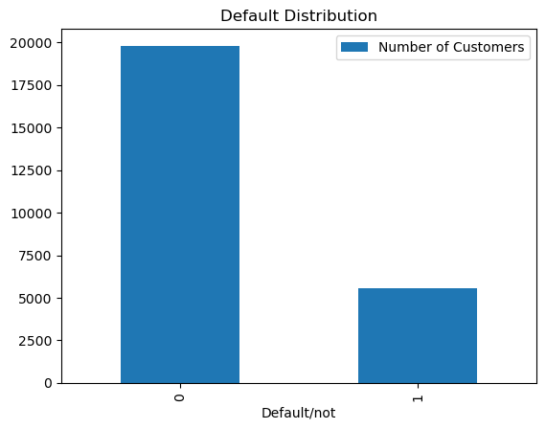
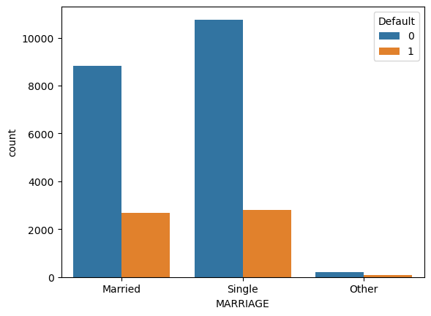
Exploratory Data Analysis and Visualization

Slide 6
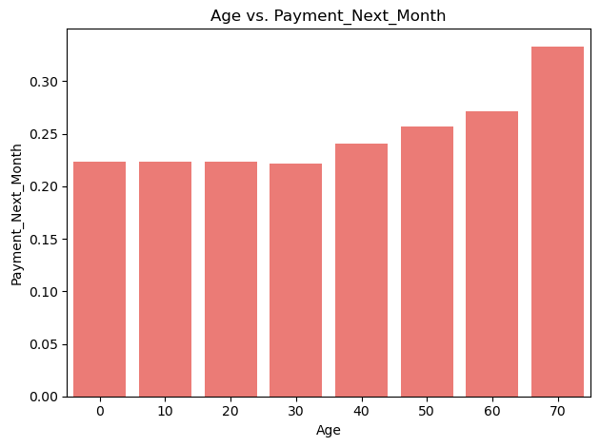
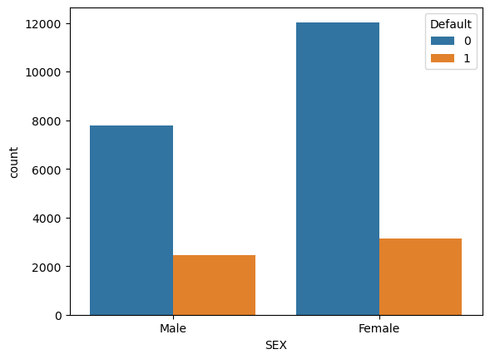
Data Reduction and Feature Selection

Slide 7
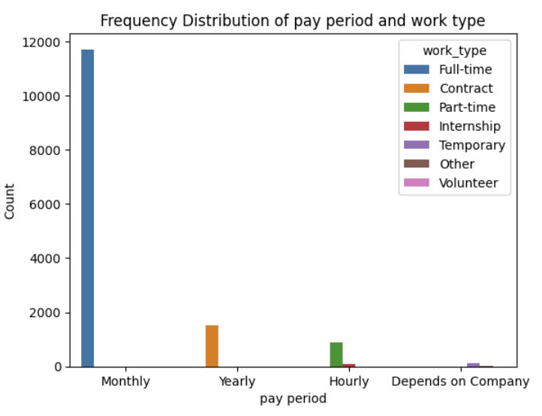
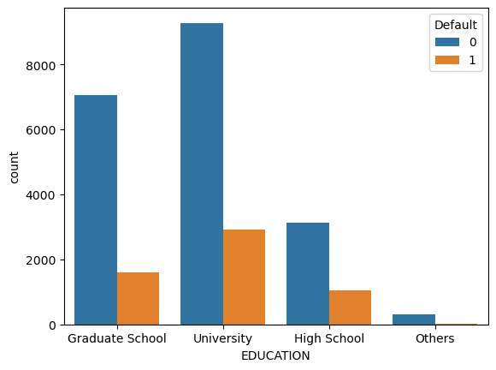
The above stacked bar chart represent the amount of employees
of different work types in various levels of work force.

