Slide 1
Meeting 19
2024/02/05

Slide 2
本次進度
幾乎完成DC 模擬
加入mos至transient 模擬
測試mos電路

Slide 3
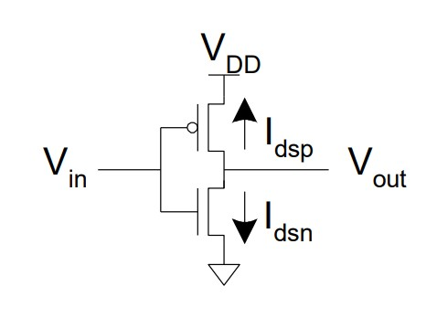
Inverter
netlist
* NMOS Characteristics
* Model and Temperature
.model N_18 NMOS(Vto=0.4 Lambda=0.02)
.options TEMP=25
* Netlist
MP1 Vs Vg VDD VDD P_18 W=1u L=0.18u
MN1 Vs Vg VSS VSS N_18 W=1u L=0.18u
* DC Sweep
VD VDD 0 dc 1
Vg Vg 0 SIN 0 1 50
*Vg Vg 0 dc 0
VS VSS 0 dc 0
.end

Slide 4
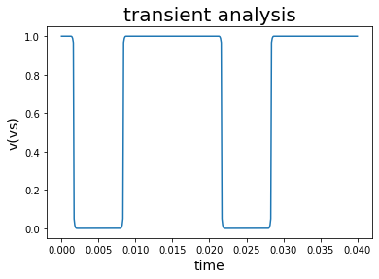
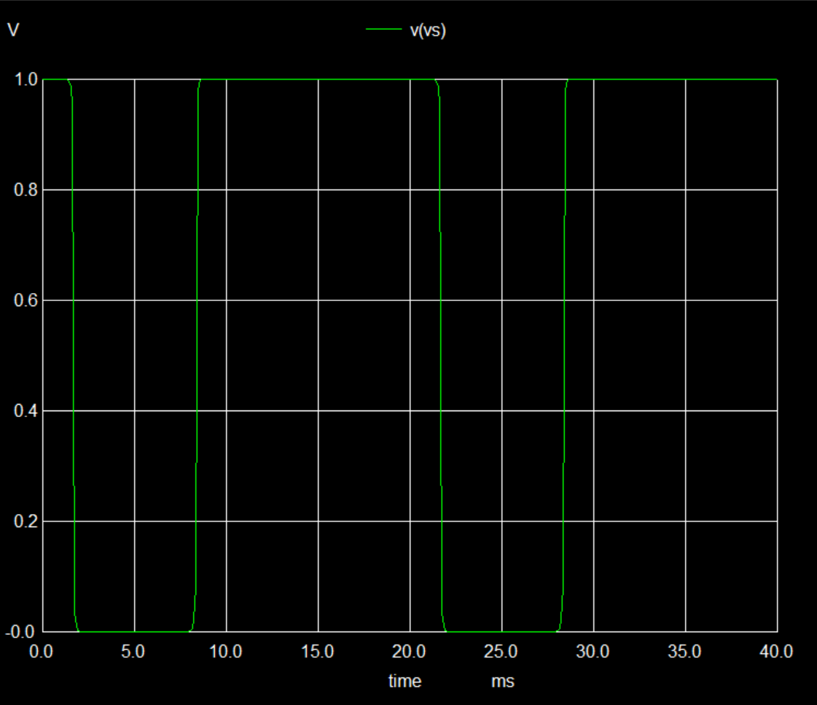
Transient 0s to 40ms

Slide 5
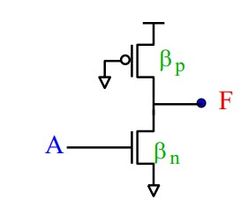
Psuedo Nmos
netlist
* NMOS Characteristics
* Model and Temperature
.model P_18 PMOS(Vto=-0.4 Lambda=0.02)
.model N_18 NMOS(Vto=0.4 Lambda=0.02)
.options TEMP=25
* Netlist
MP1 Vs VSS VDD VDD P_18 W=1u L=0.18u
MN1 Vs Vg VSS VSS N_18 W=1u L=0.18u
* DC Sweep
VD VDD 0 dc 1
Vg Vg 0 SIN 0 1 50
*Vg Vg 0 dc 0
VS VSS 0 dc 0
.end

Slide 6
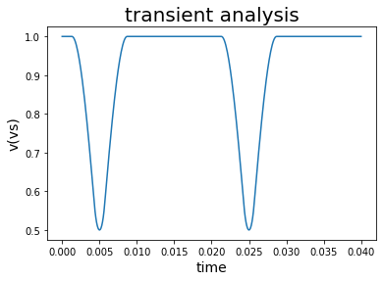
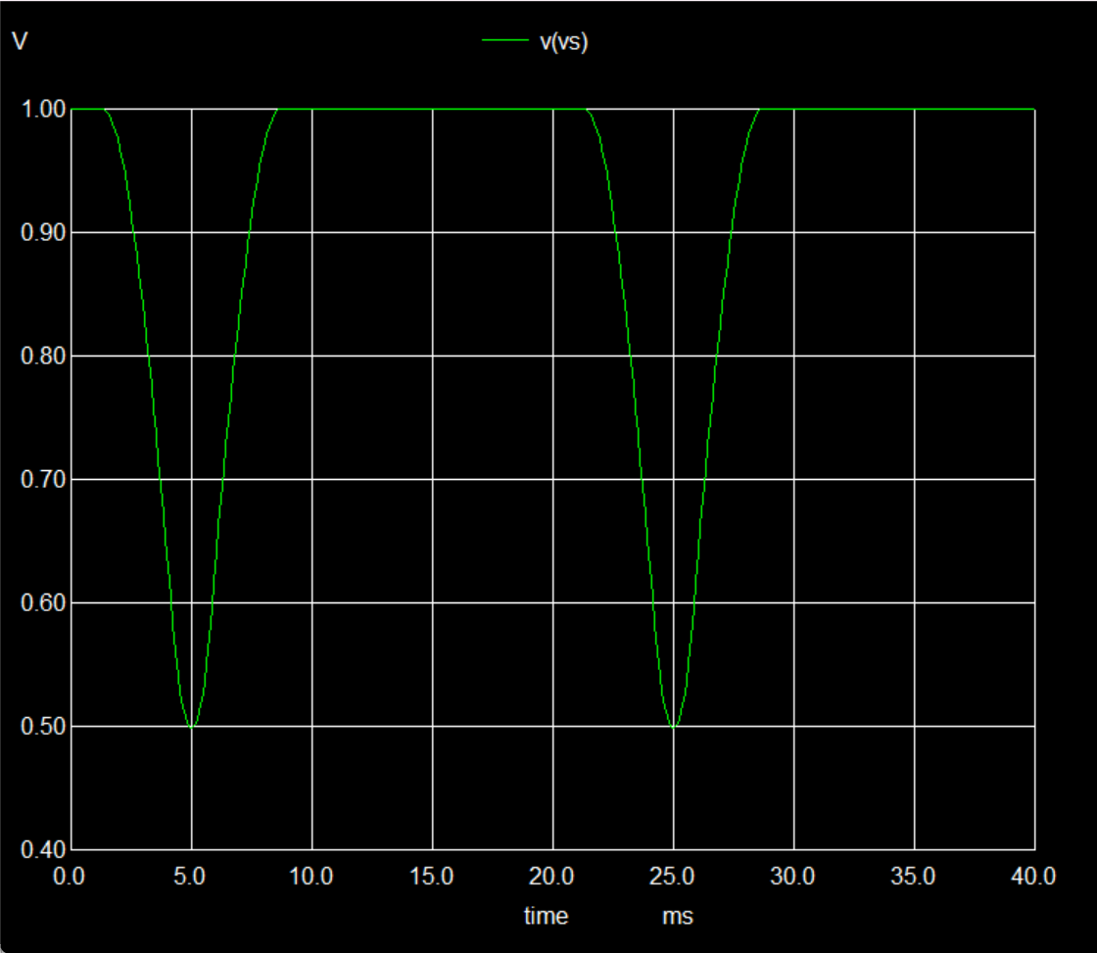
Transient 0s to 40ms

Slide 7
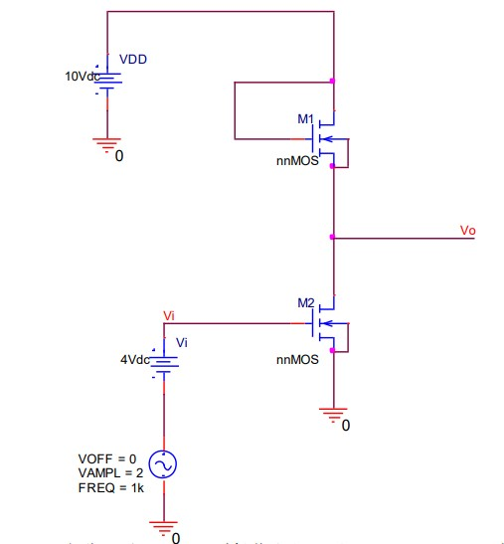
single_transistor_load
netlist
single_transistor_load
.model N_18 NMOS(Vto=0.4 Lambda=0.02)
.model P_18 PMOS(Vto=-0.4 Lambda=0.02 UO=600)
.options TEMP=25
Mn1 VDD VDD output output n_18 w=0.8u l=0.4u
Mn2 output input 0 0 n_18 w=0.8u l=0.4u
VVDD VDD 0 dc 10
vin_dc in 0 dc 2.7
vin input in sin 0 1 50
.end

Slide 8
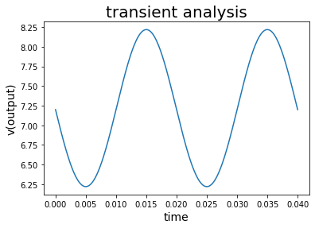
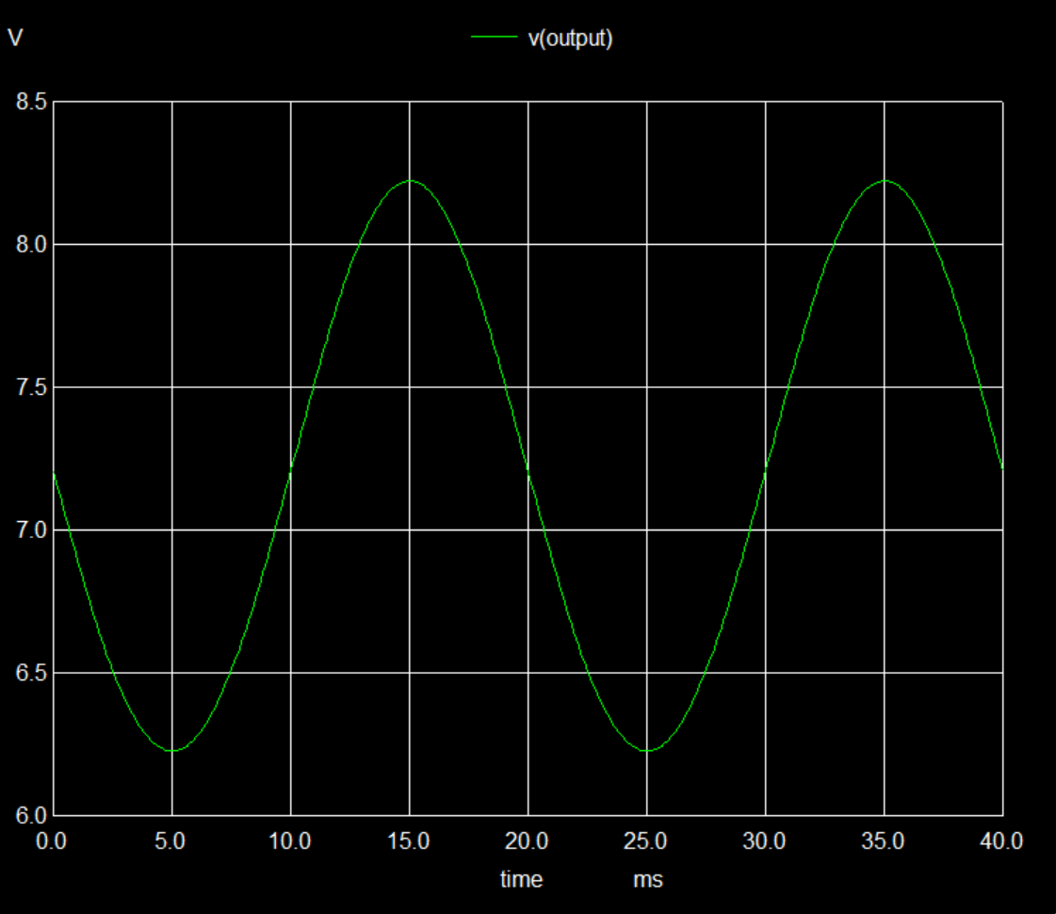
Transient 0ms to 40ms

Slide 9
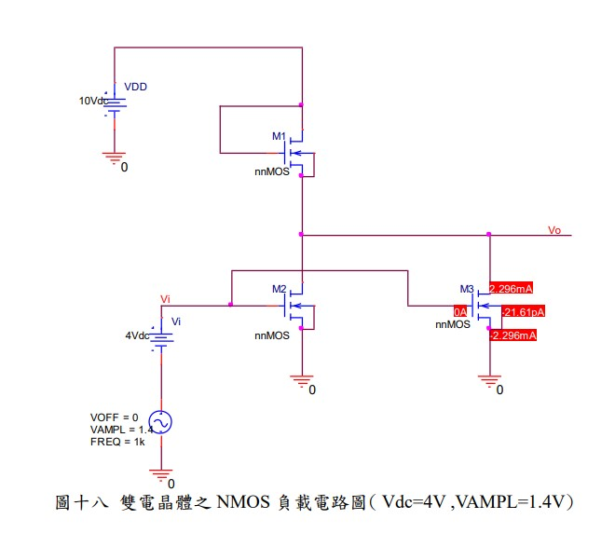
double_transistor_load
netlist
double_transistor_load
.model N_18 NMOS(Vto=0.4 Lambda=0.02)
.model P_18 PMOS(Vto=-0.4 Lambda=0.02)
Mn1 VDD VDD output output n_18 w=0.8u l=0.4u
Mn2 output input 0 0 n_18 w=0.8u l=0.4u
Mn3 output input 0 0 n_18 w=0.8u l=0.4u
vin_dc input_dc 0 dc 4
Vin input input_dc sin 0 2 50
VVDD VDD 0 dc 10
Vs Vss 0 dc 0
.end

Slide 10
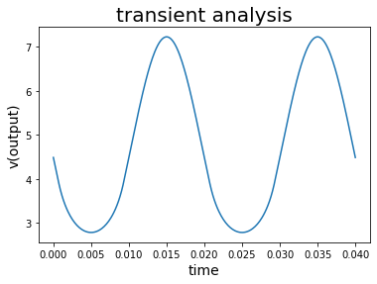
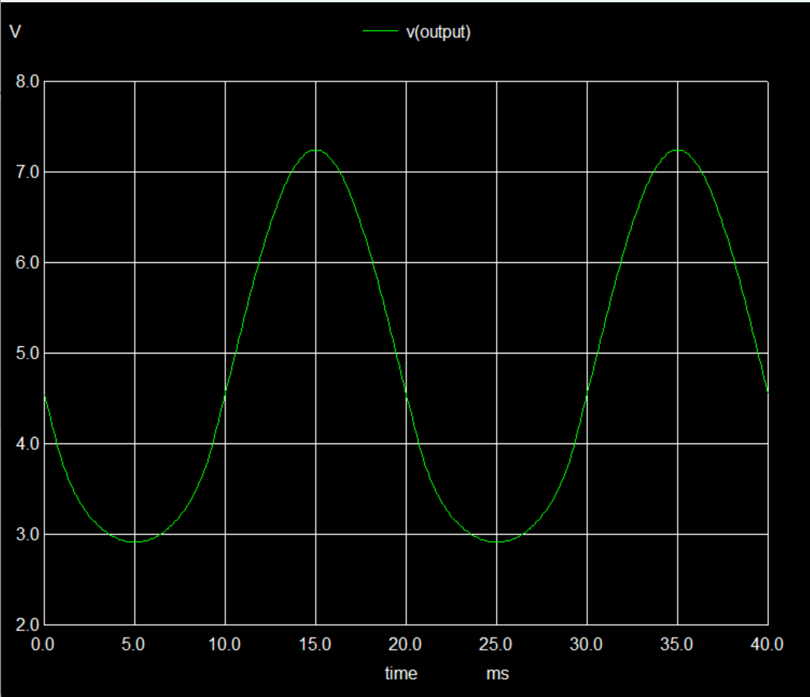
Transient 0ms to 40ms

Slide 11
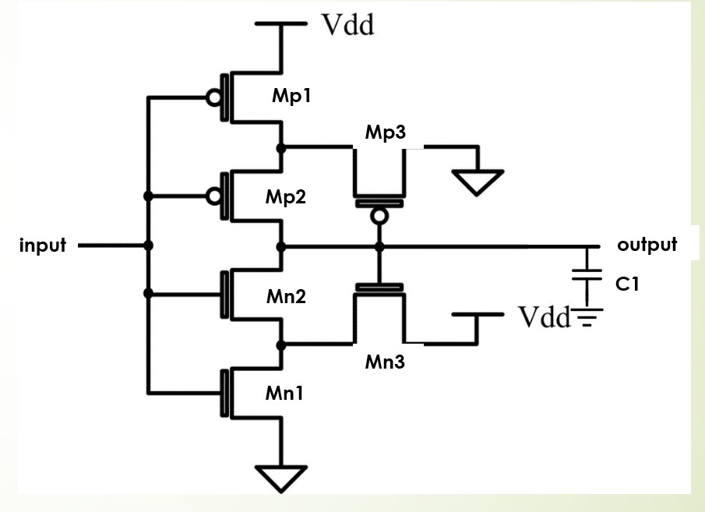
有問題的電路1:Schmitt trigger
netlist
schnitt trigger
.model N_18 NMOS(Vto=0.4 Lambda=0.02)
.model P_18 PMOS(Vto=-0.4 Lambda=0.02)
.options TEMP=25
Mp1 p1 input VDD VDD p_18 w=1.6u l=0.4u
Mp2 output input p1 VDD p_18 w=1.6u l=0.4u
Mp3 VSS output p1 VDD p_18 w=1.28u l=0.4u
Mn1 n1 input VSS VSS n_18 w=0.8u l=0.4u
Mn2 output input n1 VSS n_18 w=0.8u l=0.4u
Mn3 VDD output n1 VSS n_18 w=0.64u l=0.4u
C1 output 0 1f
VVDD VDD 0 dc 1.8
*Vg input 0 SIN 0 1.8 50
Vg input 0 dc 1.8
VS VSS 0 dc 0
.end

Slide 12
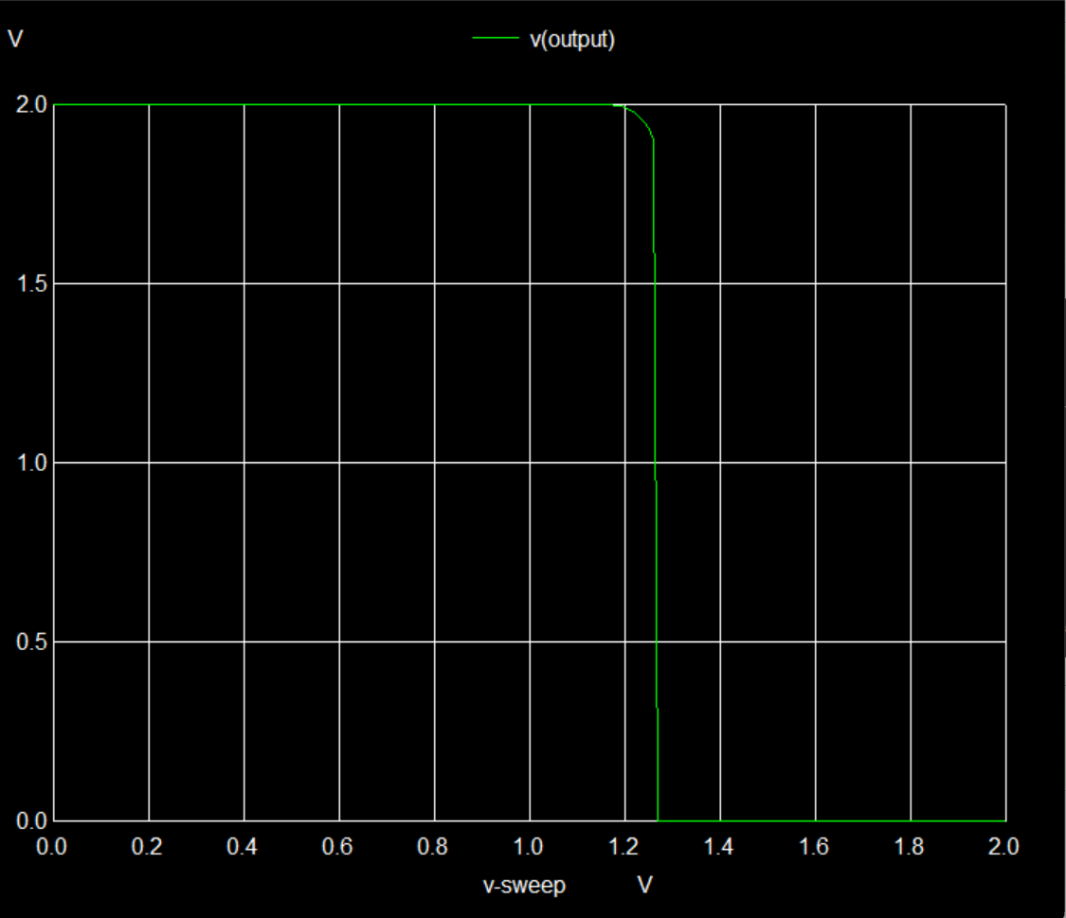
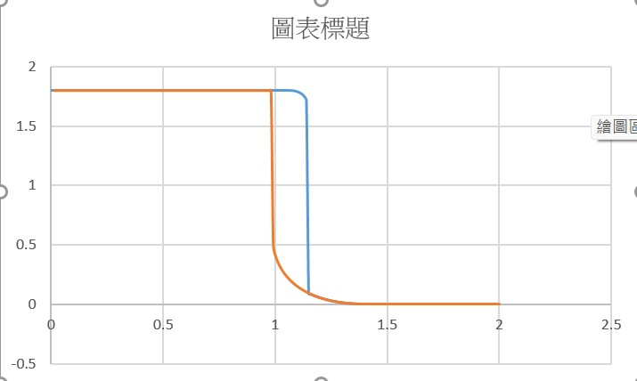
Dc Sweep:From 0V to 2V

Slide 13
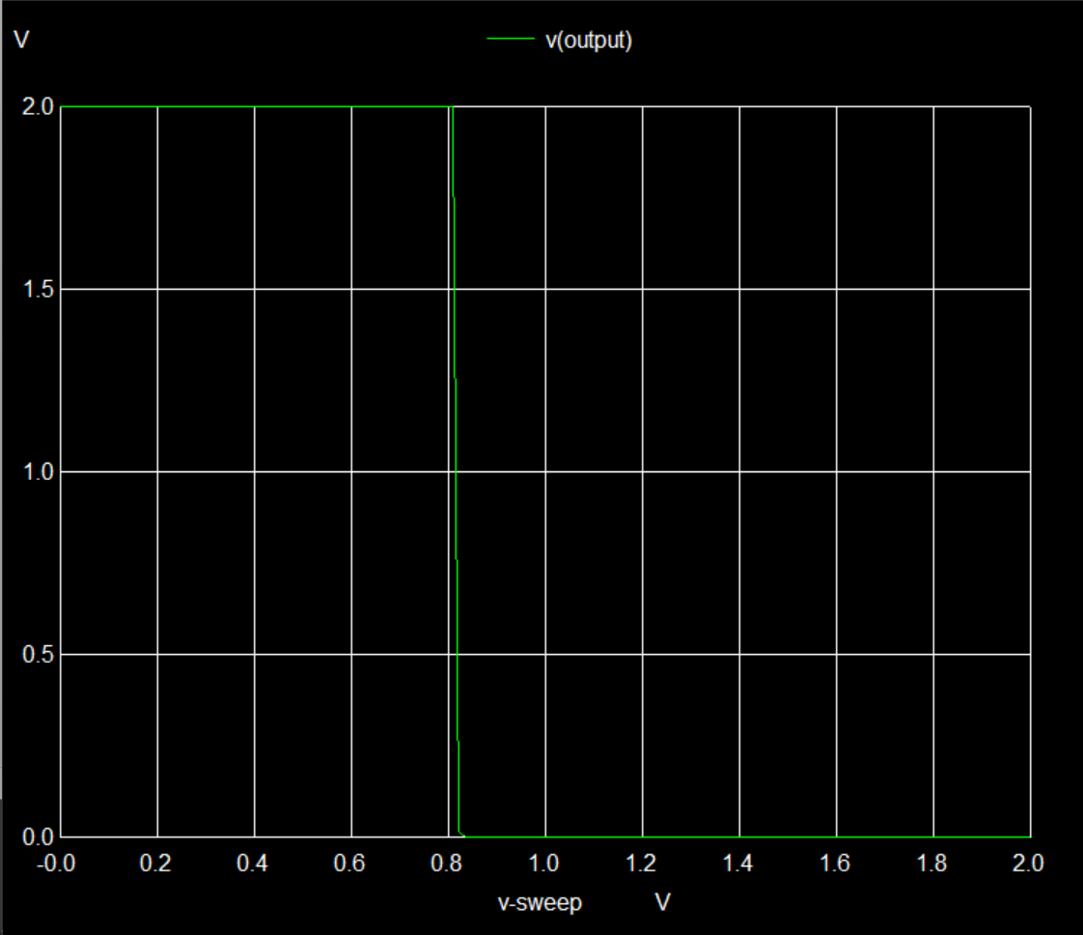
Dc Sweep:From 2V to 0V

Slide 14
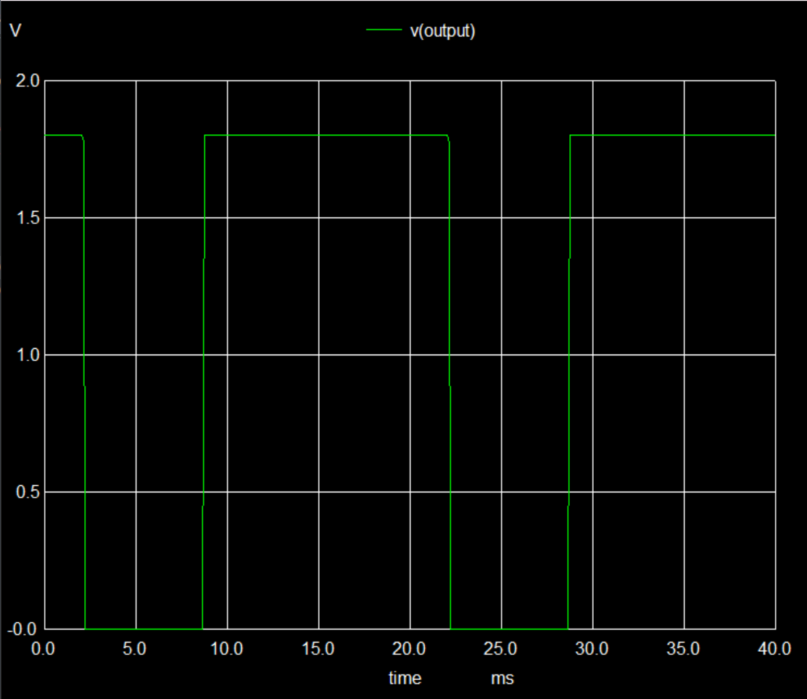
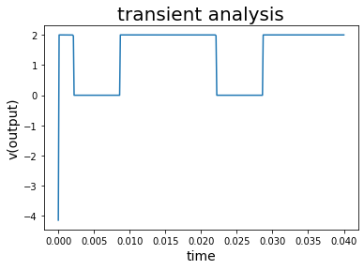
Transient 0ms to 40ms

Slide 15
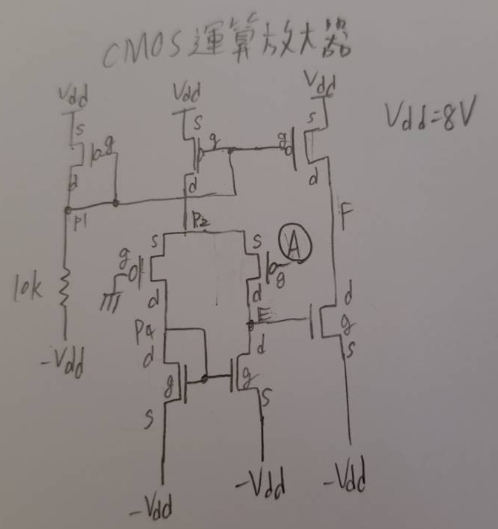
有問題的電路2:MOS Op Amp
netlist
CMOS_Operationa_amplifier
*Model and Temperature
.model N_18 NMOS(Vto=0.4 Lambda=0.02)
.model P_18 PMOS(Vto=-0.4 Lambda=0.02)
Mp1 p1 p1 VDD VDD p_18 w=1.6u l=0.4u
R1 p1 Vss 10k
Mp2 p2 p1 VDD VDD p_18 w=1.6u l=0.4u
Mp3 F p1 VDD VDD p_18 w=1.6u l=0.4u
Mp4 p4 0 p2 p2 p_18 w=1.6u l=0.4u
Mp5 E A p2 p2 p_18 w=1.6u l=0.4u
Mn1 p4 p4 Vss Vss n_18 w=0.8u l=0.4u
Mn2 E p4 Vss Vss n_18 w=0.8u l=0.4u
Mn3 F E Vss Vss n_18 w=0.8u l=0.4u
Vs Vss 0 dc -15
VVDD VDD 0 dc 15
Vin A 0 sin 0 1 50
.end

Slide 16
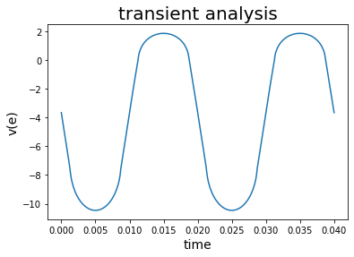
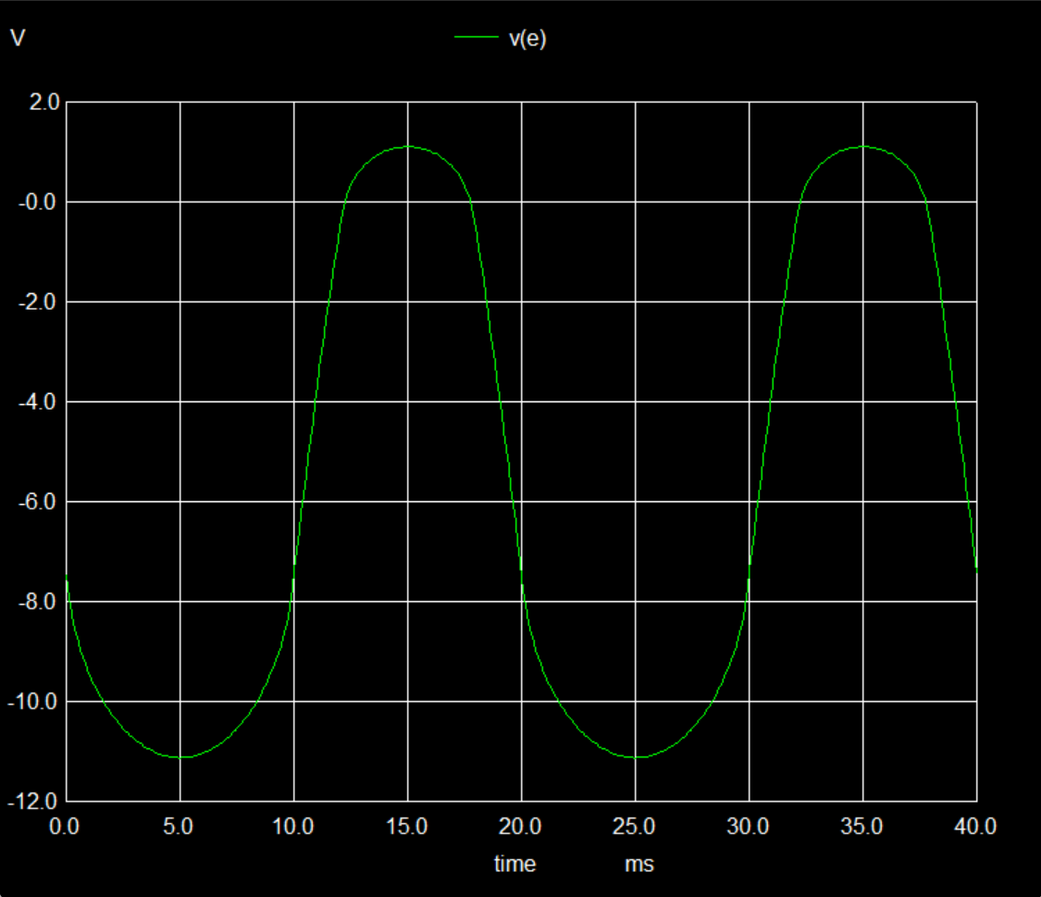
Transient 0s to 40ms: v(f)

Slide 17
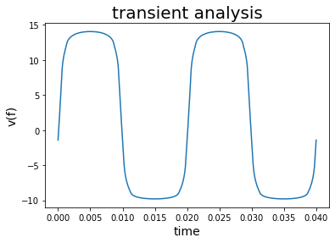
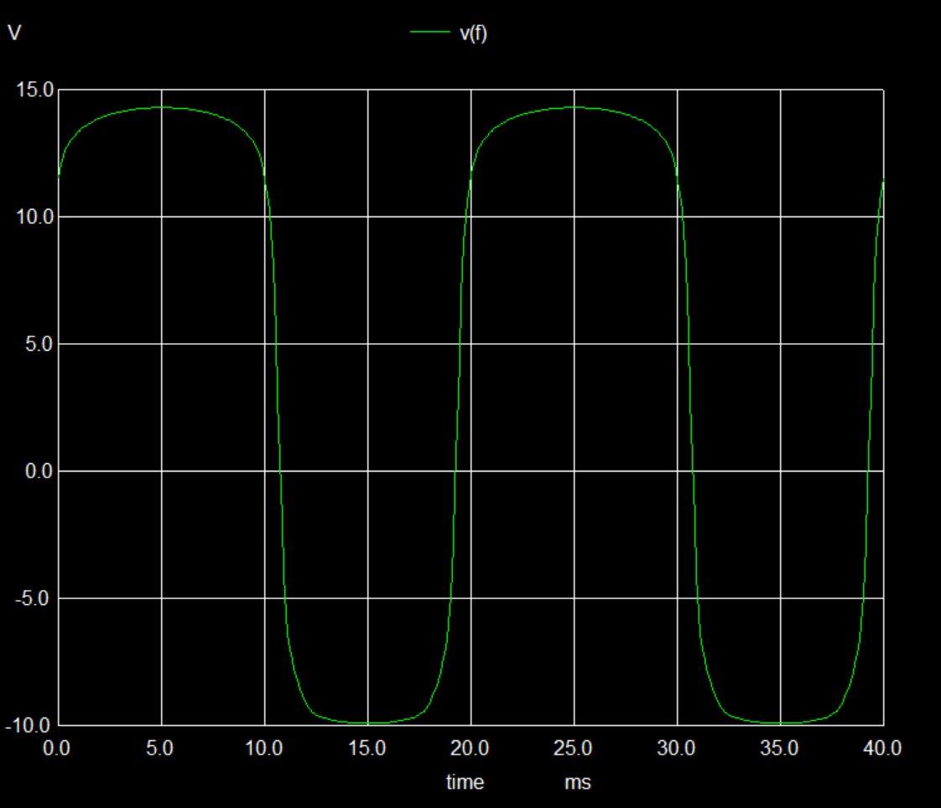
Transient 0s to 40ms: v(e)
在t=0的值有問題，推測是初值沒有給好(沒有先跑一遍DC bias)

