Slide 1
Meeting 20
2024/02/19

Slide 2
本次進度
在transient function中加入解DC bias的function

Slide 3
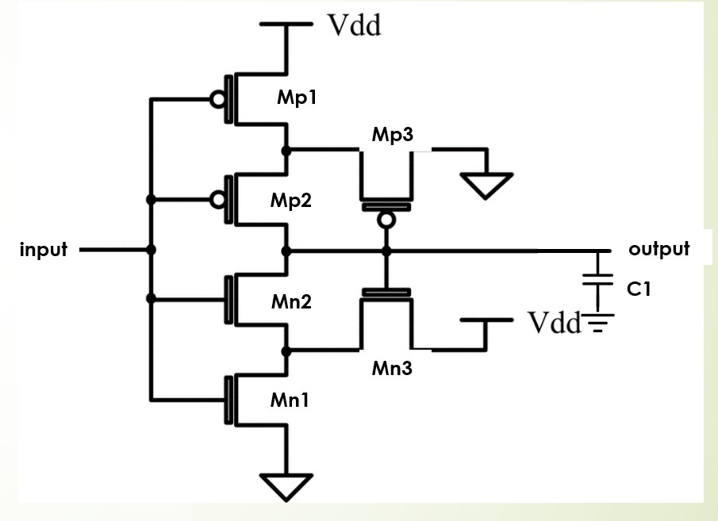
有問題的電路1:Schmitt trigger()
netlist
schnitt trigger
.model N_18 NMOS(Vto=0.4 Lambda=0.02)
.model P_18 PMOS(Vto=-0.4 Lambda=0.02)
.options TEMP=25
Mp1 p1 input VDD VDD p_18 w=1.6u l=0.4u
Mp2 output input p1 VDD p_18 w=1.6u l=0.4u
Mp3 VSS output p1 VDD p_18 w=1.28u l=0.4u
Mn1 n1 input VSS VSS n_18 w=0.8u l=0.4u
Mn2 output input n1 VSS n_18 w=0.8u l=0.4u
Mn3 VDD output n1 VSS n_18 w=0.64u l=0.4u
C1 output 0 1f
VVDD VDD 0 dc 1.8
Vg input 0 SIN 0 1.8 50
*Vg input 0 dc 1.8
VS VSS 0 dc 0
.end

Slide 4
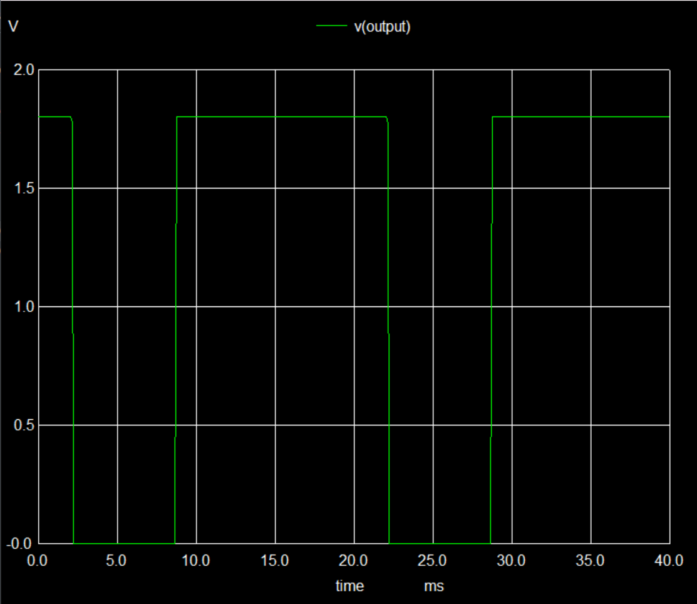
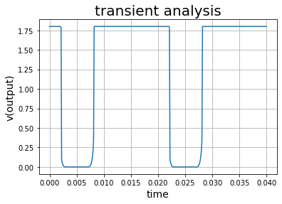
Transient 0ms to 40ms(Vss directly connect to ground)

Slide 5
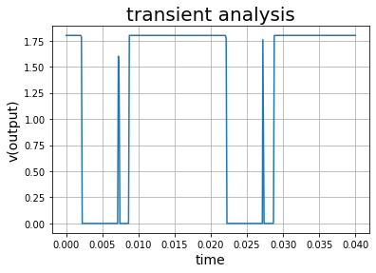
Transient 0ms to 40ms(Vss =dc source with voltage=0)

Slide 6
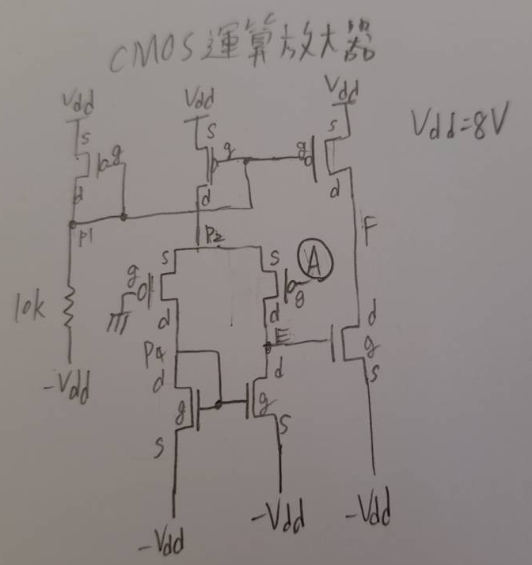
有問題的電路2:MOS Op Amp
netlist
CMOS_Operationa_amplifier
*Model and Temperature
.model N_18 NMOS(Vto=0.4 Lambda=0.02)
.model P_18 PMOS(Vto=-0.4 Lambda=0.02)
Mp1 p1 p1 VDD VDD p_18 w=1.6u l=0.4u
R1 p1 Vss 10k
Mp2 p2 p1 VDD VDD p_18 w=1.6u l=0.4u
Mp3 F p1 VDD VDD p_18 w=1.6u l=0.4u
Mp4 p4 0 p2 p2 p_18 w=1.6u l=0.4u
Mp5 E A p2 p2 p_18 w=1.6u l=0.4u
Mn1 p4 p4 Vss Vss n_18 w=0.8u l=0.4u
Mn2 E p4 Vss Vss n_18 w=0.8u l=0.4u
Mn3 F E Vss Vss n_18 w=0.8u l=0.4u
Vs Vss 0 dc -15
VVDD VDD 0 dc 15
Vin A 0 sin 0 1 50
.end

Slide 7
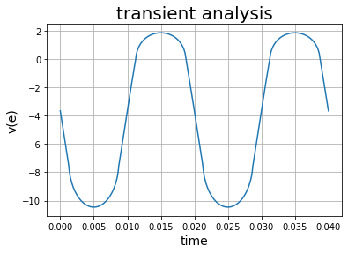
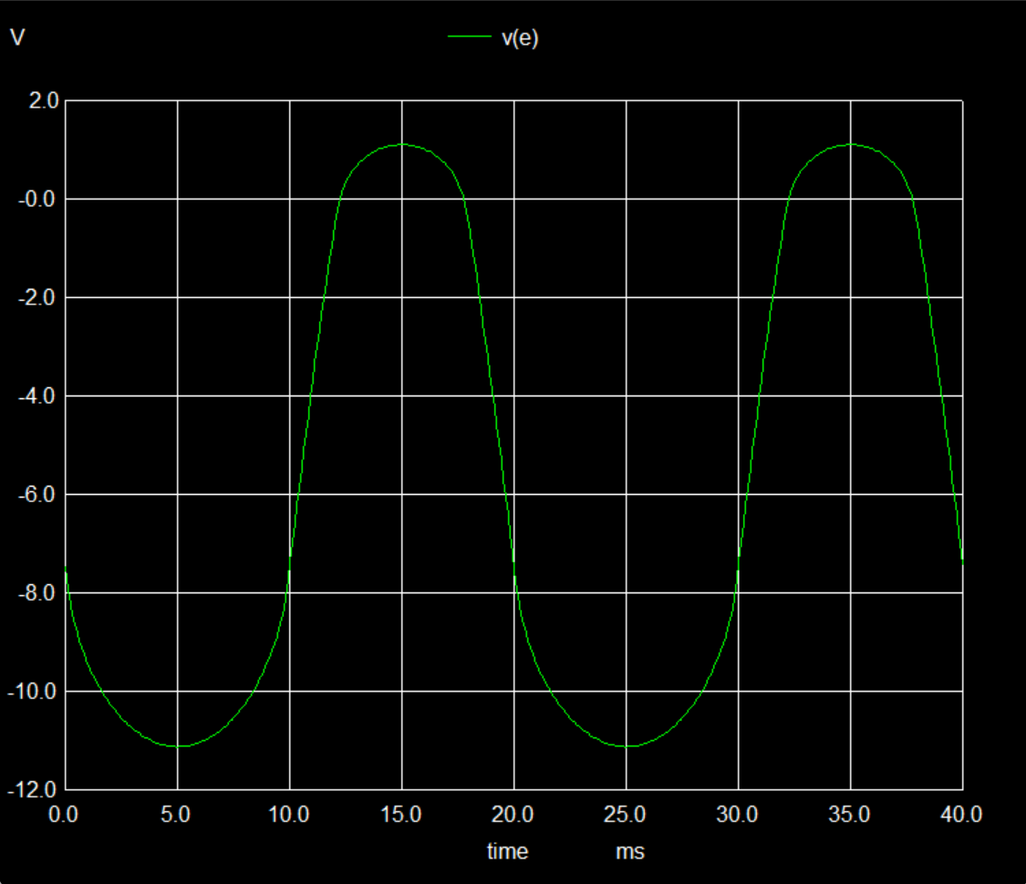
Transient 0s to 40ms: v(e)

Slide 8
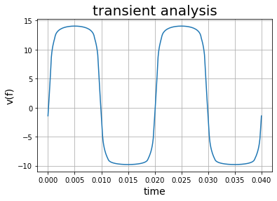
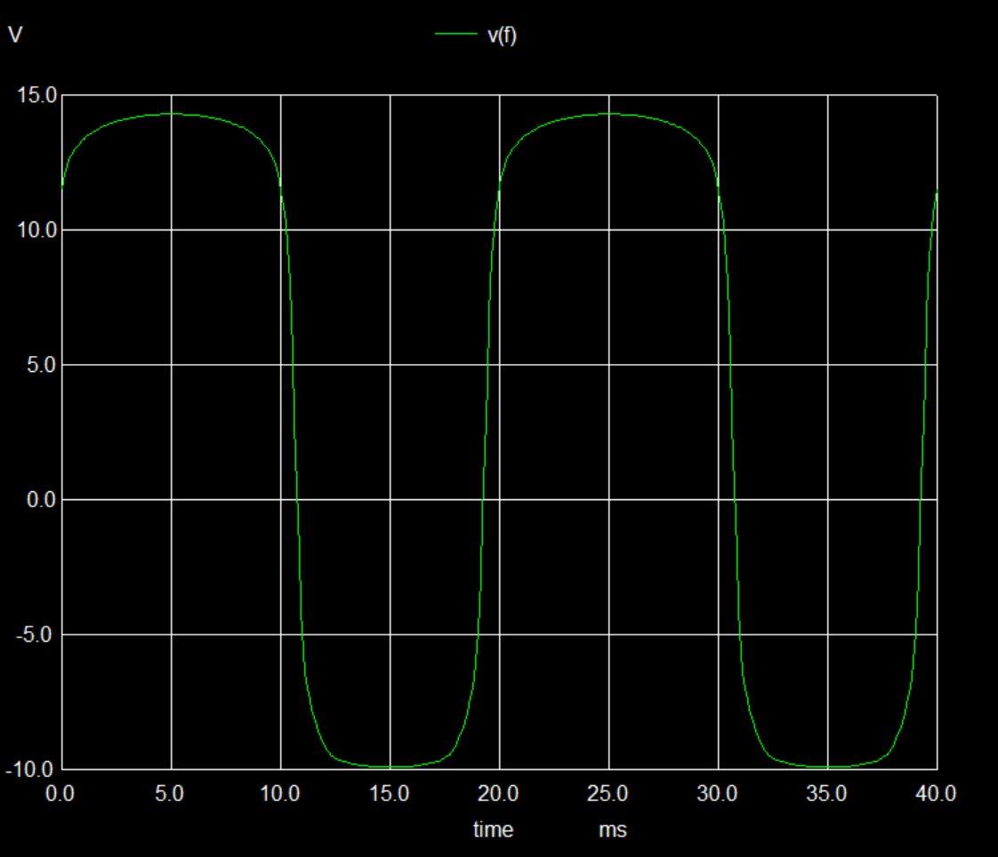
Transient 0s to 40ms: v(f)

