Slide 1
Meeting 21
2024/03/06

Slide 2
本次進度
Transient function 大致完成
Dc function 修正完成
Ac function 加入 mos元件

Slide 3
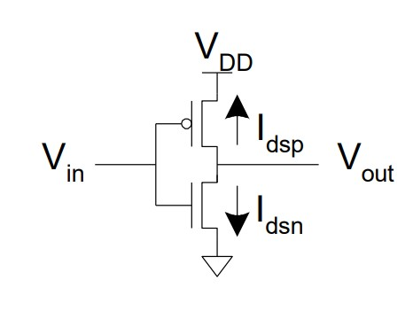
Transient testcase: Inverter
netlist
* NMOS Characteristics
* Model and Temperature
*.model N_18 NMOS(Vto=0.4 Lambda=0.02)
*.model P_18 PMOS(Vto=-0.4 Lambda=0.02)
*.options TEMP=25
* Netlist
MP1 Vout Vg VDD VDD P_18 W=1u L=0.18u
MN1 Vout Vg VSS VSS N_18 W=1u L=0.18u
* DC Sweep
VD VDD 0 dc 1
Vg Vg 0 pulse 1 0 0m 10m 10m 50m 120m 0
*Vg Vg 0 dc 0
VS VSS 0 dc 0
.end

Slide 4
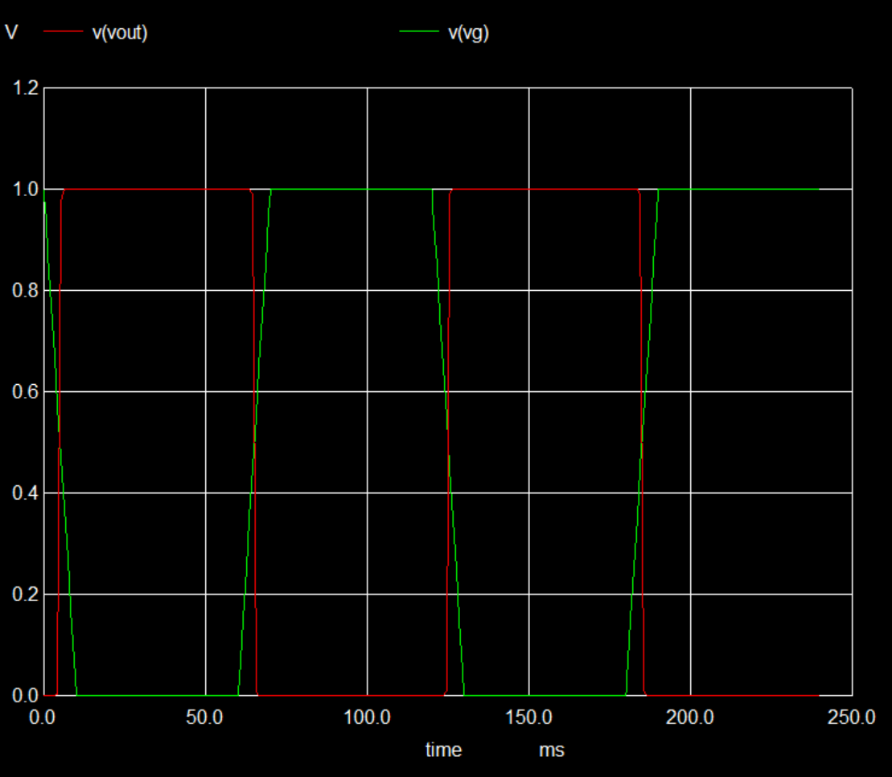
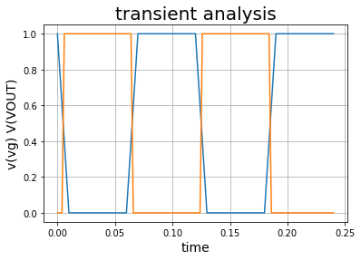
Transient 0s to 240ms

Slide 5
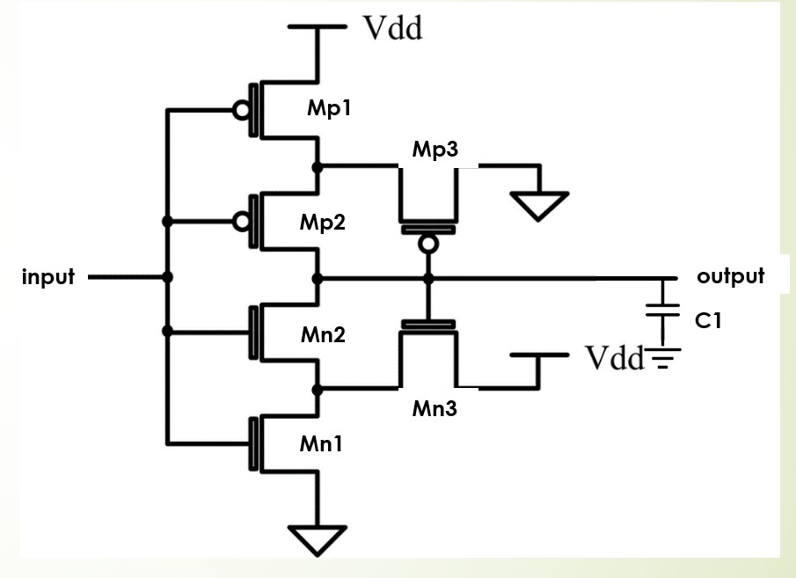
Transient testcase: Schmitt trigger
netlist
schnitt trigger
.model N_18 NMOS(Vto=0.4 Lambda=0.02)
.model P_18 PMOS(Vto=-0.4 Lambda=0.02)
.options TEMP=25
Mp1 p1 input VDD VDD p_18 w=1.6u l=0.4u
Mp2 output input p1 VDD p_18 w=1.6u l=0.4u
Mp3 VSS output p1 VDD p_18 w=1.28u l=0.4u
Mn1 n1 input VSS VSS n_18 w=0.8u l=0.4u
Mn2 output input n1 VSS n_18 w=0.8u l=0.4u
Mn3 VDD output n1 VSS n_18 w=0.64u l=0.4u
C1 output 0 1f
VVDD VDD 0 dc 1.8
Vg input 0 SIN 0 1.8 50
*Vg input 0 dc 1.8
VS VSS 0 dc 0
.end

Slide 6
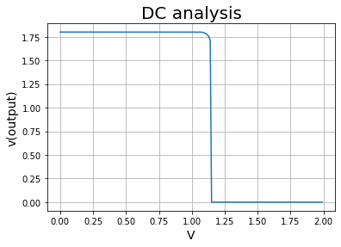
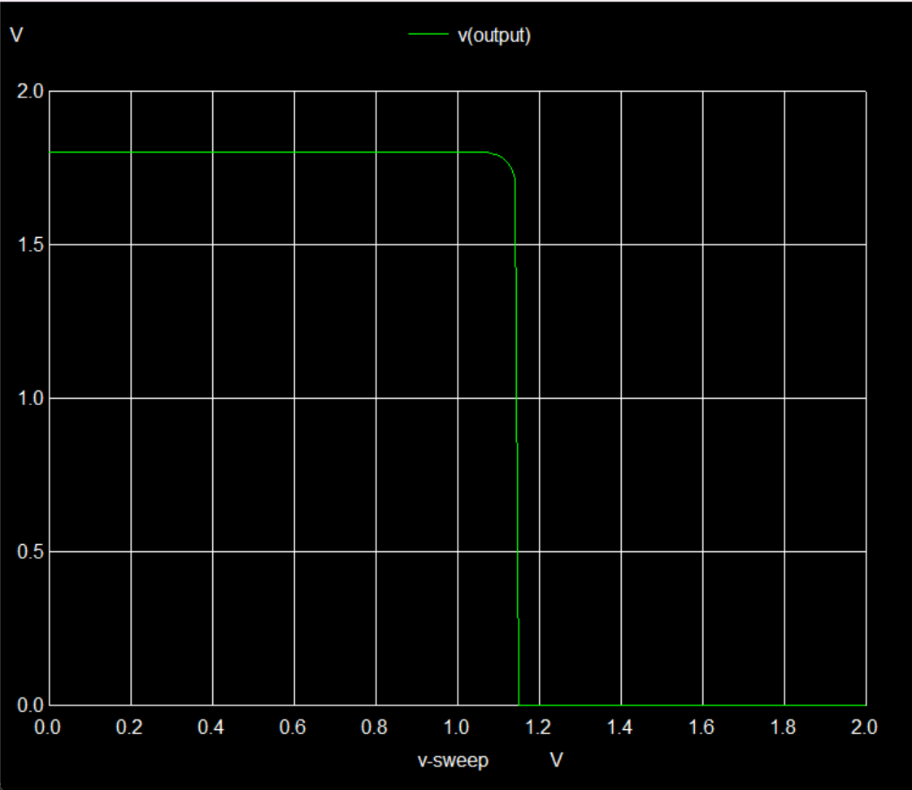
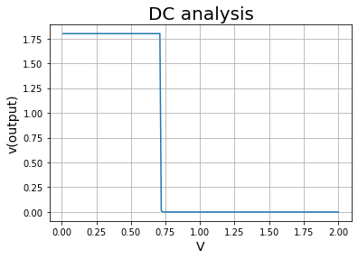
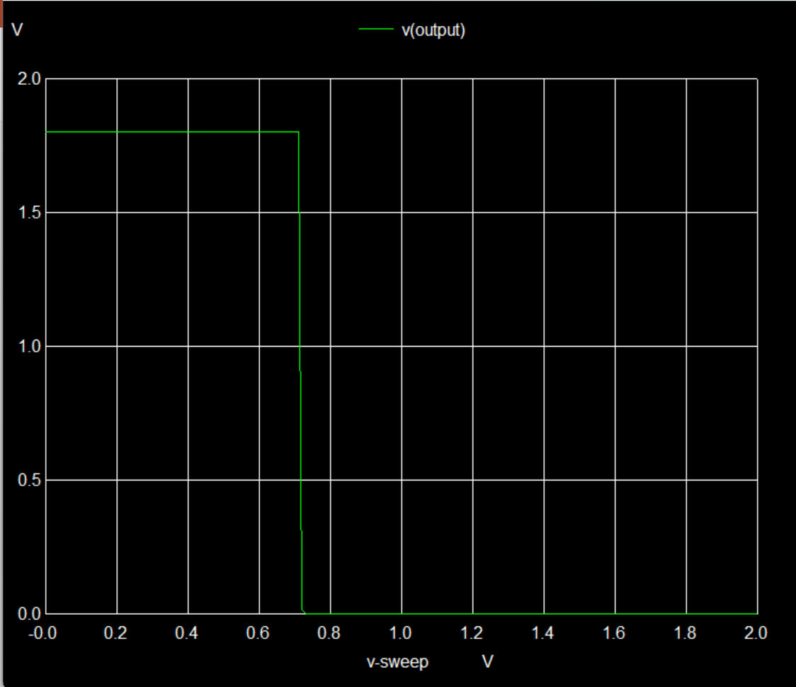
Dc function test
Vg 0V->2V
Vg 2V->0V

Slide 7
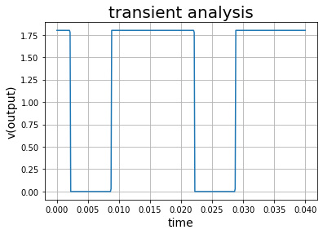
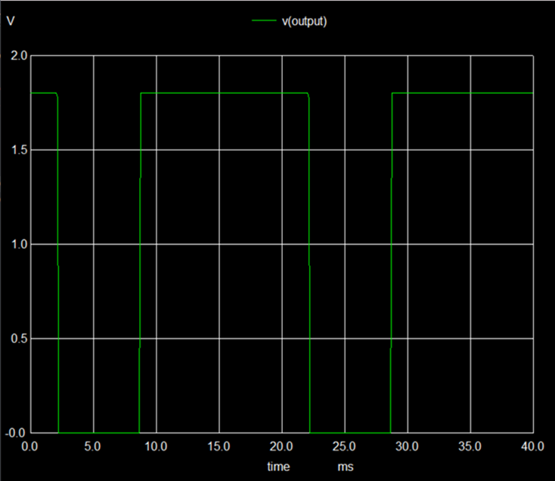
Transient 0ms to 40ms(Vss directly connect to ground)

Slide 8
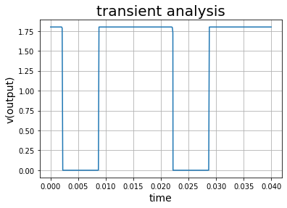
Transient 0ms to 40ms(Vss =dc source with voltage=0)

Slide 9
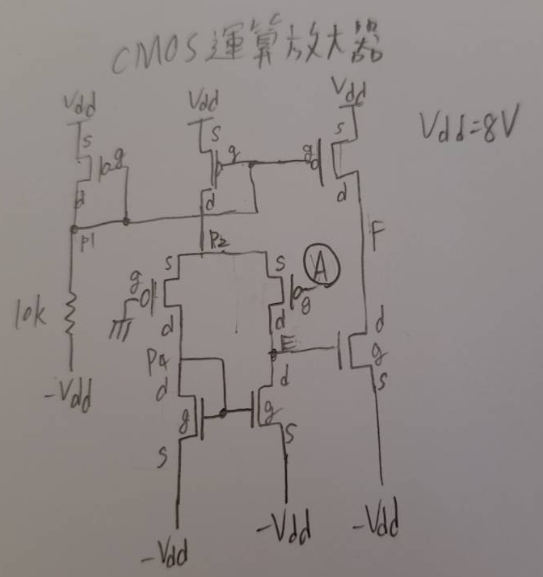
Transient testcase: MOS Op Amp
netlist
CMOS_Operationa_amplifier
*Model and Temperature
.model N_18 NMOS(Vto=0.4 Lambda=0.02)
.model P_18 PMOS(Vto=-0.4 Lambda=0.02)
Mp1 p1 p1 VDD VDD p_18 w=1.6u l=0.4u
R1 p1 Vss 10k
Mp2 p2 p1 VDD VDD p_18 w=1.6u l=0.4u
Mp3 F p1 VDD VDD p_18 w=1.6u l=0.4u
Mp4 p4 0 p2 p2 p_18 w=1.6u l=0.4u
Mp5 E A p2 p2 p_18 w=1.6u l=0.4u
Mn1 p4 p4 Vss Vss n_18 w=0.8u l=0.4u
Mn2 E p4 Vss Vss n_18 w=0.8u l=0.4u
Mn3 F E Vss Vss n_18 w=0.8u l=0.4u
Vs Vss 0 dc -15
VVDD VDD 0 dc 15
Vin A 0 sin 0 1 50
.end

Slide 10
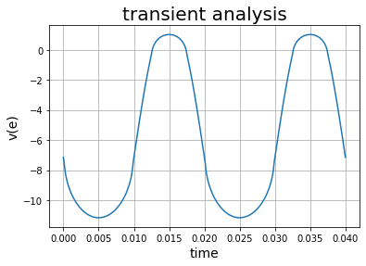
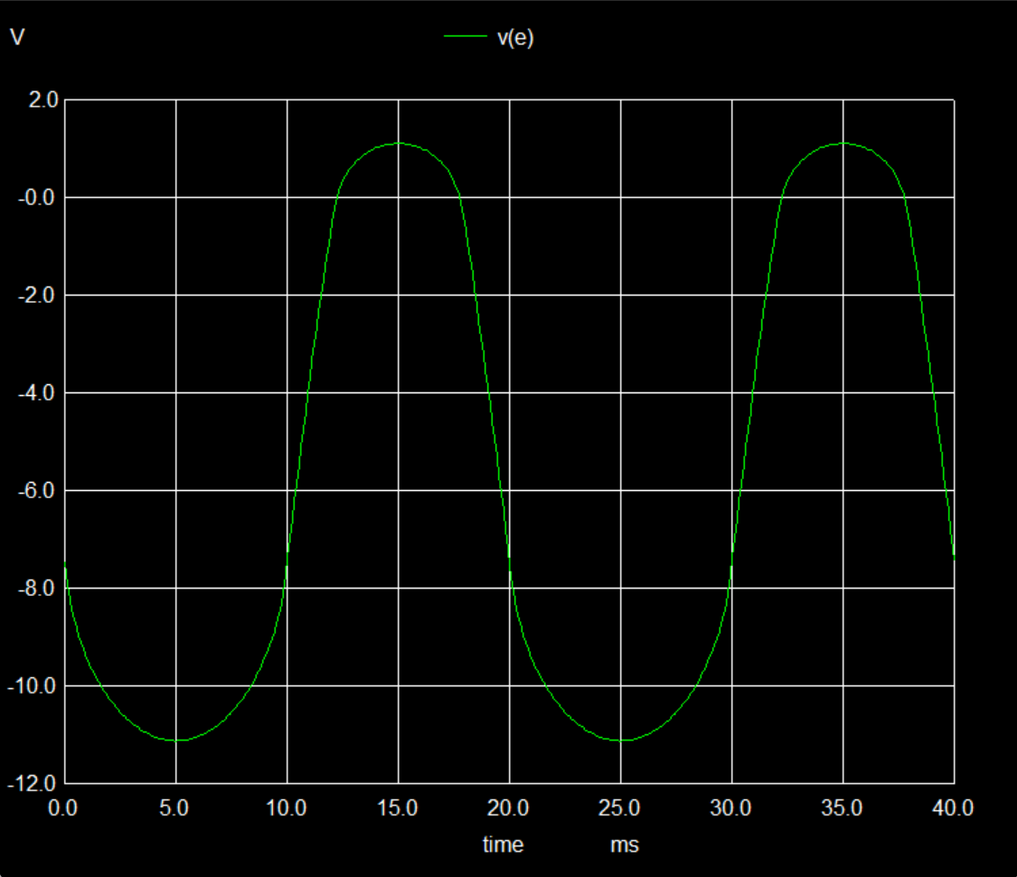
Transient 0s to 40ms: v(e)

Slide 11
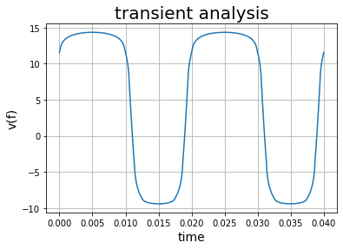
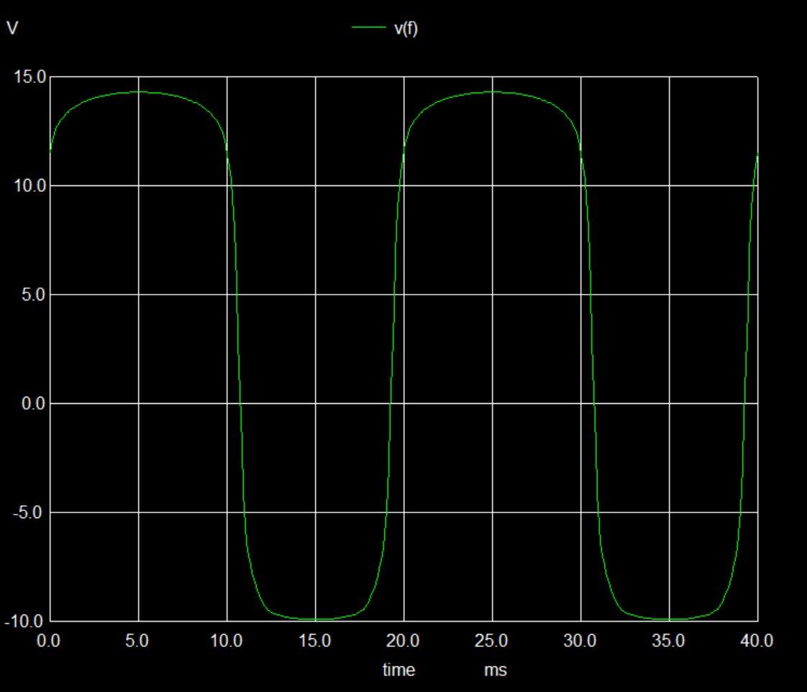
Transient 0s to 40ms: v(f)

Slide 12
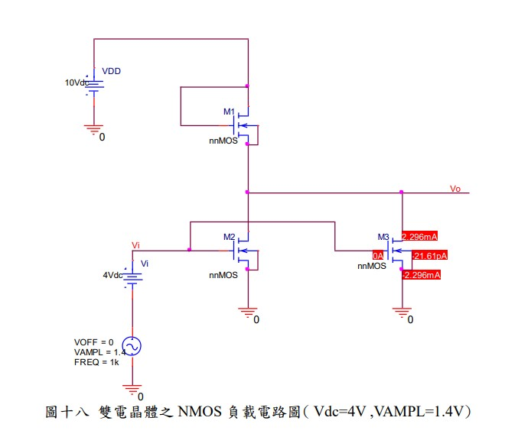
AC testcase:double_transistor_load
netlist
double_transistor_load
.model N_18 NMOS(Vto=0.4 Lambda=0.02)
.model P_18 PMOS(Vto=-0.4 Lambda=0.02)
Mn1 VDD VDD output output n_18 w=0.8u l=0.4u
Mn2 output input 0 0 n_18 w=0.8u l=0.4u
Mn3 output input 0 0 n_18 w=0.8u l=0.4u
vin_dc input_dc 0 dc 4
Vin input input_dc ac 1
VVDD VDD 0 dc 10
Vs Vss 0 dc 0
.end

Slide 13
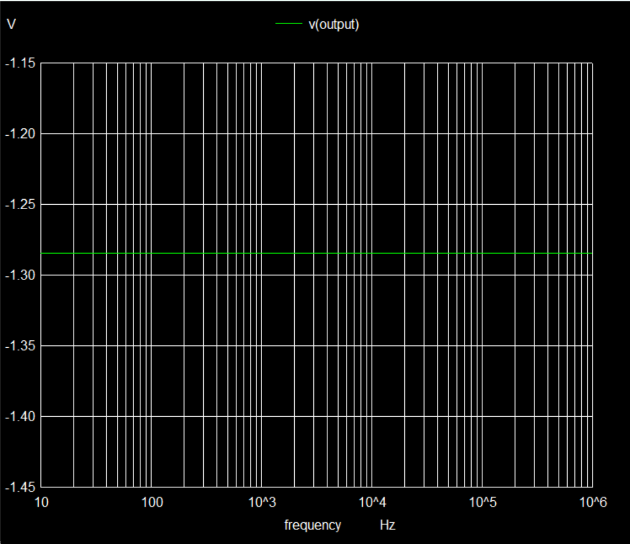
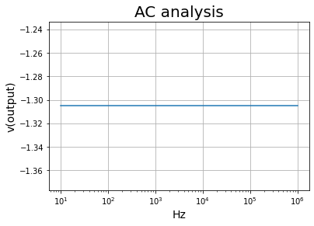
From 10Hz to 1MHz

Slide 14
未來計畫
模擬一個 5 bit counter 作為效能展示
模擬一個 4 bit full adder 作為效能展示
優化程式可讀性
用python實現SPICE模擬測試數位電路(暫定)
3~4個電路測試
嘗試在一些地方加入電感、電容(模擬非理想效應)
AC測試個filter

