Slide 1
Meeting 22
2024/03/20

Slide 2
本次進度
測試電路(D latch ,D flip flop,2 bit binary counter)

Slide 3
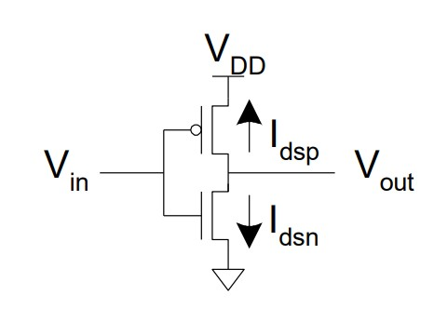
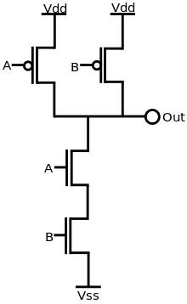
Subcircuit netist
*not gate
.subckt inv input output VDD VSS
Mp0 output input VDD VDD p_18 w=0.8u l=0.2u
Mn0 output input VSS VSS n_18 w=0.4u l=0.2u
.ends
*nand gate
.subckt nand a b out VDD VSS
Mp0 out a VDD VDD p_18 w=0.8u l=0.2u
Mp1 out b VDD VDD p_18 w=0.8u l=0.2u
Mn0 out a v2 VSS n_18 w=0.4u l=0.2u
Mn1 v2 b VSS VSS n_18 w=0.4u l=0.2u
c1 output 0 1n
.ends

Slide 4
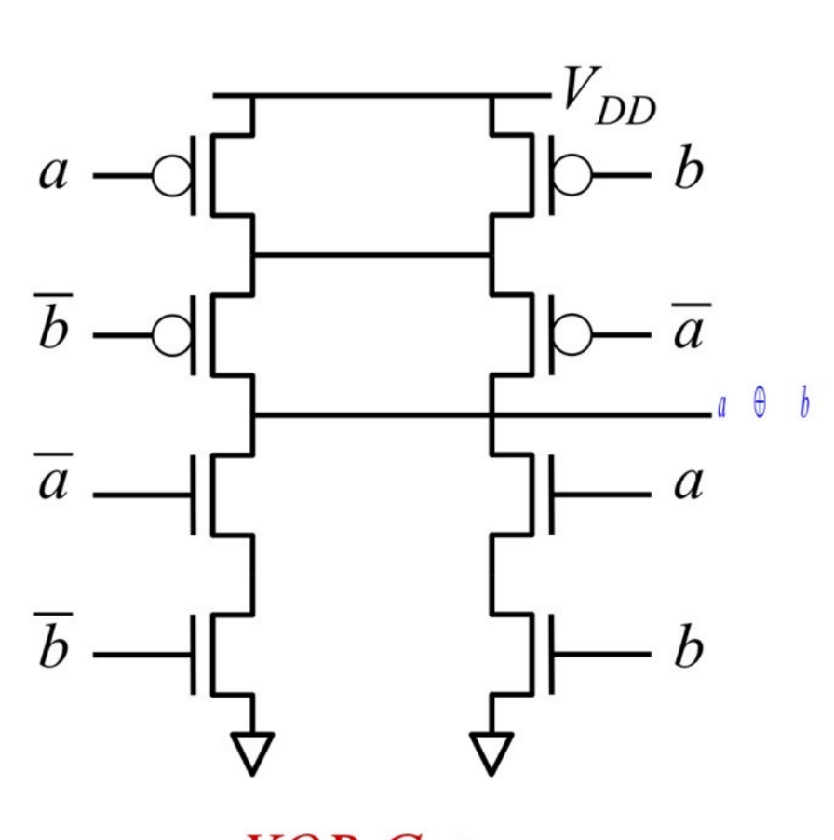
Subcircuit netist
.subckt xor a b out VDD VSS
Xinv1 a a_not VDD VSS inv
Xinv2 b b_not VDD VSS inv
Mp0 p1 b_not VDD VDD p_18 w=0.8u l=0.2u
Mp1 p1 a_not VDD VDD p_18 w=0.8u l=0.2u
Mp2 out b p1 VDD p_18 w=0.8u l=0.2u
Mp3 out a p1 VDD p_18 w=0.8u l=0.2u
Mn0 out a_not n1 VSS n_18 w=0.4u l=0.2u
Mn1 n1 b_not VSS VSS n_18 w=0.4u l=0.2u
Mn2 out a n2 VSS n_18 w=0.4u l=0.2u
Mn3 n2 b VSS VSS n_18 w=0.4u l=0.2u
.ends

Slide 5
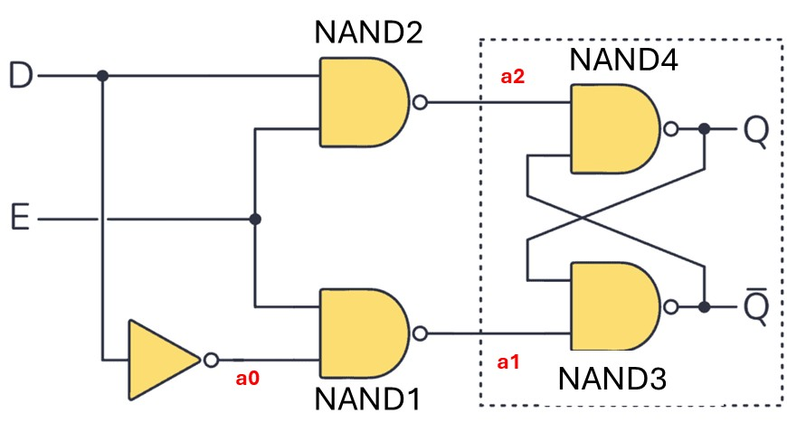
transient testcase :D latch
netlist
.subckt Dlatch E D Q Qbar VDD VSS
Xnand1 D E a1 VDD VSS nand
Xinv D a0 VDD VSS inv
Xnand2 a0 E a2 VDD VSS nand
Xnand3 Q a1 Qbar VDD VSS nand
Xnand4 a2 Qbar Q VDD VSS nand
.ends
Xdlatch En Data Q Q_bar VDD VSS Dlatch
VD VDD 0 dc 2
VS VSS 0 dc 0
Ven En 0 pulse 0 2 100m 0m 0m 100m 200m 0
Vdata Data 0 pulse 0 2 25m 0m 0m 25m 50m 0
.end

Slide 6
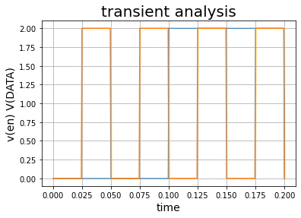
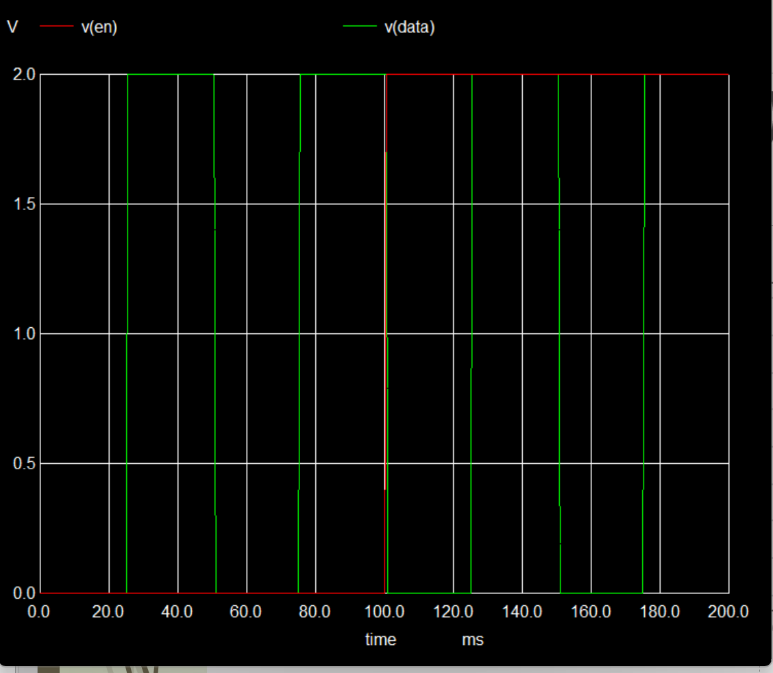
V(data) vs V(En)From 0 sec to 200ms

Slide 7
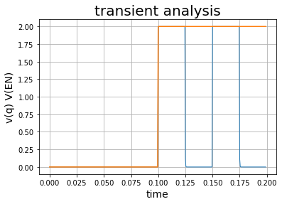
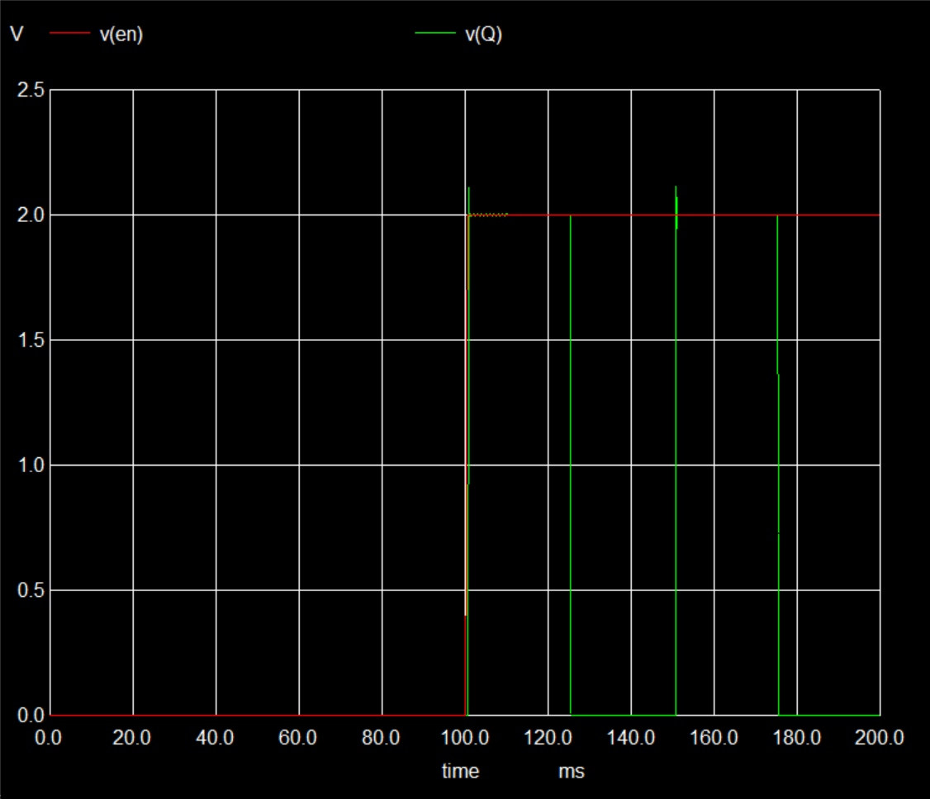
V(q) vs V(En)From 0 sec to 200ms

Slide 8
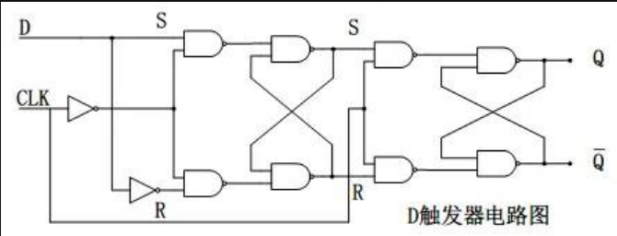
transient testcase :D flip flop
netlist
.subckt DFF CLK D Q Q_bar RESET VDD VSS
Xinv D D_inv VDD VSS inv
Xinv2 CLK CLK_inv VDD VSS inv
Xnand1 D CLK_inv a1 VDD VSS nand
Xnand2 D_inv CLK_inv a2 VDD VSS nand
Xnand3 a1 R S VDD VSS nand
Xnand4 a2 S R VDD VSS nand
Xnand5 S CLK a3 VDD VSS nand
Xnand6 R CLK a4 VDD VSS nand
Xnand7 a3 Q_bar Q VDD VSS nand
xnand8 a4 Q Q_bar VDD VSS nand
.ends
XDFF_0 CLK D_0 Q_0 D_0 VDD VSS DFF
VD VDD 0 dc 2
VS VSS 0 dc 0
*VD1 VDD1 0 dc 2
*VS1 VSS1 0 dc 0
Vclk CLK 0 pulse 0 2 100m 0m 0m 100m 200m 0
.end

Slide 9
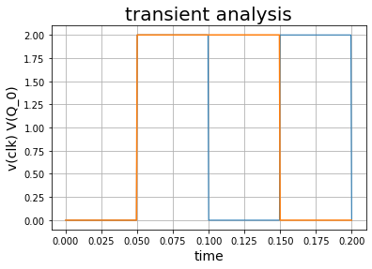
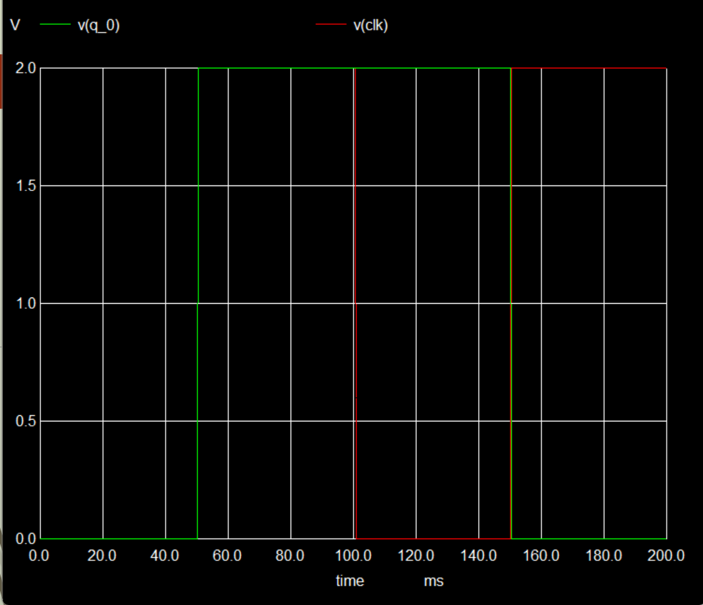
V(q)vs V(clk)From 0 sec to 200ms

Slide 10
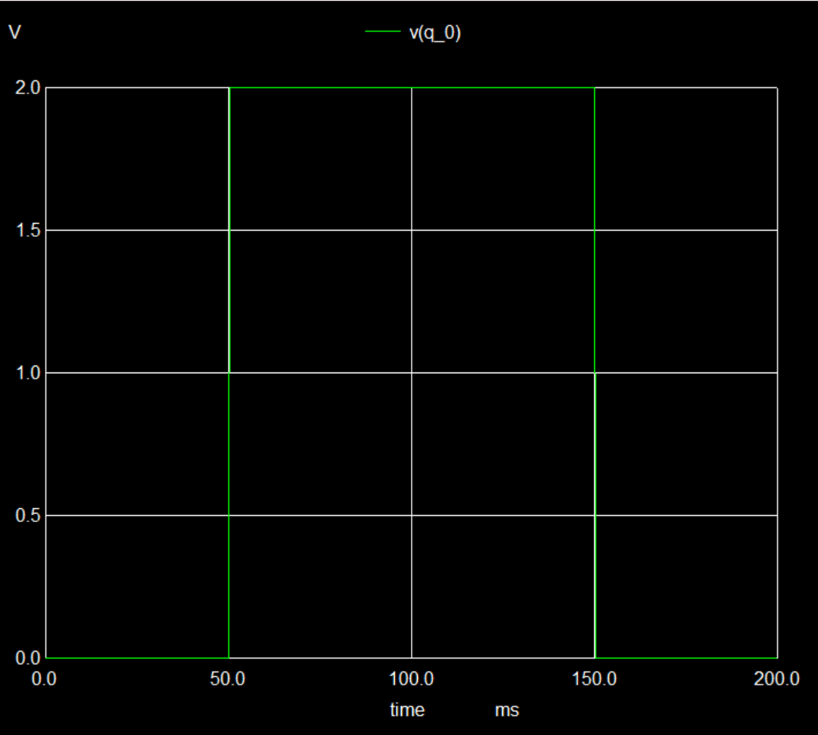
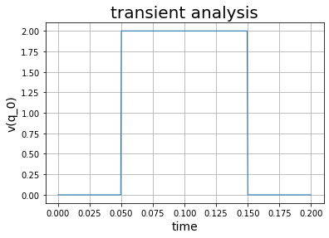
V(Q)From 0 sec to 200ms

Slide 11
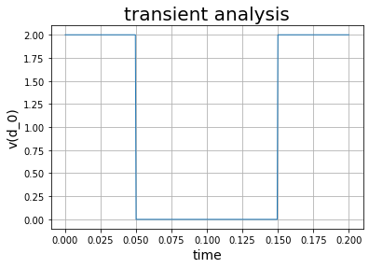
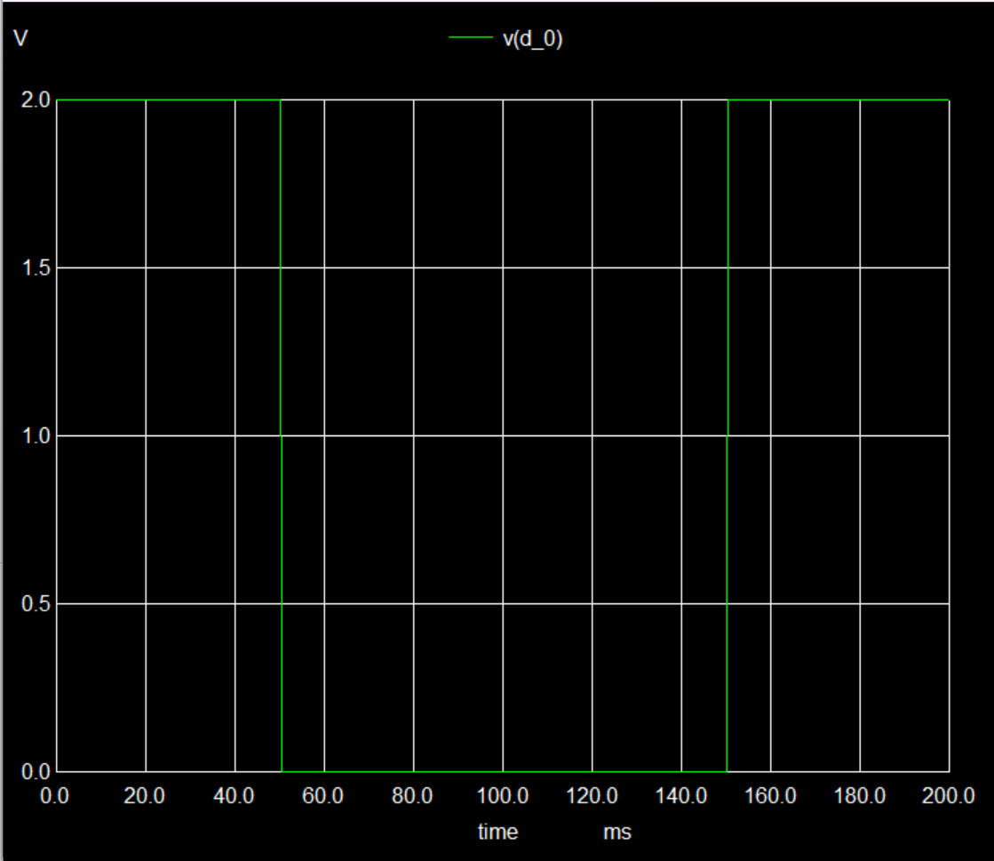
V(q_bar)From 0 sec to 200ms

Slide 12
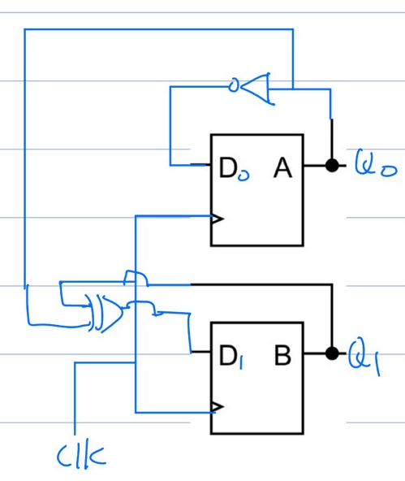
transient testcase : 2 bit counter
netlist
XDFF_0 CLK D_0 Q_0 Q_0bar VDD VSS DFF
XDFF_1 CLK D_1 Q_1 Q_1bar VDD VSS DFF
Xxor1 Q_1 Q_0 D_1 VDD VSS xor
Xinv Q_0 D_0 VDD VSS inv
VD VDD 0 dc 2
VS VSS 0 dc 0
*VD1 VDD1 0 dc 2
*VS1 VSS1 0 dc 0
*Vi Vx 0 pulse 0 2 100m 0m 0m 100m 200m 0
Vclk CLK 0 pulse 0 2 51m 0m 0m 50m 100m 0
.end
PS |  | NS
Q1 | Q0 | Q1 | Q0
0 | 0 | 0 | 1
0 | 1 | 1 | 0
1 | 0 | 1 | 1
1 | 1 | 0 | 0

Slide 13
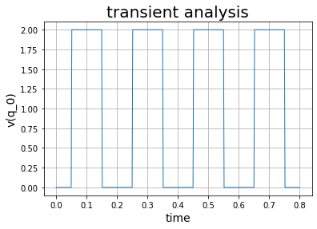
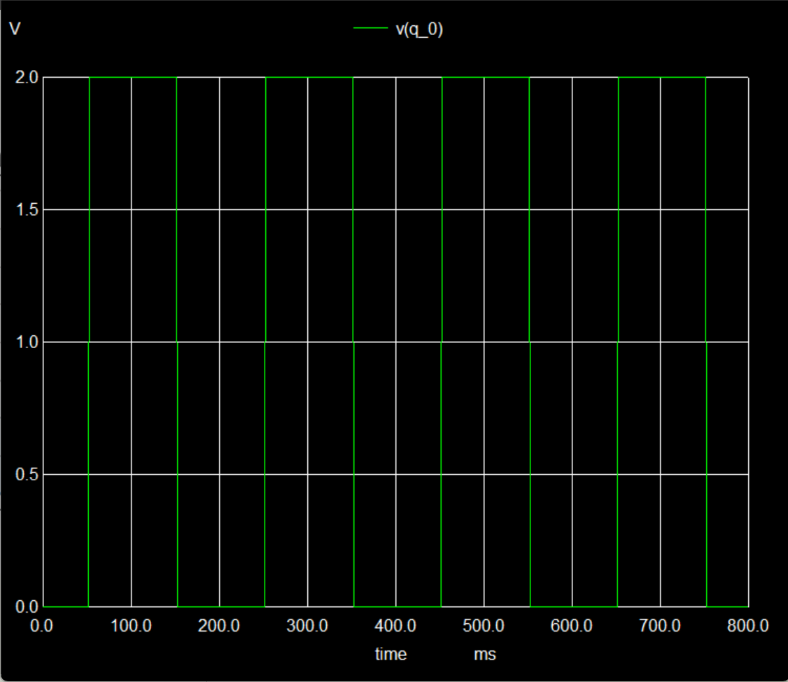
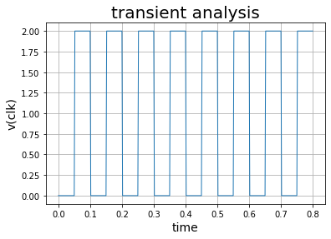
V(q_0)From 0 sec to 800ms

Slide 14
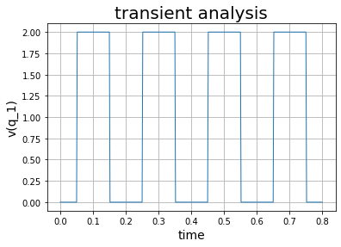
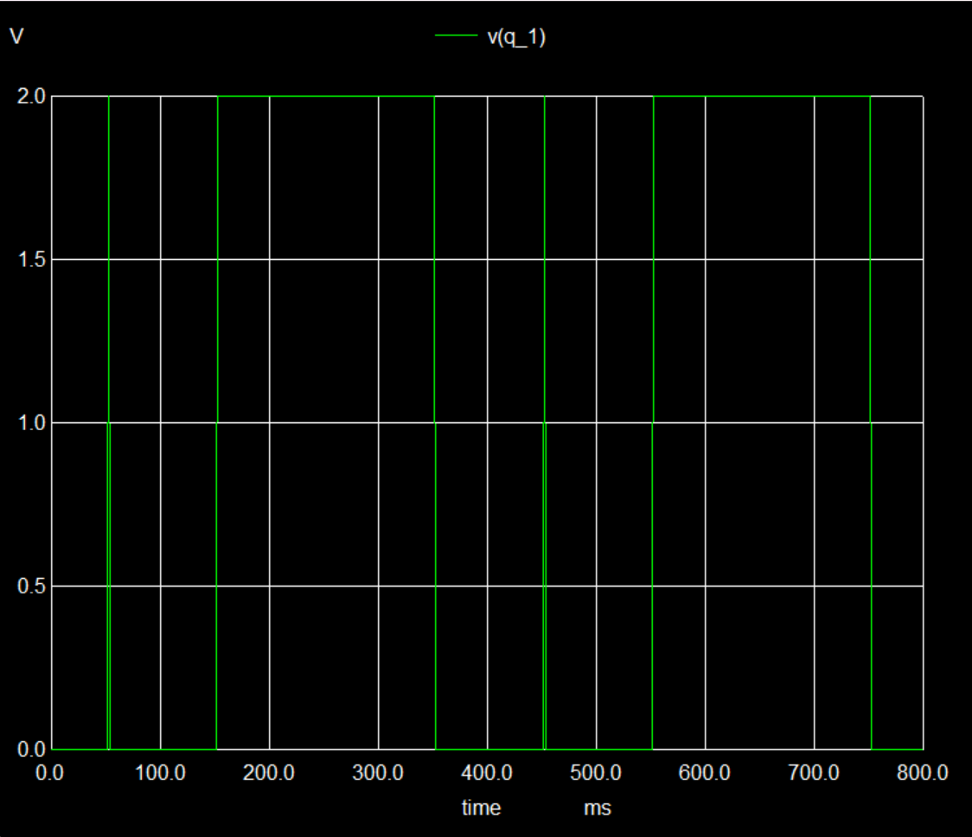
V(q_1)From 0 sec to 800ms

Slide 15
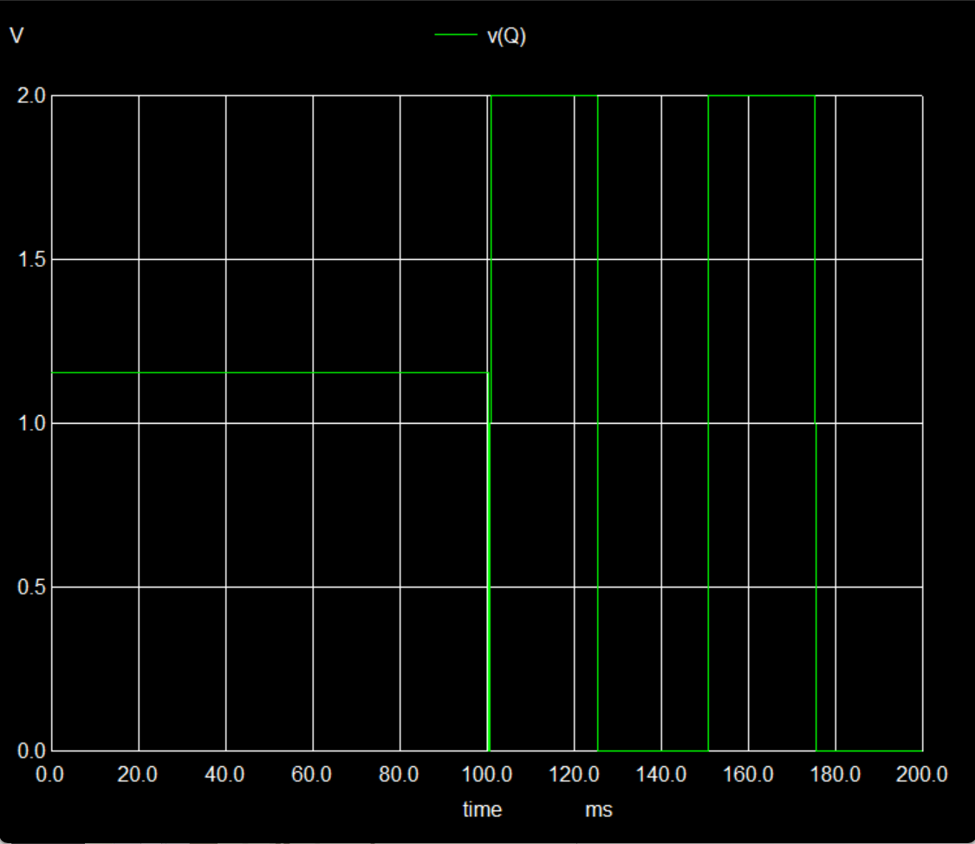
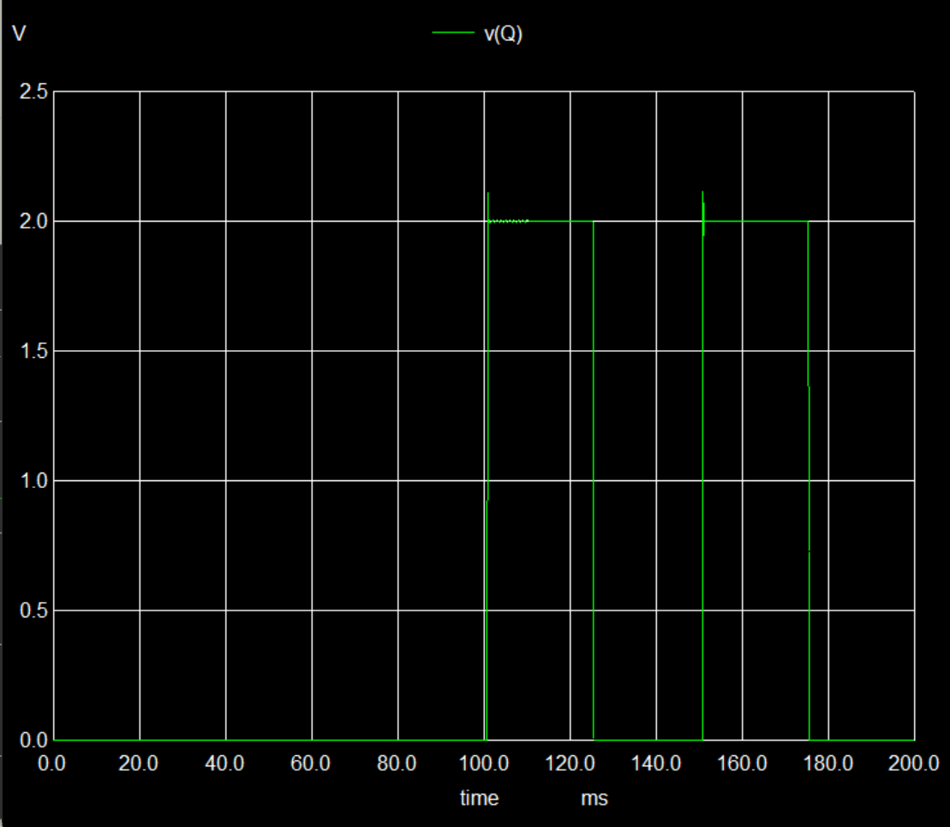
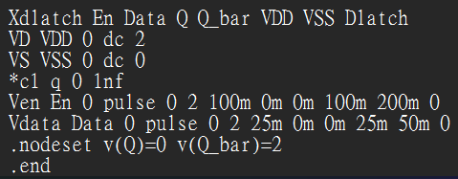
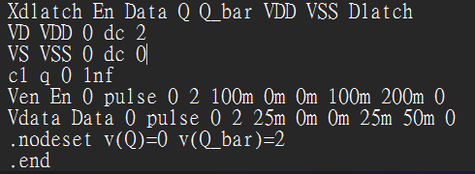
問題
為何在輸出的節點加上一個電容接地就可以使初值有改變

