Slide 1
Meeting 23
2024/04/03

Slide 2
本次進度
測試電路
5bit adder with pwl input
3 bit adder with pwl input
3 bit counter
加入pwl source (t1 v1 t2 t2)
修正 subckt parser問題

Slide 3
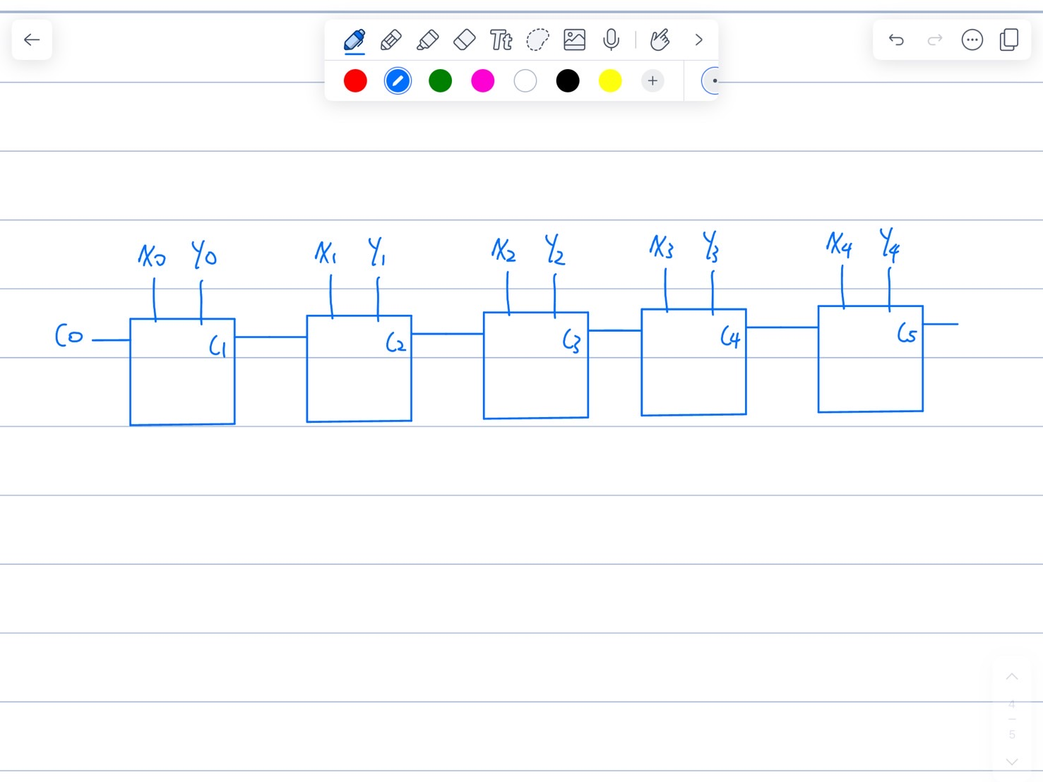
3 bit adder with pwl input
netlist
X_fa0 X0 Y0 C0 C1 S_0 VDD VSS fa
X_fa1 X1 Y1 C1 C2 S_1 VDD VSS fa
X_fa2 X2 Y2 C2 C3 S_2 VDD1 VSS1 fa
VX2 X2 VSS pwl 0 0 40m 0 40.1m 2
VX1 X1 VSS pwl 0 0 20m 0 20.1m 2 40m 2 40.1m 0
VX0 X0 VSS pwl 0 0 10m 0 10.1m 2 20m 2 20.1m 0 30m 0 30.1m 2 40m 2 40.1m 0
VY2 Y2 VSS pwl 0 0 0.1m 2 40m 2 40.1m 0
VY1 Y1 VSS pwl 0 0 20m 0 20.1m 2
VY0 Y0 VSS pwl 0 0 10m 0 10.1m 2 20m 2 20.1m 0 30m 0 30.1m 2
VC0 C0 0 Dc 0
VD1 VDD1 0 dc 2
Vs1 VSS1 0 dc 0
VD VDD 0 dc 2
Vs VSS 0 dc 0
.end

Slide 4
G輸入信號(C0固定為0)
T(ms) | X(X2X1X0) | Y(Y2Y1Y0) | S0 | S1 | S2 | Cout
0 | 0(000) | 4(100) | 0 | 0 | 1 | 0
10 | 1(001) | 5(101) | 0 | 1 | 1 | 0
20 | 2(010) | 6(110) | 0 | 0 | 0 | 1
30 | 3(011) | 7(111) | 0 | 1 | 0 | 1
40 | 4(100) | 3(011) | 1 | 1 | 1 | 0

Slide 5
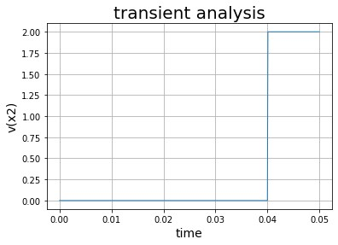
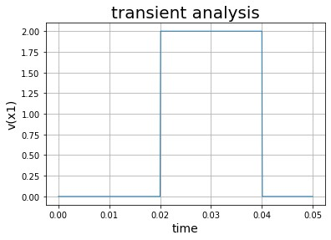
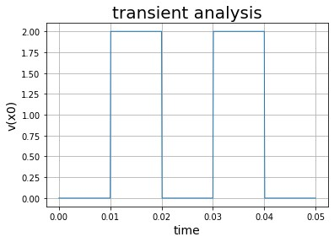
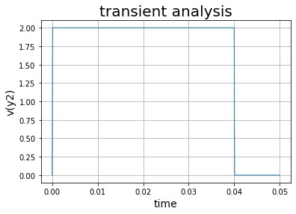
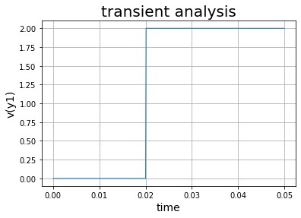
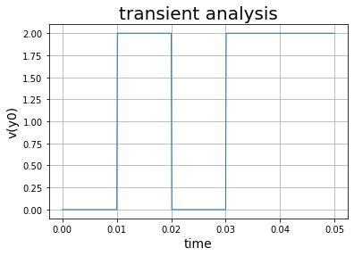
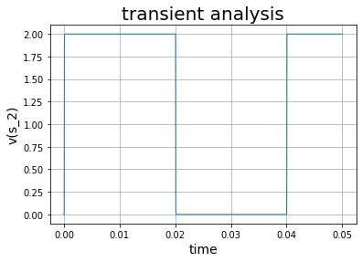
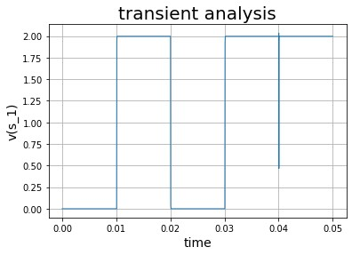
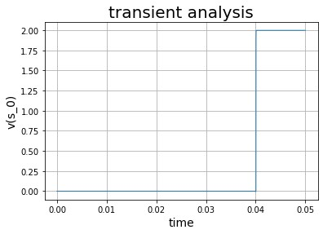

Slide 6
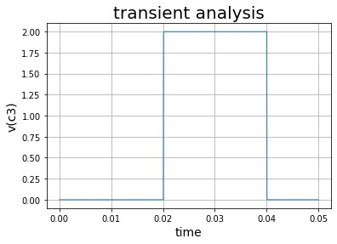
Output signal
T(ms) | X(X2X1X0) | Y(Y2Y1Y0) | S0 | S1 | S2 | Cout
0 | 0(000) | 4(100) | 0 | 0 | 1 | 0
10 | 1(001) | 5(101) | 0 | 1 | 1 | 0
20 | 2(010) | 6(110) | 0 | 0 | 0 | 1
30 | 3(011) | 7(111) | 0 | 1 | 0 | 1
40 | 4(100) | 3(011) | 1 | 1 | 1 | 0

Slide 7
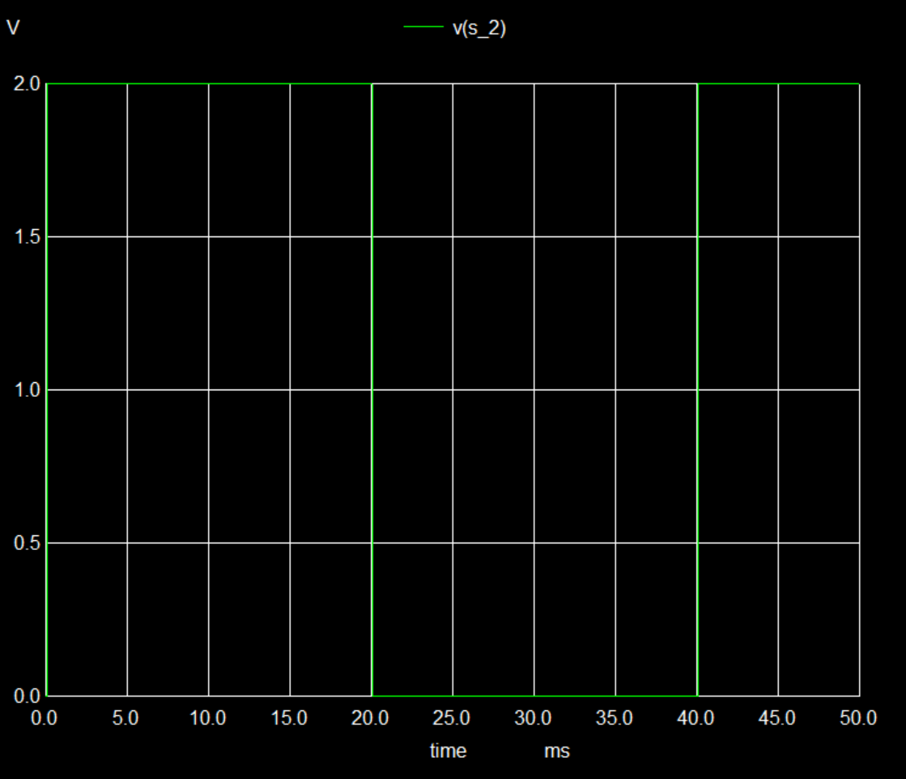
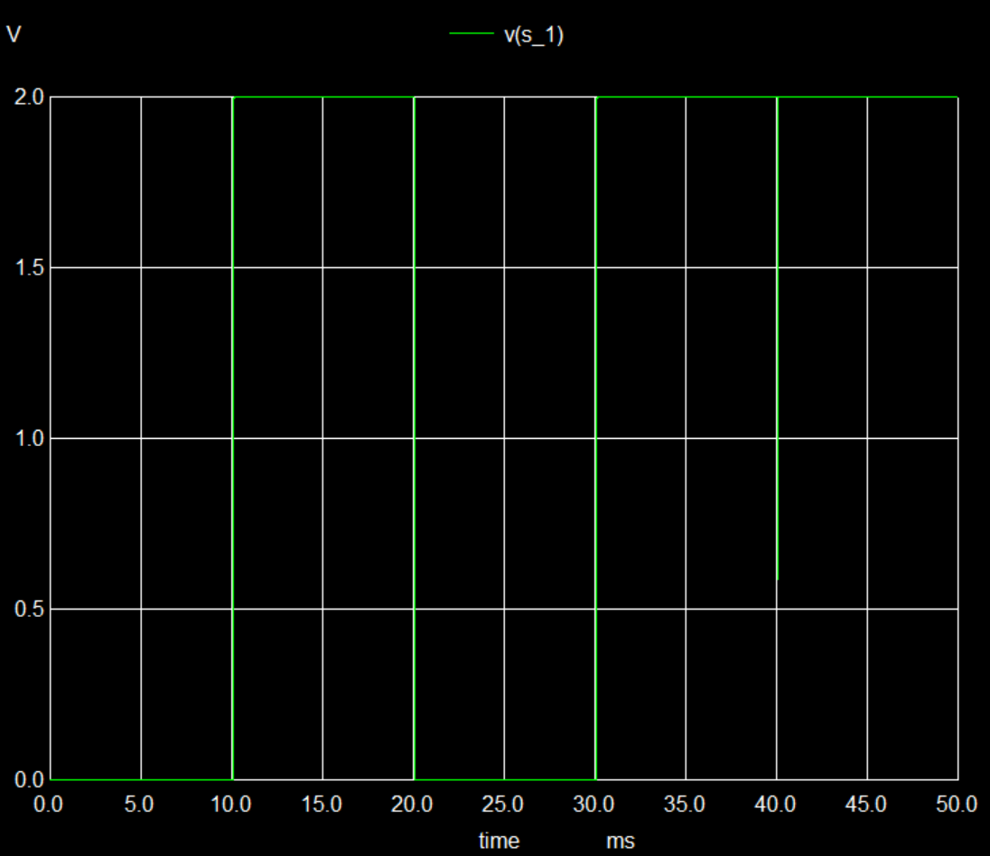
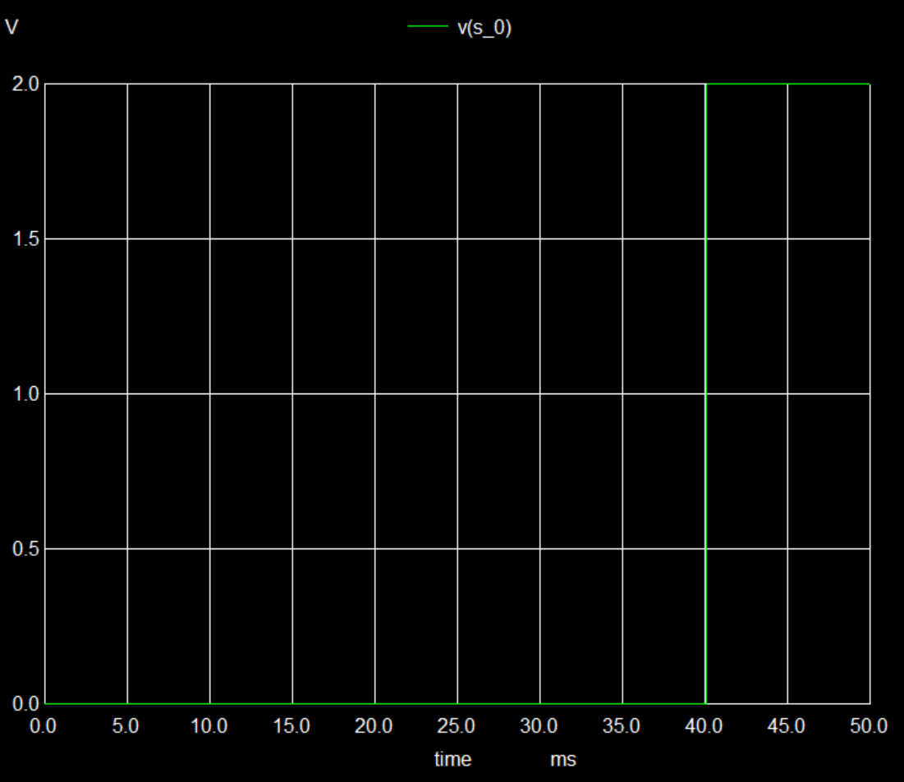
Compare with ngspice

Slide 8
transient testcase :5 bit adder

Slide 9
輸入信號
T(ms) | X(X4X3X2X1X0) | Y(Y4Y3Y2Y1Y0) | S(S4S3S2S1S0) | Cout
0 | 0(00000) | 31(11111) | 31(11111) | 0
1 | 0(00000) | 31(11111) | 31(11111) | 0
2 | 18(10010) | 31(11111) | 17(10001) | 1
3 | 18(10010) | 31(11111) | 17(10001) | 1
4 | 17(10001) | 31(11111) | 16(10000) | 1

Slide 10
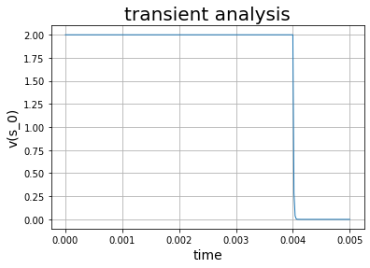
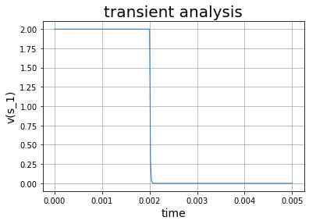

T(ms) | X(X4X3X2X1X0) | Y(Y4Y3Y2Y1Y0) | S(S4S3S2S1S0) | Cout
0 | 0(00000) | 31(11111) | 31(11111) | 0
1 | 0(00000) | 31(11111) | 31(11111) | 0
2 | 18(10010) | 31(11111) | 17(10001) | 1
3 | 18(10010) | 31(11111) | 17(10001) | 1
4 | 17(10001) | 31(11111) | 16(10000) | 1

Slide 11

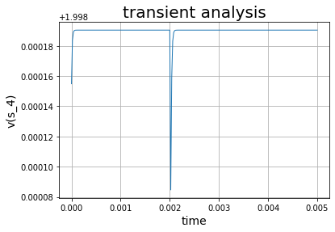
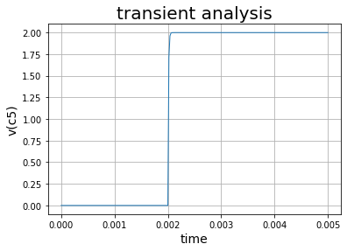
T(ms) | X(X4X3X2X1X0) | Y(Y4Y3Y2Y1Y0) | S(S4S3S2S1S0) | Cout
0 | 0(00000) | 31(11111) | 31(11111) | 0
1 | 0(00000) | 31(11111) | 31(11111) | 0
2 | 18(10010) | 31(11111) | 17(10001) | 1
3 | 18(10010) | 31(11111) | 17(10001) | 1
4 | 17(10001) | 31(11111) | 16(10000) | 1

Slide 12
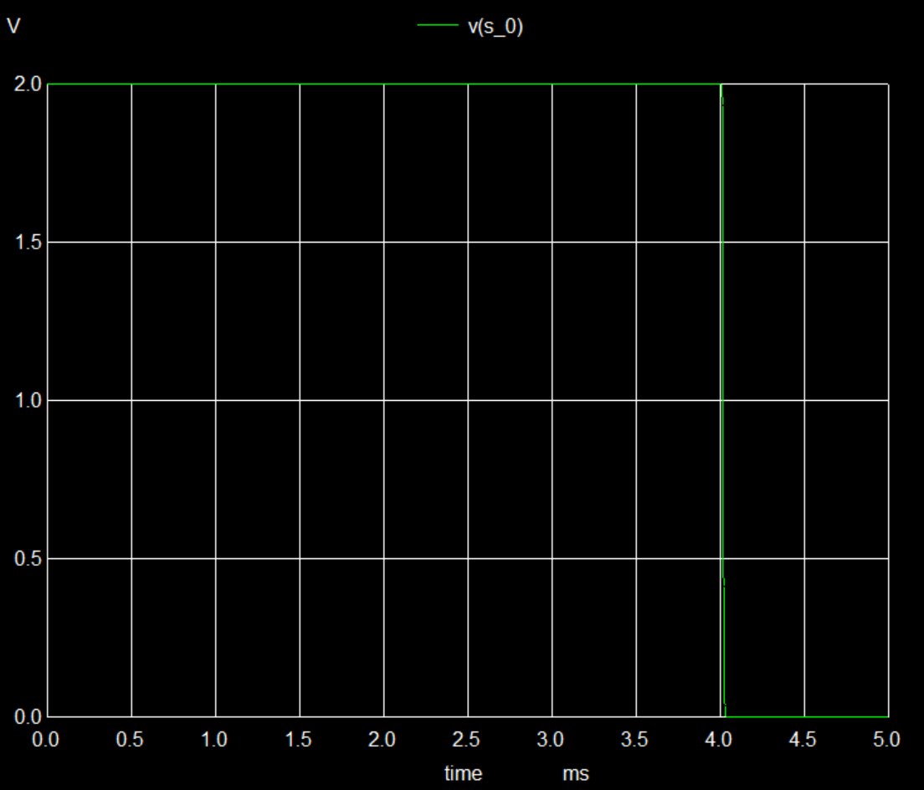
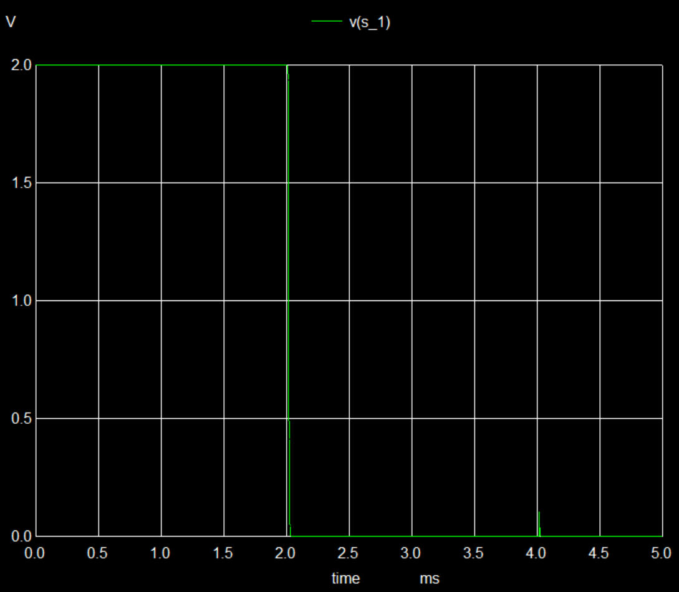
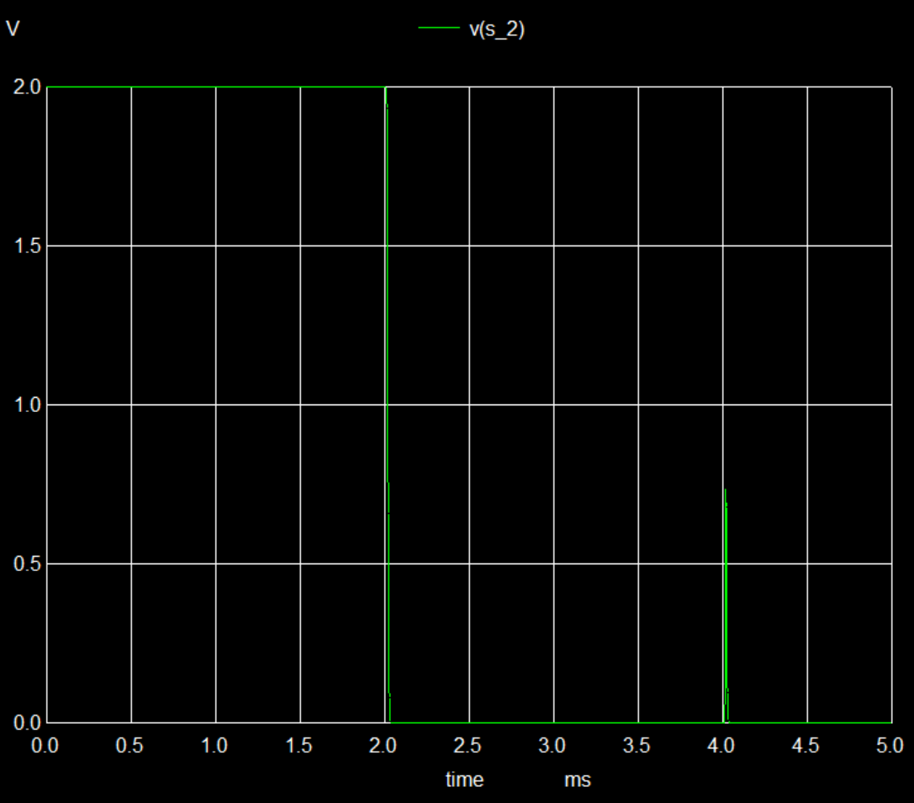

Slide 13
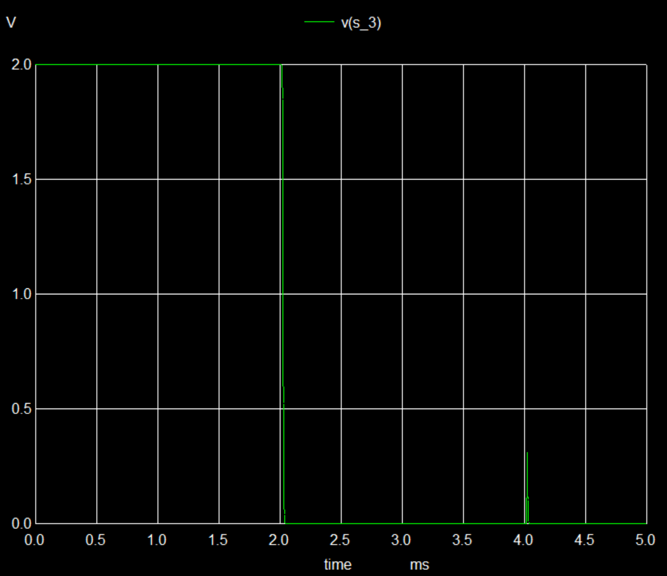
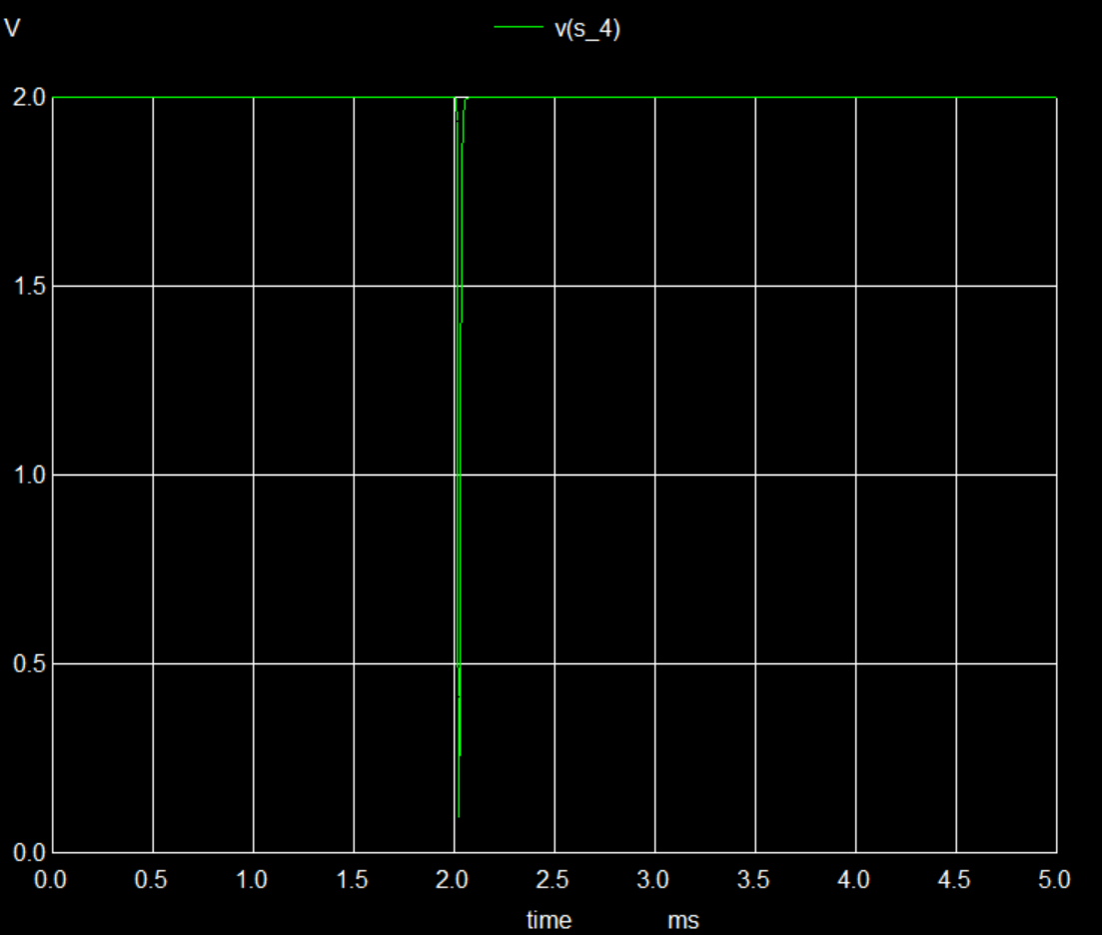
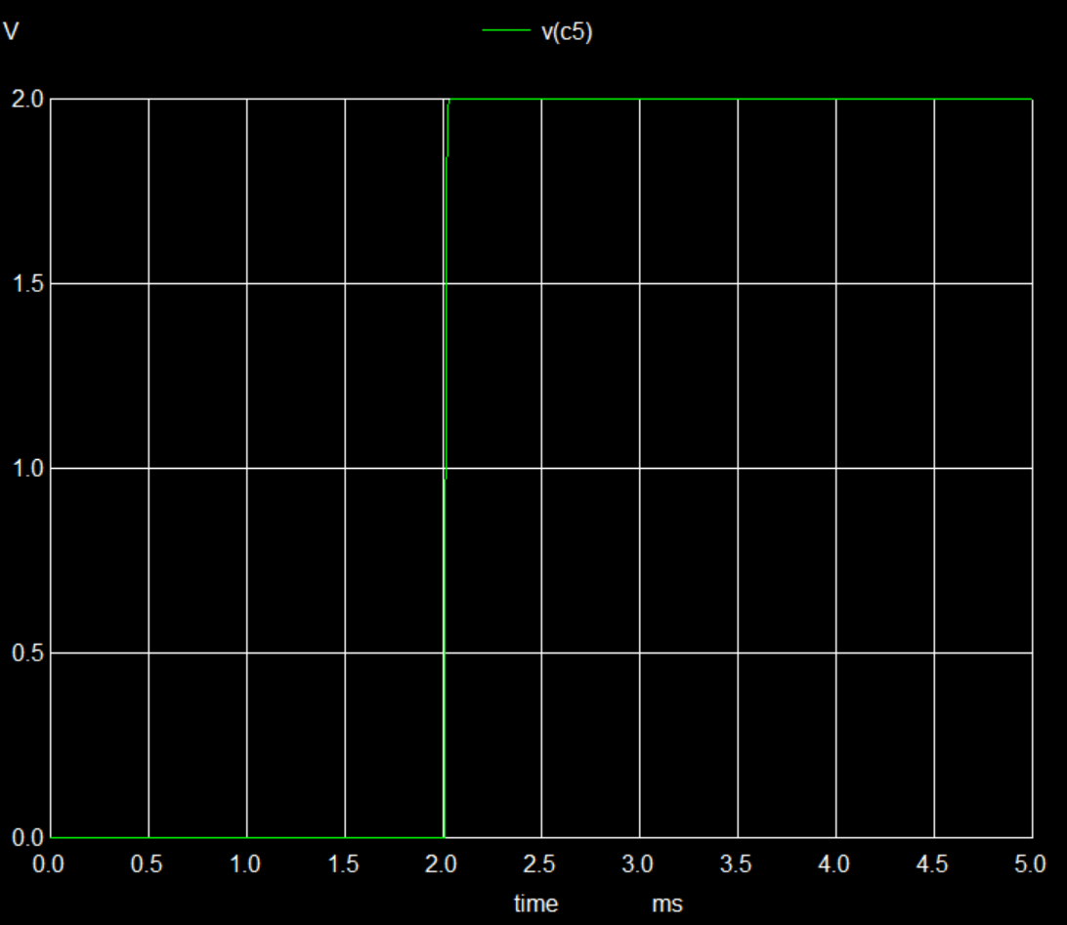

Slide 14
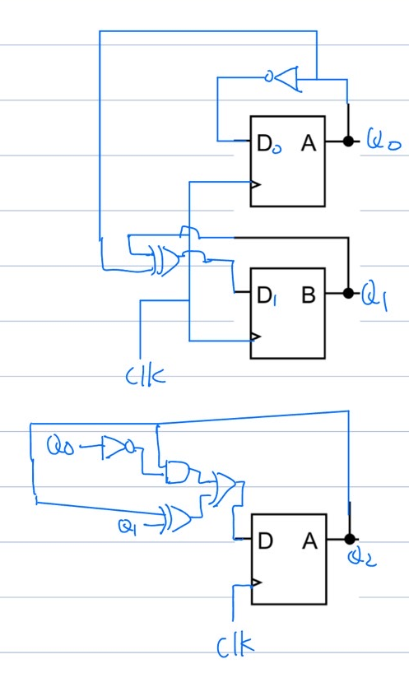
3 bit counter
netlist
X_DFF_1 D_0 clk VDD reset Q_0 Q_0bar VDD VSS DFF
Xxor1 Q_1 Q_0 D_1 VDD VSS xor
Xinv Q_0 D_0 VDD VSS inv
X_DFF_2 D_1 clk VDD reset Q_1 Q_1bar VDD VSS DFF
Xinv2 Q_0 Q_0not VDD VSS inv
Xand1 Q_2 Q_0not D_2_1 VDD VSS and
Xxor2 Q_2 Q_1 D_2_0 VDD VSS xor
Xand2 D_2_0 Q_0 D_2_2 VDD VSS and
Xor1 D_2_2 D_2_1 D_2 VDD VSS or
X_DFF_3 D_2 clk VDD reset Q_2 Q_2bar VDD VSS DFF
*VD1 D 0 pulse 0 2 100u 20u 20u 80u 220u 0
Vclk clk 0 pulse 0 2 160u 40u 40u 160u 400u 0
Vclr reset 0 pulse 0 2 40u 40u 40u 10000000u 1000000000000u 0
VD VDD 0 dc 2
Vs VSS 0 dc 0
.end

Slide 15
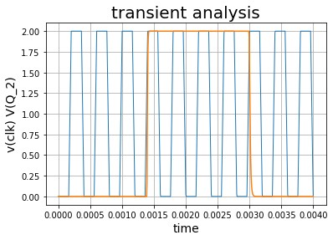
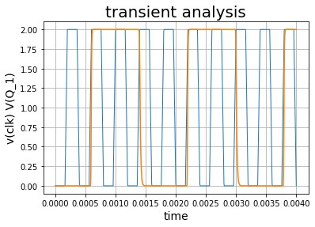
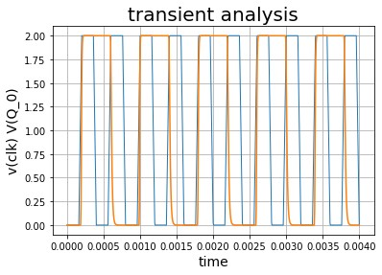
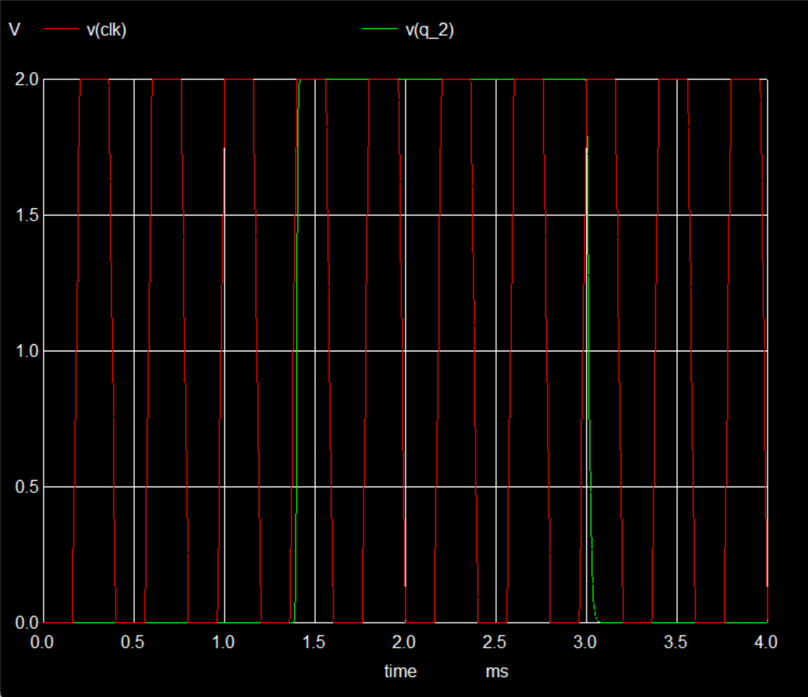
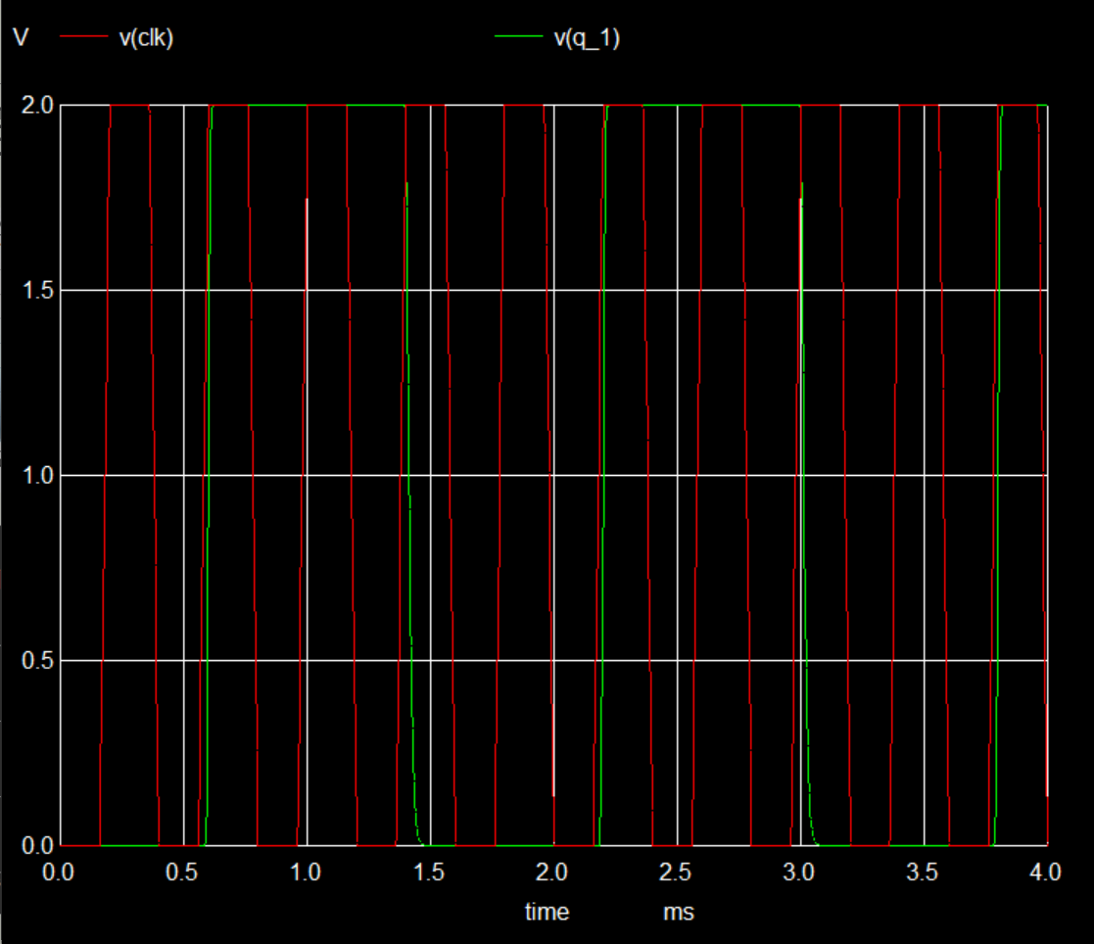
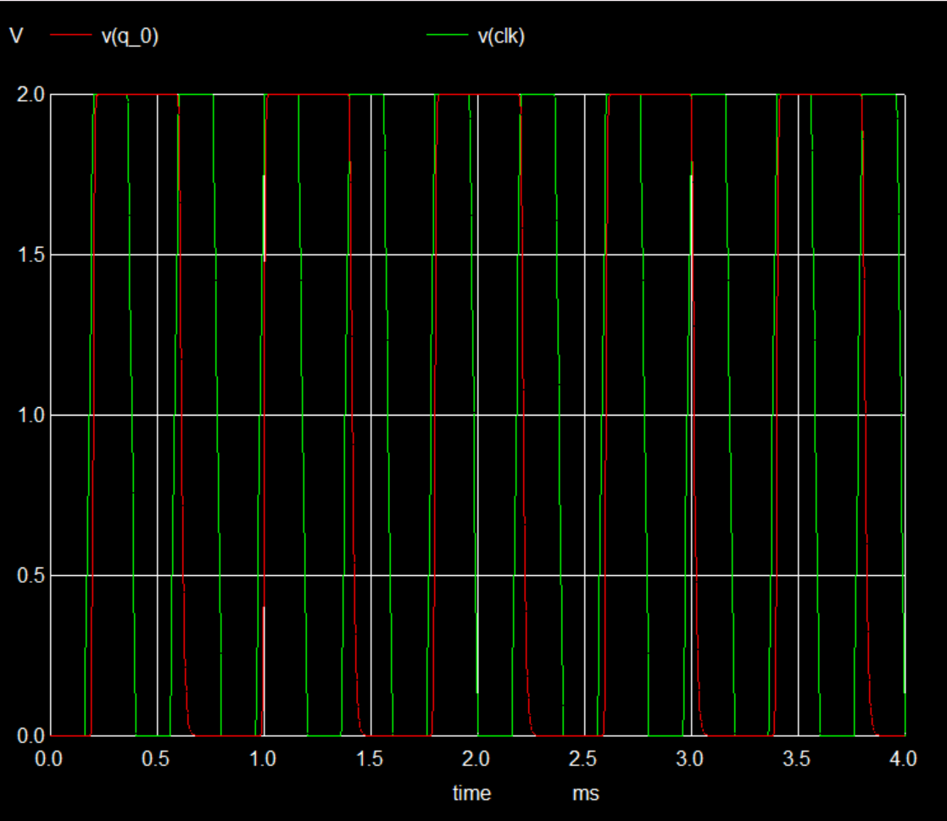
模擬結果

