Slide 1
Meeting 18
2024/01/24

Slide 2
本次進度
PMOS、NMOS DC Simulation modify

Slide 3
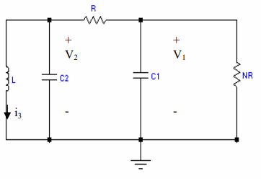
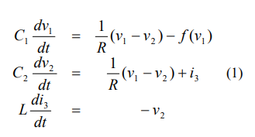
Chaotic circuit

Slide 4
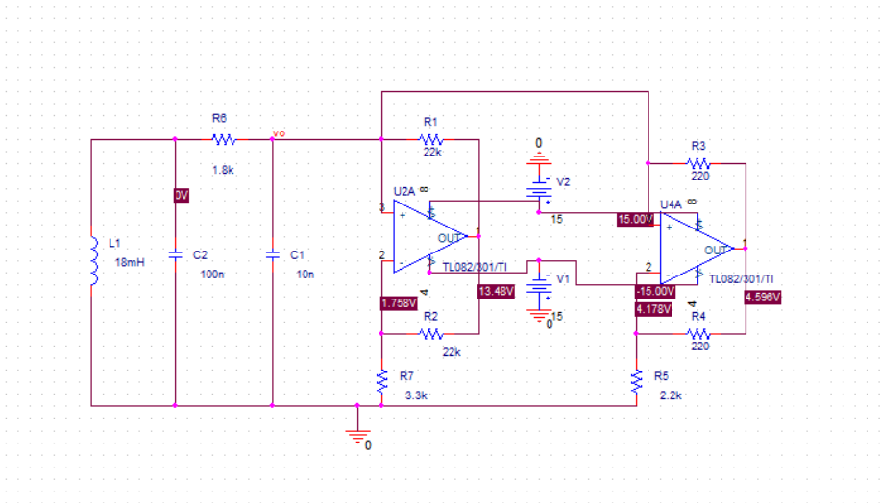
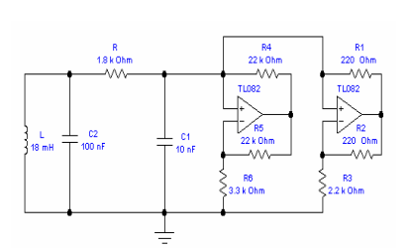
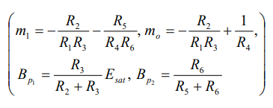
Chua’s circuit

Slide 5
Chua’s circuit

Slide 6
Time 50ms to 60ms

Slide 7
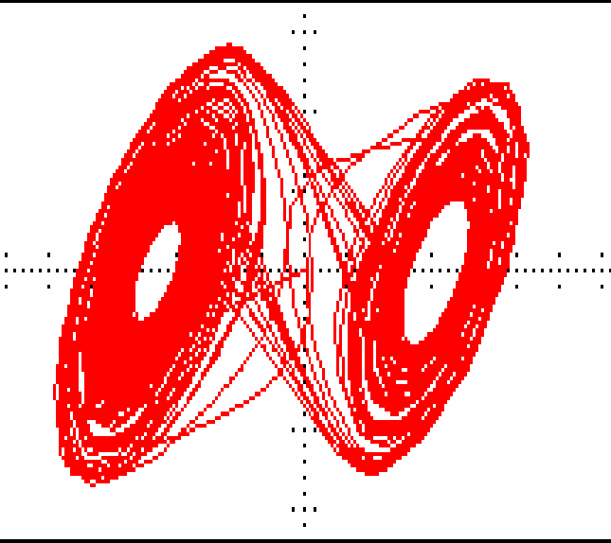
VC2 versus VC1

Slide 8
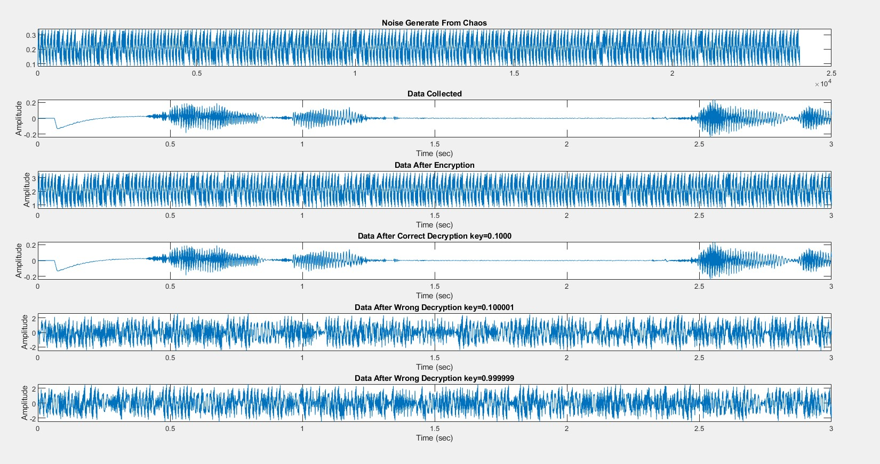
Open source(Chaotic Cryptography) 混沌加密

