Slide 1
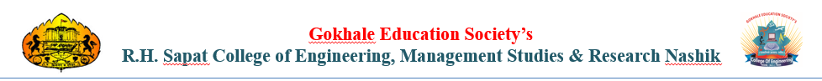
B.E PROJECT STAGE -II
SOC-Grade Image Steganography Detection Tool
Project Group No. 24
Domain : - Cyber security,
Presented By:-
1) Tanmay Devidas Khairnar (27)
2) Ritesh Rajendrasingh Pardeshi (41)
Project Guide :-
Prof. Ranjeet Pathak
B.E E&TC Engineering
(2025-2026)

Slide 2
The Critical Blindspot in Cyber Security
Corporate firewalls scan the "outside" of files (headers/extensions).
Hackers are adapting by hiding malicious code *inside* approved media.
Traditional Antiviruses pass infected images as "Safe".

Slide 3
Hiding in Plain Sight
Derived from Greek: *Steganos* (Hidden) and *Graphien* (Writing).
The practice of burying secret data within normal, digital pixels.
It bypasses visual detection (the human eye cannot see the difference).

Slide 4
The Three Pillars of the Project
The Front-End (GUI):A highly responsive user dashboard built in Python Tkinter.
The Back-End (Engine):A powerful mathematical analysis engine (`image_stego_engine.py`).
The Bridge (Threading):Asynchronous background workers to prevent system freezing.

Slide 5
Least Significant Bit (LSB) Extraction
Images consist of RGB (Red, Green, Blue) pixels.
The tool targets the "8th bit" of each color value.
It rips out these hidden 1s and 0s and reassembles the hacker's original message.

Slide 6
The "EOF" Marker Logic
Extracting bits carelessly results in digital garbage.
Our algorithm hunts for a 16-bit signature: `End of File (EOF)`.
Once found, extraction stops securely.

Slide 7
Shannon Entropy Detection
Advanced hackers delete EOF signatures to avoid detection.
To counter this, we integrated **Claude Shannon’s Entropy Theory**.
Mathematical Chaos: Encrypted payloads yield massive entropy scores (>= 7.5).

Slide 8
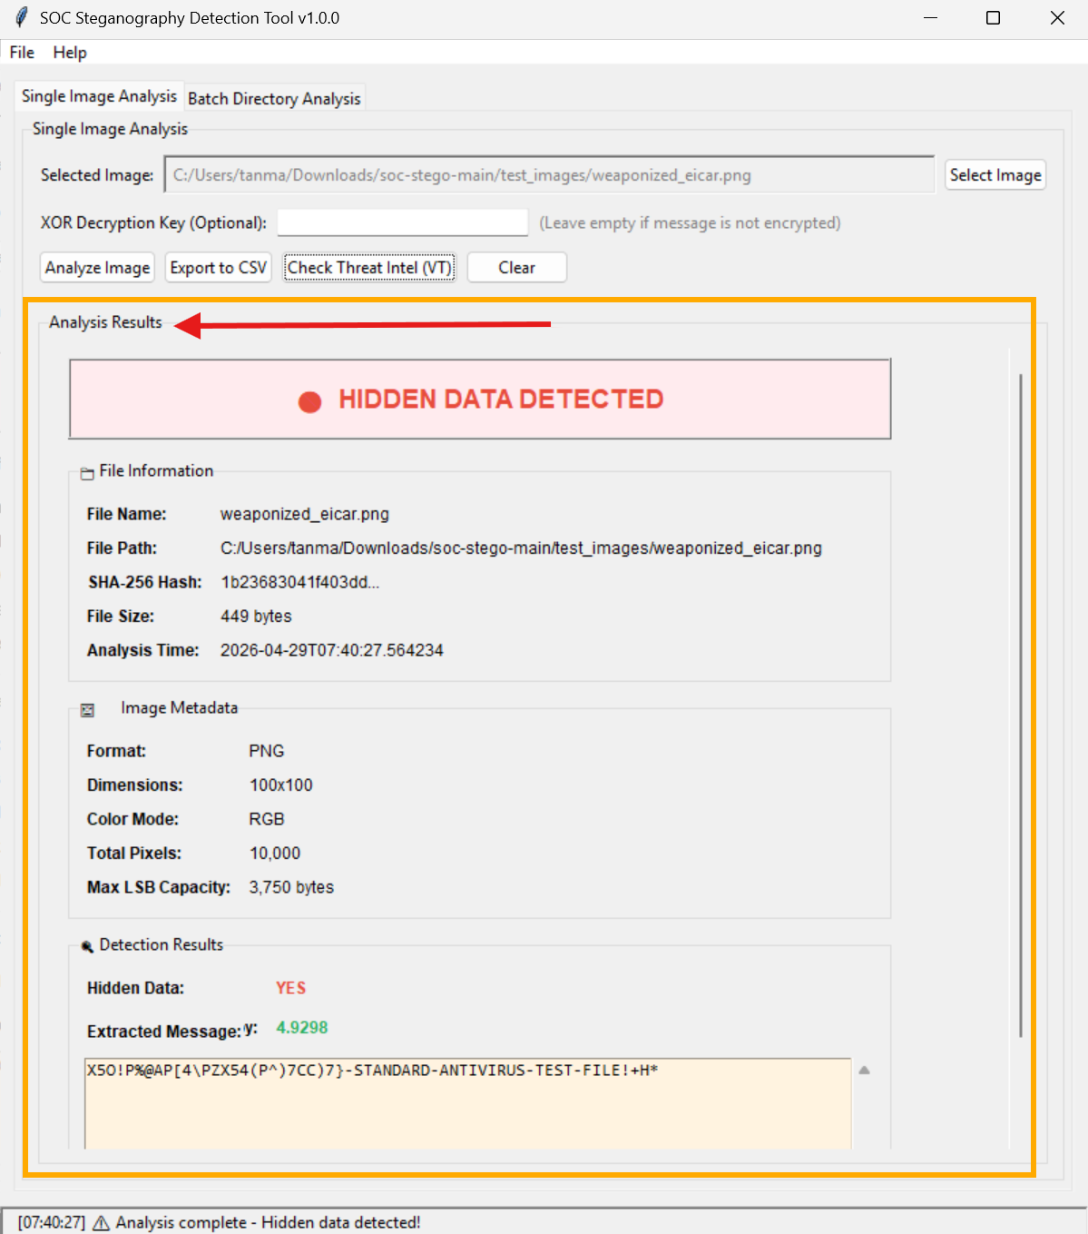
A Professional Analyst Dashboard
Instant visual alerts (Green =
Clean, Red = Critical Threat).
Provides exact Pixel Dimensions, File Hashes, and the Extracted Payload Text.
Two Modes: "Single Targeted Analysis" and "Batch Radar Analysis".

Slide 9
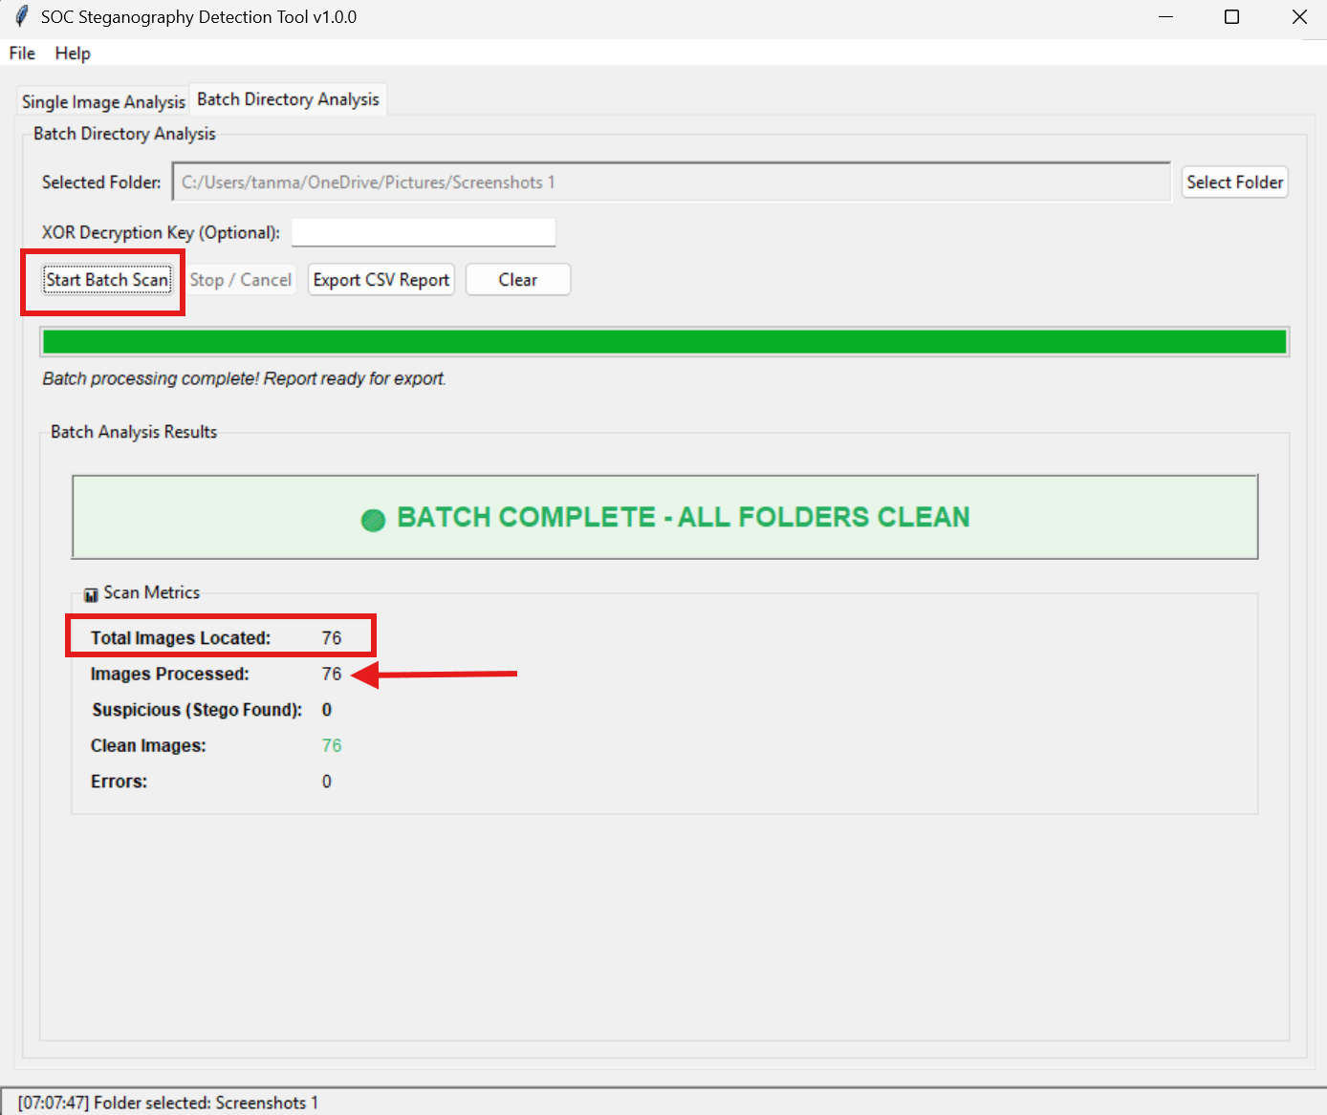
Built to Handle Stress
Processing 5,000 images on a main
UI thread causes freezing.
We built a "Dual-Lane" processing system using `concurrent.futures`.
The GUI delegates heavy math to invisible background workers

Slide 10
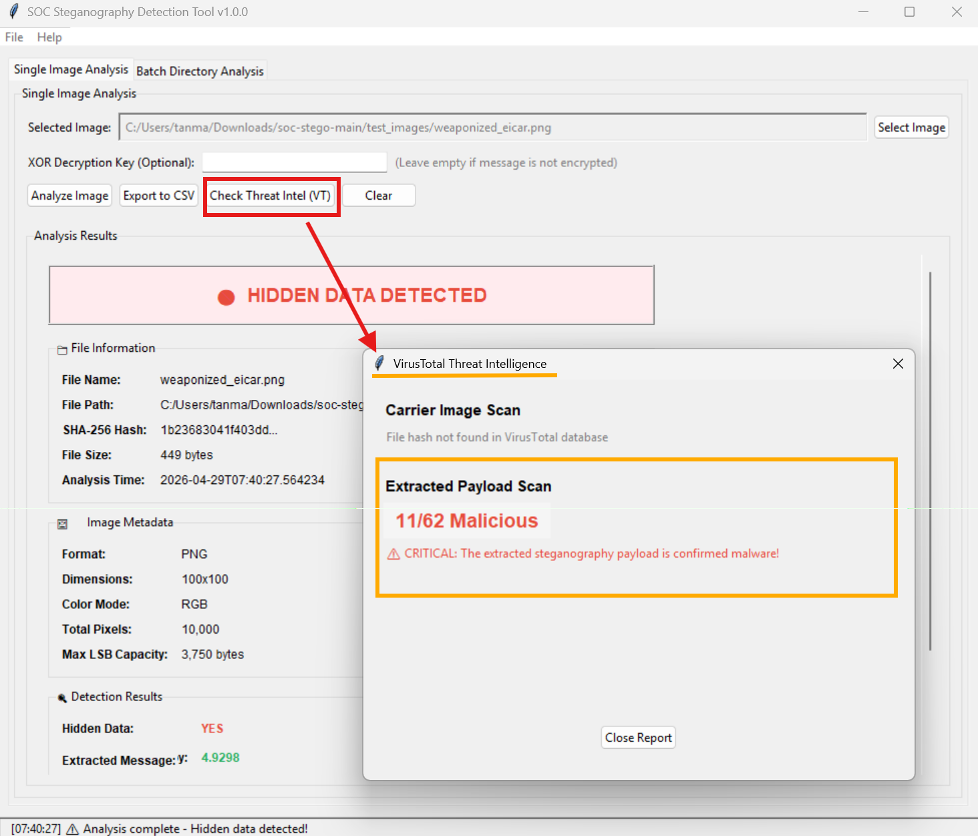
The VirusTotal API Integration
Extracting a script is great, but
proving it's a virus requires validation.
The tool connects securely via API to VirusTotal's 94 global engines.
Provides instant, real-world threat scoring.

Slide 11
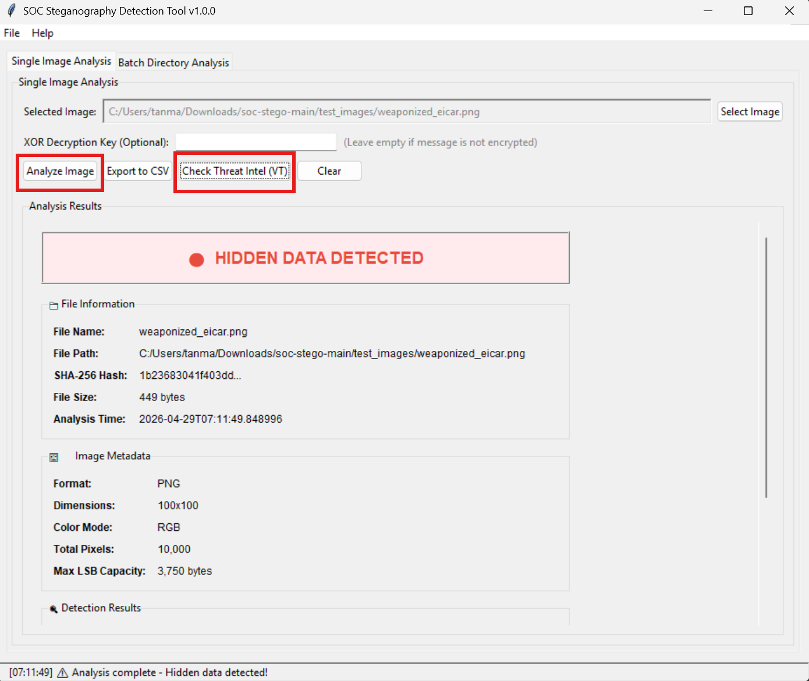
The "Dual-Scan" Proof Mechanism
Scan 1:The Carrier Image passes as "Clean" globally.
Scan 2: The Extracted Script flags as "Critical Malware" globally!
Proof that steganography works, and our tool solves it.

Slide 12
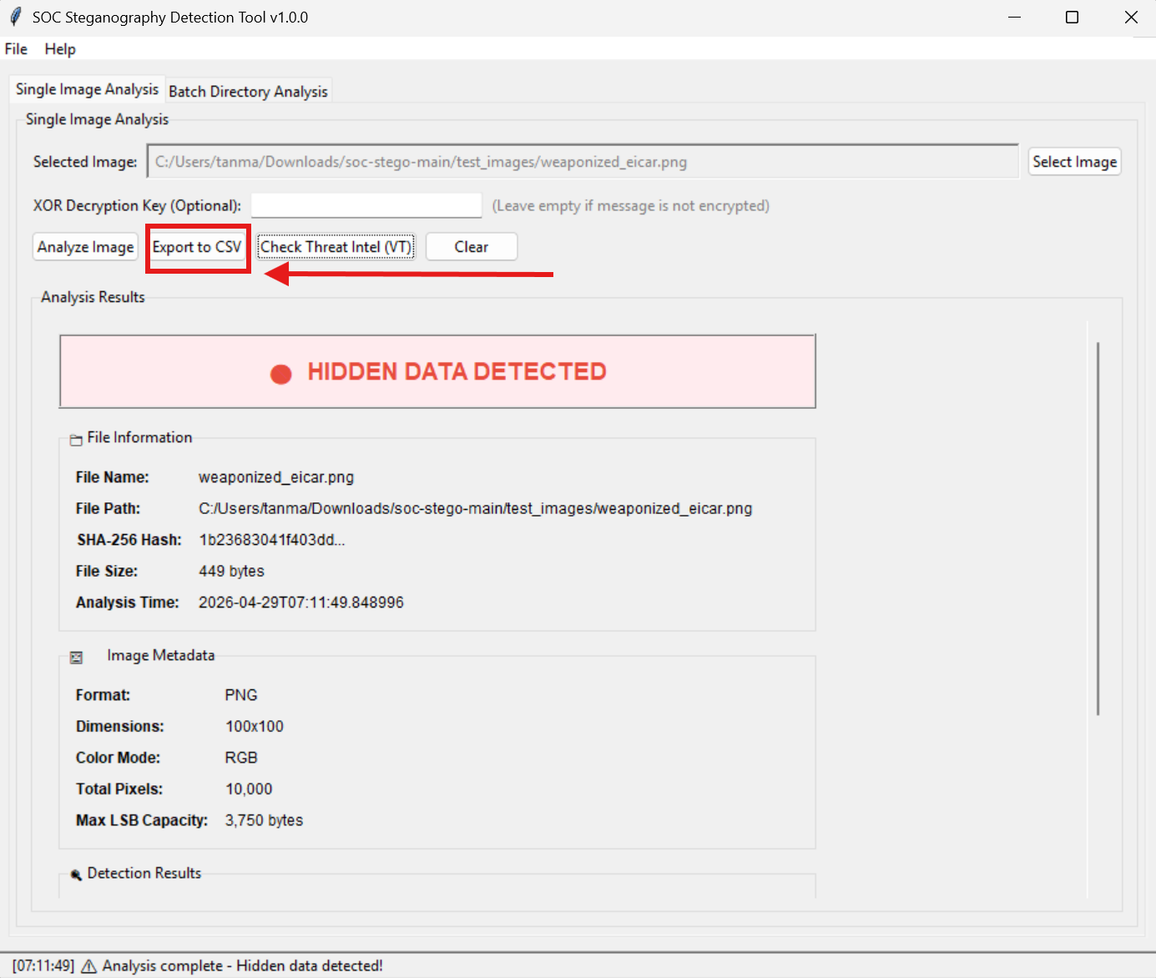
Automated Forensic Auditing
Security teams require strict legal evidence chains.
The tool automatically compiles findings into sanitized CSV logs.
Logs contain: File Hash, Timestamp, Threat Status, and Entropy Score.

Slide 13
Conclusion & Real-World Impact
Successfully exposes Signatureless Steganography.
Combines Deep Pixel Math, Multi-threading, and API Web logic.
Scalable solution for corporate network security.

