Slide 1
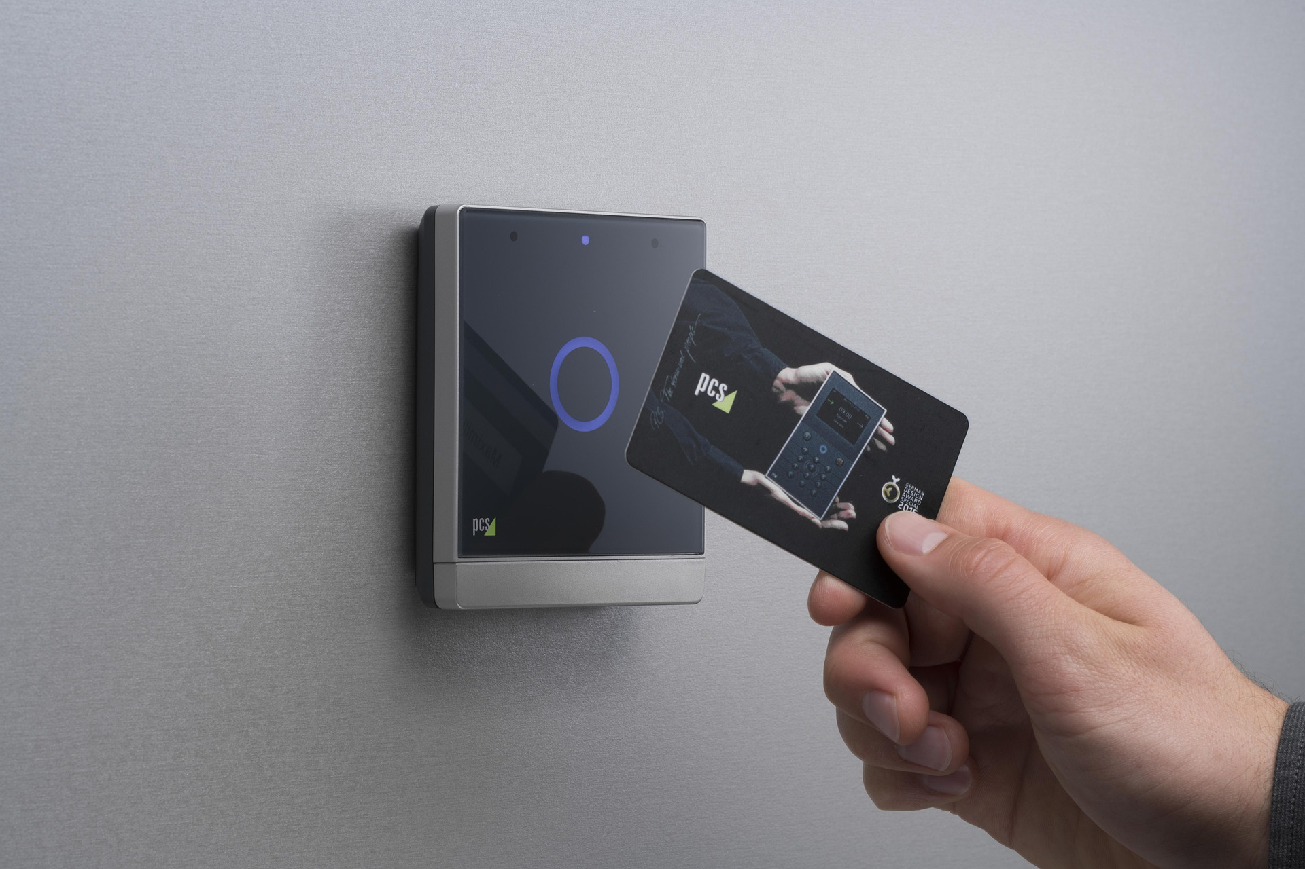
RFID Door Lock System

Slide 2
Outline:
Abstract
Introduction
Problem statement
Objectives
Required components
Circuit diagram
Conclusion
References

Slide 3
Abstract:
Access control is the process of verifying a user claimed identity and giving or denying the access. The proposed project is to secure the system to control the entry of various items through a door or passage using RFID technologies.

Slide 4
Introduction:
Radio Frequency Identification (RFID) is a generic term for technologies that use radio waves to automatically identify people or objects from a distance of several inches to hundreds of feet.
This is an Automatic identification (Auto-ID) technology by which any object can be identified automatically.
Barcode, Magnetic Strip, IC card, Optic Character Recognition (OCR), Voice Recognition, Fingerprint and Optical Strip etc,are also identification technologies.

Slide 5
Problem statement:
Designing a Door lock system based on Radio Frequency Identification (RFID) that can open the door with tap and fast way of analog door lock.

Slide 6
Objectives:
To demonstrate a practical application of the RFID technology, to use as a door lock and collects all data and store in the database. To analyse who unlocked the door at what time
To understand the working of RFID system.
To know this RFID technology and the areas where this technology can be implemented.

Slide 7
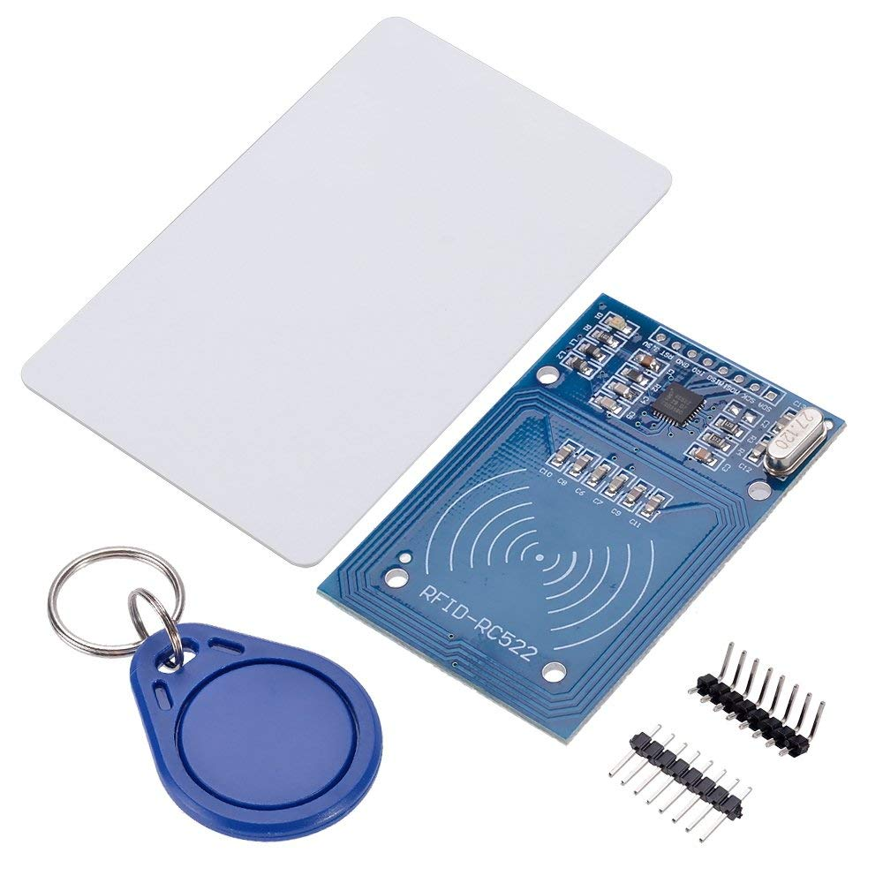
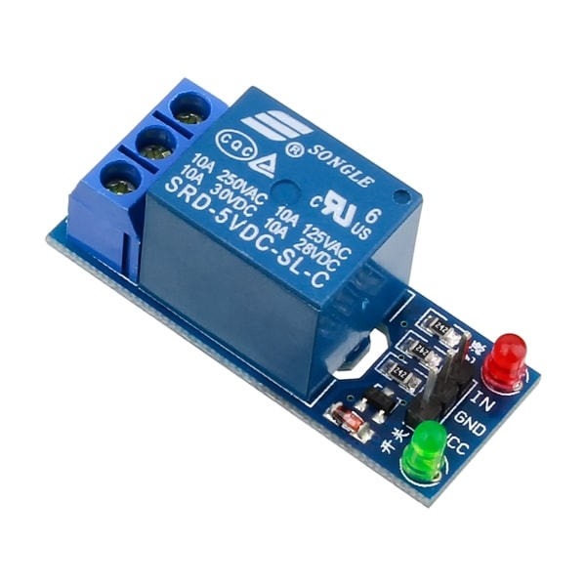
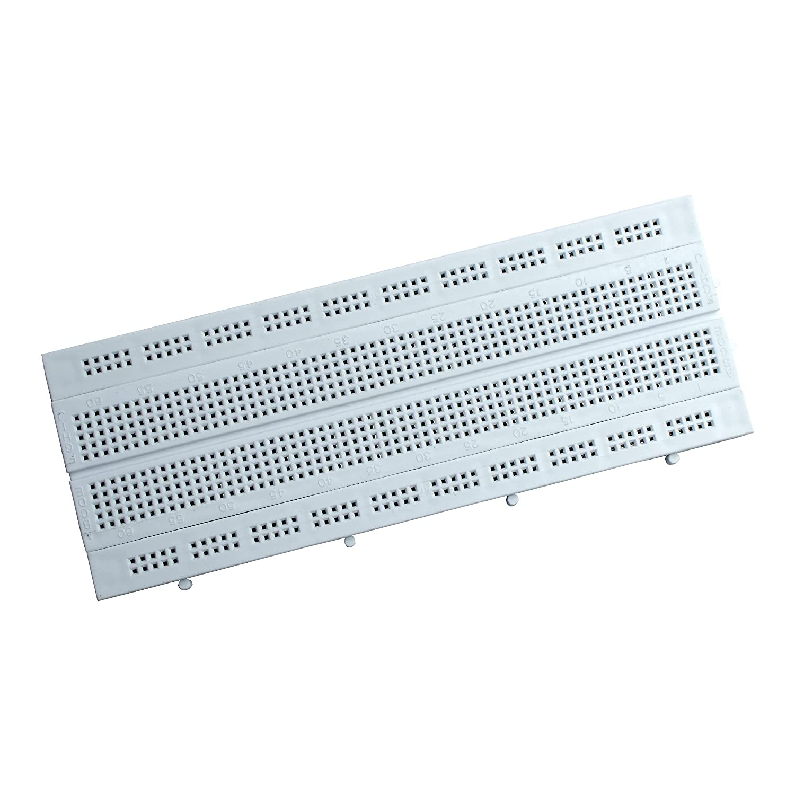
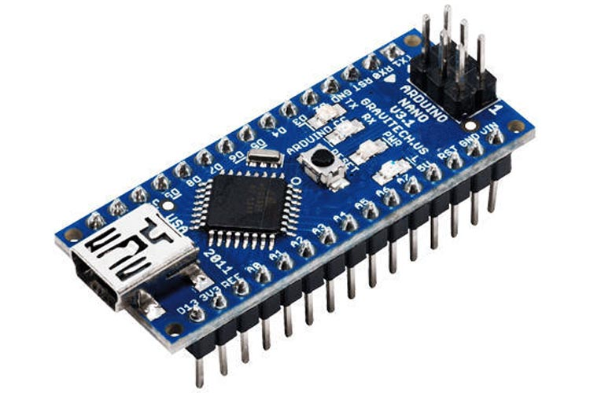
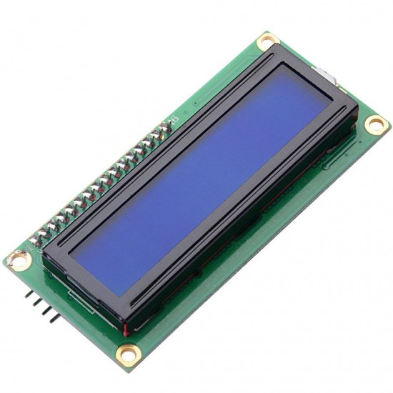
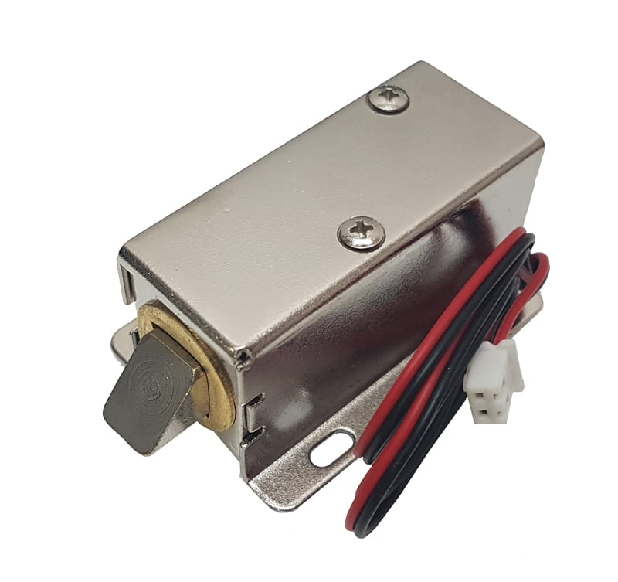
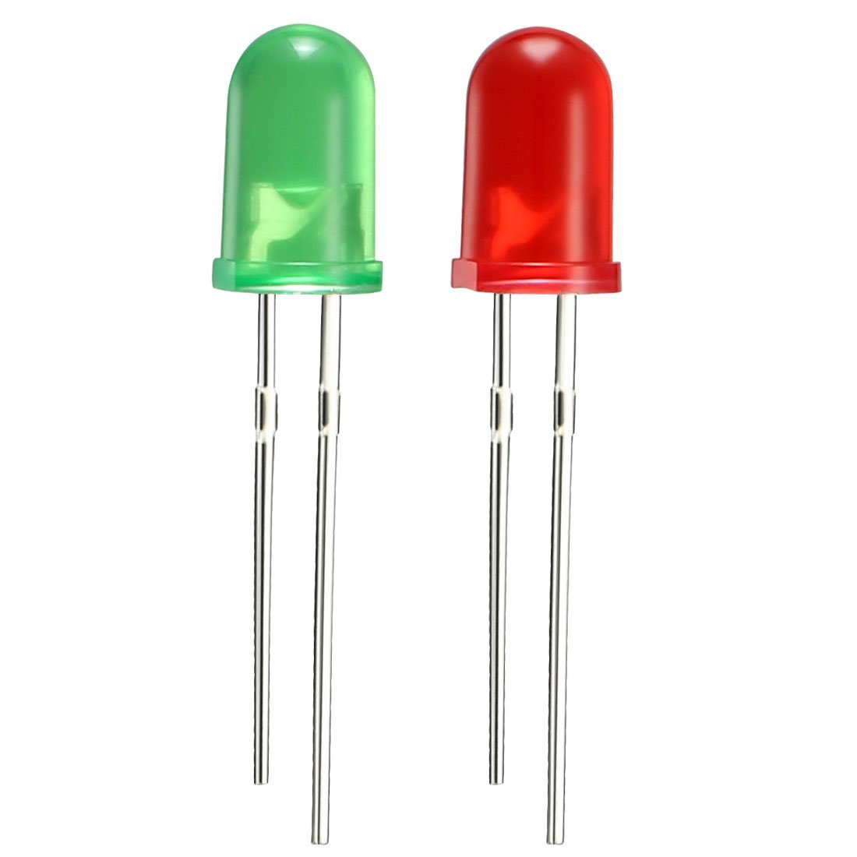
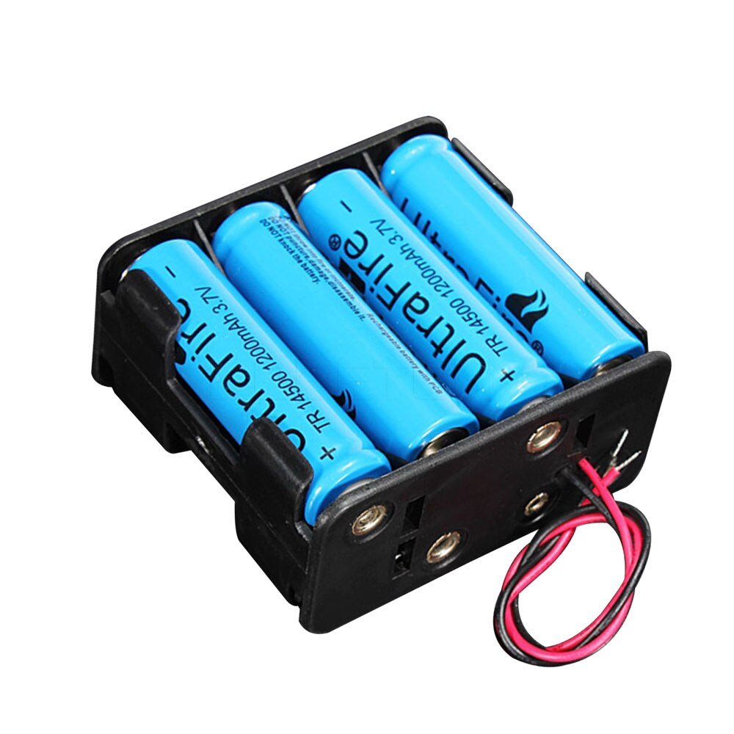
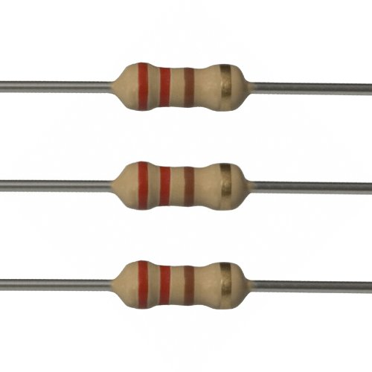
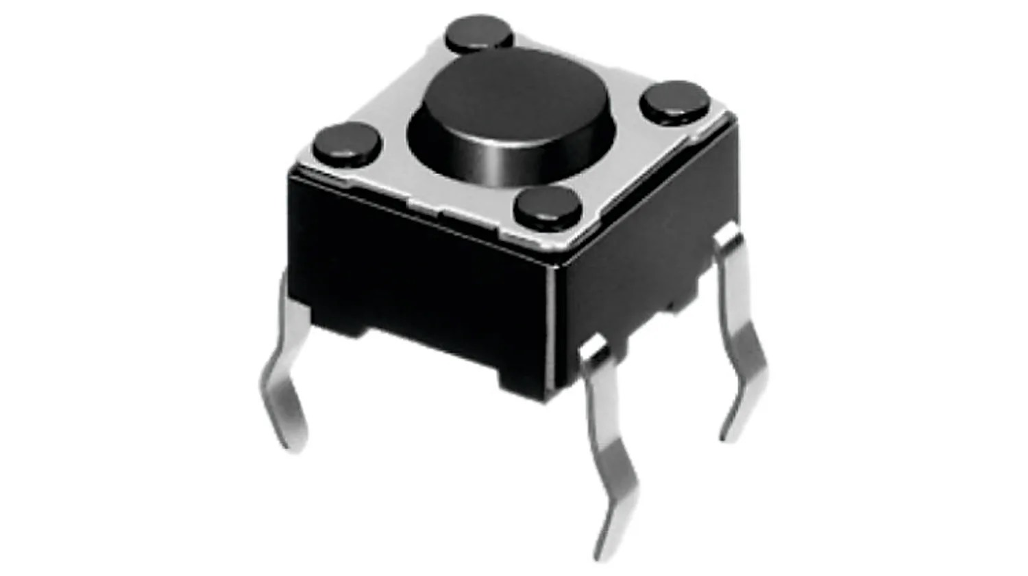
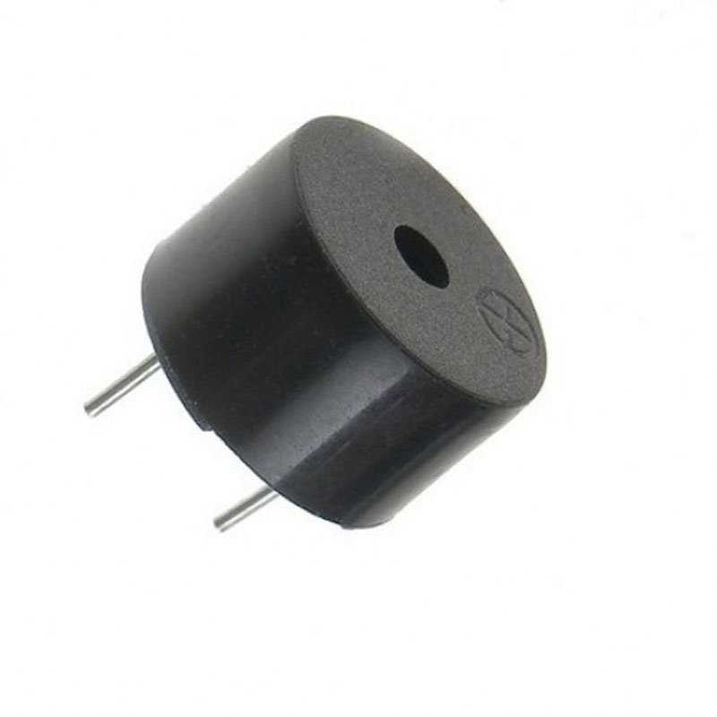
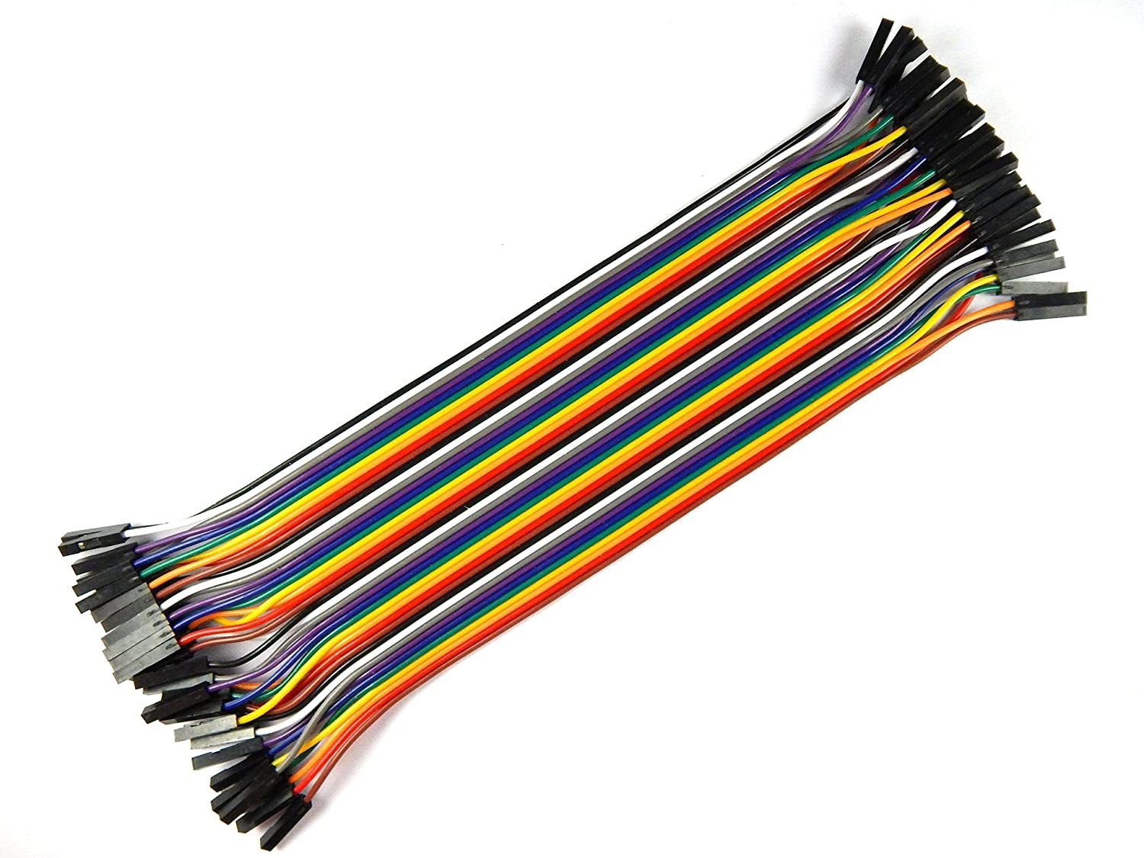
Components Required :
RFID Reader
RFID Tag
Arduino Nano
Relay Module
16*2 I2c LCD Display
12v Solenoid Lock
LED
Resistors
Tactile button
Buzzer
Jumper wires
BreadBoard
12v Battery

Slide 8
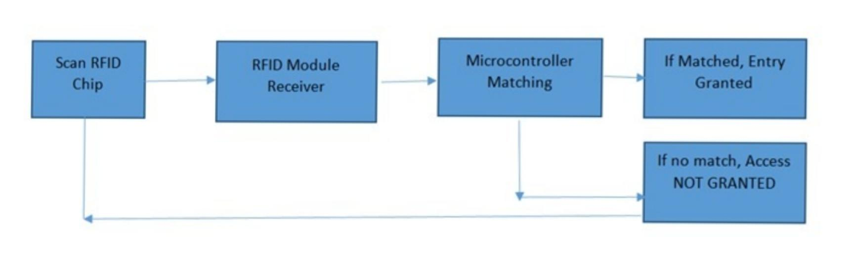
Block diagram:

Slide 9
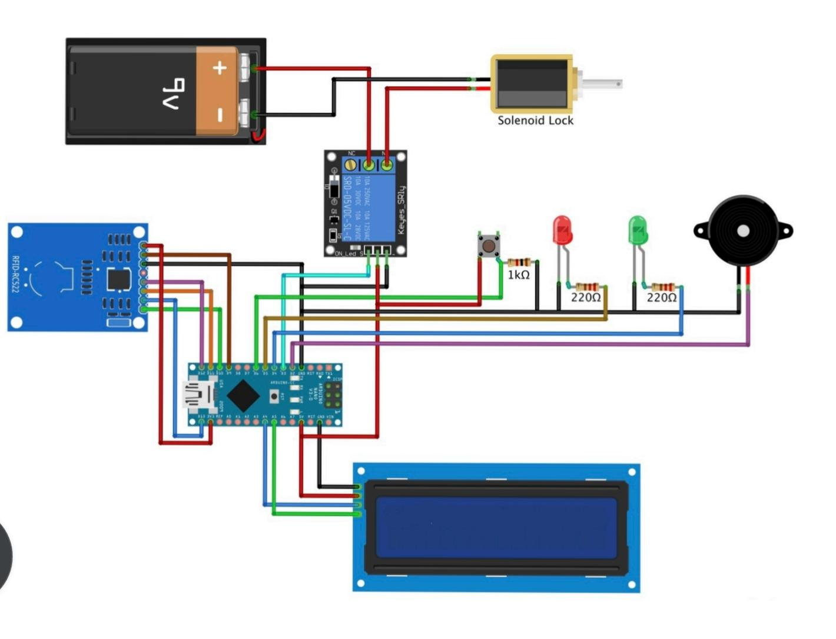
Circuit diagram:

Slide 10
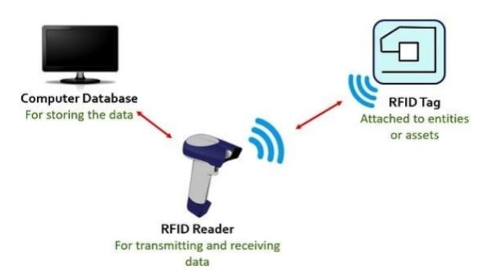
Working Function:

Slide 11
Conclusion:
RFID Door Lock is a very cheap and affordable design that allows convenience and security for users.
The design is relatively small and easy enough to install with just a couple of screws. Of course there are additional features that can be added in order to improve the system as a whole.
However, it is important to note the cost of the improvement should be taken into consideration.

Slide 12
References :
1. https://www.slideshare.net/naveeniift/RFID-and-its-applications/
2. https://www.arduino.cc/
3. www.camcode.com/asset-tags/what-are-RFID-tags/
4. www.camcode.com/asset-tags/what-are-RF

Slide 13
Thank you

