Slide 1
FUTURE VISION · PLATFORM CONCEPT
EDITH-AI
AI Situational
Awareness Platform
Vision, memory, cybersecurity awareness
and risk analysis in one platform.
Understand physical and digital environments through shared context.

Slide 2
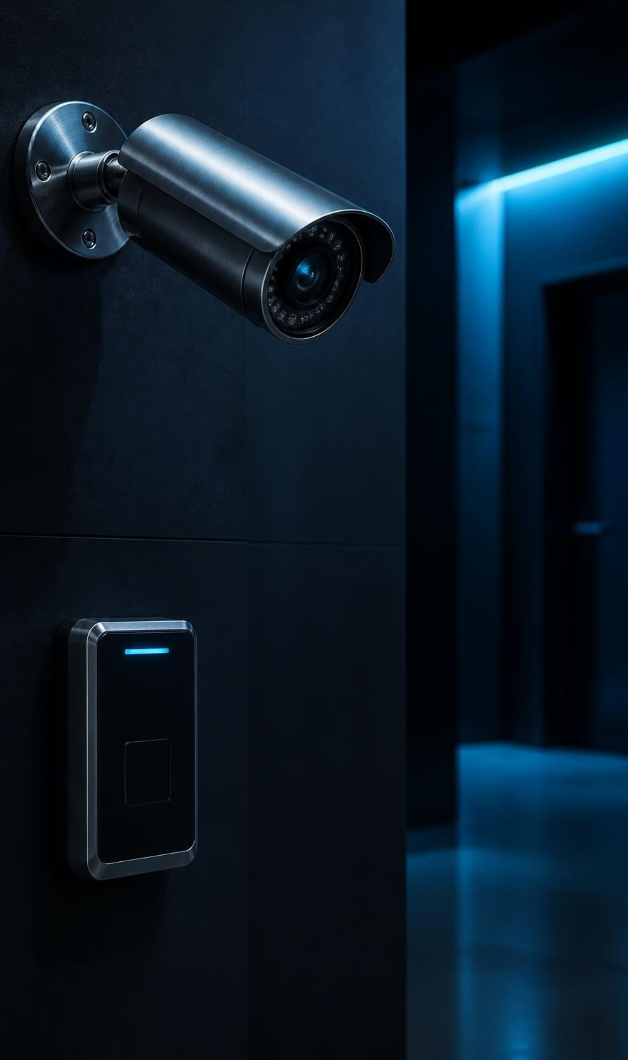
THE GAP
AI assistants answer questions but stay blind to the environment
Conversation
Fragmented signals
Traditional assistants respond to prompts, without continuously seeing, remembering or detecting environmental change.
Cameras, security monitoring, logs, documents and automation remain separate systems with no shared context.
The missing layer is awareness across systems.
EDITH-AI: AI Situational Awareness Platform
2

Slide 3

FUTURE VISION
One system for physical and digital awareness
One AI connects what it sees, remembers and detects to help people understand their surroundings.
Physical context
Digital context
People, objects, places and changes.
Devices, network activity and events.
Shared memory. Connected reasoning.
EDITH-AI: AI Situational Awareness Platform
3

Slide 4
FUTURE VISION · CAPABILITY MAP
What EDITH-AI is
An intelligent awareness platform with an assistant the user can talk to.
Perceive
Understand
Respond
Computer vision and AI interpret the environment.
Memory, cybersecurity awareness, anomaly detection and risk analysis connect the signals.
A conversational assistant and automation support informed action.
CURRENT PROTOTYPE · BUDGET CONSTRAINT
1,000–2,000 EGP · Minimal hardware. The full capability map remains Future Vision.
EDITH-AI: AI Situational Awareness Platform
4
Notes:
The brief does not specify which individual capabilities have been demonstrated. Present the capability map as intended scope, not as evidence of a complete product. The prototype budget is a constraint, not a claim of delivered performance.

Slide 5
FUTURE VISION · END-TO-END FLOW
How EDITH-AI works
Signals become context, then evidence-backed decisions and action.
01
02
03
04
05
06
Input
Perception
Memory
Reasoning
Risk
Action
Cameras, network signals, logs and documents.
Extract observations from incoming signals.
Store events and retrieve prior context.
Connect observations across sources.
Detect anomalies and prioritize evidence.
Notify users and support automation.
Dashboard alerts
Voice assistant
Smart glasses
EDITH-AI: AI Situational Awareness Platform
5

Slide 6
FUTURE VISION · ILLUSTRATIVE CAMERA VIEW
Vision engine understands the environment
Perception capabilities
Consent-based person recognition
Object recognition
Scene understanding
OCR
Visual question answering
Person recognition requires consent.
Ask about the view. Ground the answer in visible evidence.
EDITH-AI: AI Situational Awareness Platform
6

Slide 7
FUTURE VISION · EVENT HISTORY
Memory turns events into context
Remember people, objects, locations and events. Retrieve history to answer with context.
People
Environment
Alerts
Consent-based observations.
Where change occurred.
What warranted review.
Objects
Network
Actions
What was present.
Device events.
What followed.
“What changed, and what happened before it?”
Illustrative query · A connected history supports a contextual answer.
EDITH-AI: AI Situational Awareness Platform
7

Slide 8

FUTURE VISION · EVIDENCE FIRST
Anomaly detection and evidence-based risk scoring
Learn normal patterns
Establish context before interpreting change.
Flag the unexpected
Surface deviations for review, with supporting observations.
Prioritize risk
Score significance and show the evidence behind the assessment.
Never claim certainty without evidence.
EDITH-AI: AI Situational Awareness Platform
8

Slide 9





FUTURE VISION · CYBERVISION
CyberVision exposes unknown devices on the network
Device awareness
Known camera
Known workstation
Unknown device
Recognized inventory
Known server
Review required
Recognized inventory
Recognized inventory
Identity
History
Change
Monitor IP, MAC and hostname.
Track first-seen and last-seen times.
Flag suspicious network changes.
Illustrative topology · Unknown means unrecognized, not proven malicious.
EDITH-AI: AI Situational Awareness Platform
9

Slide 10
FUTURE VISION · ILLUSTRATIVE CORRELATION
Correlating physical and cyber events
Two observations can justify investigation without establishing responsibility.
PHYSICAL EVENT
CYBER EVENT
CORRELATED ALERT
A person enters a restricted lab
An unknown network device appears
Investigate the coincidence
A camera observation supplies physical context.
A network observation supplies digital context.
Present both events and their evidence for human review.
Correlation, never an automatic accusation.
The alert does not prove that the person owns the device or caused the network event.
EDITH-AI: AI Situational Awareness Platform
10
Notes:
Explain the example as an investigation cue. Temporal association alone does not establish causation, device ownership or intent. The reviewer must examine the evidence before drawing conclusions.

