Slide 1
ACADEMIC PORTFOLIO PROJECT
Sales Performance
Dashboard
Power BI · AdventureWorks · 2015–2017
Designed and analyzed by
KHALID BAHADILAH
Data Analytics · Business Intelligence · DAX
01 / 05
Notes:
[Sources]
- Project title and author: user-provided Power BI project.
- AdventureWorks background: https://learn.microsoft.com/en-us/sql/samples/adventureworks-install-configure
[/Sources]

Slide 2
POWER BI · ACADEMIC PORTFOLIO
02 / 05
One page captures the commercial picture
Validated directly against 56,046 sales lines.
84,174
$24.91M
$10.46M
units sold
total revenue
net profit
1.50
$444.54
$186.59
avg. units / line
avg. revenue / line
avg. profit / line
Notes:
[Sources]
- Metrics: repository CSV files; calculations documented in docs/metric-definitions.md.
- AdventureWorks background: https://learn.microsoft.com/en-us/sql/samples/adventureworks-install-configure
[/Sources]

Slide 3
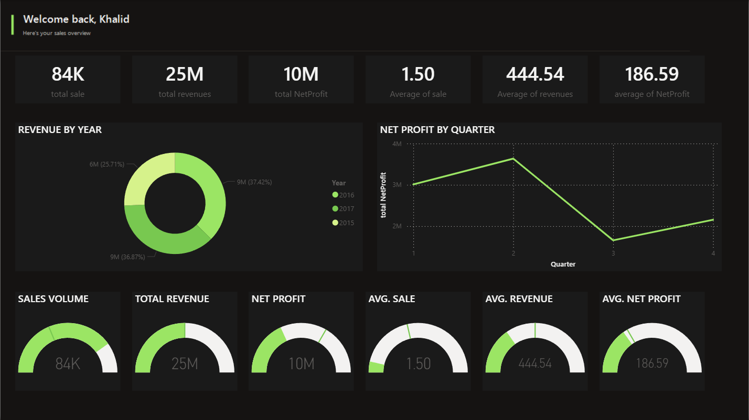
POWER BI · ACADEMIC PORTFOLIO
03 / 05
The performance story fits on one screen
KPIs, annual revenue mix, quarterly profit, and at-a-glance gauges.
Notes:
[Sources]
- Dashboard screenshot: user-provided Power BI report captured locally from report/Sales Performance Dashboard.pbix.
[/Sources]

Slide 4
POWER BI · ACADEMIC PORTFOLIO
04 / 05
Three patterns stand out in the data
The strongest result is concentration—not randomness.
2016
Q2
94.9%
$9.32M revenue
$3.64M net profit
revenue from Bikes
The strongest annual result, narrowly ahead of 2017.
The most profitable quarter across the combined period.
A highly concentrated mix and the clearest commercial driver.
Overall net profit margin: 42.0%
Notes:
[Sources]
- Metrics: repository CSV files; calculations documented in docs/metric-definitions.md.
[/Sources]

Slide 5
FROM DATA TO DECISION
05 / 05
Built as a complete analytics workflow
The dashboard is the final layer—not the whole project.
01
CSV sources
Sales, customers, products, categories, and returns
02
Power Query
Import, type validation, and repeatable refresh
03
Model + DAX
Relationships, revenue, profit, and KPI measures
04
Power BI
Executive dashboard and decision-ready storytelling
github.com/KHALEDBL1/Sales-Performance-Dashboard-Power-BI
Power BI · Power Query · DAX · Data Modeling
Notes:
[Sources]
- Technical workflow: user-provided report and included CSV files.
- Repository URL: https://github.com/KHALEDBL1/Sales-Performance-Dashboard-Power-BI
[/Sources]

