Slide 1
AquaClear
Underwater Image Enhancement & Color Correction
Khaled Noaman
Image Processing Course • Istanbul Arel University • 2026

Slide 2
The Problem: Underwater Vision
Why do underwater photos look bad?
Color Attenuation
Scattering & Haze
Low Contrast & Blur
• Water absorbs light depending on wavelength. • Red disappears first (at ~5m). • Results in strong blue/green color cast.
• Particles in water scatter light. • Creates a foggy 'haze' effect. • Lowers overall visibility and contrast.
• Loss of high-frequency details. • Edges become soft. • Floating marine snow adds noise.

Slide 3
The Solution: Classical IP
No Neural Networks, just Math and Matrices.
Why Classical IP?
• Fast and lightweight (runs in milliseconds). • Highly interpretable (we know exactly what every parameter does). • Deterministic results (no hallucinations).
The AquaClear Pipeline
1. Noise Reduction → 2. Color Correction → 3. Dehazing → 4. Contrast → 5. Sharpening

Slide 4
Physics of Underwater Light
Why do colors disappear?
Wavelength Absorption
The Jaffe-McGlamery Model
Water acts as a dense filter. It absorbs different wavelengths at different depths: • <b>Red (650nm)</b>: Disappears first (3-5 meters). • <b>Orange/Yellow</b>: Fades by 15-20 meters. • <b>Blue/Green</b>: Penetrates the deepest. Result = The classic 'washed-out blue' tint.
Total Image = Direct Signal + Forward Scatter + Backscatter • <b>Direct Signal</b>: The clear light from the object. • <b>Forward Scatter</b>: Blurs the edges. • <b>Backscatter</b>: Hit particles and bounces back (Haze). Our algorithms try to reverse this model.

Slide 5
Digital Image Fundamentals
Applied theory in the project.
Color Spaces Used
Spatial Domain Filtering
• <b>RGB</b>: Base matrices. Used for display and Gray World compensation. • <b>LAB (CIE1976)</b>: Separates Luminance (L) from Color (A,B). Used for Contrast Enhancement (CLAHE) to preserve perceived hues. • <b>HSV</b>: Used for calculating colorfulness and saturation metrics.
Modifying pixels based on their neighborhoods. • <b>Convolution</b>: Using n x n spatial kernels. • <b>Laplacian (2nd derivative)</b>: For edge detection. • <b>Gaussian Filters</b>: For smoothing.

Slide 6
Deep Dive: Noise Reduction
Removing marine snow and sensor noise.
The Problem: Non-Linear Noise
Standard linear filters (like Mean or Gaussian blur) will reduce noise, but they ruin the image by blurring the edges. Underwater images already suffer from blur due to forward scattering.
The Solution: Bilateral Filtering
Bilateral filters combine a spatial Gaussian (distance) with a range Gaussian (intensity difference). • Smooths flat regions (removes noise). • Stops smoothing when it detects a sharp intensity jump (keeps edges sharp).

Slide 7
Live Demo: AquaClear Workflow
How the application processes images.
1 Upload
2 Analyze
3 Enhance

Slide 8
Step 1: Auto-Analysis Matrix
Demo Step 1/4: Auto-Analyze
Detecting physical properties from pixels.
Diagnostic Processing
Before applying filters, the backend calculates global metrics: • <b>Color Shift:</b> Mean(B) - Mean(R) > Threshold indicates depth. • <b>Contrast:</b> Global standard deviation (if < 30, needs heavy CLAHE). • <b>Blur:</b> Variance of Laplacian (if < 100, needs high unsharp strength).
Code Snippet: Dynamic Parameterization
laplacian_var = cv2.Laplacian(gray, cv2.CV_64F).var() if laplacian_var < 100: settings["unsharp_strength"] = 2.5 # Very blurry, strong sharpening settings["noise_method"] = "nlm" # Use Non-Local Means (heavy noise) elif laplacian_var < 300: settings["unsharp_strength"] = 1.5 # Standard sharpening

Slide 9
Step 2: Color Shift & Transmission
Demo Step 2/4: Color & Dehaze
Fixing attenuation & scattering.
Gray World Theorem
Dark Channel Prior (DCP)
Hypothesis: Given an image with enough variety, the average value of R, G, and B should be equal (neutral gray). Implementation: 1. Calculate mean of R, G, B. 2. Find global average. 3. Scale up deficient channels (Red) by (Avg / Mean_R). Optional: Channel compensation blends Red based on Green.
Breakthrough algorithm (He et al.). 1. <b>Dark Channel:</b> Minimum filter across R,G,B locally. 2. <b>A-light:</b> Use brightest 0.1% of Dark Channel pixels to estimate Atmospheric Light. 3. <b>Transmission Map (t):</b> Calculates scattering distance. 4. <b>Recovery:</b> J = (I - A)/max(t, 0.1) + A.

Slide 10
Step 3: Edge Details
Demo Step 3/4: Details
Making features distinct.
CLAHE vs Global Histogram Equalization
• <b>Global HE:</b> Spreads all pixel intensities across the full 0-255 range. It washes out scenes and destroys local contrast. • <b>CLAHE:</b> Divides image into 8x8 blocks. Equalizes locally. Clips peaks in histograms to prevent noise blowout. Re-interpolates using bilinear interpolation to remove grid lines.
Unsharp Masking (Frequency Domain)
High-frequency data = edges. Low-frequency data = flat colors. 1. Create Low-Pass image (Gaussian Blur). 2. High-Pass (Edges) = Original - Low-Pass. 3. Sharpened = Original + (Strength * High-Pass).

Slide 11
Step 4: Objective Quality Assessment
Demo Step 4/4: Metrics
Math measuring quality.
PSNR (Peak Signal-to-Noise)
SSIM (Structural Similarity)
Measures reconstruction fidelity. 10 * log10(MAX² / Mean Squared Error). Values 20-40dB are typical; higher means less structural damage from filters.
Perceptual metric. Measures structural information change rather than absolute errors in pixels. Considers Luminance, Contrast, and Structure independently.
UCIQE (Underwater Color Image Quality)
Shannon Entropy
Linear combination of standard deviation of chroma, avg saturation, and contrast of luminance. Designed specifically to measure underwater un-blurring.
Measures information content/richness via histogram probability distribution. Enhancement should dramatically increase total entropy.

Slide 12
Complete System Architecture
Production-ready Web Application.
User Interface (HTML/CSS/JS)
Node.js Server (Express/Multer)
Python Engine (OpenCV/NumPy)
• Client interacts with stateless API. • Node.js handles HTTP parsing and temporary file storage. • Python is invoked via Subprocesses (JSON payload in/out). Data returned via Base64 Strings.

Slide 13
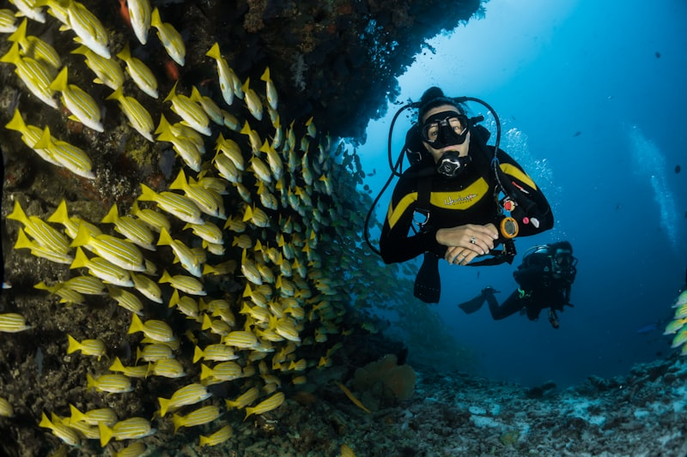
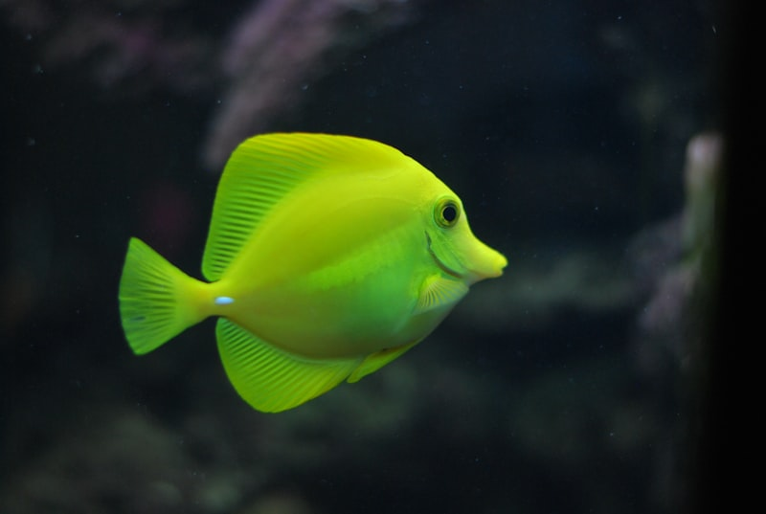
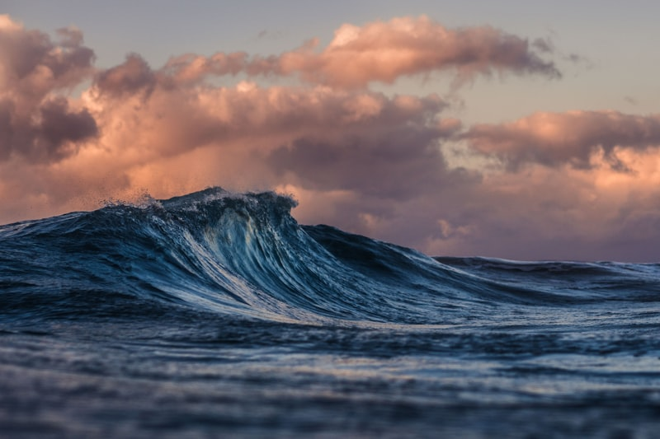
Visual Results
Before & After Comparisons from the App.
Coral Reef (Raw)
Jellyfish (Raw)
Deep Ocean (Raw)
The AquaClear pipeline automatically detects the dense blue/green tint in these raw inputs, calculates the atmospheric transmission map, and restores the lost reds and contrast in < 0.5 seconds.

Slide 14
Architectural Stack
How the pieces fit together.
Frontend UI
Web Server
IP Engine
• Vanilla HTML/CSS/JS (Flat Design) • Data-theme (Dark/Light) • LocalStorage for theme persistence • No frontend frameworks
• Node.js + Express • Multer for multipart form uploads • Subprocesses to trigger Python via CLI
• Python 3.10 • OpenCV (cv2) for image matrices • NumPy for fast math • Base64 encode for returning images

Slide 15
UZEM Forum Question
Required component.
Question:
Why is CLAHE (Contrast Limited Adaptive Histogram Equalization) applied to the Luminance (L) channel of the LAB color space rather than applying standard Histogram Equalization to RGB channels?
Answer:
Applying equalization directly to R, G, and B changes the color ratios, which alters the original hues (color distortion). By converting to LAB space, we separate Lightness (L) from color data (A, B). Applying CLAHE only to the L channel boosts contrast without changing the actual colors of the fish or water. The 'Limited' part of CLAHE also prevents flat areas like open water from becoming too noisy.

Slide 16
Conclusion
Final thoughts.
Summary of Work:
• Successfully built an underwater image enhancement pipeline using 100% classical Image Processing. • Developed an intuitive Node.js/HTML web application featuring Auto-Analysis and Dark Mode. • Demonstrated that complex CNNs aren't always necessary for image restoration if mathematical priors (like Dark Channel) are utilized. Thanks for listening!

