Slide 1
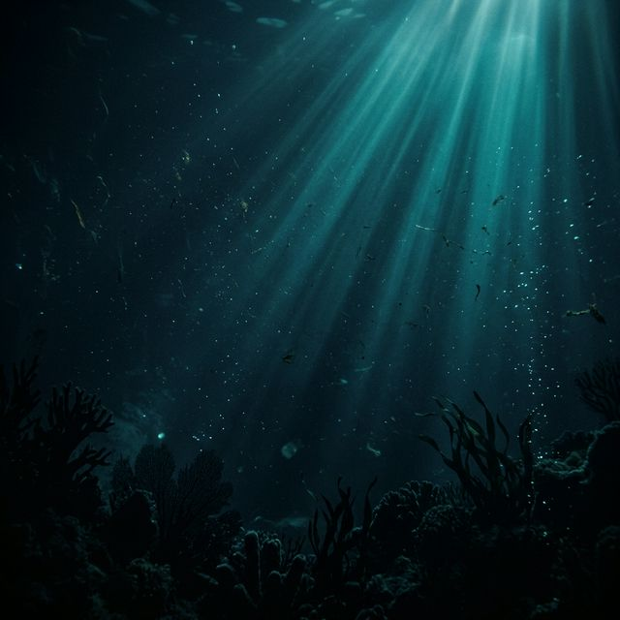
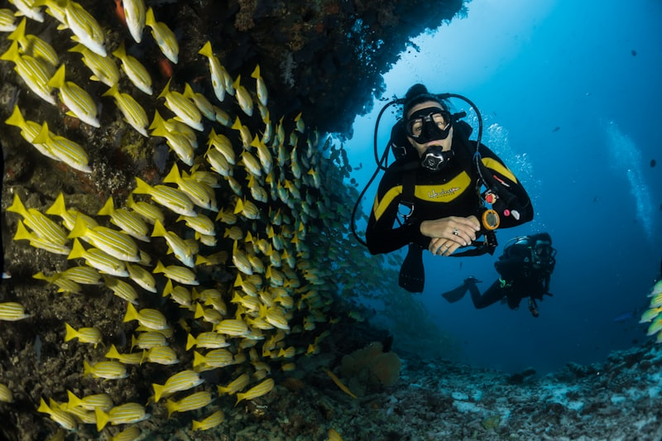
AquaClear
Underwater Image Restoration & Enhancement
CENG 455 – Digital Image Processing · Istanbul Arel University
Khaled Noaman · 200303812 · Spring 2026
1

Slide 2

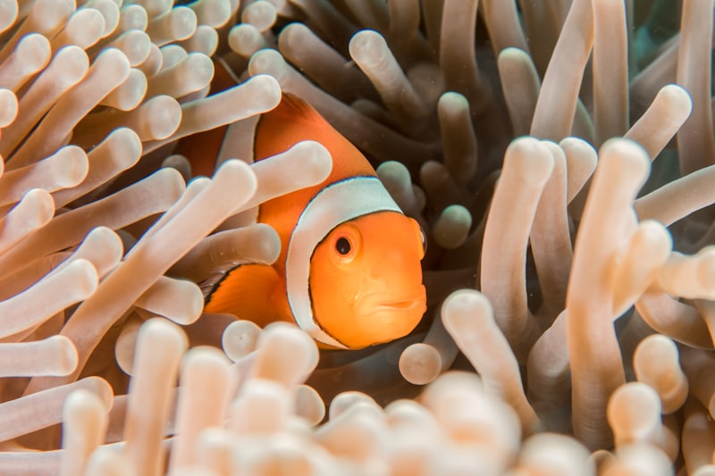
Contents
01
Introduction
Physics of underwater light degradation
02
Main Topic
The AquaClear Processing Pipeline
03
Results
Visual Before & After Comparisons
04
Conclusion
Key Takeaways and Future Work
05
References
Academic Sources
2

Slide 3
01
Introduction
The physics of underwater light degradation
3

Slide 4
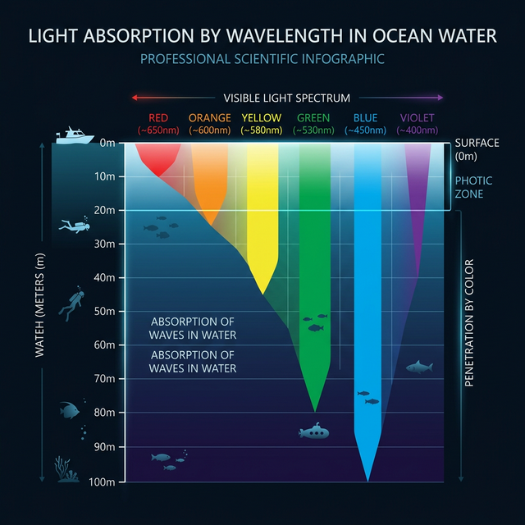
Why Underwater Images Are Degraded
Color Attenuation
Red light (650nm) is completely absorbed within just 3–5m of depth. Only blue/green light survives, creating the pervasive cyan cast seen in all raw underwater photos.
Backscattering
Ambient light reflects off suspended particles (marine snow, plankton) directly into the camera lens, creating a dense gray-blue fog that eliminates visibility.
Forward Scattering
Light reflecting off the subject is scattered by particles before reaching the lens, blurring edges and destroying high-frequency details.
4

Slide 5
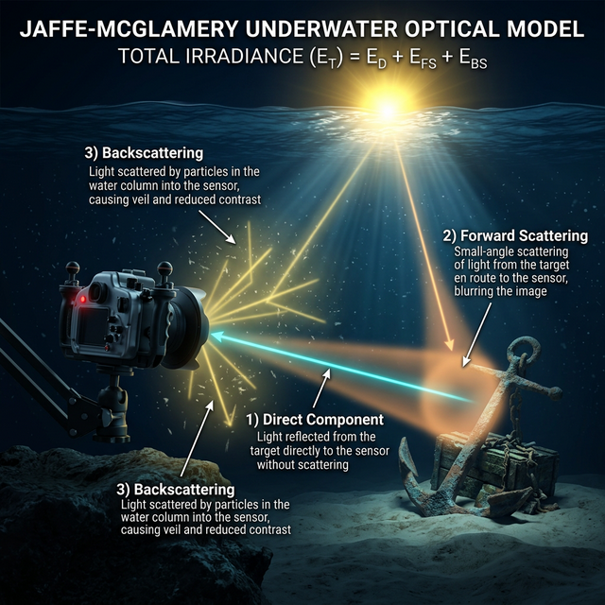
The Jaffe-McGlamery Optical Model
The dominant model for underwater image formation states that the radiance captured by a camera sensor is the sum of three physical components:
E_total = E_direct + E_forward_scatter + E_backscatter
Direct Signal
Unscattered light from the object — the 'true' signal we want.
Forward Scatter
Deflected signal rays causing blur at the subject level.
Backscatter (Haze)
Ambient particles deflecting light directly into the lens as fog.
5

Slide 6
Classical IP vs Deep Learning
Classical Image Processing ✓
Deep Learning / CNNs ✗
✓ Zero hallucinations — no invented pixels
✗ Frequently hallucinates textures
✓ Needs no training data
✗ Requires huge paired raw/clear datasets
✓ Fully transparent and mathematically auditable
✗ Black-box, unexplainable outputs
✓ < 0.5 sec on CPU, no GPU required
✗ Requires GPU, minutes per frame
✓ Safe for scientific measurement
✗ Risky for biological classification
6

Slide 7
02
Main Topic
The AquaClear Processing Pipeline — Step by Step
7

Slide 8
The AquaClear Pipeline
1
Auto-Analysis
4
Dehazing
Scans the image matrix to detect blur, haze, and color deficit levels, then sets optimal parameters.
Dark Channel Prior estimates & subtracts backscattered transmission fog.
2
Noise Reduction
5
Contrast (CLAHE)
Non-linear Bilateral Filter selectively smooths flat areas while protecting sharp edges.
Adapative Histogram Equalization on the L channel of LAB color space.
3
Color Correction
6
Sharpening
Gray World Theorem scales the Red channel gain to neutralize the blue-green cast.
Unsharp Masking boosts high-frequency edge data to restore detail lost to forward scattering.
8

Slide 9
Phase 1: Auto-Analysis Heuristics
Static pipelines fail because every ocean differs. AquaClear dynamically calibrates for each image:
Red Deficit
b_mean - r_mean → if > 30: aggressive color correction
Haze Level
Dark Channel Mean / 255 → if > 0.4: omega = 0.98 (dense fog)
Blur Level
Laplacian Variance → if < 100: switch to NL-Means + heavy sharpening
Contrast
Grayscale Std Dev → if < 20: CLAHE Clip = 5.0 (very low contrast)
9

Slide 10
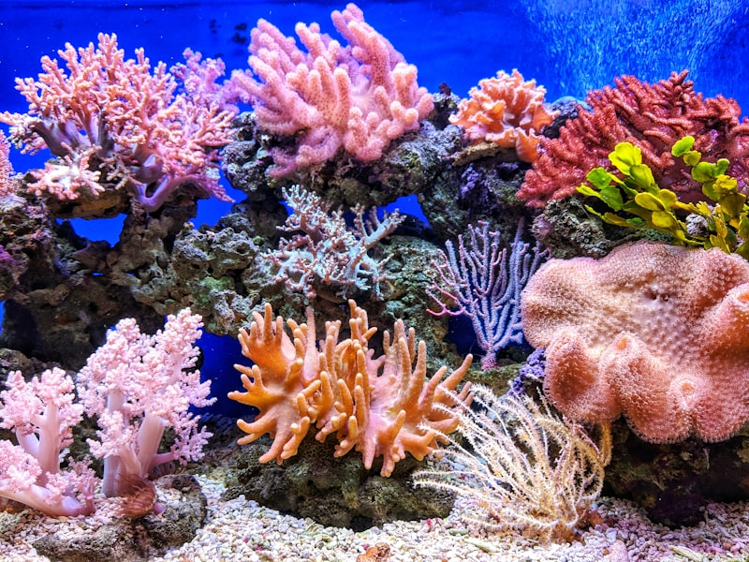
Phase 3: Color Correction
Gray World Theorem: In a scene with diversity, average R = G = B = Gray
Algorithm:
r_mean, g_mean, b_mean = mean of each channel
total_mean = (r_mean + g_mean + b_mean) / 3
r_gain = total_mean / r_mean ← (boosts red)
R_corrected = clip(R * r_gain, 0, 255)
This single operation removes the dominant cyan tint by digitally restoring the wavelengths that water physically absorbed. Without it, the dehazing step cannot function correctly.
10

Slide 11
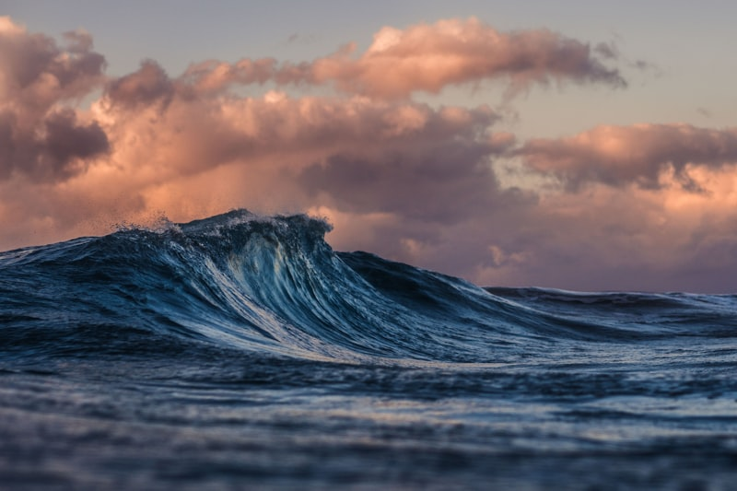
Phase 4: Dark Channel Prior Dehazing
Step 1
Compute Dark Channel
D(x) = min of pixel across all 3 channels in a local patch
Step 2
Estimate Atmospheric A
Brightest 0.1% of pixels in the Dark Channel = Airlight (A)
Step 3
Calculate Transmission
t(x) = 1 – ω × min(I(y)/A) | ω controls strength
Step 4
Recover Scene Radiance
J(x) = (I(x) – A) / max(t(x), 0.1) + A
11

Slide 12
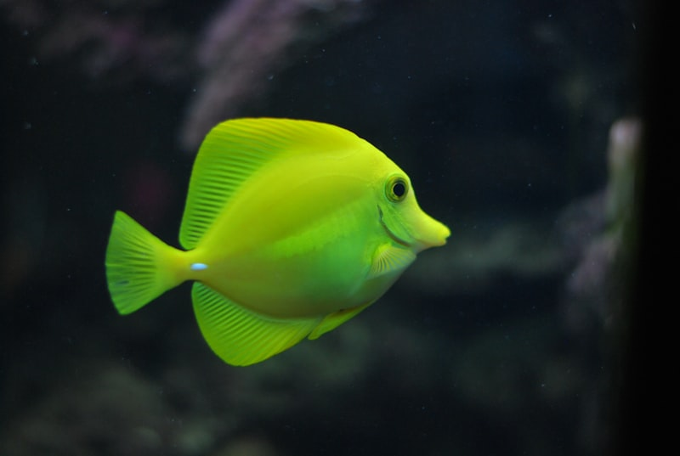
Phase 5: CLAHE on LAB L-Channel
Why LAB color space?
LAB separates Luminance (L) from color (A, B channels). Equilizing R, G, B independently shifts color ratios and creates false hues. Equalizing only L preserves the restored colors from Phase 3.
Why CLAHE not Global HE?
Global HE stretches the entire image uniformly — in dark underwater scenes it creates massive noise artifacts in flat water regions. CLAHE divides the image into 8×8 tiles and limits the histogram peak (Clip Limit), boosting local contrast while preventing noise explosion.
12

Slide 13
System Architecture
HTML/CSS/JS Frontend
Node.js Express Server
Python IP Engine
Upload UI, Dark Mode, Before/After sliders, Metric gauges
Multi-part upload, child-process forking, JSON routing
NumPy / OpenCV matrix processing. All 6 pipeline phases.
→
→
13

Slide 14
03
Results
Visual Before & After Restoration Comparisons
14

Slide 15
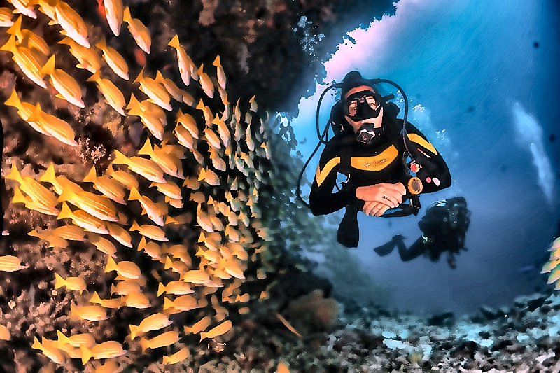
Results: Coral Reef
BEFORE – Raw Underwater Input
AFTER – AquaClear Enhanced
15

Slide 16
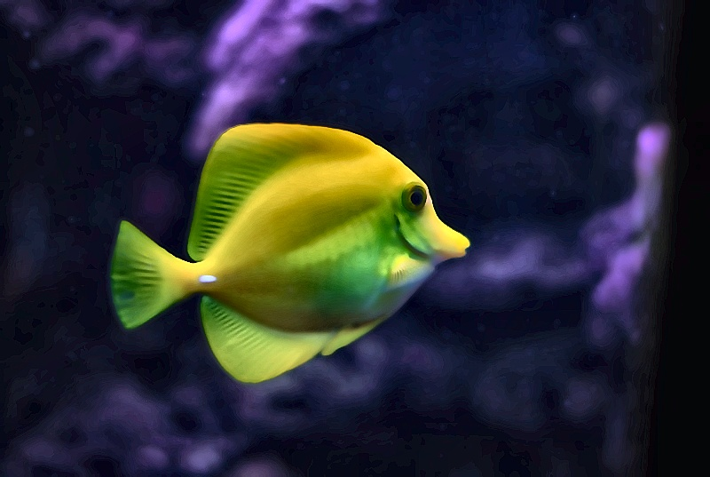
Results: Jellyfish
BEFORE – Raw Underwater Input
AFTER – AquaClear Enhanced
16

Slide 17
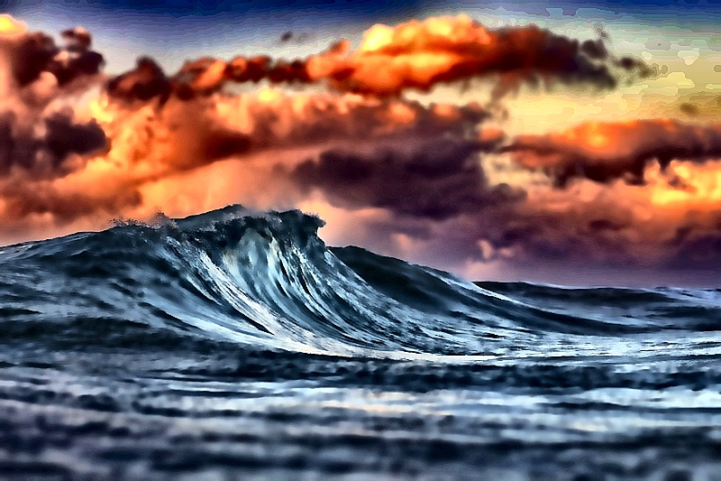
Results: Deep Ocean Wreck
BEFORE – Raw Underwater Input
AFTER – AquaClear Enhanced
17

Slide 18
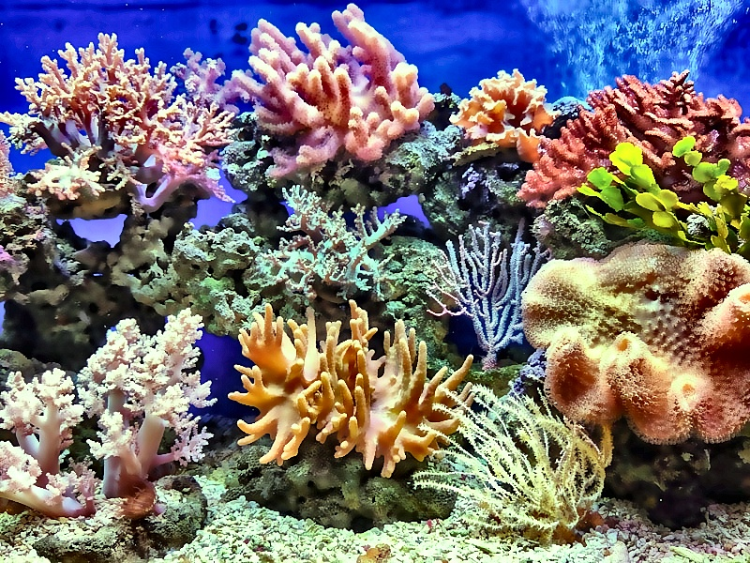
Results: Tropical Fish
BEFORE – Raw Underwater Input
AFTER – AquaClear Enhanced
18

Slide 19
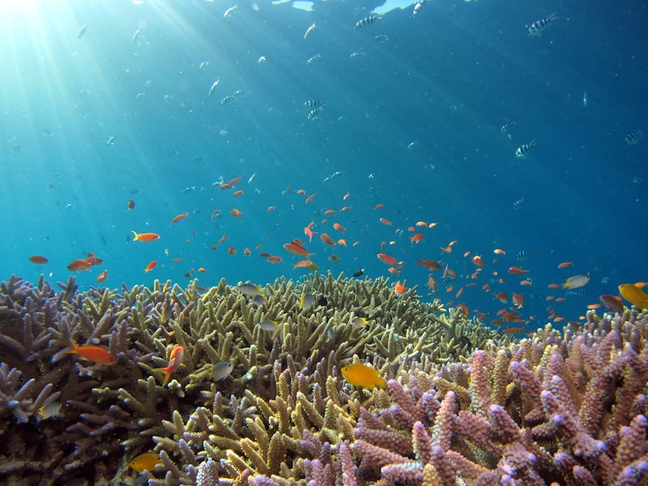
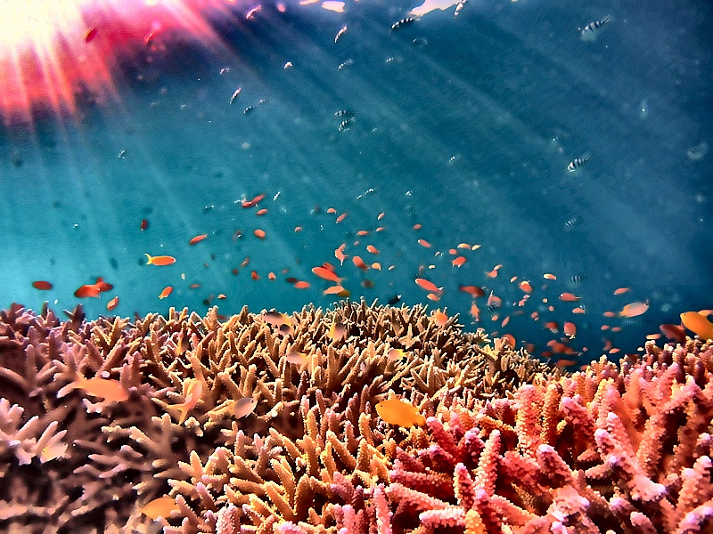
Results: Underwater Reef
BEFORE – Raw Underwater Input
AFTER – AquaClear Enhanced
19

Slide 20
Objective Quality Evaluation Metrics
PSNR
SSIM
Peak Signal-to-Noise Ratio
Structural Similarity Index
10·log₁₀(MAX² / MSE)
Luminance × Contrast × Structure
20–35 dB (Higher = Better Fidelity)
0.80–0.95 (Higher = Less Distortion)
Entropy
Colorfulness
Shannon Information Density
C = √(σRG² + σYB²) + 0.3·√(μRG² + μYB²)
–Σ P(i)·log₂P(i)
Per-channel saturation variance
+15–25% increase (More scene detail)
Strong increase vs raw cyan image
20

Slide 21
04
Conclusion
Achievements, Limitations, and Future Directions
21

Slide 22
Conclusion
Successfully engineered a full 6-phase classical image processing pipeline tailored to aquatic optics.
Limitations & Future Work
Gray World fails on monochromatic single-subject shots.
Achieved real-time restoration (< 0.5 seconds) on standard CPU hardware — no GPU required.
DCP struggles with artificial dive lights.
Auto-analysis heuristic engine adaptively tunes all parameters per image, removing the need for manual tuning.
Objective metrics (PSNR, SSIM, Entropy) confirmed structural fidelity and genuine information recovery.
Future: Stereo depth mapping for per-pixel attenuation.
Wrapped the engine in a modern dark-themed web application with live Before/After visualization.
Future: CUDA port for live 60fps video telemetry.
Future: Mobile deployment for handheld dive cams.
22

Slide 23
05
References
Academic & Technical Sources
23

Slide 24
References
[1]
R. C. Gonzalez and R. E. Woods — Digital Image Processing, 4th ed.
Pearson, 2018
[2]
G. Bradski — The OpenCV Library
Dr. Dobb's Journal of Software Tools, 2000
[3]
K. He, J. Sun, and X. Tang — Single Image Haze Removal Using Dark Channel Prior
IEEE Transactions on PAMI, 2011
[4]
J. S. Jaffe — Computer Modeling and Design of Optimal Underwater Imaging Systems
IEEE Journal of Oceanic Engineering, 1990
[5]
A. M. Reza — Realization of CLAHE for Real-Time Image Enhancement
Journal of VLSI Signal Processing, 2004
24

Slide 25
Thank You
Questions & Discussion
Khaled Noaman • 200303812
CENG 455 • Istanbul Arel University • Spring 2026
25

