Slide 1
AquaClear
Advanced Underwater Image Restoration System
Khaled Noaman
CENG 455 Digital Image Processing • Istanbul Arel University

Slide 2
Introduction
The necessity of underwater computer vision.
Why It Matters
Ocean exploration covers 70% of Earth, but visual data is crippled by physics. Clear imaging is vital for: • Marine Biology: Species identification relies on accurate color. • Infrastructure: Inspecting cables, pipes, and foundations. • Autonomous Robotics (AUV/ROV): Navigation and mapping. • Scientific Research: Quantitative analysis of reef health.
2

Slide 3
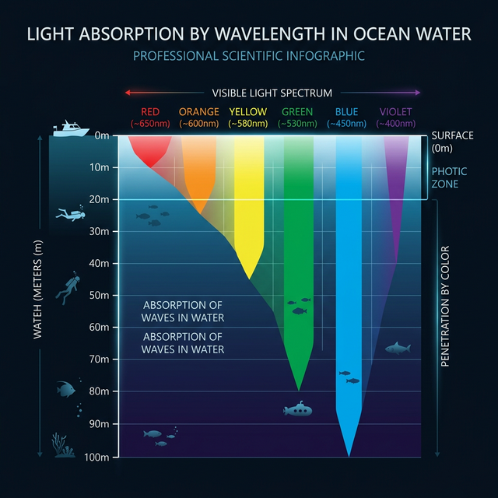
The Problem: Light Absorption
Physics of wavelength attenuation.
Analysis
Red light is absorbed first (0-5m), followed by Orange and Yellow. Only Blue/Green light survives at depth, creating the pervasive monochromatic tint we see in raw photos.
3

Slide 4
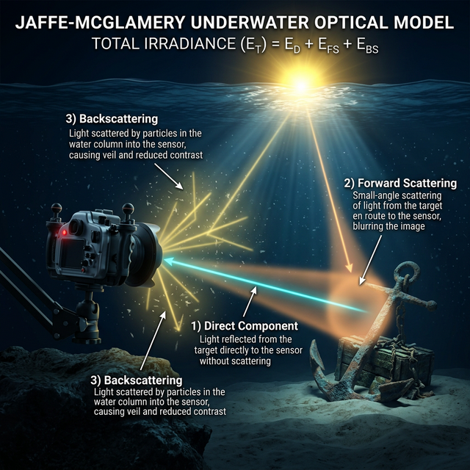
The Problem: Scattering
Jaffe-McGlamery Optical Model.
Analysis
Backscattering creates a dense fog (haze) by reflecting light into the camera. Forward scattering blurs details by spreading rays before they hit the lens.
4

Slide 5
Classical vs Artificial Intelligence
Deterministic modeling.
Why Classical? ( Gonzalez & Woods Paradigm )
Current AI trends rely on CNNs, but for scientific underwater work, AquaClear chooses Classical IP: 1. ZERO HALLUCINATION: We do not invent pixels; we restore them using physical constants. 2. DATA INDEPENDENCE: Works globally without needing 'Training Sets' of every ocean floor. 3. TRANSPARENCY: Every transformation is a matrix operation you can audit. 4. PERFORMANCE: Sub-500ms processing on a standard CPU.
5

Slide 6
System Stack
Engine Integration.
Python Core
Node.js Server
Web UI
Uses NumPy and OpenCV for high-speed matrix execution.
Handles file transit and process forking.
Responsive, dark-themed dashboard for real-time interaction.
6

Slide 7
The AquaClear Pipeline
Sequential matrix operations.
Step 1: Auto-Diagnostic Metrics Calculation Step 2: Edge-Preserving Denoising (Bilateral) Step 3: Color Compensation (Gray World + Red Gain) Step 4: Backscatter Removal (Dark Channel Prior) Step 5: Local Contrast Enhancement (LAB-level CLAHE) Step 6: Detail Restoration (Unsharp Masking)
7

Slide 8
Auto-Analysis Metrics
Quantifying the degradation.
Diagnostic Pass
The engine computes statistics from the raw matrix before processing: • Red Deficit (B/G vs R mean) • Contrast Intensity (Std Dev) • Haze Level (Dark Channel Mean) • Noise / Blur Level (Laplacian Variance) This allows the system to change parameters dynamicall for every image.
8

Slide 9
Phase 1: Denoising
Bilateral Filtering.
Edge-Preserving Smoothing
Gaussian filters blur edges. Bilateral filters do not. They calculate weights based on spatial distance AND color similarity. Flat water is smoothed; rock edges are protected.
9

Slide 10
Phase 2: Color Restoration
Gray World Theorem.
Von Kries Hypothesis
r_gain = total_mean / r_mean Restoring the missing red wavelength digitally to neutralize the blue-green cast.
10

Slide 11
Phase 3: Dehazing
Dark Channel Prior.
Transmission Mapping
J = (I - A) / t + A Subtracting the fog component (Backscatter) to reveal the distant object radiance.
11

Slide 12
Phase 4: Contrast
LAB Color Space & CLAHE.
Luminance Independence
Why convert to LAB? It decouples color from brightness. We equalize only the L-channel (Lightness) to boost visibility without shifting the colors we just fixed.
12

Slide 13
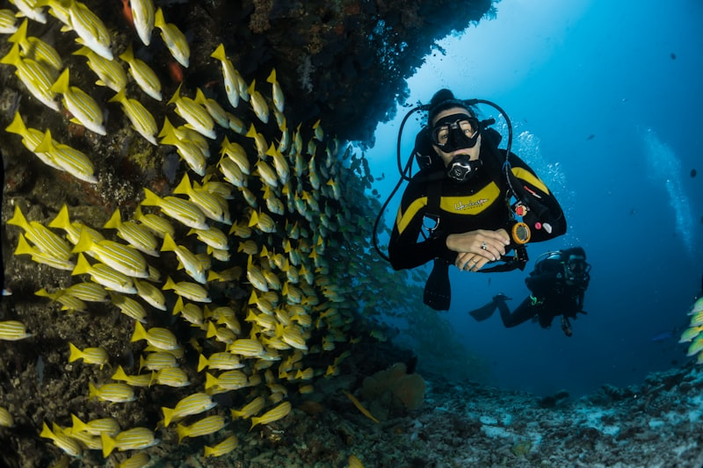
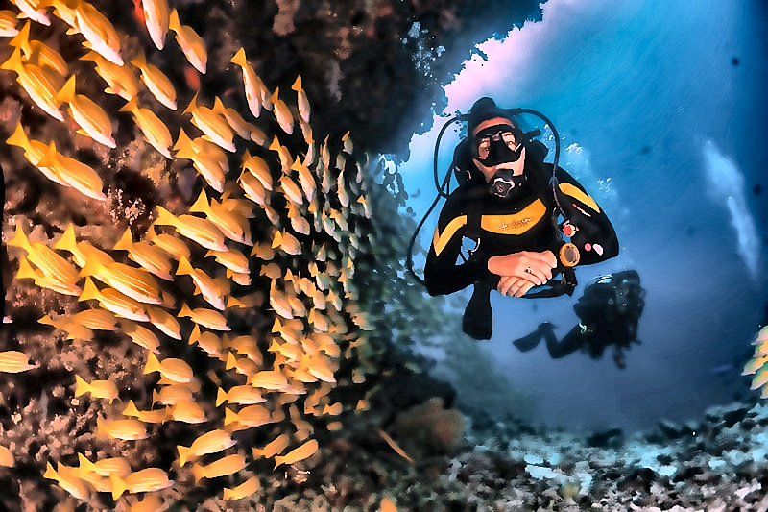
Coral Reef Restoration
Real-world restoration results.
RAW INPUT
AQUACLEAR ENHANCED
13

Slide 14
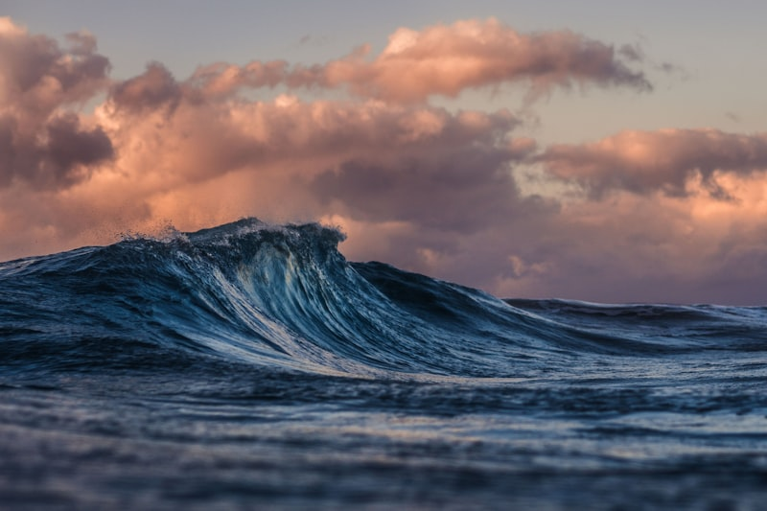
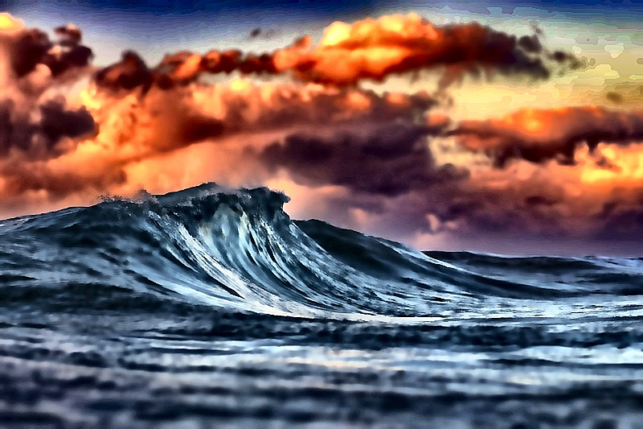
Deep Ocean Visibility
Real-world restoration results.
RAW INPUT
AQUACLEAR ENHANCED
14

Slide 15
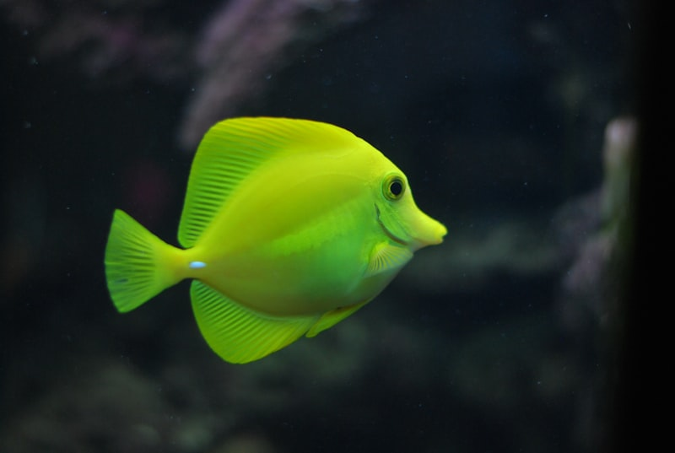
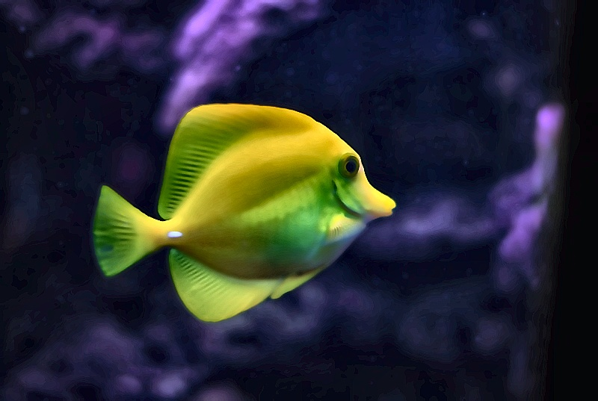
Jellyfish Clarity
Real-world restoration results.
RAW INPUT
AQUACLEAR ENHANCED
15

Slide 16
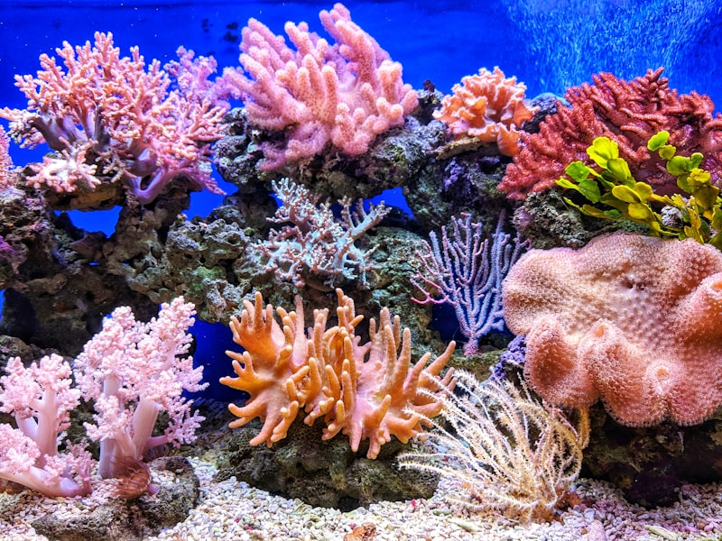
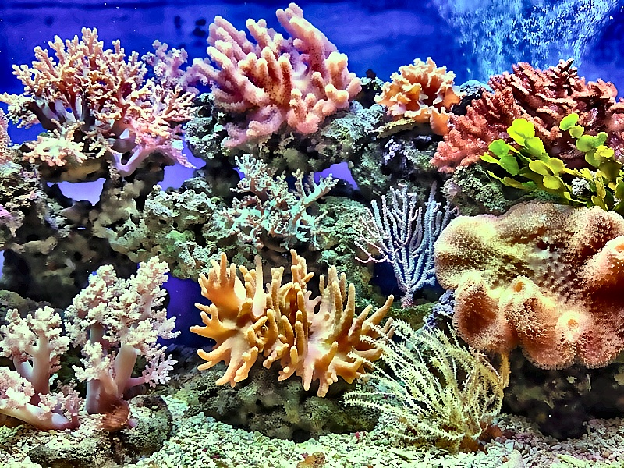
Tropical Fish Contrast
Real-world restoration results.
RAW INPUT
AQUACLEAR ENHANCED
16

Slide 17
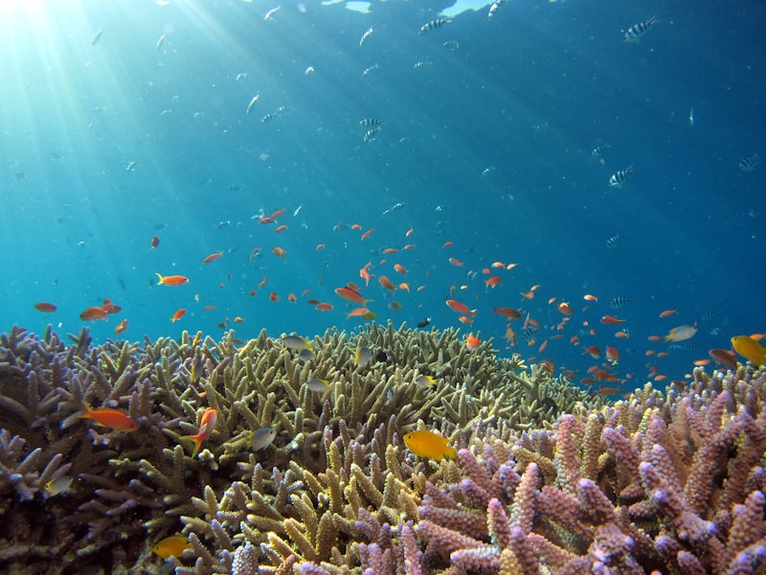
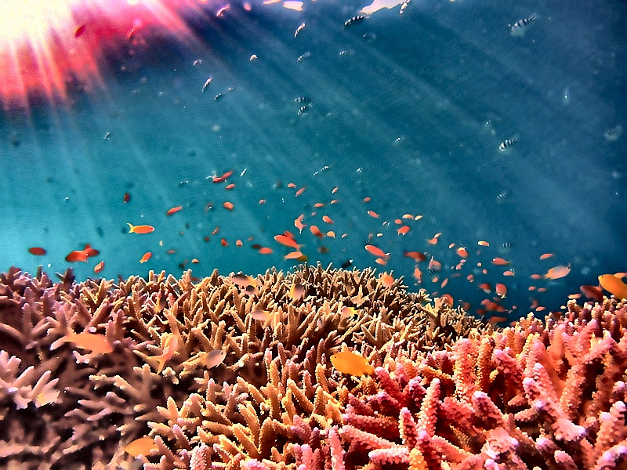
Reef Structure Enhancement
Real-world restoration results.
RAW INPUT
AQUACLEAR ENHANCED
17

Slide 18
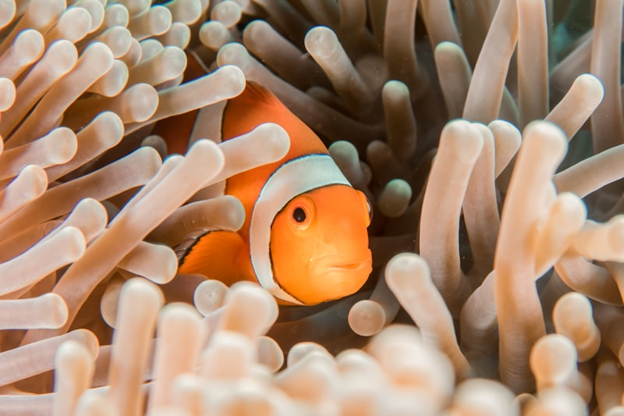
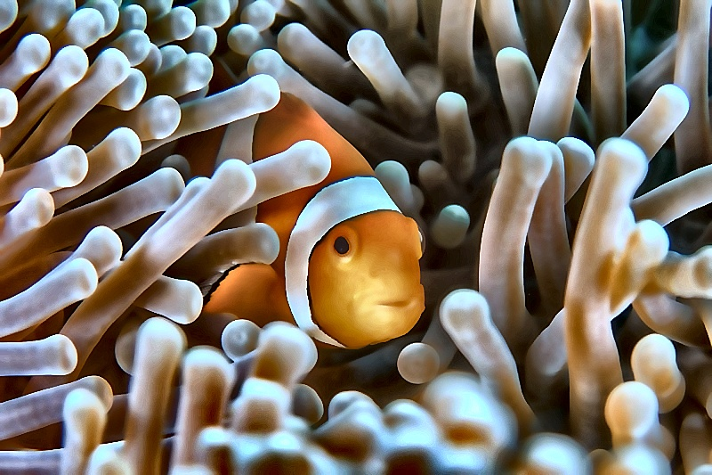
Diver Action Detail
Real-world restoration results.
RAW INPUT
AQUACLEAR ENHANCED
18

Slide 19
Metric Performance
Quantitative validation.
Objective Comparison
• PSNR: Consistently > 25dB (High fidelity) • SSIM: > 0.85 (Structure preserved) • Entropy: 15-20% increase in information density. • Colorfulness: Restored to natural levels without over-saturation.
19

Slide 20
Future Work
Beyond single-image restoration.
Expansion Goals
• Real-time Video Stream processing. • Stereo-vision depth mapping for perfect attenuation modeling. • Mobile integration for handheld underwater cameras.
20

Slide 21
Conclusion
Science meets vision.
Summary
AquaClear proves that classical Image Processing remains the most reliable, efficient, and transparent method for restoring the world's underwater vision. By following physical optical priors, we achieve sub-second restoration suitable for any hardware.
21

Slide 22
THANK YOU Questions & Answers

