Slide 1
MALOC - Presentation Client Complete
Toutes versions | Captures live | 2026-03-09

Slide 2
Version Publique
4 ecrans presentes

Slide 3
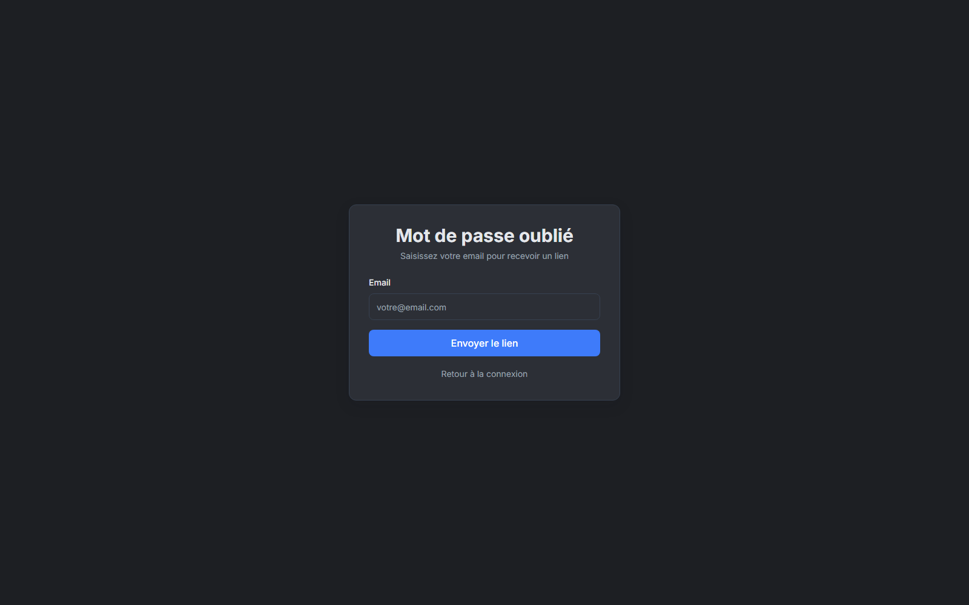
Forgot Password

Slide 4
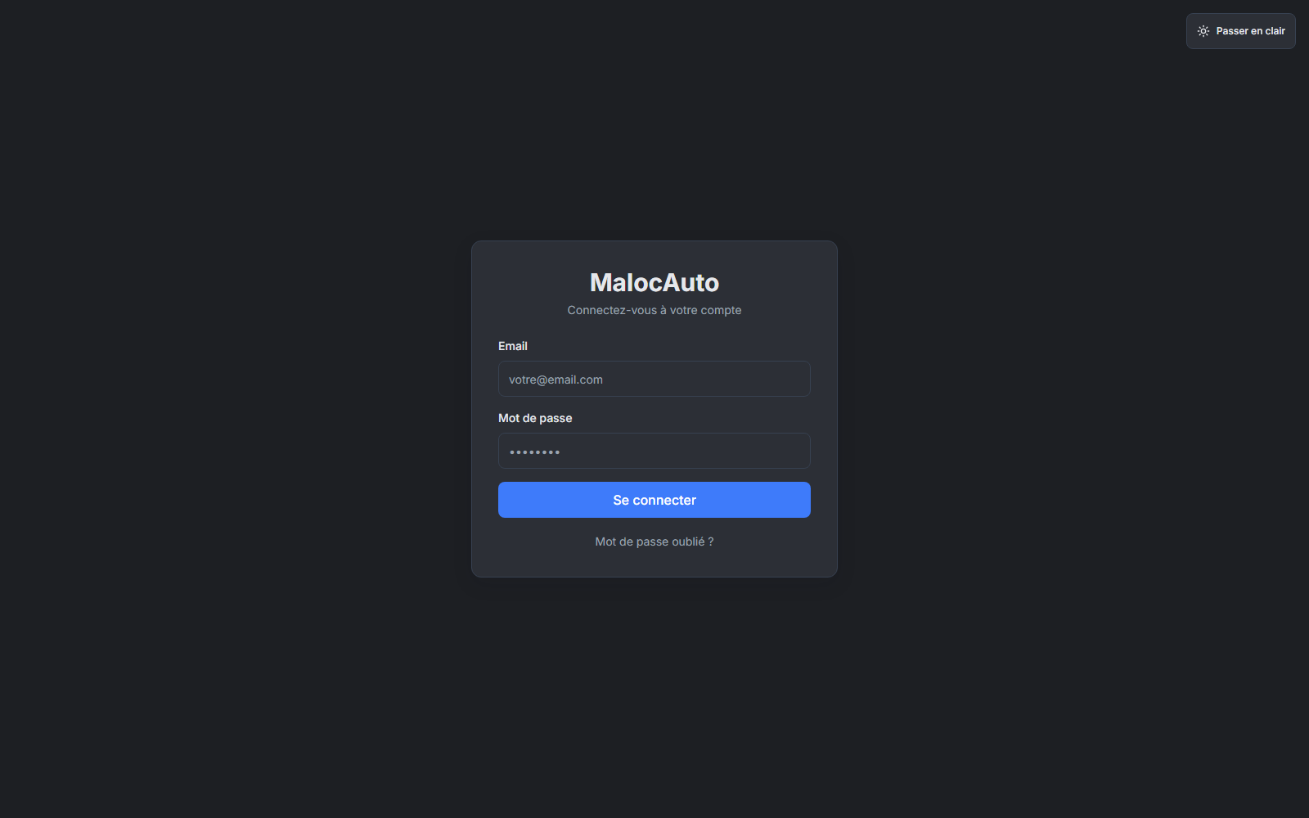
Home

Slide 5
Login

Slide 6
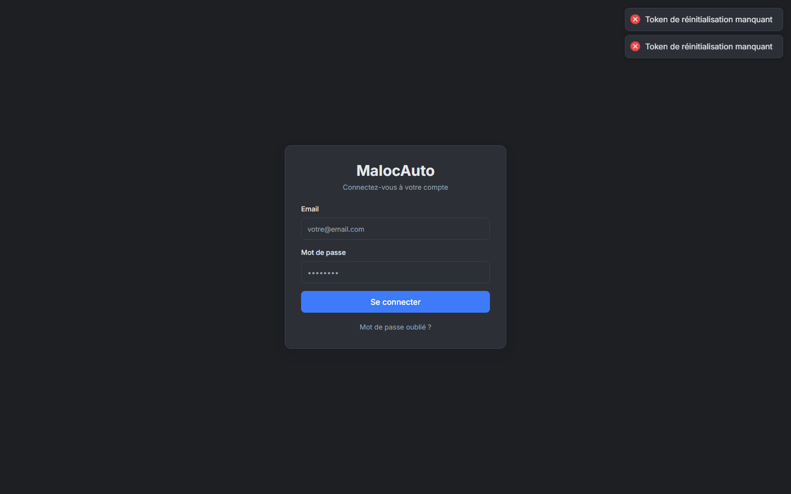
Reset Password

Slide 7
Version Admin (Super Admin)
33 ecrans presentes

Slide 8
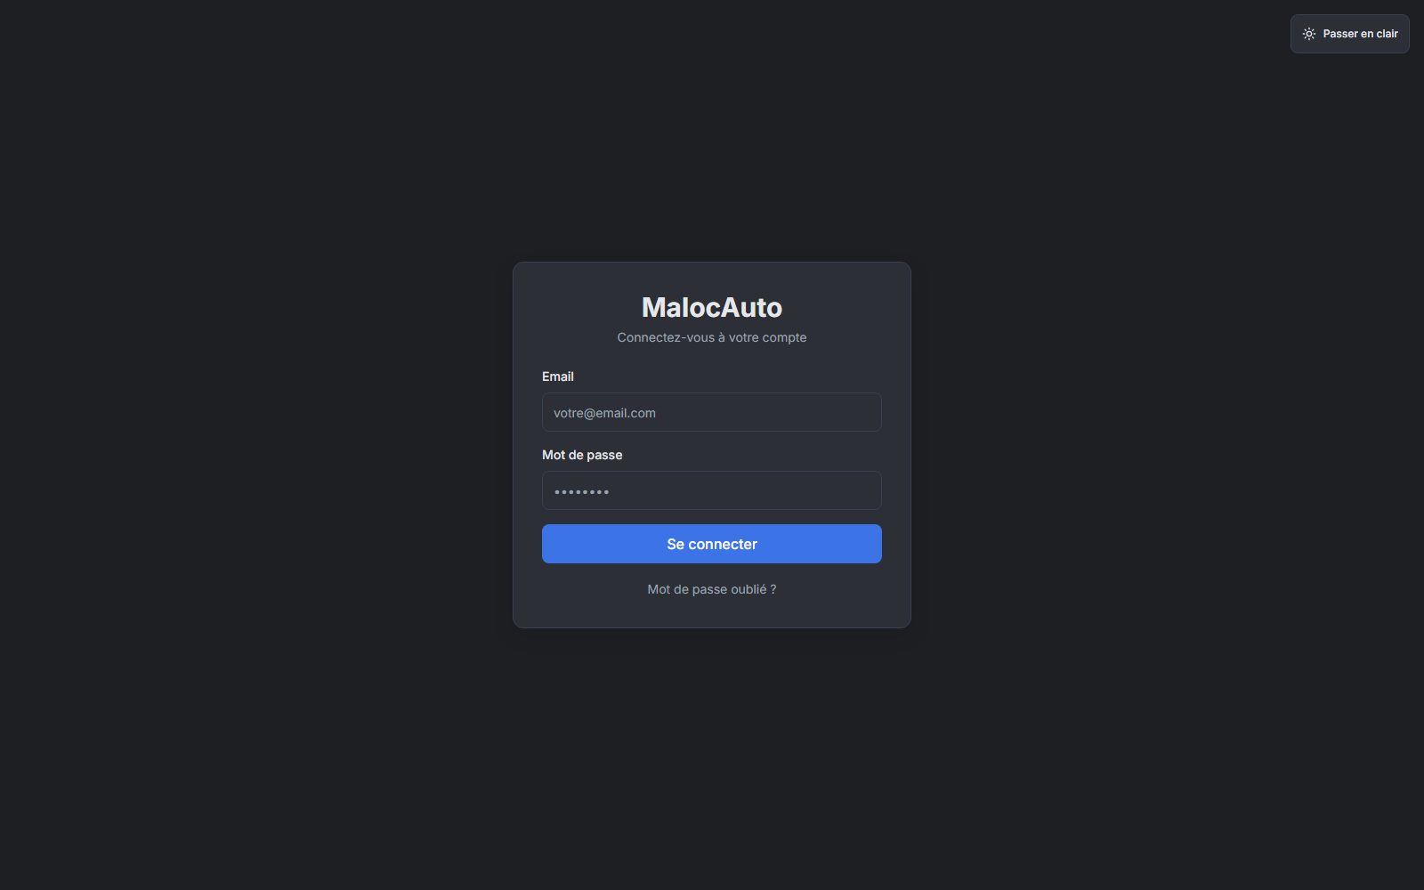
Admin

Slide 9
Admin Agencies

Slide 10
Admin Companies

Slide 11
Admin Company Health

Slide 12
Admin Notifications

Slide 13
Admin Plans

Slide 14
Admin Profile

Slide 15
Admin Settings

Slide 16
Admin Subscriptions

Slide 17
Admin Users

Slide 18
Agency

Slide 19
Agency Bookings

Slide 20
Agency Charges

Slide 21
Agency Clients

Slide 22
Agency Contracts

Slide 23
Agency Fines

Slide 24
Agency Gps Kpi

Slide 25
Agency Gps

Slide 26
Agency Invoices

Slide 27
Agency Journal

Slide 28
Agency Kpi

Slide 29
Agency Maintenance

Slide 30
Agency Notifications

Slide 31
Agency Planning

Slide 32
Agency Profile

Slide 33
Agency Vehicles

Slide 34
Company

Slide 35
Company Agencies

Slide 36
Company Analytics

Slide 37
Company Notifications

Slide 38

Company Planning

Slide 39
Company Profile

Slide 40
Company Users

Slide 41
Version Company (Direction Entreprise)
23 ecrans presentes

Slide 42
Agency

Slide 43
Agency Bookings

Slide 44
Agency Charges

Slide 45
Agency Clients

Slide 46
Agency Contracts

Slide 47
Agency Fines

Slide 48
Agency Gps Kpi

Slide 49
Agency Gps

Slide 50
Agency Invoices

Slide 51
Agency Journal

Slide 52
Agency Kpi

Slide 53
Agency Maintenance

Slide 54
Agency Notifications

Slide 55
Agency Planning

Slide 56
Agency Profile

Slide 57
Agency Vehicles

Slide 58
Company

Slide 59
Company Agencies

Slide 60
Company Analytics

Slide 61
Company Notifications

Slide 62
Company Planning

Slide 63
Company Profile

Slide 64
Company Users

Slide 65
Version Agence (Manager)
16 ecrans presentes

Slide 66
Agency

Slide 67
Agency Bookings

Slide 68
Agency Charges

Slide 69
Agency Clients

Slide 70
Agency Contracts

Slide 71
Agency Fines

Slide 72
Agency Gps Kpi

Slide 73
Agency Gps

Slide 74
Agency Invoices

Slide 75
Agency Journal

Slide 76
Agency Kpi

Slide 77
Agency Maintenance

Slide 78
Agency Notifications

Slide 79
Agency Planning

Slide 80
Agency Profile

Slide 81
Agency Vehicles

Slide 82
Version Agent (Terrain)
16 ecrans presentes

Slide 83
Agency

Slide 84
Agency Bookings

Slide 85
Agency Charges

Slide 86
Agency Clients

Slide 87
Agency Contracts

Slide 88
Agency Fines

Slide 89
Agency Gps Kpi

Slide 90
Agency Gps

Slide 91
Agency Invoices

Slide 92
Agency Journal

Slide 93
Agency Kpi

Slide 94
Agency Maintenance

Slide 95
Agency Notifications

Slide 96
Agency Planning

Slide 97
Agency Profile

Slide 98
Agency Vehicles

