Slide 1
ANALYSIS OF TORONTO NEIGHORHOODS TO OPEN A RESTAURANT
KHANDAKAER ABIR HOSSAIN

Slide 2
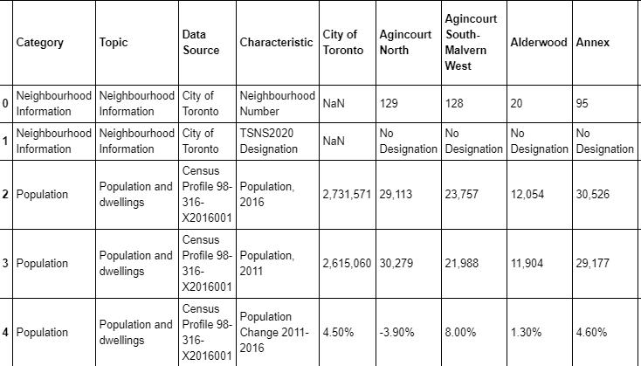
DATA SAMPLE

Slide 3
INTRODUCTION
Depending on data of population in neighbourhood and their income, the existing competitors, the aim of this study is to choose the suitable location to open a restaurant.

Slide 4
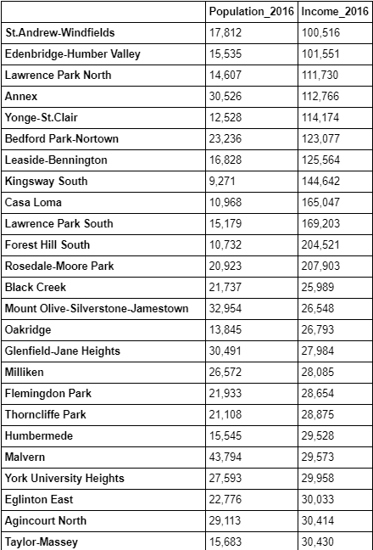
RESULTS SAMPLE

Slide 5
results
Based on our observations, it is noticeable that most of the restaurants are placed on main streets of southern part while many affluent neighborhoods are in northern side.

Slide 6
conclusion
IT IS RECOMMENDED TO RESEARCH MORE TO FIND ON MORE VARIABLES TO DECIDE THE SUITABLE LOCATION.HOWEVER, THIS REPORT CAN CONTRIBUTE TO OPEN RESTAURANT AND DO FURTHER RESEARCH TO INVESTORS

