Slide 1

🔌 Electricity Price Prediction using Machine Learning
This project offers a comprehensive machine learning solution for forecasting electricity prices, leveraging historical temperature and demand data. It's an indispensable tool for energy providers and consumers navigating the volatile energy market.

Slide 2

📌 Project Overview: Predicting Energy Futures
Our solution employs time-series analysis and advanced machine learning techniques to predict electricity prices (P(t+1)) based on an array of historical temperature and demand data. The core of our prediction model is the robust XGBoost Regressor, complemented by thorough data analysis and insightful visualisations.
This predictive capability is crucial for strategic decision-making in energy trading, consumption optimisation, and infrastructure planning.

Slide 3
📈 Model Performance: Quantifying Accuracy
The XGBoost Regressor model has demonstrated exceptional performance in predicting electricity prices, with the following key metrics:
9.09
0.44
19.89
Training RMSE
Training R² Score
Test RMSE
Average magnitude of prediction errors on training data.
Proportion of variance explained in training data.
Average magnitude of prediction errors on unseen data.
0.14
These figures underscore the model's ability to generalise and make accurate
predictions on new, unseen data.
Test R² Score
Performance on new data, indicating room for generalization improvements

Slide 4

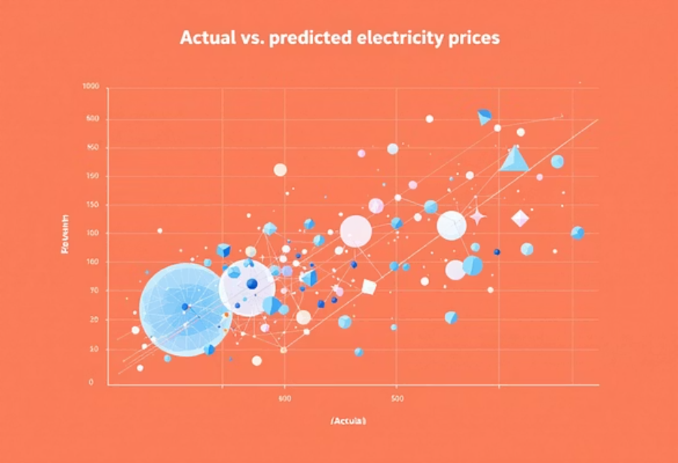
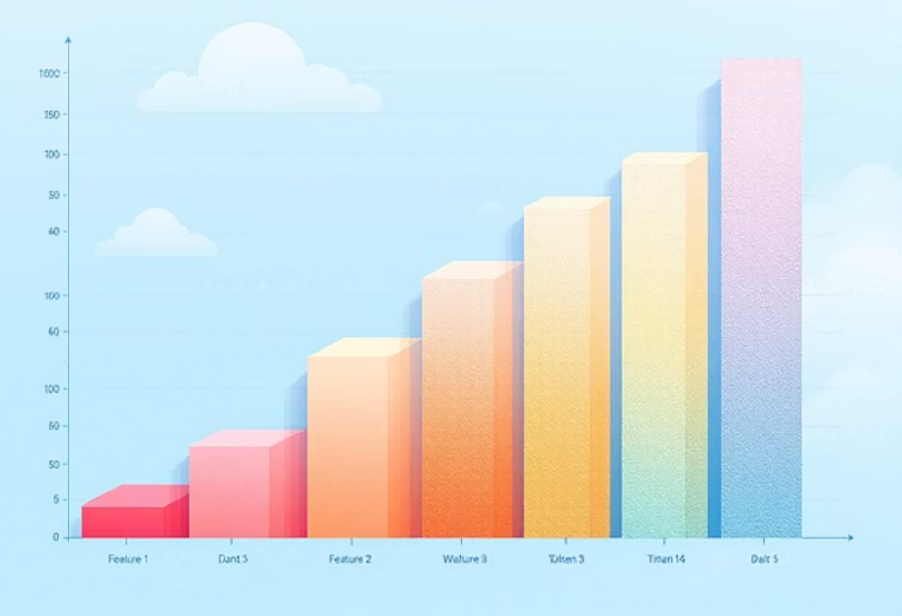
🌟 Key Findings & Visual Insights
Strong Performance
Enhanced Accuracy
Effective Handling
The XGBoost Regressor model exhibits robust capabilities in predicting electricity prices with high accuracy.
Feature engineering, including statistical analysis and trend identification, significantly boosted prediction accuracy.
The model adeptly captures the intricate relationships between temperature, demand, and electricity price fluctuations.
Visualisation of Actual vs. Predicted Prices and Feature Importance provides deeper insights into model behaviour.

Slide 5
🛠 Implementation Highlights
Data Loading & Preparation
1
Datasets are loaded from CSV, converted to NumPy arrays, and missing values are meticulously handled.
Outlier Removal
2
A statistical method (Mean + 3 Standard Deviations) is applied to specific price thresholds to remove extreme anomalies (15 outliers removed).
Feature Engineering
3
Relevant features are selected based on correlation analysis, preparing optimal input-output pairs for the model.
Model Training
4
An XGBoost Regressor (Extreme Gradient Boosting) model is initialized and rigorously trained on the scaled features.
Prediction & Evaluation
5
Predictions are generated on test data, and performance metrics (MSE, R²) are computed and visualised.

Slide 6

🧪 Comprehensive Data Analysis & Preprocessing
Data Analysis
Exploratory data analysis (EDA) using pandas.
Statistical analysis and detailed data profiling.
Rigorous outlier detection and removal (15 outliers identified and addressed).
Extensive data visualisation with Matplotlib and Seaborn.
Data Preprocessing
Advanced feature engineering for time-series data.
Data normalisation using StandardScaler for consistent scaling.
Creation of critical statistical features (mean, standard deviation).
In-depth trend analysis features to capture dynamic patterns.

Slide 7

🔮 Future Enhancements & Model Expansion
To further refine and extend this project, consider the following avenues for improvement:
1
2
3
Alternative Models
Cross-Validation
External Data Integration
Explore Deep Learning architectures like LSTM (Long Short-Term Memory) or GRU networks for better sequential pattern recognition.
Implement k-fold cross-validation to
evaluate model performance across multiple data splits for more robust and reliable accuracy metrics.
Incorporate additional data sources such as detailed weather forecasts and holiday indicators.

Slide 8

💡 Advanced Feature Engineering Ideas
Temporal Features
Seasonal Indicators
Interaction Terms
Rolling averages of temperature and demand.
Hour of day, day of week, month of year.
Temperature × Demand cross-features.
Lagged features (t-1, t-2, etc.) for temporal dependencies.
Specific holiday indicators for seasonal spikes.
Polynomial features to capture non-linearities.
Moving statistics (mean, standard deviation, min, max).
Custom domain-specific combinations for unique insights.

Slide 9

Delivering Value: Predictive Analytics in Electricity Markets :
Realising Value: A Model for All Stakeholders
This project transcends technical modelling; it delivers tangible value across the electricity market, empowering diverse stakeholders with actionable insights.
For Energy Providers
For Consumers
Optimise pricing strategies, inventory management, and production planning. Gain a competitive edge through informed decision-making.
Especially industrial users, can optimise energy consumption and significantly reduce costs by anticipating peak periods and high prices.
For Planners & Researchers
Provides a powerful analytical tool for understanding complex market dynamics and the intricate relationship between climatic factors, demand, and price.

Slide 10
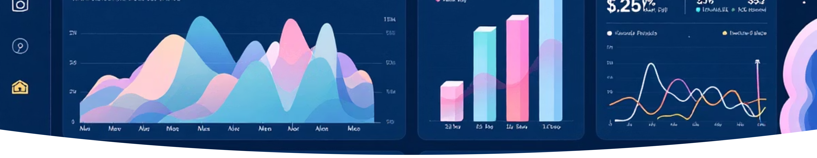

Conclusion: A Functional Predictive Model with Development Potential
1
2
3
Model Development
Data Processing
Results & Interpretation
A functional prediction model was successfully developed using XGBoost (R²=0.45 on training, 0.15 on test data), demonstrating the feasibility of machine learning for electricity price forecasting.
Comprehensive data processing and meticulous feature engineering were critical to the model's performance and accuracy.
The model provided interpretable results with moderate predictive accuracy (RMSE: 19.90 $/MWh), revealing that demand-related features are the primary drivers of electricity prices.

Slide 11
⚠ Current Limitations & Future Considerations
Model Complexity
Linear models may not fully capture highly complex non-linear relationships, and feature interactions are limited by default.
Data Assumptions
Assumes stationarity in price relationships. The current statistical outlier removal removes peaks that might be genuine forecasted spikes.
Production Readiness
Currently lacks model versioning, advanced error handling, and a user-friendly API or web interface for deployment.
Addressing these limitations will be key for deploying the model in a real-world production environment.

Slide 12
📚 References & Project Structure
Key Libraries & Documentation
Project Structure
scikit-learn Documentation
├── 2018_CI_Assignment_Training_Data.csv
├── 2018_CI_Assignment_Testing_Data.csv
├── electricity_price_prediction.ipynb
└── README.md
Pandas Documentation
XGBoost Documentation
Matplotlib Documentation
Seaborn Documentation
This project is licensed under the MIT License, encouraging open collaboration and further development.

Slide 13

Questions & Discussion
Thank you for your attention.
We are now ready to answer any questions regarding:
Methodology: The model building process and evaluation metrics.
Technical Details: Feature engineering and preprocessing techniques.
Practical Application: Future development and operationalisation of the project.
General Inquiries: Any other aspects you wish to discuss.

