Slide 1
Triggers
Triggers are actions whose execution is triggered
  – when some event occurs and
  – the specified condition is satisfied.
Triggers have the form
  event ! condition ! action
        or
  condition ! event ! action
When event occurs, the condition is checked and, if it is satisfied, the action is executed. Alternatively, the trigger condition can also be checked before the event occurs.

Slide 2
Triggers
In databases, an event can be the occurrence of a table operation such as
      – delete,
      – insert, or
      – update.
The trigger condition is based on the values of the items in the table.

Slide 3
Triggers
Triggers are used for many purposes in databases, for example:
– Automatically execute actions whenever an event occurs
– Implement constraints and business rules – this happens behind the scenes.
– Maintain views – this also happens behind the scenes.

Slide 4
Triggers
Example
– Automatically place a new book order for Everest Books whenever the number of copies of a book falls below the specified threshold.

Slide 5
Triggers - Advantages
Triggers simplify writing of SQL queries
– Code common to SQL queries is taken out and stored with the database server.
- the code will no longer be in the application which will make the application smaller.

Slide 6
Triggers in SQL
An SQL trigger is a rule or action along with a condition that is associated with a table.
The trigger fires, that is, its action is executed upon the occurrence of an
event such as an INSERT, DELETE, or UPDATE operation and the
satisfaction of the associated condition’

Slide 7
Triggers in SQL
Trigger Creation
CREATE TRIGGER tname
[BEFORE|AFTER]
[INSERT|DELETE|UPDATE [OF columns]]
ON table
WHEN (condition)
[FOR EACH ROW ]
[statement BEGIN ATOMIC statements END];

Slide 8
Triggers in SQL
The WHEN condition is identical to the condition in the WHERE clause of a SELECT.
In case the trigger action consists of multiple statements, then they must be bracketed by BEGIN ATOMIC and END.

Slide 9
Triggers in SQL - Old & New Values
Triggers have access to both the old and new values of the tables they are associated with.
When the trigger event is the
– UPDATE operation, SQL allows the trigger to refer to both the old and new values of the table and its fields.
- The keywords OLD and NEW are used for this purpose.
– INSERT operation, the trigger has access to the values of the new rows
– DELETE operation, the trigger has access to the values of the deleted rows.

Slide 10
Triggers in SQL -
Suppose we want to define a trigger on the table Books that
– generates a 10 copy replenishment order for a book
– whenever the number of copies of the books in inventory falls below 5.
The Books table was defined earlier as
CREATE TABLE Books (
ISBN CHAR(10) PRIMARY KEY,
Title VARCHAR(50), Price DECIMAL(5,2),
Authors VARCHAR (50), Pages INT, PubDate YEAR(4),
Qty INT
) ENGINE = InnoDB;

Slide 11
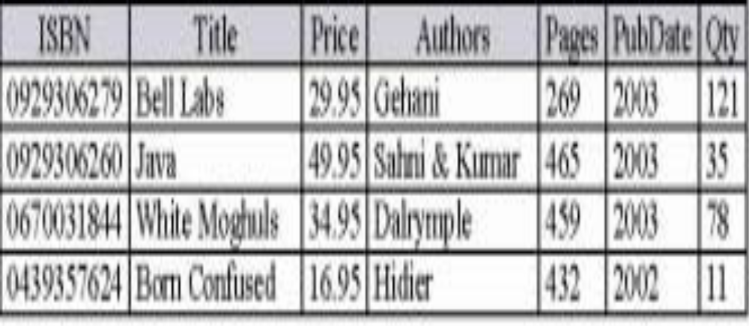
Triggers in SQL -
Books Table

Slide 12
Triggers in SQL -
In this example, books will be reordered by inserting appropriate information in the ReOrder table
(instead of generating an invoice):
CREATE TABLE ReOrder(
  ISBN CHAR(10)
  ReOrderDate DATE,
  ReOrderQty INT
);
Table ReOrder must be examined periodically to generate a “real” (physical or electronic) order for the books listed.

Slide 13
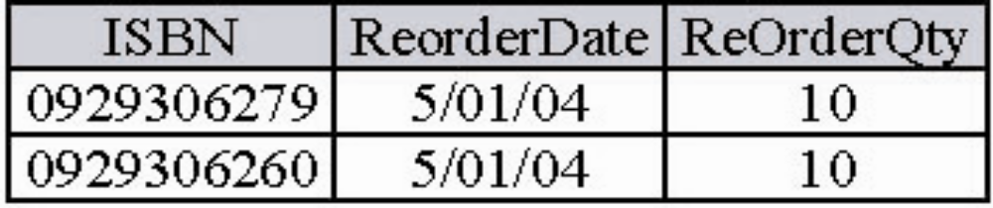
Triggers in SQL -
The rows used to generate orders must then be deleted from the ReOrder table.

Slide 14
Triggers in SQL -
Trigger ReOrderTrigger inserts a row in the ReOrder table whenever the quantity of a book in stock goes below 5:
CREATE TRIGGER ReOrderTrigger
AFTER UPDATE ON Books
REFERENCING NEW ROW AS NewRow
FOR EACH ROW
WHEN (NewRow.Qty < 5)
BEGIN ATOMIC
INSERT INTO ReOrder
VALUES (NewRow.ISBN,CURRENT_DATE,10);
END;

Slide 15
Triggers in SQL -
The above trigger definition is not quite correct
– Once the quantity goes below 5, each update causes the trigger to fire as long as the value remains below 5.
– Should fire only when the number of copies goes from 5 or above 5 to
below 5.

Slide 16
Triggers in SQL -
Here is the revised definition:
CREATE TRIGGER ReOrderTrigger
AFTER UPDATE ON Books
REFERENCING NEW ROW AS NewRow,
OLD ROW AS OldRow
FOR EACH ROW
WHEN (NewRow.Qty<5 AND OldRow.Qty>=5)
BEGIN ATOMIC
INSERT INTO ReOrder
VALUES(NewRow.ISBN,CURRENT_DATE,10);
END;

Slide 17
Triggers in SQL - Firing
Upon the occurrence of a trigger event and if the
condition is satisfied, then the trigger fires.\
  • By default, a trigger action is executed only once.
  • If multiple rows are changed by the operation activating the trigger (e.g., DELETE or an UPDATE), then trigger action can be executed once for each row
– use the clause FOR EACH ROW.

Slide 18
Triggers in SQL - Checking
SELECT ISBN, ReorderDate, ReOrderQty
FROM ReOrder;

Slide 19
Triggers in SQL - Firing
Triggers are executed as part of the transaction
activating trigger
  – If trigger action does not execute successfully, then the transaction activating the trigger is aborted.
  – No change will be made to the database.

Slide 20
Triggers in SQL - Deletion
  Triggers are deleted using the
  DROP TRIGGER statement
  DROP TRIGGER tname;
  Where tname is the trigger being deleted
  DROP TRI
  GGER ReOrderTrigger

