Slide 1
AVIOS — AI-Augmented Linux-like Scheduler A reproducible research prototype for ML-driven scheduling decisions
Author: Dhanushree K (Solo Project) Date: September 2025

Slide 2
Problem Statement
Why Scheduling Matters:
CPU scheduler is the “heart of the OS” — decides which tasks run, directly impacting user experience and system efficiency.
Key Challenge:
Trade-off between responsiveness (short, interactive tasks) and fairness/throughput (long-running or batch tasks).
Example: a heavy background job can delay a simple interactive click.
Why Traditional Heuristics Struggle:
Linux schedulers (CFS, RR, FIFO) rely on hand-crafted rules.
Fixed heuristics → fail to adapt across diverse workloads.
Short tasks often wait behind long ones; responsiveness suffers.

Slide 3
Objective
Build an AI-augmented Linux-like scheduler simulator.
Use ML-based task classification (resource, interactivity, execution length, priority) to guide:
Scheduler assignment (FIFO, RR, CFS)
Time-slice scaling (RR/CFS quantum, VRUNTIME adjustment)
Goal:
Reduce turnaround & response time for latency-sensitive tasks
Preserve throughput, fairness, and CPU utilization

Slide 4
System Overview (Architecture)
Flow: Trace → Task Classifier (ML) → Score Calculation → Scheduler Decision → Metrics & Logs
Trace ingestion: CSV workload traces collected from real & synthetic tasks
Classification: 4 ML models assign task type & behavior
Score calculation: combines labels into a unified scheduling score
Scheduler: decides queue placement & quantum adjustments
Metrics: logs per-task turnaround, response, fairness, utilization

Slide 5
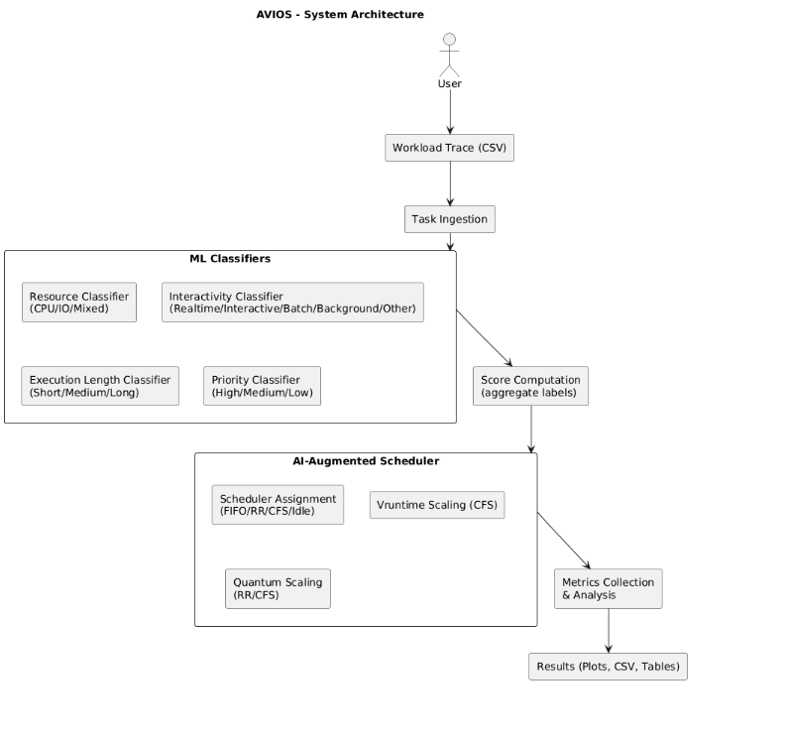
System Architecture Diagram

Slide 6
Task Classification (ML Part)
4 classifiers trained:
Resource type → CPU / IO / Mixed
Interactivity → Real-time / Interactive / Batch / Background / Other
Execution length → Short / Medium / Long
Priority class → High / Medium / Low
Accuracy Results:
All models achieve 99–100% test accuracy
Robust across 5-fold cross-validation

Slide 7
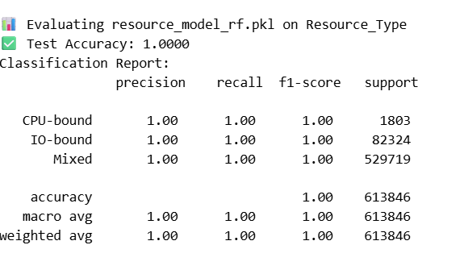
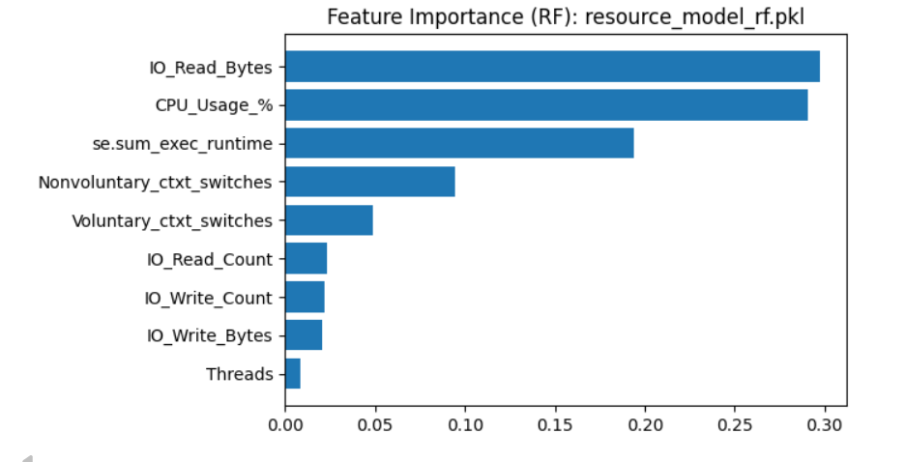
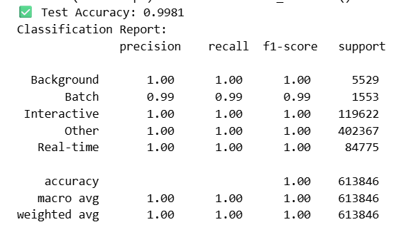
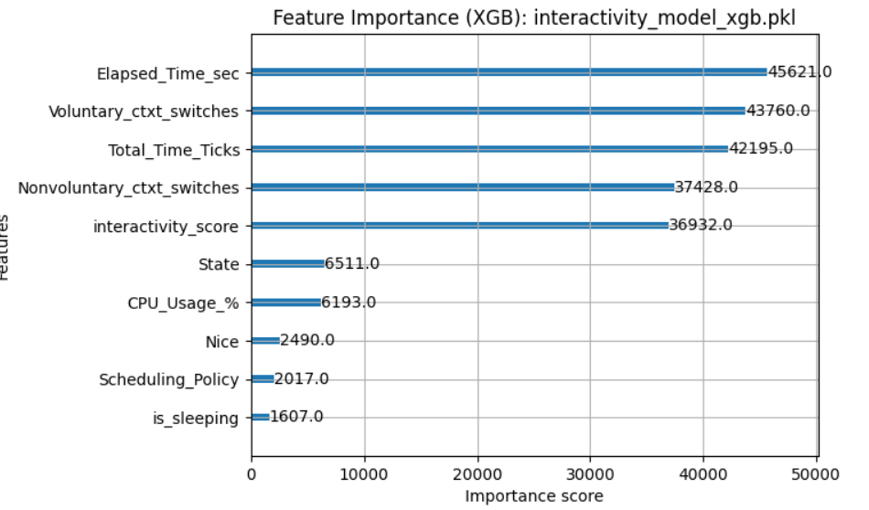

Slide 8
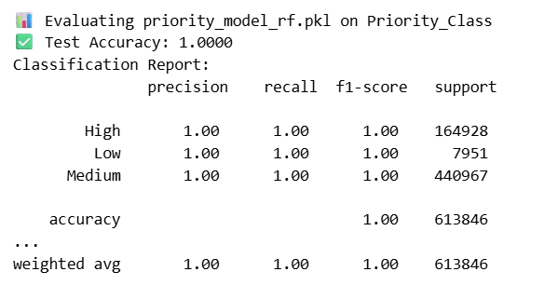
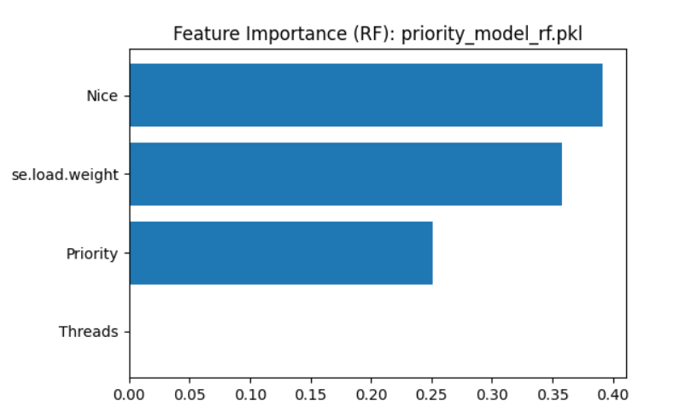
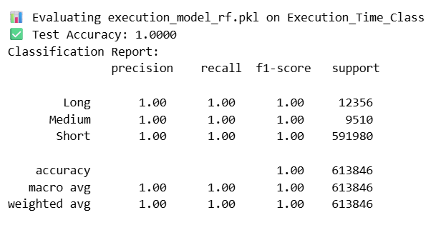
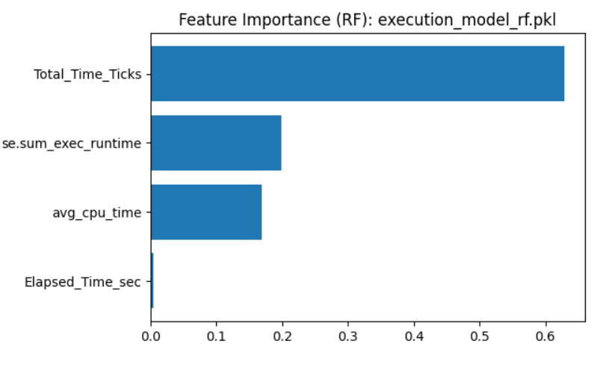

Slide 9
Scheduler Design
Baseline Queues:
FIFO → real-time tasks
RR → interactive, short tasks
CFS → general-purpose fairness
IDLE → background jobs
AI Augmentations:
Scheduler assignment: Classifier score decides queue
VRUNTIME scaling: Favor high-score tasks in CFS
Quantum scaling: Longer/important tasks get larger time slices in RR & CFS
Decision Flow:
Input task → ML classification → Score → Queue + Quantum → Execution

Slide 10
Evaluation Setup
Workloads used: CPU-bound, IO-bound, Batch, Real-time, Stress, Mixed Realistic
Dataset sizes: ~900–1400 tasks per workload (Mixed Realistic = 1227 tasks)
Metrics evaluated:
Turnaround time (average, median)
Response time (average, p95)
Fairness (Jain index)
Throughput & CPU utilization

Slide 11
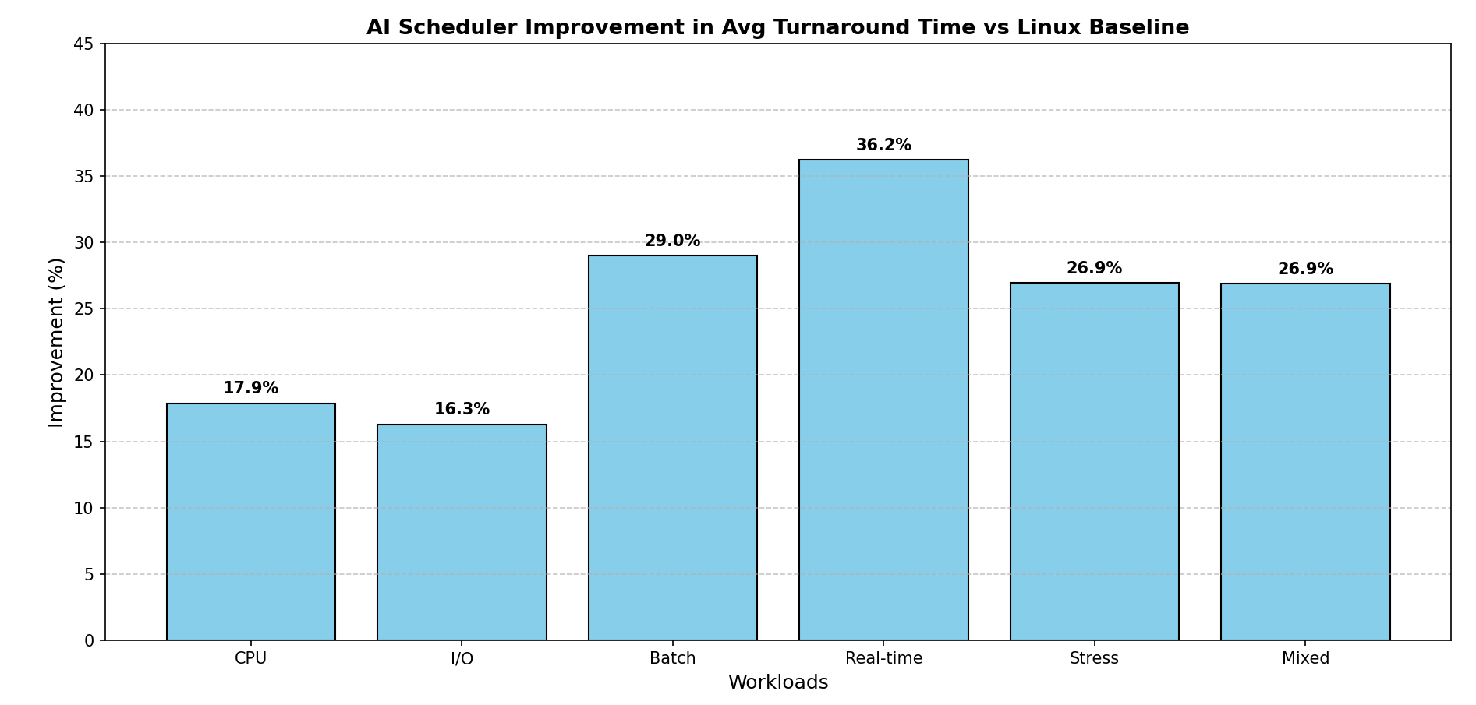
Results (Workload Comparisons)
Workload (Tasks) | Avg Turnaround ↓ | Median Turnaround ↓ | Avg Response ↓
Mixed(Realistic) [1227] | 13,337.84 → 9,749.65 (26.9%) | 9009 → 3893 (56.8%) | 13,308.30 → 9,718.07 (27%)
CPU [942] | 11,044.21 → 9,069.18 (17.9%) | 7826 → 7763.5 (0.8%) | 11,002.10 → 9,027.00 (18%)
I/O [1383] | 235,751.33→197,340.84 (16.3%) | 28,047 → 22,427 (20%) | 235,288.61 → 196,877.98 (16.3%)
Real-time [929] | 10,412.89 → 6,640.26 (36.2%) | 10,858 → 2051 (81.1%) | 10,384.11 → 6,610.78 (36.3%)
Stress [1330] | 254,771.76→ 186,110.76 (27%) | 41,083 → 12,711 (69.1%) | 252,713.19 → 184,041.65 (27.2%)
Batch [972] | 71,601.53 → 50,828.56 (29%) | 26,421.5 → 12,007 (54.6%) | 71,114.42 → 50,335.50 (29.2%)

Slide 12
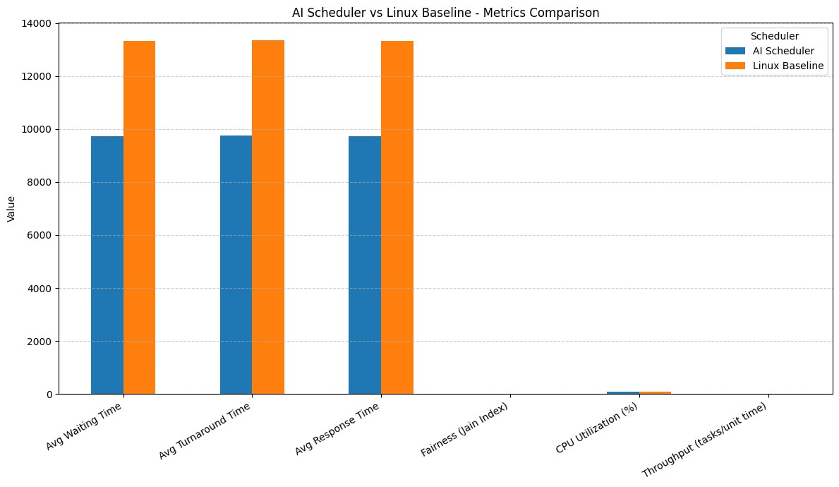
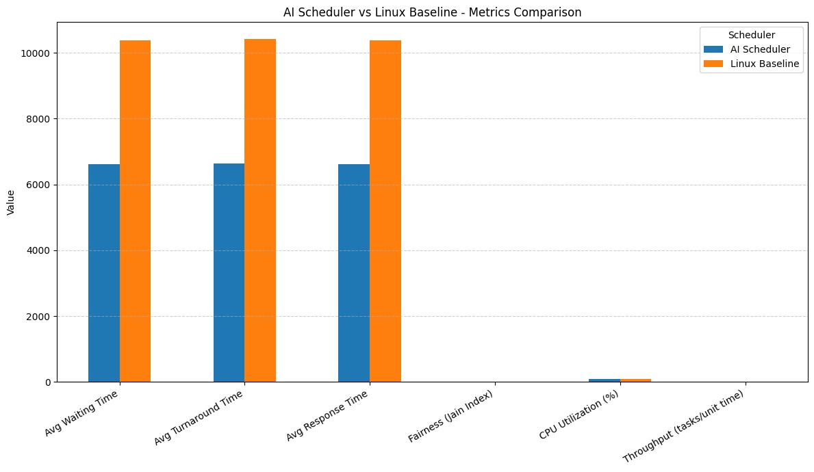
Mixed (Realistic) workload
Realtime workload

Slide 13
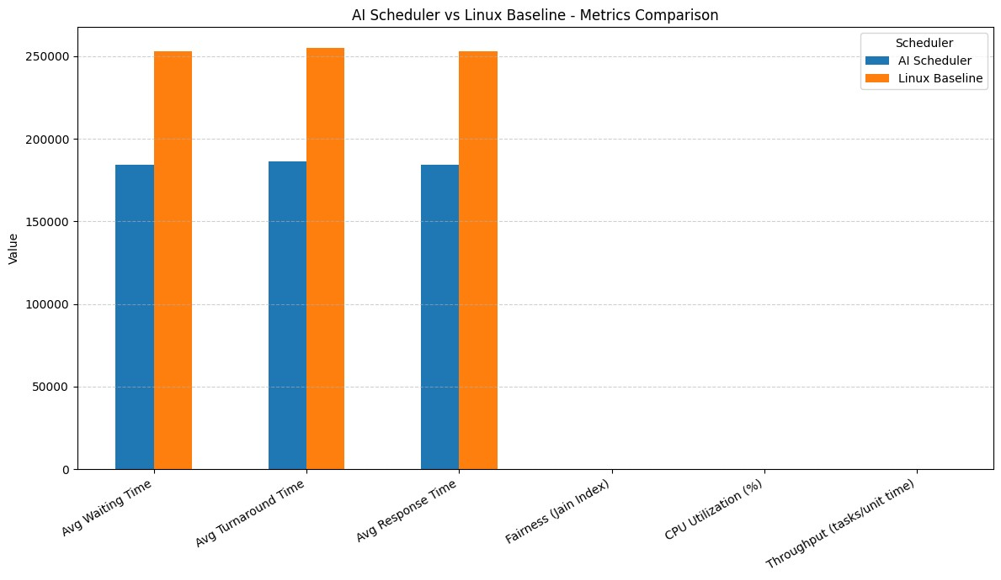
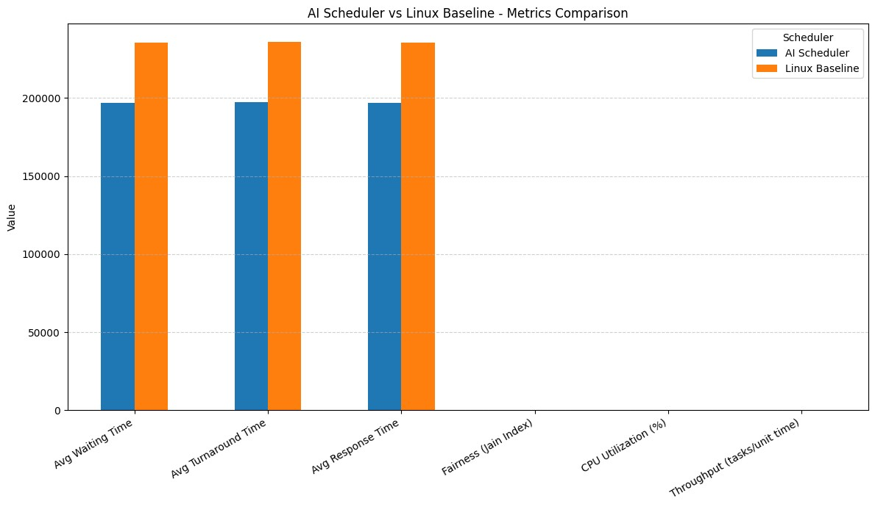
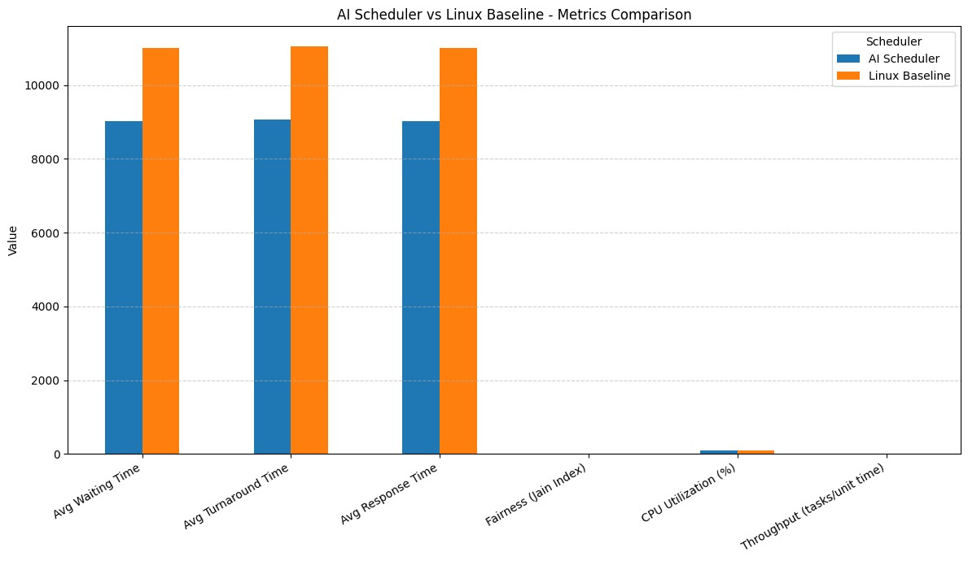
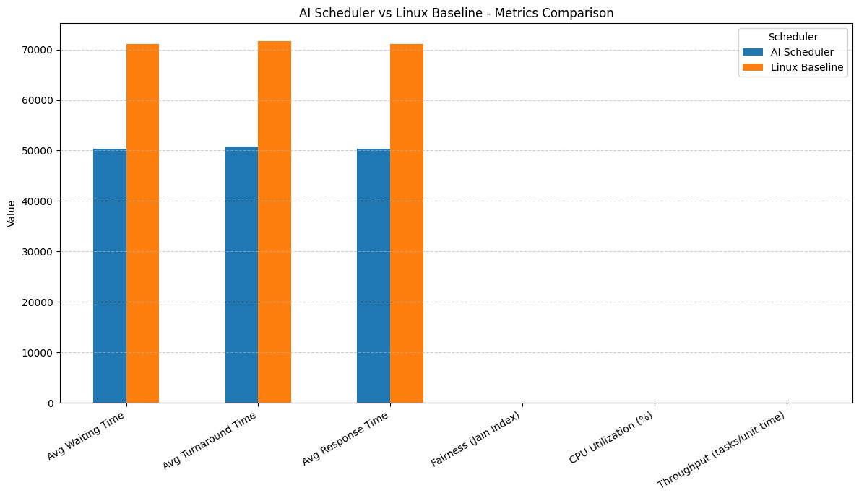
IO workload
Stress workload
CPU workload
Batch workload

Slide 14
Statistical Significance
Paired Wilcoxon tests run on per-task turnaround & response
Results significant at p < 0.05 across all workloads
Example:
Confirms improvements are robust, not random variance
Workload | Avg Turnaround ↓ | Wilcoxon p-value
Real-time | -36% | < 1e-9
Mixed | -27% | < 0.01

Slide 15
Ablation Study
Scheduler assignment only → largest improvements across all workloads
Quantum & VRUNTIME scaling → further improvements and lead to lower context switches
Combined → best overall balance

Slide 16
Conclusions
Reproducible pipeline: workloads, scripts, models, results all included
AI-guided scheduling → consistently reduces turnaround & response across all kinds of workloads
Fairness, throughput, utilization preserved
Reproducible pipeline: workloads, scripts, models, results all included
Demonstrates ML + systems can work together in scheduling

Slide 17
Future Work
Collect larger & more diverse traces
Integrate with Linux kernel module for real benchmarking
Explore adaptive / online learning for dynamic workloads

Slide 18
Thank You
Contact info:
Email: khdhanu5243@gmail.com
LinkedIn: linkedin.com/in/dhanushree-k-9135122ab
GitHub: github.com/KHDhanu

