Slide 1
General Robot Programming Task
Driver Station
RoboRio
Receive/Transmits DS Information
Read Joystick Buttons/Axis
Determine Current State of Robot (Enable/Disable)
Determine Current Mode (Auto/TeleOp/Test)
Read Sensor Data
Convert Sensor/Buttons to meaningful value
Determine what Robot should do
Generate proper electrical signals for Robot Hardware
Receive/Transmit DS Information
START
Functionality provided by WPILIBJ
Functionality provided by Team Code

Slide 2
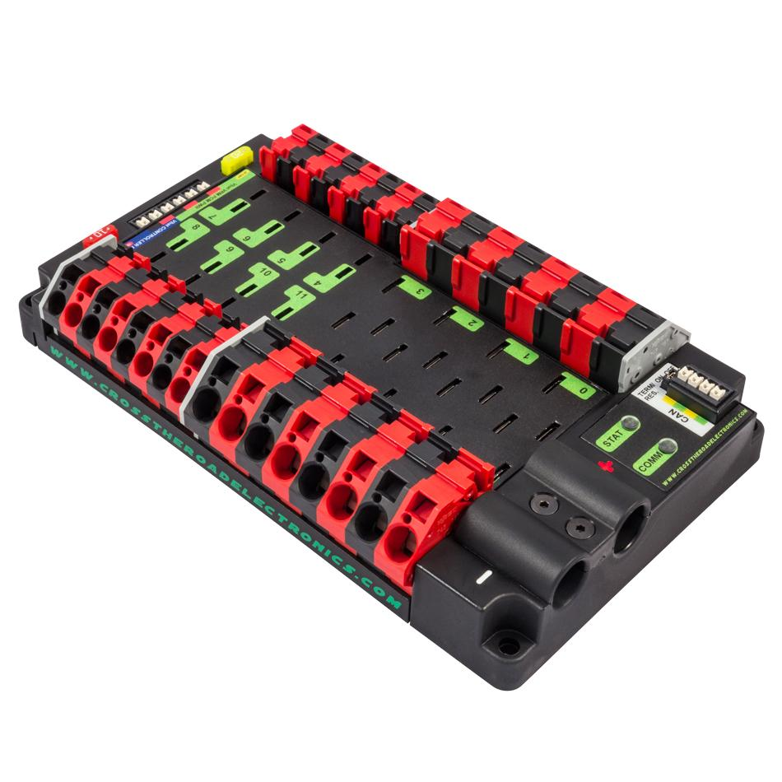
PCM Power
VRM Power
30 Amp Channels
4-7
RoboRio
Power
40 Amp Channels
0-3
CAN Term.
Resistor
CAN Bus
30 Amp Channels
8-11
CAN Status
Lights
40 Amp Channels
12-15
Main Battery
Input

Slide 3
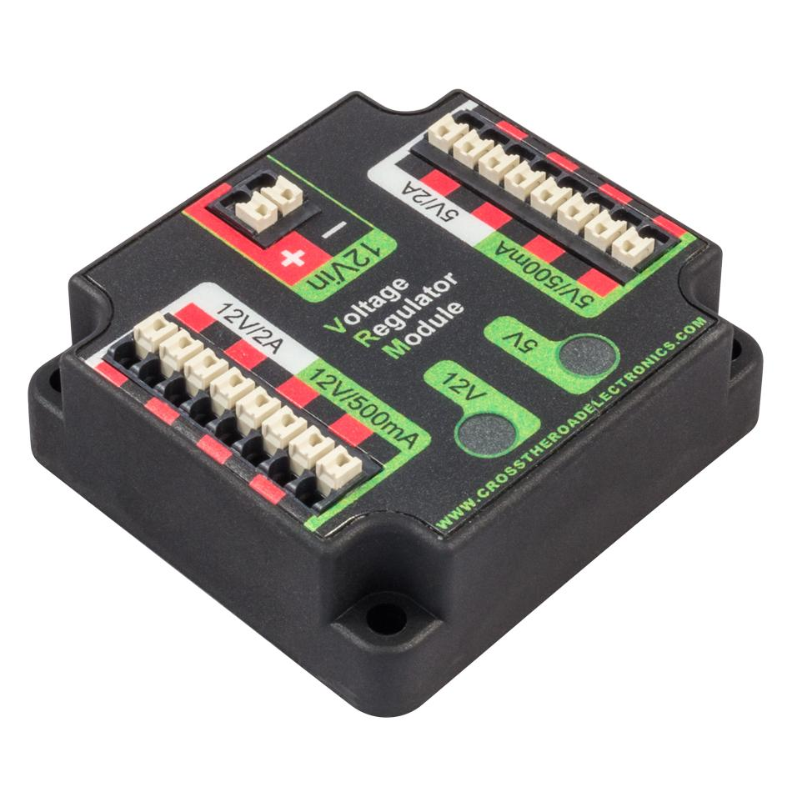
Regulated 5V
2A Peak
Unregulated 12V
Input
Regulated 5V
500mA Peak
Regulated 12V
2A Peak
Regulator Circuit
Status Lights
Regulated 12V
500mA Peak

Slide 4
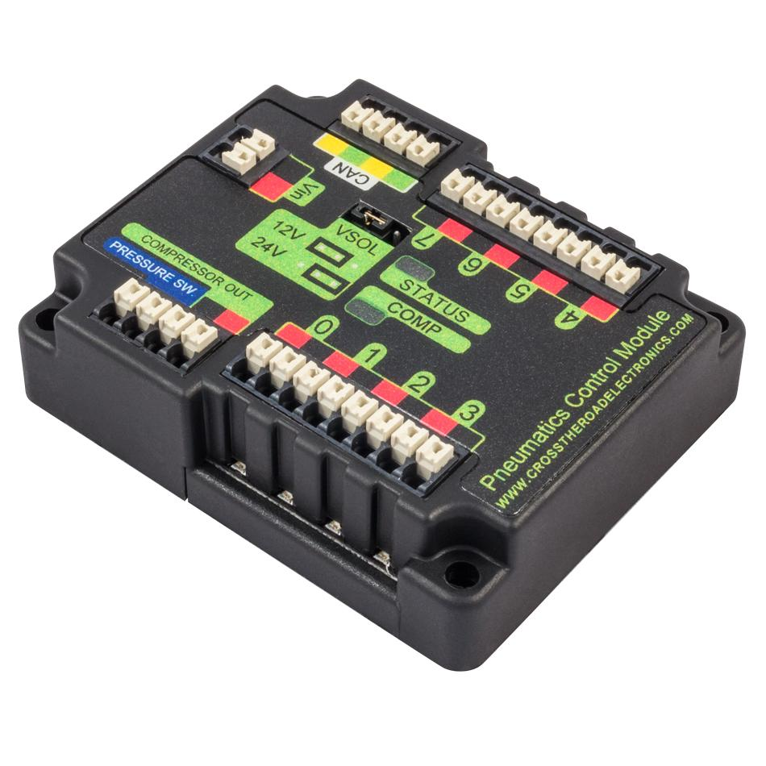
CAN Bus
Interface
Unregulated
12V Input
12V or 24V
Output Jumper
(Default is 12V)
12/24V Solenoid Channels
4 - 7
Pressure Switch
Direct Wire
Status Lights
Compressor
Direct Wire
12/24V Solenoid Channels
0 - 3

Slide 5
Off
Or
Max Brightness
Off
Or
Variable Brightness

Slide 6
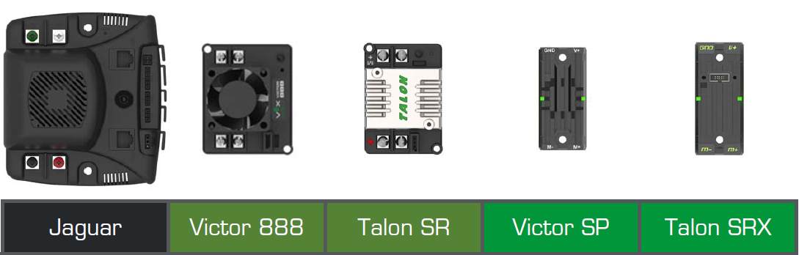

Slide 7
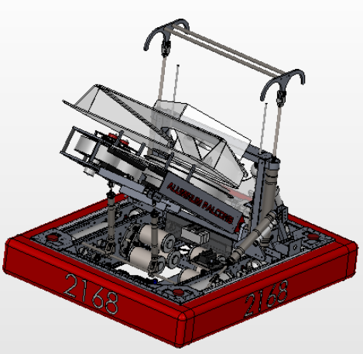
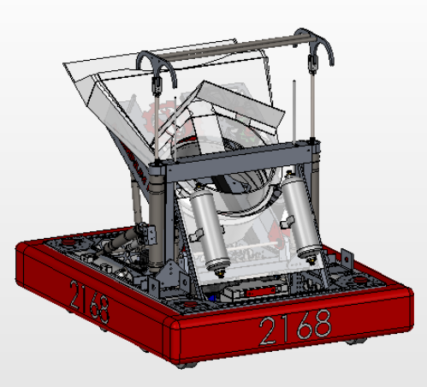
Hanger
2013 Competition Robot Subsystems
Shooter
Hopper
Elevator
Drivetrain

Slide 8
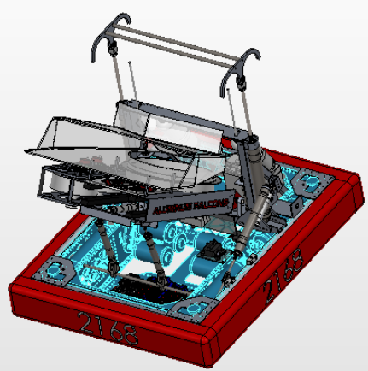
Bumper
Drivetrain

Slide 9
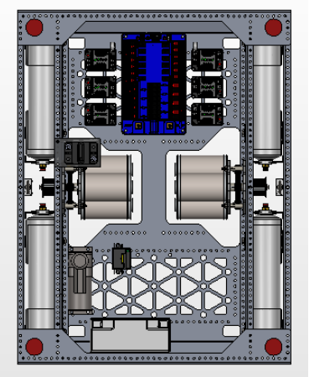
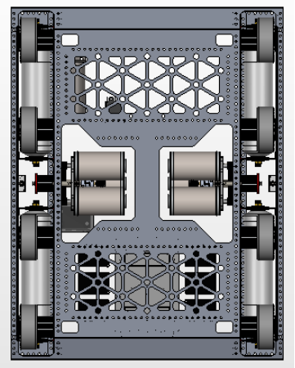
Top Looking Down
Bottom Looking Up
Motor Controllers
CIM Motor
Transmissions
8-wheel
drive

Slide 10
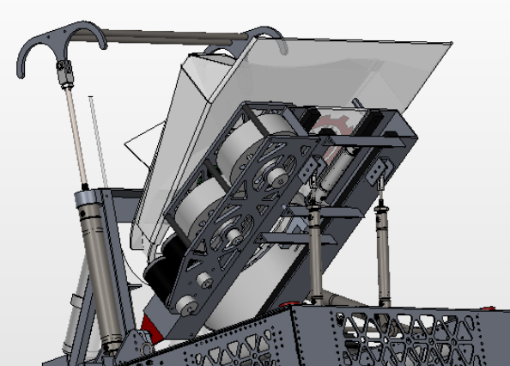
Frisbee Hopper
In-line Shooter Wheels
Frisbee Muzzle
2 Mini-Cim
Motors

Slide 11
Input Voltage
(From Batt)
Vin > 6.2V
6V Servo Supply
Vin < 6.8V
Current Limit/Disable
6V terminals
5V Supply
5V terminals
3.3V Supply
3.3V terminals

Slide 12
THIS PICTURE WILL BE RELEASED AFTER THE 2015 FIRST ROBOTICS COMPETITON KICKOFF
OR AS SOON AS PRE-ORDERED ROBORIO UNITS SHIP
WHICH EVER COMES FIRST

