Slide 1
Predicting London House Prices
Kenny Hunt

Slide 2
Experiment
Import Data on current house prices from Zoopla API.
Analyse on which variables have highest impact on house price
Create Machine Learning Algorithm to predict house prices
Analyse accuracy of Algorithm

Slide 3
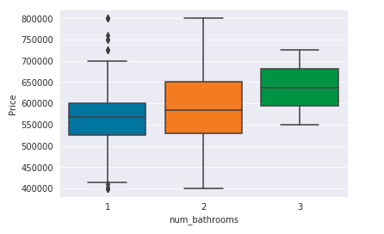
Relationship between property price and number of bathrooms
One bathroom property on average 550k
Two bathroom property 580k
Second bathroom costs 30k
Siginificant Increase on 3 bathroom apartments as generally much larger

Slide 4
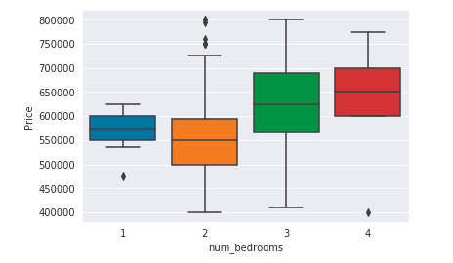
Relationship between property price and number of bedrooms
Strange results in the form of one-bed properties being more expensive on average than 2 beds.
What causes this?
Build age?
Location?
Expected linear relationship between 2/3/4 beds
Further investigation required into one beds
They are located in two specific neighbourhoods.

Slide 5
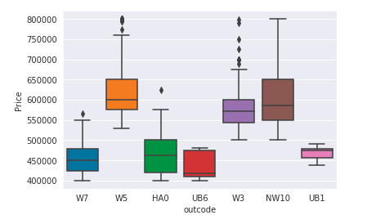
Relationship between property price and Neighbourhood
Significant relationship between outcode and price.
Identifies previous analysis skewed due to the fact that the highest priced properties are in the same neighbourhoods that contain the one beds.
Bias due to small dataset

Slide 6
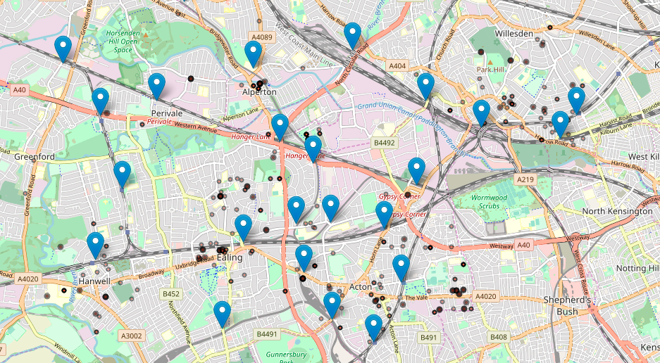
Relationship between property price and location to transport links
More expensive properties are located next to tube stations
Less expensive properties are located further away
Living close to a tube station costs an additional 30K
Living close to a train station is cheaper than living close to a tube station by ~10k

Slide 7
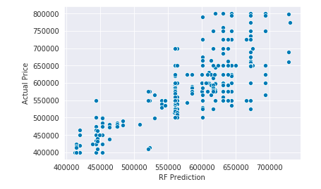
Model Score – Random Forest
Slight linear relationship
Need larger dataset to make more accurate

Slide 8
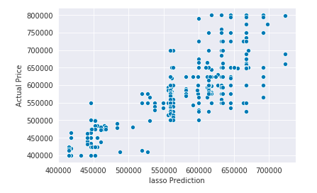
Model Score - Lasso
Slight linear relationship
Need larger dataset to make more accurate

Slide 9
Conclusion
Strong analysis to understand underlying drivers of house prices in London
Need a larger dataset to improve accuracy
Improve analysis on one-bed properties
Deep dive on what makes a specific neighbourhood more expensive?
Crime figures?
Amenities
Shopping Centres

