Slide 1
WEEK 8 · DAY 1 · APPLIED RAG ENGINEERING COURSE
RAG Evaluation Project
Evaluating RAG Systems with RAGAS Concepts
Manual evaluation of Faithfulness and Context Precision
EnlivenAI Solutions · September 2026
Faithfulness · Context Precision · RAGAS Framework

Slide 2
AGENDA
What this session covers
▪ Why RAG evaluation matters — runs ≠ reliable, root cause, controlled experiments
▪ Two core metrics — Faithfulness and Context Precision
▪ Project structure & dataset — 6 test examples, files and outputs
▪ How the evaluation runs — the manual scoring workflow
▪ Score interpretation — the 0.0–1.0 rubric
▪ Improvement strategies — prompts, retriever, chunking
▪ Manual vs RAGAS automation — when to use each
▪ Key takeaways & next steps — and references
Core question: Did the system retrieve the right information, and did the answer use that information correctly?
RAG Evaluation Project · Week 8 Day 1
2

Slide 3
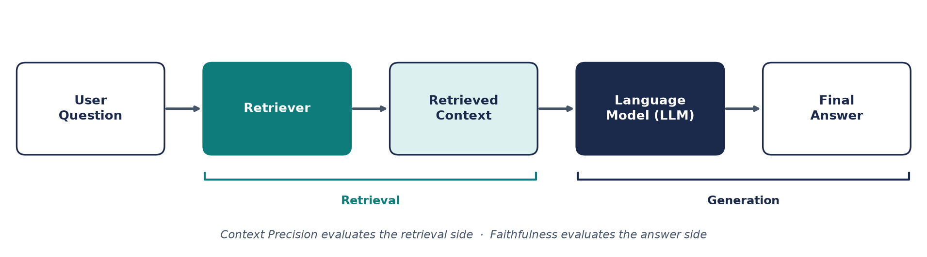
BACKGROUND
The RAG workflow — and where evaluation fits
The key evaluation question: Did the system retrieve the right information, and did the answer use that information correctly?
A RAG system follows the pipeline above — evaluation checks both sides: retrieval quality (Context Precision) and answer quality (Faithfulness).
RAG Evaluation Project · Week 8 Day 1
3

Slide 4
MOTIVATION
Why RAG evaluation matters
1
2
3
Runs ≠ Reliable
Finds Root Cause
Controls Experiments
A RAG app can execute without errors and still return weak, incomplete, or unsupported answers.
Evaluation separates retrieval problems from answer-generation problems — so you fix the right component.
Changing one setting (chunk size, top-k, prompt) may improve one score while weakening another.
Rule of the day: change only ONE setting at a time and keep questions + documents the same.
RAG Evaluation Project · Week 8 Day 1
4

Slide 5
METRIC 1
Faithfulness — does the answer stay within the evidence?
Question: Is every important claim supported by the retrieved context?
Measures: whether the answer stays within the evidence.
Detects: LLM hallucinations, unsupported claims, information drift.
WORKED EXAMPLE
Context: "Employees receive 20
annual leave days."
Answer: "Employees receive 20
days and a travel allowance."
score = supported claims / total claims
Count claims in the answer; count how many the contexts support.
✖ “travel allowance” is unsupported → lower faithfulness.
How to score it in this project: read the answer and contexts → count the total claims in the answer → count claims supported by the contexts → enter both numbers; the evaluator computes supported / total.
Score 2/2 = 1.0 (faithful) · a missing, added, or altered detail lowers the score.
RAG Evaluation Project · Week 8 Day 1
5

Slide 6
METRIC 2
Context Precision — how much retrieved context is useful?
Question: How much of the retrieved context is actually useful?
Measures: the quality and relevance of retrieval.
Detects: retriever noise, irrelevant results, over-fetching.
WORKED EXAMPLE
Question: "What is the remote
work policy?"
Retrieved 5 chunks — only 3
are relevant.
score = useful chunks / total chunks
Count retrieved chunks; count how many help answer the question.
precision = 3/5 = 0.60 — moderate: some noise in retrieval.
How to score it in this project: read the question and all retrieved chunks → count total chunks → count chunks genuinely useful for answering (not just topically related) → the evaluator computes useful / total.
E.g. medical + dental useful out of 4 retrieved (gym, vacation too) → 2/4 = 0.50.
RAG Evaluation Project · Week 8 Day 1
6

Slide 7
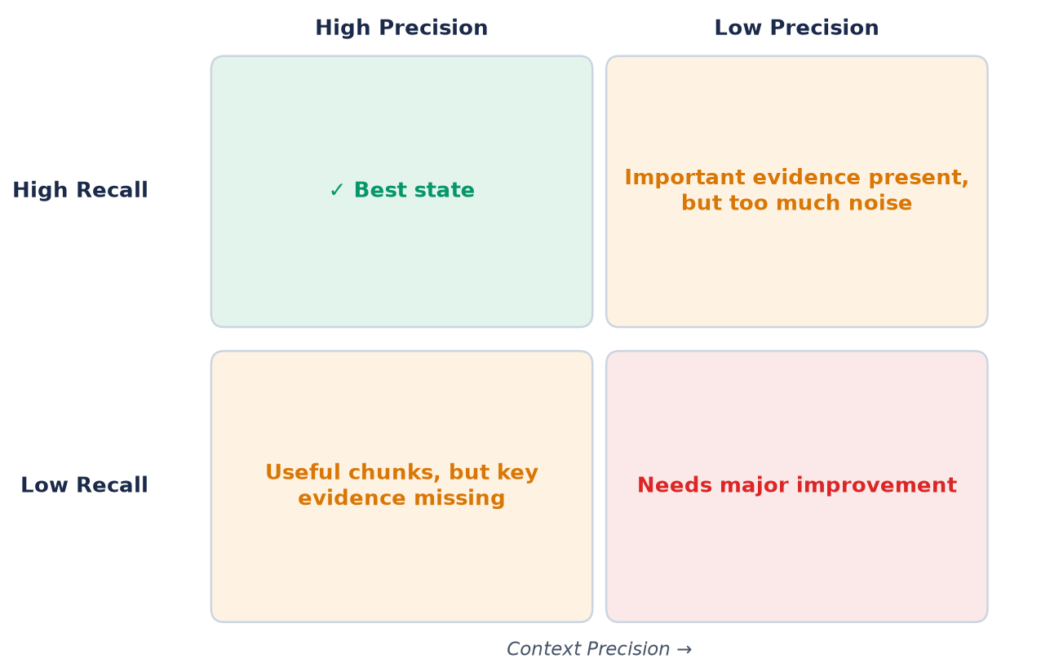
RETRIEVAL QUALITY
Context Precision + Recall matrix
Read the quadrants:
High Precision + High Recall — the best state: useful chunks and complete evidence.
High Precision + Low Recall — useful chunks, but key evidence is missing.
Low Precision + High Recall — important evidence present, but too much noise.
Low Precision + Low Recall — needs major improvement.
This project measures precision directly; recall is diagnosed from missing evidence — low recall fixes live in chunking, query expansion, and coverage.
RAG Evaluation Project · Week 8 Day 1
7

Slide 8
ARCHITECTURE
Project structure — files and their roles
File | Role
main.py | Orchestration: welcome, loads evaluation_data.json, loops over examples, summary, saves outputs
manual_evaluation.py | ManualEvaluator: claim counting (Faithfulness) and useful-chunk counting (Context Precision)
evaluation_data.json | Test dataset — 6 examples: question, answer, contexts, ground_truth
results/evaluation_report.csv | Generated: per-example score breakdown (11 columns, e.g. supported/unsupported claims)
results/improvement_report.json | Generated: averages, weakest metric, one improvement recommendation
requirements.txt | Core: python-dotenv==1.0.0 · Optional: ragas==0.1.12, langchain==0.1.0, anthropic==0.7.0
.env.example | Environment template: ANTHROPIC_API_KEY, OPENAI_API_KEY, EVALUATION_MODEL, EMBEDDING_MODEL
Run it: pip install -r requirements.txt → python main.py
RAG Evaluation Project · Week 8 Day 1
8

Slide 9
DATASET
The 6-example test dataset
# | Topic | Key facts in the answer | Chunks | Ground truth
1 | Annual leave | 20 annual leave days per year | 1 | 20 paid annual leave days per year
2 | Remote work | 3 days remote per week; 2 days required in office | 2 | 3 days remote, 2 days office required per week
3 | Health insurance | Medical, dental, vision + mental health; 80% employee / 50% dependent | 2 | 80% employee, 50% dependent coverage
4 | Performance reviews | Twice a year — June and December (+ onboarding nuance) | 3 | Mid-year June, year-end December
5 | Parental leave | 12 weeks paid for both parents; unpaid up to 6 months total | 1 | 12 weeks paid parental leave, both parents
6 | Professional development | $2,500 annual budget — courses, conferences, certifications, training | 3 | $2,500 annual budget per employee
Evaluator’s watch-out: example 3’s answer mentions mental health while its contexts list only medical, dental and vision — a claim-support nuance you must catch when counting supported claims.
Each example carries four fields: question, answer, contexts (retrieved chunks), ground_truth.
RAG Evaluation Project · Week 8 Day 1
9

Slide 10
WORKFLOW
How the evaluation runs — step by step
Install & launch
pip install -r requirements.txt → python main.py
Load dataset
Script loads the 6 evaluation examples from evaluation_data.json
1
2
Score faithfulness
Count total claims → count supported claims → supported / total
Score precision
Count total chunks → count useful chunks → useful / total
3
4
Summarize
Averages, per-example table, weakest metric identified
Save & recommend
Write CSV, enter ONE recommendation, write improvement_report.json
5
6
improvement_report.json fields: total_examples_evaluated · average_faithfulness_score · average_context_precision_score · weakest_metric · weakest_metric_score · improvement_recommendation
evaluation_report.csv columns: Example, Question, Ground Truth, Faithfulness Score, Total/Supported/Unsupported Claims, Context Precision Score, Total/Useful/Irrelevant Chunks
RAG Evaluation Project · Week 8 Day 1
10

Slide 11
INTERPRETATION
Score rubric — both metrics, 0.0 to 1.0
Band | Faithfulness | Context Precision
0.0–0.3 Poor | Frequent unsupported claims — LLM hallucinating; prompt adjustment needed | Mostly irrelevant chunks — search not working; major tuning needed
0.4–0.6 Fair | Mix of supported / unsupported — prompt review needed | Mixed results, significant noise — retriever needs adjustment
0.7–0.85 Good | Most claims supported — room to improve prompt specificity | Most chunks relevant — good foundation, optimize further
0.9–1.0 Excellent | All claims stay within evidence | Retriever highly accurate — minimal noise
Score pattern → first thing to inspect: Low Faithfulness → prompt + generated answer · Low Precision → retriever, top-k, filters · Low Recall → chunking, query expansion, coverage
Golden rule: change only ONE setting at a time and keep questions + documents the same.
RAG Evaluation Project · Week 8 Day 1
11

Slide 12
IMPROVEMENT · GENERATION
If faithfulness is low (< 0.7) — fix the LLM side
1 · Constrain the prompt
Answer ONLY from the provided context; if it’s not there, say “The provided context does not contain this information.”
prompt = """Answer the user's
question ONLY using the provided
context. If the context doesn't
contain the answer, say
'The provided context does not
contain this information.'
Do not use any external
knowledge or make assumptions."""
2 · Ground the rules
1 only use the context · 2 no own knowledge · 3 state missing info clearly · 4 cite which part supports the answer
3 · temperature = 0
Deterministic output — best for factual RAG answers; high randomness is not good for RAG.
WHY IT WORKS
The failure mode is the LLM adding plausible-sounding details (like the “travel allowance”) that no chunk supports. Constraints + deterministic decoding + citations pull every claim back onto the retrieved evidence.
4 · Chain-of-thought
Step 1 search the context → Step 2 extract only directly-answering facts → Step 3 answer with citations.
Target: move the score into 0.7–0.85 (Good) or higher — 0.9–1.0 means every claim is supported.
RAG Evaluation Project · Week 8 Day 1
12

Slide 13
IMPROVEMENT · RETRIEVAL
If precision or recall is low (< 0.7) — fix the retriever side
LOW PRECISION — too much noise
LOW RECALL — evidence missing
▪ Lower top-k: retrieve fewer, better results (top-k 20 → 5)
▪ Metadata filters: source = employee_handbook, category = benefits
▪ Clean the query: “tell me about leave days and also…” → “annual leave days policy”
▪ Similarity threshold: keep only results with score > 0.5
▪ Hybrid search: vector + keyword → deduplicate and rank
▪ Increase top-k: 3 → 20 to widen the net — but watch precision doesn’t drop
▪ Better chunking: from 2000 tokens / 0 overlap → chunk size 400, overlap 50
▪ Query expansion: “leave policy” → + “vacation days”, “time off”, “PTO”, “annual leave”
▪ Multi-hop retrieval: search in steps (benefits → insurance → mental health), merge with ranking
▪ Index more content: recall is limited by what you have — add documents/sections
Trade-off alert: raising top-k can lift recall while hurting precision — measure both, change one thing at a time.
RAG Evaluation Project · Week 8 Day 1
13

Slide 14
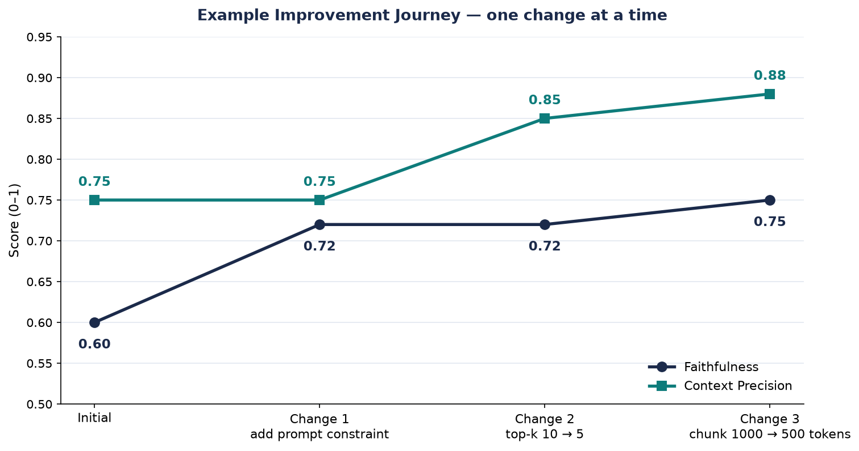
CASE STUDY
Example improvement journey — one change at a time
Step | Change | Result
Initial | — | Faithfulness 0.60 · Precision 0.75
Change 1 | Add prompt constraint | Faithfulness → 0.72
Change 2 | top-k 10 → 5 | Precision → 0.85
Change 3 | Chunk size 1000 → 500 | Precision 0.88 · Faithfulness 0.75
Final | — | Faithfulness 0.75 · Precision 0.88
4-phase workflow:
1 Diagnosis → 2 Targeted fix (ONE change) → 3 Measure & iterate → 4 Balance & optimize
Escalate if no gain after 2–3 changes: data quality · dataset too small (6 examples) · stronger LLM · rethink architecture.
RAG Evaluation Project · Week 8 Day 1
14

Slide 15
AUTOMATION
Manual evaluation vs RAGAS automated evaluation
Approach | Strengths | Watch out
Manual (this project) | ✓ Easy to understand for beginners · ✓ Best for small classroom tests | ⚠ Human judgment can vary
RAGAS automated | ✓ Faster for many examples · ✓ Useful for repeated experiments | ⚠ Scores still need human review
Recommended workflow: start with manual evaluation to understand the concepts → then use RAGAS for repeated experiments.
pip install ragas
from ragas import evaluate
from ragas.metrics import faithfulness,
answer_relevancy, context_precision,
context_recall
RAGAS metrics
faithfulness · answer_relevancy · context_precision · context_recall — the four standard scores, with human review still in the loop.
RAG Evaluation Project · Week 8 Day 1
15

Slide 16
WRAP-UP
Key takeaways & next steps
You can now:
▪ Create a small evaluation dataset
▪ Run manual quality checks on RAG outputs
▪ Read and interpret evaluation scores
▪ Identify which component needs improvement — retriever vs LLM
▪ Write an improvement report with actionable recommendations
Next steps:
▪ Try different retriever settings (top-k, filters) and re-evaluate
▪ Modify the LLM prompt and compare faithfulness scores
▪ Build a RAGAS-based evaluation pipeline for automation
▪ Create a more complex dataset from your own domain
Avoid: changing multiple things at once · using different datasets for re-evaluation · ignoring trade-offs · premature automation · unrealistic targets (0.95+ scores are rare in production).
References: RAGAS Paper — arxiv.org/abs/2309.15217 · RAGAS GitHub — github.com/explodinggradients/ragas · Anthropic LLM Evaluation Guide
RAG Evaluation Project · Week 8 Day 1
16

