Slide 1

Clinical Records Interactive Search (CRIS)
Dr Giouliana Kadra-Scalzo, IoPPN, King’s College London

Slide 2


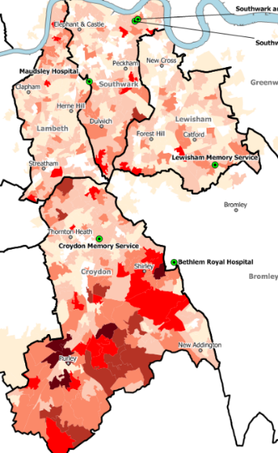

SLAM Biomedical Research Centre (BRC)
Coverage – Lambeth, Southwark, Lewisham, Croydon
Base population – c.1.4m
Records- since 2007 (updated every 24hrs)
EHRs- c. 500,000
Approvals: Oxford Research Ethics Committee C
(reference 08/H606/71+5)
Clinical services – specialist MH Trust
CAMHS
General adult psychiatry
Older adult services
Learning difficulties
Addictions
National
IAPT
Forensic
King’s College London (KCL)
.
Southwark
Lambeth
Lewisham
Croydon
South London and Maudsley (SLAM)
Notes:
2

Slide 3

The CRIS platform
A governance model
A data processing pipeline
A service

Slide 4
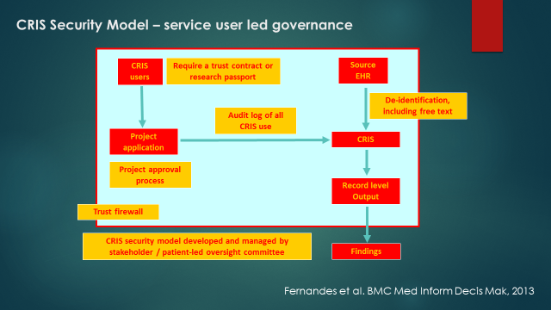
A governance model

Slide 5
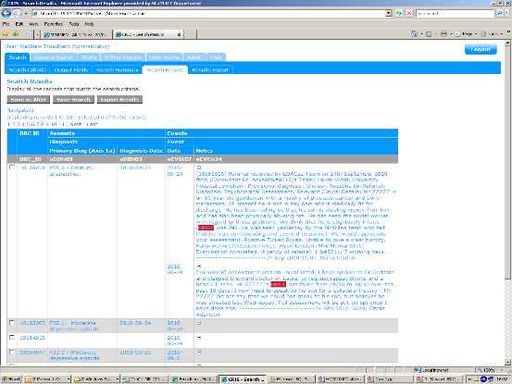
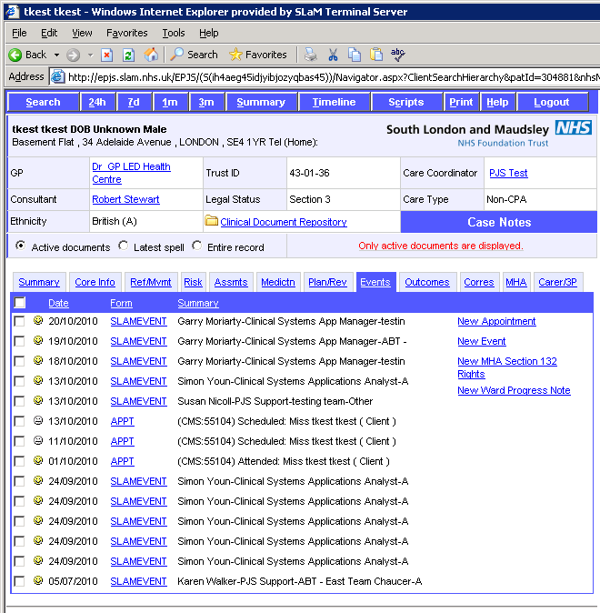
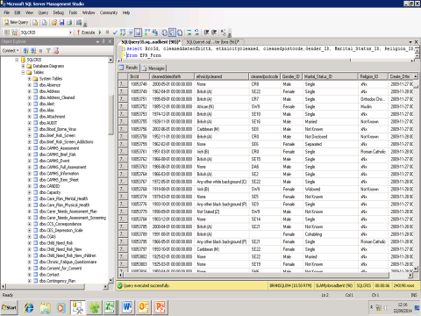
CRIS – core functionality
CRIS front end
EHR
Data Source
De-identification
Processing pipeline
CRIS SQL

Slide 6
CRIS data
Structured
Ethnicity
Diagnosis
Free-text
Inpatient progress notes
Clinical summaries
NLP
Smoking
Antipsychotic medication
HoNOS
Psychotherapy

Slide 7



CRIS with natural language processing
Intervention indications
☑ = complete
 = in progress
Intervention context
Intervention
Outcome
Symptoms
Psychosis
Positive ☑
Negative ☑
Disorganisation ☑
Manic ☑
Catatonic ☑
Cognitive ☑
Affective
Depressive ☑
Instability ☑
Anxiety ☑
Obsessive/compulsive ☑
Behaviour
Agitation/withdrawal ☑
Other
Insight ☑ Suicidality 
Context
Cognitive function ☑
Social care ☑
Living alone ☑
Diagnosis ☑
Occupation ☑ 
Education ☑ 
Physical disorders ☑  Investigations ☑ 
Violence/abuse ☑ 
Life stressors 
Substances
Smoking ☑
Alcohol 
Cannabis ☑
Mephedrone ☑
Amphetamine ☑
Cocaine ☑
Others 
Interventions
Pharmacotherapy ☑
Polypharmacy ☑
Adherence/compliance 
Non-response, resistance ☑
Psychotherapy
CBT ☑ (receipt, offer, etc.)
DBT 
CAT 
Family ☑
Outcomes
Adverse drug events
Extrapyramidal ☑
Other ☑ 
Symptom trajectories ☑ 
Improvement
Deterioration
General mental health ☑ 
Improvement
Deterioration
Violence ☑
Dementia with Lewy Bodies ☑ 
Visual hallucinations
Recurrent falls
Drowsiness
Fluctuation
Bad dreams / nightmares
Parkinsonism

Slide 8
CRIS – core functionality
CRIS front end
Internal linkages
Pharmacy data
Biobank and ‘omics data
Psychological therapies (IAPT)
King’s Health Partners
EHR
Data Source
External linkages
Primary Care
National Pupil Database
BadgerNet (neonatology)
London Ambulance Service
Clinical Data Linkage Service
CRIS SQL
‘Context’
Local environment (SELCoH)
Social media (PHEME)
Mortality
Cancer registration
Hospitalisation
Perera et al 2016, BMJ Open

Slide 9
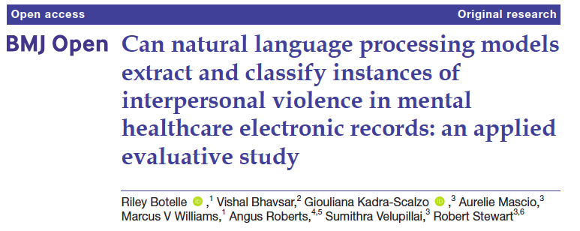
Using natural language processing to extract and classify instances of interpersonal violence in mental healthcare electronic records

Slide 10
Background
People with mental illness are more likely to experience violent victimisation compared to the general population- 15–45% of female patients report experiences of victimization in the past year, and 40–90% reporting lifetime victimization.
Similar patterns have been observed for domestic violence, sexual violence, violence perpetration, and witnessing violence.
Potential for electronic health records kept by mental health services

Slide 11
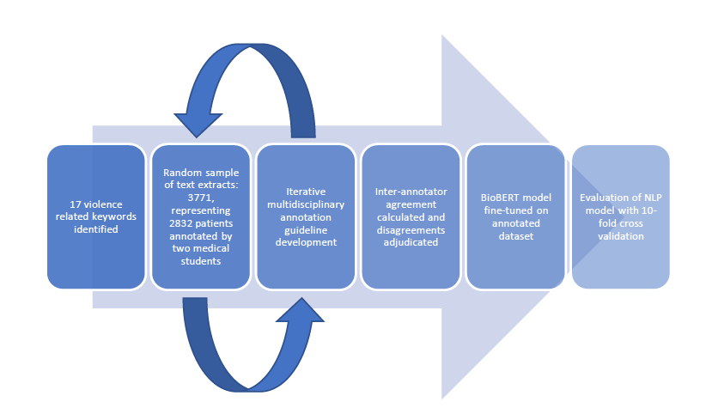
Method
Figure 1. The process of annotation, development and evaluation of NLP models
Keywords
Nouns
% abus%
% attack%
% beat%
% violenc%
% hit%
% rape%
% assault%
Verbs:
% fight%
% fought%
% slap%
% chok%
% push%
% punch%
% strangul%
% strangl%
% threw%
% struck%

Slide 12
Method
Table 1: Example of text fragments extracted for annotation in this study, alongside corresponding labels and assigned annotations.
Step 2
Step 3
Step 1
Example of text fragment | Label | Annotation
“They were abused in their childhood” | Violence presence, victim | Affirmed
“Patient used to hit her partner” | Violence presence, perpetrator; physical, domestic | Affirmed
“Patient stabbed his roommate” | Violence presence, perpetrator; physical, domestic | Affirmed
“Expressed a lot of interest in violence, nazism” | Violence presence | Irrelevant
“No violence or aggression noted” | Violence presence | Negated
Possible labels:
violence presence- affirmed, negated or irrelevant
patient status- victim, perpetrator, and/or witness
violence type- domestic, physical, sexual

Slide 13
Method
NLP model development
We used a pre-trained BioBERT model and fine-tuned it on the annotated dataset. Each set was generated independently (ensuring no overlap). Three datasets were used for:
model testing and training (development stage, 3771 sentences);
model fine-tuning (1411 sentences);
model blind testing (100 newly annotated sentences not used for model training or fine-tuning was also assessed).
Our aim was to produce seven binary classification models for each annotated labels.
We evaluated the models with 10-fold cross validation, comprising 10% annotated text extracts for testing, and 90% text extracts in training, in each fold.
Standard markers of NLP performance: precision (or positive predictive value), recall (or sensitivity) and F1 score (the harmonic mean of precision and recall), using weighted averages to take into account the dataset’s imbalance (i.e. differing numbers of extracts generated for each keyword). Reported scores corresponded to the mean across the 10 test sets.

Slide 14
Results
Table 2. NLP model performances on the training and testing dataset (3,771 text extracts); and on blind test set with a 90% probability threshold (100 sentences) for the six labels.
 | Training set (average score on 10-fold cross-validation) |  |  | Blind test set
Annotation label | Precision | Recall | F1-score | F1-score
Violence presence | 93% | 93% | 93% | 95%
Patient status: Perpetrator | 89% | 89% | 89% | 85%
Patient status: Victim | 91% | 89% | 91% | 90%
Violence type: Domestic | 94% | 94% | 94% | 93%
Violence type: Physical | 91% | 92% | 91% | 98%
Violence type: Sexual | 98% | 97% | 97% | 93%
Inter-annotator agreement was high: 82-96% (60-85% Cohen’s kappa) for the six annotation labels.
For one annotation label (witness) we were unable to generate a model due to insufficient data size.

Slide 15
Reflections
Strengths
Limitations
Implications

Slide 16
Thank you
giouliana.kadra@kcl.ac.uk

Slide 17
Key References
Khalifeh H, Moran P, Borschmann R, et al. Domestic and sexual violence against patients with severe mental illness. Psychol Med 2015;45:875–86. doi:10.1017/S0033291714001962
Khalifeh H, Johnson S, Howard LM, et al. Violent and non-violent crime against adults with severe mental illness. British Journal of Psychiatry 2015;206:275–82. doi:10.1192/bjp.bp.114.147843
Fazel S, Gulati G, Linsell L, et al. Schizophrenia and violence: Systematic review and meta-analysis. PLoS Medicine 2009;6. doi:10.1371/journal.pmed.1000120
Kadra G, Dean K, Hotopf M, et al. Investigating Exposure to Violence and Mental Health in a Diverse Urban Community Sample: Data from the South East London Community Health (SELCoH) Survey. PLOS ONE 2014;9:e93660. doi:10.1371/journal.pone.0093660
Lee J, Yoon W, Kim S, et al. BioBERT: a pre-trained biomedical language representation model for biomedical text mining. Bioinformatics 2020;36:1234–40. doi:10.1093/bioinformatics/btz682
Mascio A, Kraljevic Z, Bean D, et al. Comparative Analysis of Text Classification Approaches in Electronic Health Records. arXiv:200506624 [cs] Published Online First: 8 May 2020.http://arxiv.org/abs/2005.06624 (accessed 18 Jan 2021).
Jackson RG, Patel R, Jayatilleke N, et al. Natural language processing to extract symptoms of severe mental illness from clinical text: the Clinical Record Interactive Search Comprehensive Data Extraction (CRIS-CODE) project. BMJ Open 2017;7:e012012. doi:10.1136/bmjopen-2016-012012
Perera G, Broadbent M, Callard F, et al. Cohort profile of the South London and Maudsley NHS Foundation Trust Biomedical Research Centre (SLaM BRC) Case Register: current status and recent enhancement of an Electronic Mental Health Record-derived data resource. BMJ Open 2016;6:e008721. doi:10.1136/bmjopen-2015-008721
Clinical Record Interactive Search (CRIS). https://www.slam.nhs.uk/quality-and-research/clinical-record-interactive-search-cris/
All NLP apps currently available in CRIS- https://www.maudsleybrc.nihr.ac.uk/facilities/clinical-record-interactive-search-cris/cris-natural-language-processing/

Slide 18
Results
Table 3: Proportion of each label in the training and testing dataset – affirmed or negated/irrelevant.
Annotation label | Affirmed, N (%) | Negated or irrelevant, N (%) | Total
Violence presence | 2199 (58) | 1572 (42) | 3771
Patient status: Perpetrator | 1350 (61) | 849 (39) | 2199
Patient status: Victim | 731 (33) | 1468 (67) | 2199
Violence type: Domestic | 723 (33) | 1476 (67) | 2199
Violence type: Physical | 1724 (78) | 475 (22) | 2199
Violence type: Sexual | 353 (16) | 1846 (84) | 2199
* Each text extract was first annotated for the violence presence label, then if this was affirmed, further annotated for the other labels related to patient status and violence type (see figure 1 for further details). Therefore denominator totals for the violence presence label is larger than that for the other labels.

