Slide 1





Development Cycle
Training corpus
Test corpus
Train a model
Model
Apply the model on new unseen data
Algorithm,
Parameters,
…

Slide 2
Development Cycle
Training data
Unseen data
Train a model
Model
Apply the model on new unseen data
Algorithm,
Parameters,
…
How do we know how good the model is?

Slide 3
Tuning
Supervised machine learning algorithms require
parameters
different features and combinations
How can we develop a model that we believe will work well on unseen data?

Slide 4
Development Cycle
Training corpus
Test corpus
Train a model
Model
Apply the model on new unseen data
Algorithm,
Parameters,
…

Slide 5
Development Cycle
Training corpus
Split into training and tuning corpora
Test corpus
Train a model
Model
Apply the model on new unseen data
Algorithm,
Parameters,
…

Slide 6
Development Cycle
Training corpus
Split into training and tuning corpora
Train a model
Model
Train and evaluate different configurations using e.g. cross-validation
Algorithm,
Parameters,
…
Model with best result is used for final evaluation

Slide 7
Cross-validation
Splits the training data into n portions
Each iteration, one n^{th} is used for testing, the rest for training
All results averaged

Slide 8

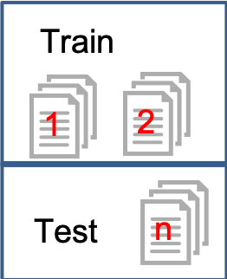
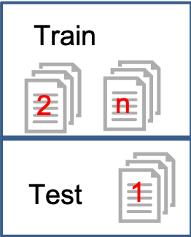
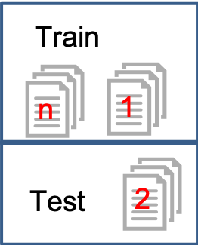
Cross-validation
Result 1
+
Result 2
+
Result 3
1
Model
Training corpus
Divide into n folds
2
Average
…
Each iteration holds out a different portion for testing
Result
n

Slide 9
Final evaluation
Gold standard
To evaluate model performance, we need test data with the ‘right answers’
This has to be different data than the training data!

Slide 10
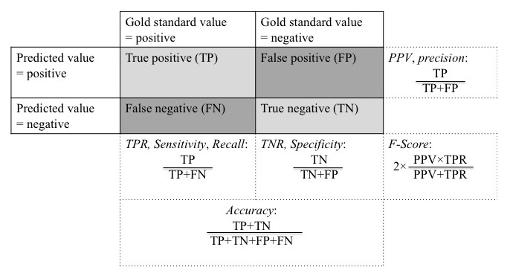
Intrinsic evaluation

Slide 11
Intrinsic evaluation
Micro and macro average
Micro average is computed on all instances
Macro average is computed independently for each class and then averaged
Problematic if there is big class imbalance

Slide 12
Practicals
We will use sklearn, nltk, spacy and jupyter notebooks today
You can try different machine learning algorithms, and you will work on evaluation in different ways.
Other tools you can try
GATE has support for most supervised learning algorithms and allows for easy experimentation with other language features
Weka
…

Slide 13
Thank you! sumithra.velupillai@kcl.ac.uk

