Slide 1
A knowledge graph system for Project Management: a knowledge Learning approach
Presented by: IA Project Team
Collaborated with Tenstep Tunisia

Slide 2
Outline
1
Context and motivations
2
Objectives and approach
3
Illustration Example
Notes:
Here is the outline of the presentation. I will start by introducing the context and motivations behind our work. Then, I will explain the problematic and our objectives. After that, I will present a summary of the state-of-the-art of existing decomposition-based many-objective evolutionary algorithms. Next, I am going to detail our three contributions and finally I will finish with the conclusions and future works.

Slide 3
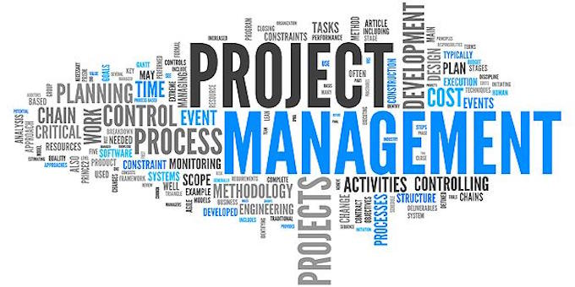
Context and motivations (1/3)
2024-2025
Notes:
Project management is the process of planning, organizing, executing, and controlling the activities of a project to achieve specific goals within a defined scope, timeframe, and budget. It involves coordinating resources (people, equipment, technology, etc.), managing stakeholders, and applying structured methodologies to ensure the successful completion of a project.

Slide 4
Context and motivations (2/3)
Introduction
Despite the exponential growth of Project Management (PM) practice, projects have still issues with being over budget, behind schedule, and with lower functionality that the planned scope [Hamzane et al., 2020].
Project Failure
Inadequate Project Planning
Poor Risk Management
Insufficient Stakeholder Engagement stakeholders’ expectations are not aligned early
Unrealistic Scheduling and Poor Time Management
Notes:
So let’s start with multi-objective optimization. A multi-objective optimization problem can be defined as minimizing or maximizing a number of objectives under a number of equalities and inequalities constraints. In multi-objective optimization, there is no one unique solution but possibly an uncountable set of solutions that is called the Pareto optimal set. The image of those solutions in the objective space will form the Pareto optimal front. The two main goals of multi-objective optimization are convergence and diversity. Convergence which consits in providing a set of solutions that approach the Pareto front as much as possible while the diversity spreads those solutions over the Pareto front as uniform as possible. Evolutionary algorithms have proven their strength in solving multi-objective optimization problems in that they are able to provide a set of compromise solutions as output in a single optimization run and they are insensitive to the shape of the Pareto front.

Slide 5
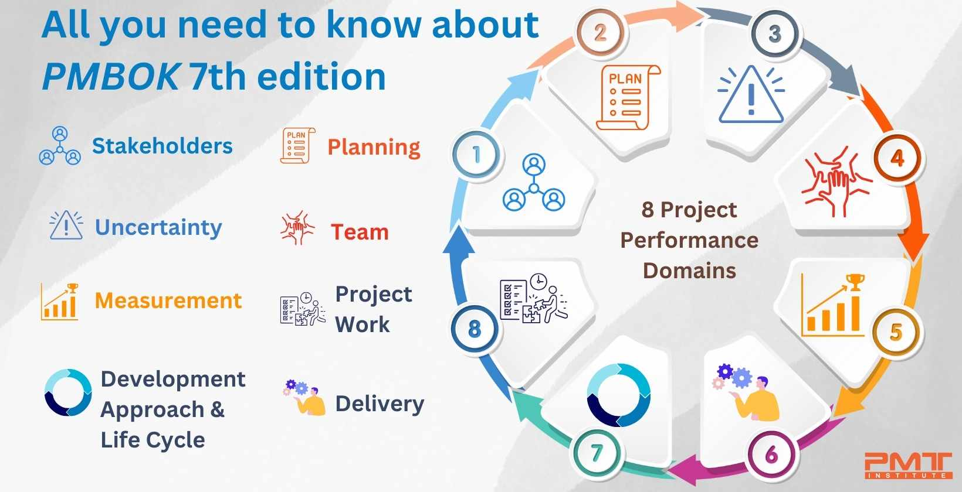
Context and motivations (3/3)
2024-2025

Slide 6

Introduction
Objectives
As a knowledge-intensive domain with processes and tools, the PM requires effective
management of the knowledge to assist project stakeholders in making right decisions:
Identify from the literature :
The well-established PM practices: limits, challenges and
applicability
Matching PM practices according to their requirements
To assist practitioners and researchers better study the impact of their decisions and evaluate the Project Management (PM) as precisely as possible :
Propose an automatic building approach on PM
1
Learn from unstructured corpus “PMBOk 7th ”: the knowledge retrieval process
2024-2025
Notes:
Several constraint handling techniques have proven their ability to guide the solutions towards the feasible regions of the Pareto front when solving constrained MOPs. The question here is how will be the infeasible regions when solving CMaOPs? And how to design new constraint handling techniques for CMaOPs? The objectives of this doctoral thesis are first to propose a decomposition-based dominance relation to solve MaOPs, second to design a decomposition-based approach to solve MaOPs with complex Pareto fronts. Third, to propose new constraint handling strategies based on decomposition to solve CMaOPs.

Slide 7
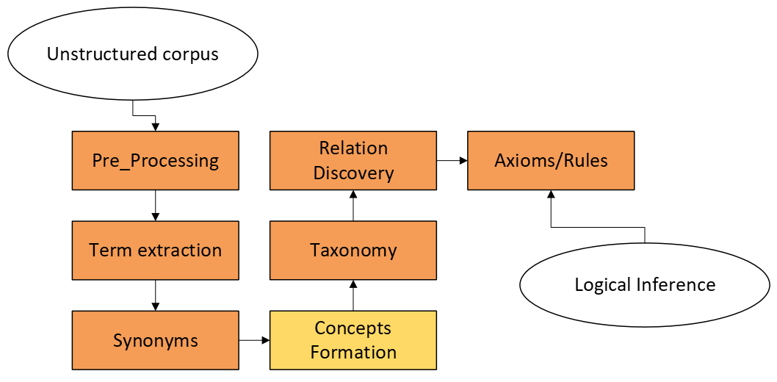
2024-2025

Slide 8
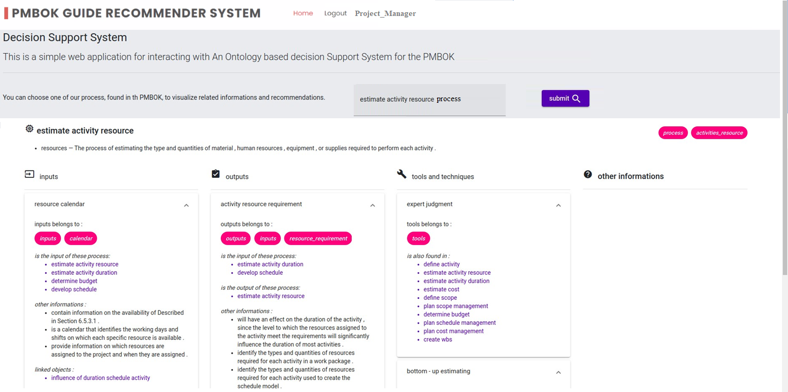
Contributions
A Knowledge-Based Recommendation System on PM
System implementation and illustration
System illustration

Slide 9
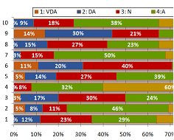
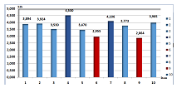
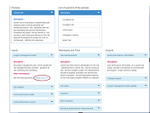
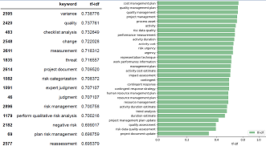
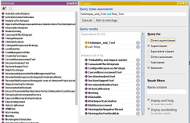
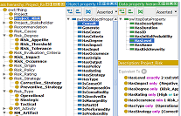
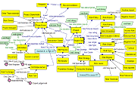
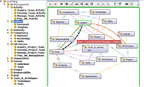
Thank you for your attention

