Slide 1


IA & Cognition project
[5 DS]
A knowledge graph Based on recommender system for monitoring Risk issues on PM
Supervised By :
IA & cognition Team
[2024-2025 ]
Esprit Tunisia

Slide 2



Outline
IA Project Context & Motivation
Project outlines
prototypes with Illustrations

Slide 3
IA project Context
Project Risk Management (PRM), a knowledge-intensive process with processes
and tools, requires effective management of risk-related knowledge that can assist
in making the right decision by managers [elyamani et al., 2024]. PRMoverview.png
→Only 23% of IT projects had been delivered on time, budget and with quality
requirements as initially specified [Standish Group International, 2024].
Project Failures
Inadequate standardization of PRM terminologies [Verner & Sarwar, 2022].
The lack of a cohesive body of knowledge with a shared conceptual model among
project stakeholders [ Toskova, 2019].
Different overlapping PM best practices, standards and guidelines [ Almessabi, 2020].
PM frameworks language is not computer interpretable [ Park & Park, 2021].
Some processes such as risk monitoring and risk control, are not yet integrated on IA tools.

Slide 4
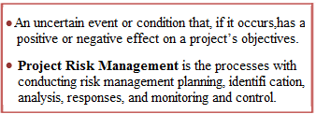
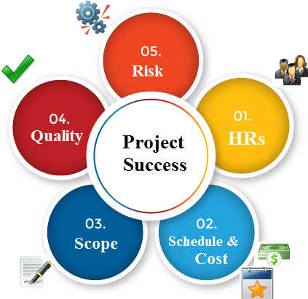




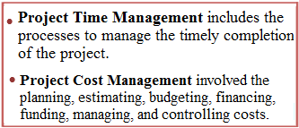
IA project Context
Iron Triangle [PMI, 2021]
How ?
To handle the PRM terminologies problem with respect to RISK standards
To formalize the content of such practice from a human readable format to a computer
interpretable format
PRM challenges
1
The convergence toward DL architectures with respect to semantic technologies to address the current issues on RM knowledge area !
2
4/40
12/01/2022

Slide 5
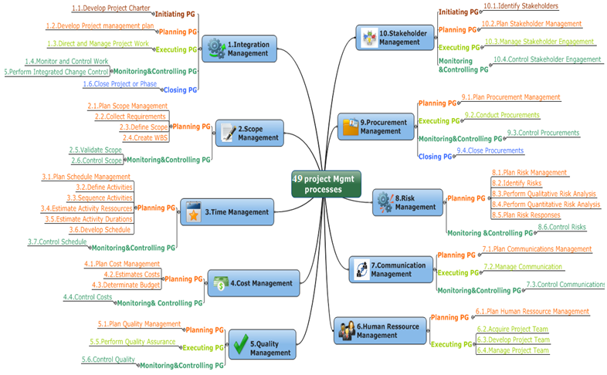
IA Project Context: CORPUS
PMI Risk standard weaks
PMI Risk Management standard [ PMI, 2017]
Why ?
Lacks of agility and strategic view by using
all the available knowledge/tools.
The continuous revisions with translation
into various languages.
Disagreement and terminological
ambiguities
Lacks the focus on the Knowledge Flow
Theory.
Semantic interoperability issue
Generic body of knowledge with rigorous specifications of six Processes, 80 Tools and Techniques, considered as the reference practical PM Framework .
1
2
Standardizes generally accepted PM concepts and practices.
Provides a common vocabulary with a comprehensive set of definitions.
3
Modelling the content of PMI standard for RM via a conceptual graph
Attaches a formal semantic representation to standard content (machine- readable format).
Establishes an internal integration within processes in terms of inputs, T&T and outputs.
Improves the standard interoperability to raison and predict.
0
As the PMBOK 6th proposes several practices around PM with rich terminologies, it is considered ideal for acting as the PM corpus in this work.
5/40
12/01/2022

Slide 6
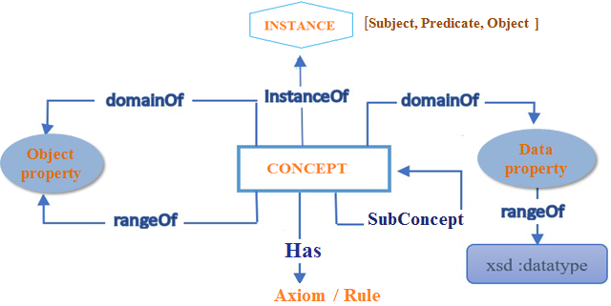
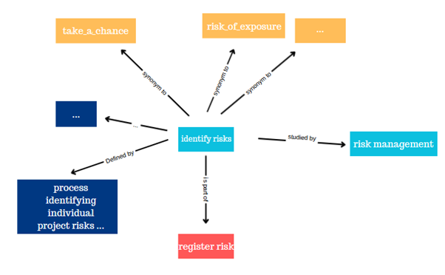
IA project Context: Knowledge graph
Text Ontology learning (OL)
Knowledge Graph
Structured conceptual representation of DATA that connects data points through relationships, providing a semantic context.
The process to acquire and represent knowledge from unstructured data in a format machine
understandable using NLP techniques [Al-Aswadi et al., 2020]. OL layer cake
Provides a consensus of knowledge.
Ensures the semantic interoperability among the project stakeholders.
Acts as a knowledge repository to share, reuse and reason over it.
Improves the accuracy and precision under the project implementation.

Slide 7
Motivation & Objectives
Motivation
In order to assist practitioners and researchers to better study the impact of their decisions and evaluate the Project Risk (PR) as precisely as possible :
Propose an automatic building approach on Project Risk Management (PRM) to model a
conceptual graph
1
Learn from unstructured corpus “RM standard ”: the knowledge retrieval process
Optimize the preprocessed data on according to PMBOK guideline → Knowledge enrichment
The resulting preprocessed data will be converted into graph with respect to data structure
Construct graph
Node and edge feature engineering→ Graph embedding
conceptual graph generation
2
Implement a recommender engine that infers personalized recommendation , guidelines, information from the proposed conceptual optimized graph → Final output is a web application
3
7

Slide 8
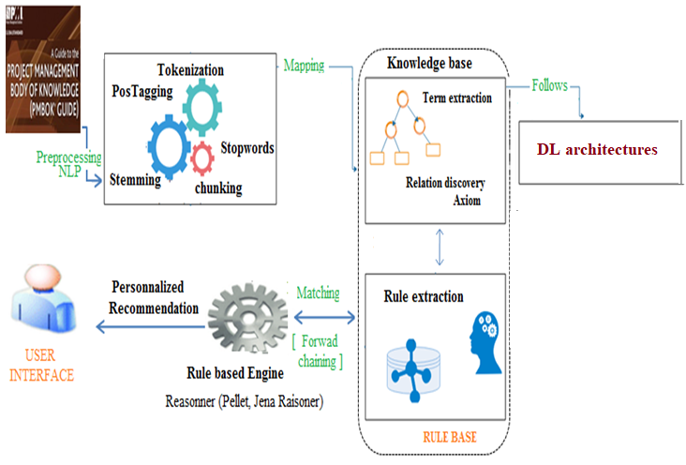
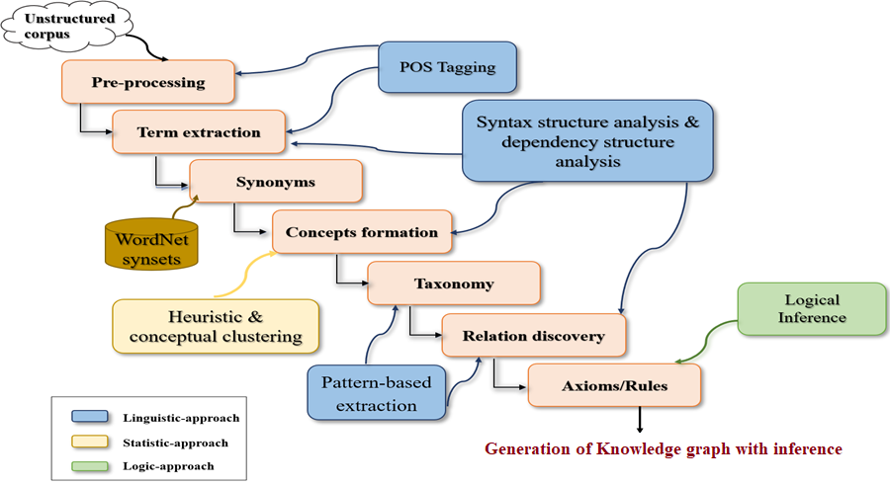
System architecture

Slide 9
Project Outlines: Steps to be followed
knowledge retrieval module (1): aims to extract the relevant knowledge (concepts, instances, relationships) from PMI’s corpus which is the reference best practice on RM.
Conceptual graph building module (2): With respect to the DL layers, we automatically structure and represent the RM knowledge into Graph structure . Then, a recommendation engine will be developed to encapsulate the interdependencies between concepts (e.g. “IF PR has probability value between 0.8 and 1 and impact rating value 100, THEN we obtain very high exposure and score value 100”).
The recommendation module (3) aims to infer personalized recommendation, advices on whether additional information is needed and suggests ways to obtain such information using recommendation techniques and approaches.
EXAMPLE:
For each process, the related tools and the deliverables (documents, lesson learned) are inferred based on user’s search query and profile.
A web-based system is implemented to support practitioners (e.g. project manager, risk owner, risk action owner) activities and then make the right decisions.

Slide 10

Project Outlines: Steps to be followed
The automatic knowledge retrieval process from unstructured text which is PMI’s standard for PRM (116 pages) using NLP techniques ,transformer models and LLMs.
This retrieved knowledge will be parsed following DL architecture layers into into GRAPH( concepts , Object properties, axioms ,rules , synonyms, keywords,,,) for building conceptual graph by applying machine learning techniques and deep learning architectures to structure the knowledge elements.
Based on graph repository by implementing association rules/rule base, Recommendations, guidelines and other information will inferred and predicted.
Implement a conceptual graph based recommendation system as a web application to infer a real-time personalized recommendation according to project stakeholder’s requests →The system evaluation through expert review meeting, black-box testing methods, etc.

Slide 11
Prototypes with illustrations
Conceptual graph Illustration
Graph illustration

Slide 12
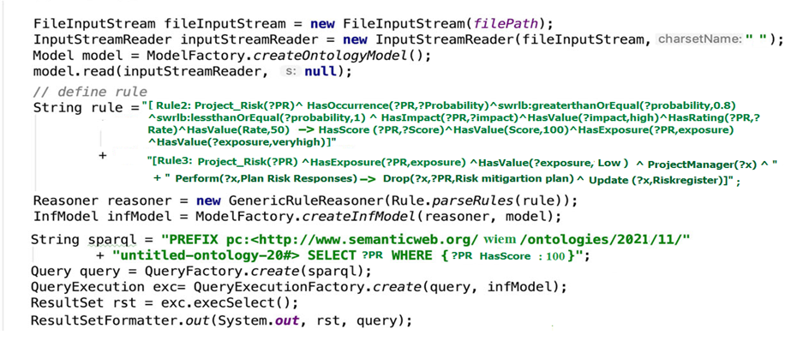
Prototypes with illustrations
Rule-Based recommendation engine
The reasoning process

Slide 13
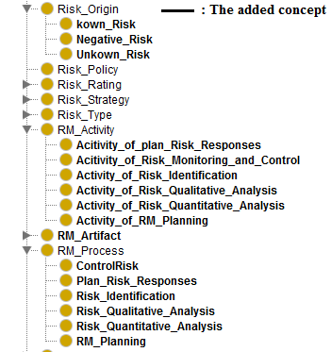
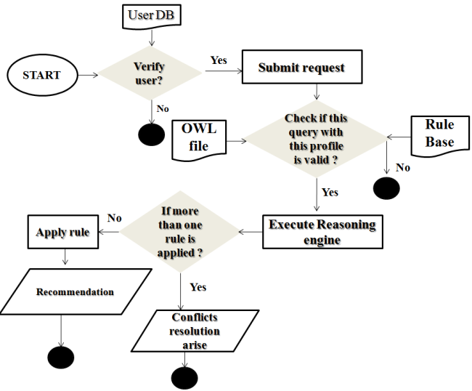
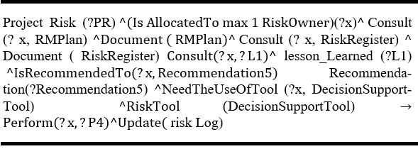
Prototypes with illustrations
Rule Base Illustration
We obtain a KB including 1492 concepts, 360 object properties, 66 instances, 90 data properties , 187 axioms and 22 rules.
Express reasoning sentence with SWRL language.

Slide 14
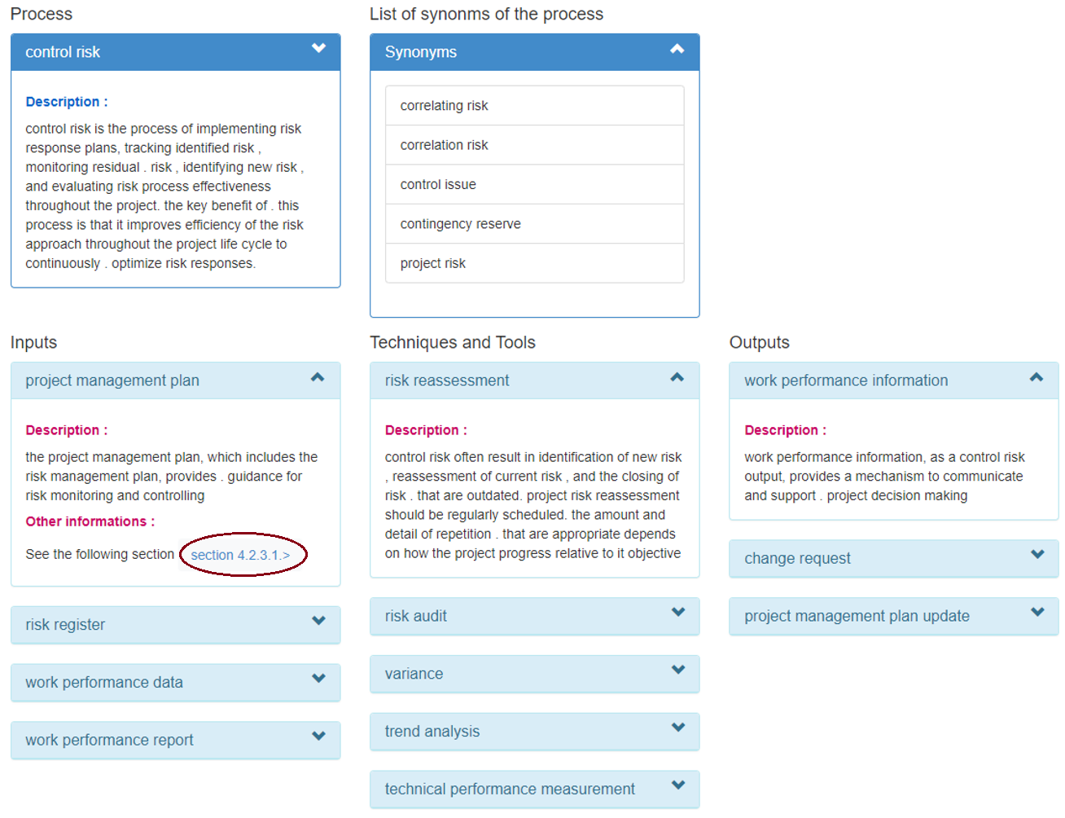
Prototypes with illustrations
System illustration
2022/2023

Slide 15


