Slide 1

Shared Security Model
Illustrative OCI learning diagram | No cloud execution

Slide 2

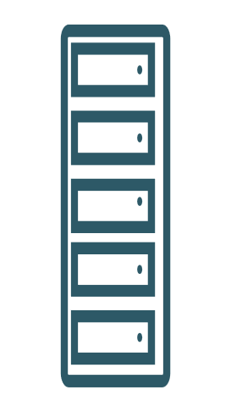


Shared Security Model
ILLUSTRATIVE LEARNING MODEL | NOT AN AS-BUILT DEPLOYMENT
Oracle secures physical infrastructure
Oracle
Physical facilities
customer responsibility depends on service model
Customer
Identity / guest OS / data
Shared security responsibility. Management / concept arrows unless explicitly marked traffic.
Scope: illustrative learning only; no OCI provisioning or paid service execution.
AI-assisted illustrative model; verify official docs. No OCI resources created.

Slide 3
Assumptions / scope
Shared security responsibility. Management / concept arrows unless explicitly marked traffic.
Scope: illustrative learning only; no OCI provisioning or paid service execution.
Repeated labels denote the same role in separate relationship views, not extra resources.
Service-family icon meanings and exact official toolkit titles are disclosed in the model JSON.
서비스별 고객·Oracle 책임 경계 비교
실제 OCI 실행·배포 검증은 수행하지 않았다.
이 논리 관계도는 Subnet 배치나 네트워크 route를 증명하지 않는다.

Slide 4
Validation checkpoints / sources
Confirm service-specific semantics; no cloud provisioning.
Verify native PowerPoint, hierarchy, endpoint attachment and icon provenance.
https://docs.oracle.com/en-us/iaas/Content/cloud-adoption-framework/security.htm

