Slide 1

Virtual Cloud Network (VCN)
Illustrative OCI learning diagram | No cloud execution

Slide 2
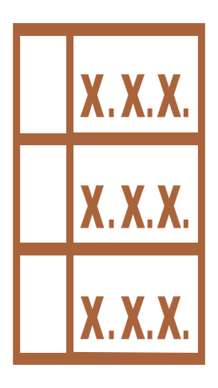


Virtual Cloud Network (VCN)
ILLUSTRATIVE LEARNING MODEL | NOT AN AS-BUILT DEPLOYMENT
OCI Region
Regional VCN 10.0.0.0/16
Regional Private Subnet 10.0.1.0/24
associated route table
Route Table
Security List
Compute / VNIC
associated security list
VCN and regional subnet span ADs. Routes select next hops; security rules separately permit traffic.
Service-family icon meanings and exact official toolkit titles are disclosed in the model JSON.
AI-assisted illustrative model; verify official docs. No OCI resources created.

Slide 3
Assumptions / scope
VCN and regional subnet span ADs. Routes select next hops; security rules separately permit traffic.
Service-family icon meanings and exact official toolkit titles are disclosed in the model JSON.
VCN·Subnet·경로·보안 연계 설계; 실제 생성 없음
실제 OCI 실행·배포 검증은 수행하지 않았다.
이 논리 관계도는 Subnet 배치나 네트워크 route를 증명하지 않는다.

Slide 4
Validation checkpoints / sources
Confirm service-specific semantics; no cloud provisioning.
Verify native PowerPoint, hierarchy, endpoint attachment and icon provenance.
https://docs.oracle.com/en-us/iaas/Content/Network/Concepts/overview.htm

