Slide 1

CIDR Blocks
Illustrative OCI learning diagram | No cloud execution

Slide 2
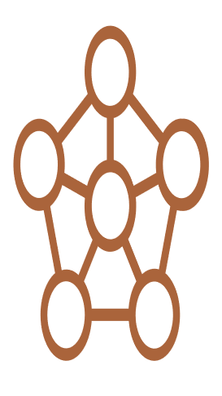
CIDR Blocks
ILLUSTRATIVE LEARNING MODEL | NOT AN AS-BUILT DEPLOYMENT
VCN 10.0.0.0/16
Subnet A 10.0.1.0/24
Subnet B 10.0.2.0/24
VCN address plan
address-plan view
Peer CIDR
10.1.0.0/16
compare: no overlap
CIDR containment and non-overlap. Management / concept arrows unless explicitly marked traffic.
Scope: illustrative learning only; no OCI provisioning or paid service execution.
AI-assisted illustrative model; verify official docs. No OCI resources created.

Slide 3
Assumptions / scope
CIDR containment and non-overlap. Management / concept arrows unless explicitly marked traffic.
Scope: illustrative learning only; no OCI provisioning or paid service execution.
Arbitrary illustrative private CIDRs; no peering is configured.
Service-family icon meanings and exact official toolkit titles are disclosed in the model JSON.
Subnet은 VCN 범위 내 상호 비중첩; 피어 대역도 대조
실제 OCI 실행·배포 검증은 수행하지 않았다.
이 논리 관계도는 Subnet 배치나 네트워크 route를 증명하지 않는다.

Slide 4
Validation checkpoints / sources
Confirm service-specific semantics; no cloud provisioning.
Verify native PowerPoint, hierarchy, endpoint attachment and icon provenance.
https://docs.oracle.com/en-us/iaas/Content/Network/Concepts/overview.htm

