Slide 1
Laptop Price Prediction System
Kaveesh Senevirathne
GDSE 58

Slide 2
Introduction
Good morning, everyone. I'm excited to introduce my project: the 'Laptop Price Prediction System.' In a world inundated with laptop options, our system leverages the power of machine learning to streamline decision-making. By forecasting laptop prices based on specifications, we empower users with essential insights for confident purchasing decisions.
Join me as we delve into how data, algorithms, and intuitive interfaces converge to revolutionize the laptop shopping journey.
01

Slide 3
Problem
In the ever-expanding landscape of laptops, consumers face a significant challenge in making informed purchase decisions. With a multitude of brands, models, and specifications available, determining the fair market value of a laptop tailored to individual needs becomes a complex task. The absence of a reliable tool for predicting laptop prices hinders users from navigating this vast market with confidence.
02

Slide 4
Solution
Our 'Laptop Price Prediction System' uses machine learning to analyze historical data and predict laptop prices based on specifications. This tool empowers consumers by offering insights and a user-friendly experience. With features like 'The Predictor,' users can get a tentative price range for their desired laptop configurations.
03

Slide 5
FEATURES
Visualizations
Visualizes the spread of laptop prices based on different manufacturers.
Insights into the range of pricing strategies adopted by various companies. Illustrates the average prices of laptops categorized by their RAM capacities..
The Predictor
User-Friendly Interface: An intuitive form guides users through the input process.
Transparency: Users gain insights into how each specified configuration contributes to the predicted price.
Quick and Informed Decisions: The Predictor streamlines the decision-making process, offering users a swift and data-driven perspective on potential laptop purchases.
04

Slide 6
Technology Stack
Backend
Flask - A lightweight and versatile web framework for building the backend API
Python - The primary programming language for developing the Flask application.
Machine Learning Library - Scikit-learn
Frontend
HTML,CSS - The trio for building the user interface
Web Service
AWS - Hosting platforms for deploying and hosting your Flask application.
05

Slide 7
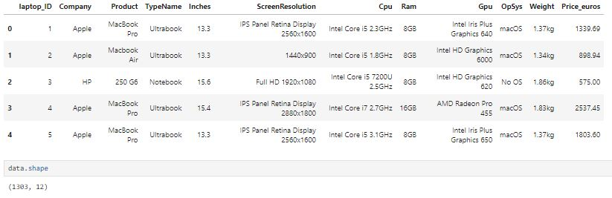
Machine learning model build
Data Set
06

Slide 8
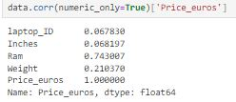
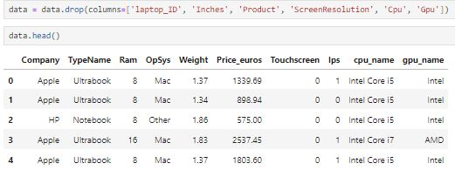
Machine learning model build
Correlation
Final Dataset
07

Slide 9
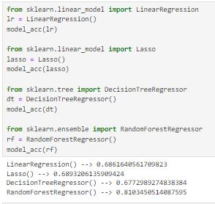
Machine learning model Train
Regression
08

Slide 10
Thank you
Thank you for choosing our Laptop Price Prediction System! Your engagement is valuable to us, and we appreciate the opportunity to assist you in making informed decisions about your next laptop purchase.

