Slide 1
TA
KP
FT
1. Start application
1. Request Bluetooth connection
3. Request Serial communication connection
2. Response Bluetooth connection
4. Response Serial communication connection
5. Generate a random character
6. Display the random character
7. Send the character code
8. Enable the Electromagnet(match the character code )
9. Send the character code
10. Enable the Electromagnet(match the character code )
11. Detect the Keyboard Interrupt
12. Send an Electromagnet Disabled Signal
13. Disable the Electromagnet
14. Send an Electromagnet Disabled Signal
15. Disable the Electromagnet
16. Generate another random character
.
.
.
.
.
.
.
.
.

Slide 2
Computer
Typing Assistant
Keyboard Panel
FingerTip
Application
Arduino Mega
Arduino Uno
Serial communicate Master
Serial communicate Slave
Bluetooth communicate Master
Bluetooth communicate Slave
Random-character Generator
Practice-note Displayer
Interrupt Detector
Electromagnet state Converter
Electromagnet state Converter
Keyboard
Voltage Convert
(12V → 5V)
USB Serial
(5V)
External Voltage
(12V)

Slide 3
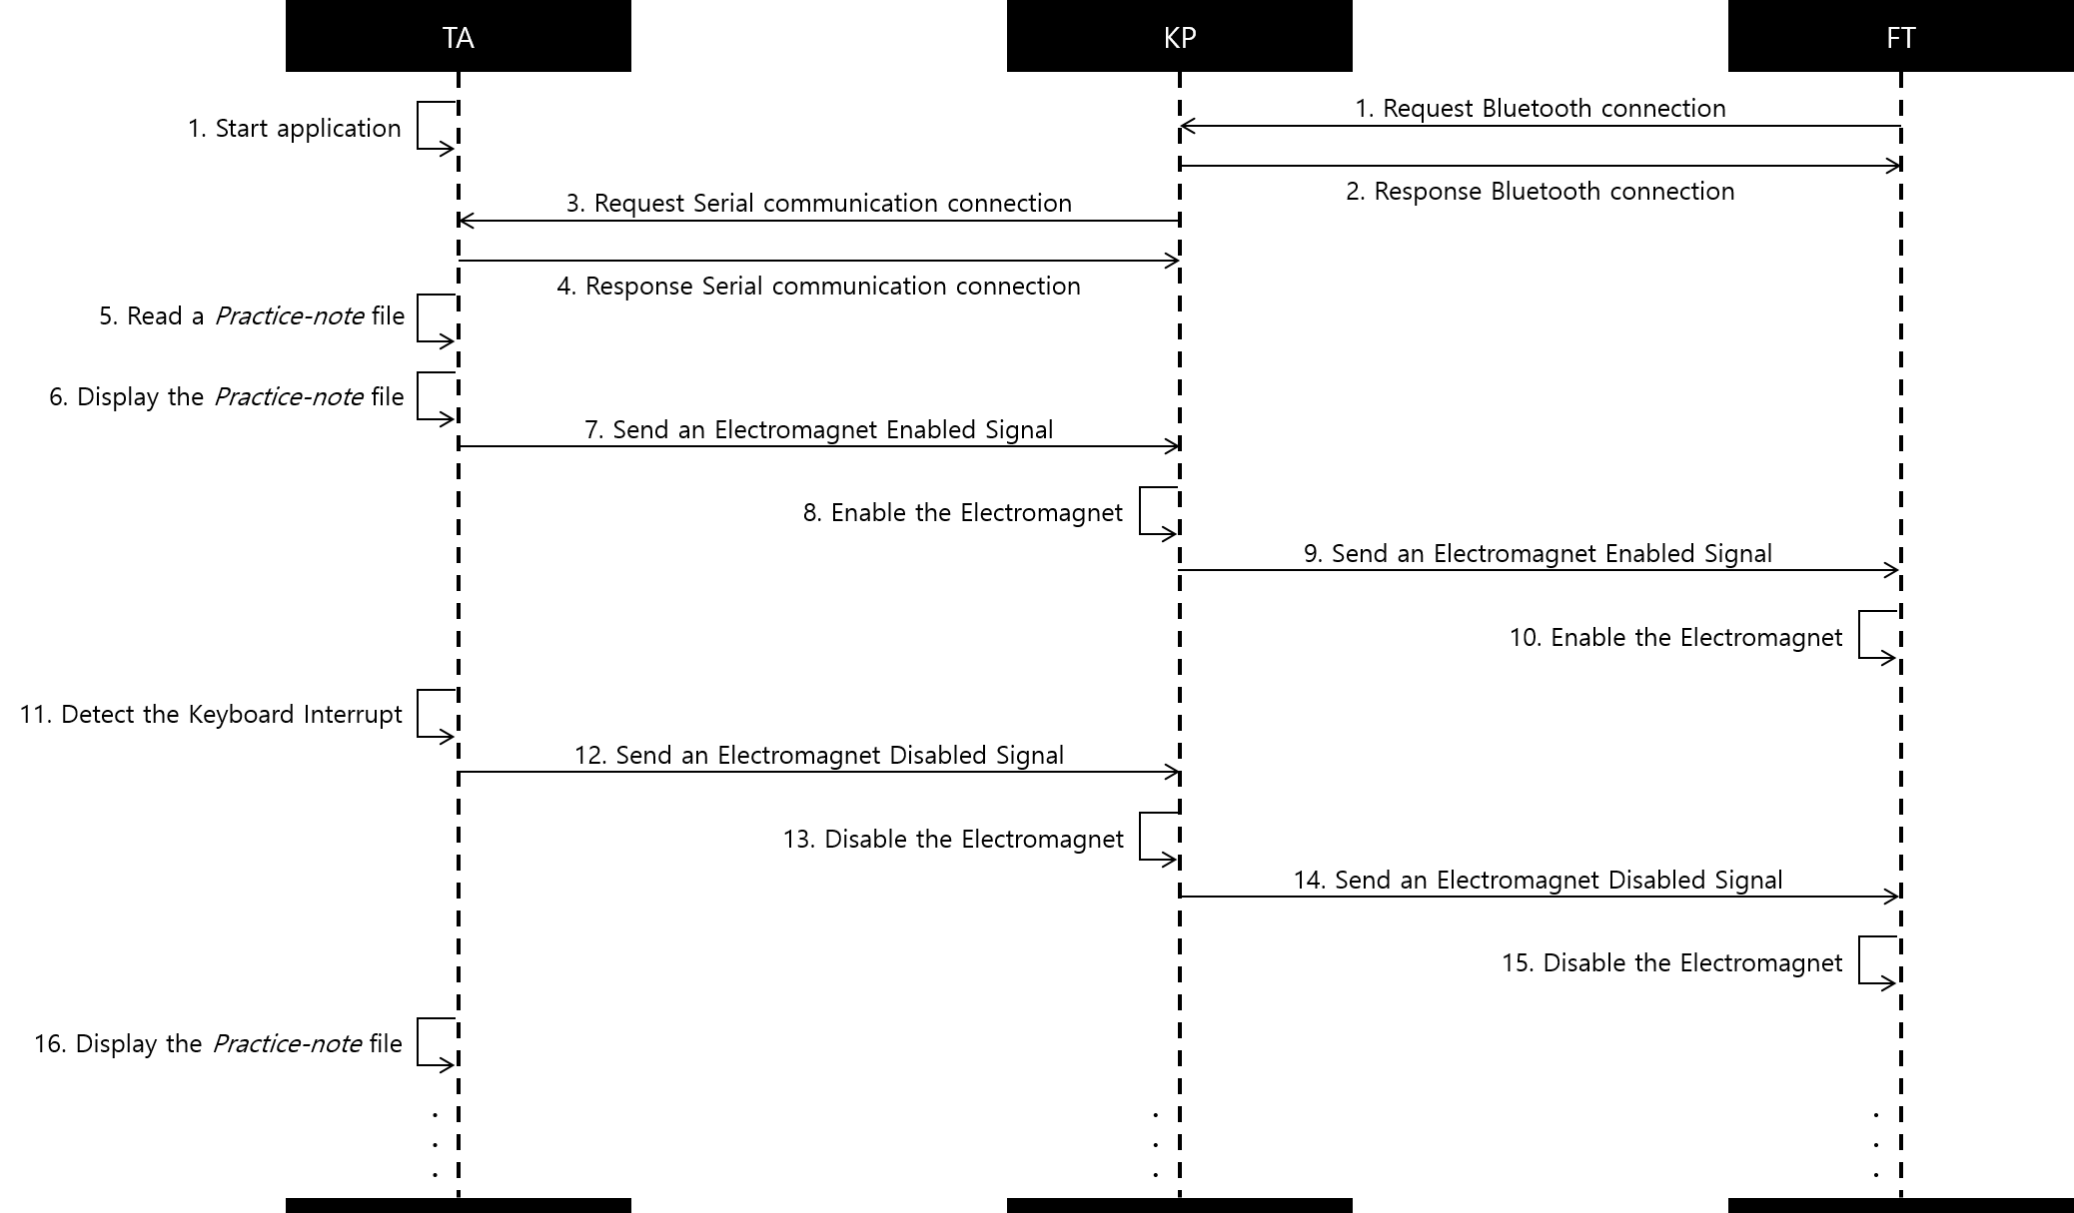

Slide 4
