Slide 1
Hybrid AML Fraud Detection in PostgreSQL + Apache AGE
LIVE DEMO SNAPSHOT
1
shared PostgreSQL + AGE stack
14
main slides in the demo flow
Problem statement, graph rationale, storage architecture, query execution, and EXPLAIN-based performance analysis
2
focus areas: storage + execution
This demo asks whether one relational system can keep AML data authoritative in PostgreSQL while still supporting graph-style fraud analysis through Apache AGE.
2 + 3
major operations + appendix backups
Research lens: compare relational SQL and Cypher on the same Hybrid AML dataset, then explain the performance gap through storage design and execution plans.
Source: README.md; docs/reports/detection_rules_pseudocode.md; docs/reports/cycle_benchmark_summary.md.
1

Slide 2
This deck directly covers the Phase 3 demo rubric from application behavior to database internals.
The revised flow makes the demo requirements explicit before the two query paths.
Rubric item
Where covered
Deck evidence
Two major application operations
Slides 9 to 10 for smurfing and Slides 12 to 13 for circular trading.
Each operation gets one application slide and one EXPLAIN analysis slide.
Application of system focus areas
Slides 8 and 11 are dedicated concept slides.
Storage Architecture and Query Execution each get their own richer explanation.
What the application does / what the database does internally / why it matters
Slides 9 and 12 use those exact three prompts.
The rubric wording is visible in the slide titles inside each operation panel.
Runnable evidence
Slide 6 plus Appendix A1 and A2.
Code, schema, dataset, and instructions to run are mapped to repo paths.
Performance explanation
Slides 10, 11, 13, and 14.
EXPLAIN operator summaries and planning/execution medians show why SQL is faster here.
14
3
2
2
main slides
appendix slides
major operations
focus areas
DECK LOGIC
Every required demo element now maps to an explicit main slide or appendix artifact.
Source: docs/guidelines/551_project_guideline_sp26.pdf; README.md; docs/reports/detection_rules_pseudocode.md.
2

Slide 3
AML monitoring is not just reporting over rows; it is also analysis over connected transaction networks.
The problem statement and research question both come from that dual structure.
Problem statement
Research question
What we evaluate
AML data starts as transactional rows, but suspicious behavior appears across multiple accounts and transfers.
Can PostgreSQL + Apache AGE support both relational AML queries and graph-style path analysis on one shared dataset?
Correctness of the two query paths on the same labeled scenarios.
A simple reporting-only view can miss how money moves through networks of related entities.
If yes, where do the performance costs actually come from?
Storage design, execution plans, planning time, and execution time.
Relational side of AML
Graph side of AML
Project hypothesis
Customers, accounts, and transaction logs need trusted ACID storage, joins, filters, and repeatable setup.
Suspicious flows create paths, rings, fan-in funnels, and link analysis questions over account relationships.
A graph layer inside PostgreSQL may preserve one-stack simplicity while still expressing graph-shaped AML rules.
Our source of truth is still relational.
The same data behaves like a network.
The tradeoff should appear in EXPLAIN output and runtime medians.
Rows
Paths
Loops
Links
trusted records
movement chains
ring patterns
entity relationships
KEY MESSAGE
AML data has a dual nature: rows for trusted records, graphs for suspicious movement patterns.
Source: docs/proposal/Phase 1_ Project Proposal.pdf; README.md; docs/reports/Phase2_MidtermReport_ChanyoungKim_YogitaMutyala.pdf.
3

Slide 4
Why graph analysis matters in AML
AML workloads often ask who is connected to whom, through which path, and within which time window.
Many-hop transaction chains
Circular trading rings
Fan-in and fan-out flows
Linked entities
Funds can move through several accounts before reaching a suspicious destination.
A -> B -> C -> A loops are defined by ordered edges across distinct accounts.
Smurfing and layering both create unusual concentration or dispersion patterns.
Shell accounts, shared controllers, and related parties create relationship-first investigations.
That is naturally a path problem, not a single-row problem.
The suspicious signal lives in the cycle.
These are network shapes over transfers.
Entity linkage extends beyond one table join.
AML pattern
Why graph-style reasoning fits
Project connection
Connected transaction networks
Accounts become nodes and transfers become edges, so suspicious chains become traversals.
Our circular trading rule operates directly on a transfer network.
Relationship-first reasoning
Investigators care about paths, neighborhoods, and repeating motifs rather than isolated facts.
The tuned graph keeps only transfer edges to focus that reasoning.
Complex chains at scale
External AML graph references highlight long chains and related-entity discovery as common fraud tasks.
We use those ideas as motivation, then benchmark them on one stack.
AML takeaway: AML data is row-based and relationship-based at the same time, so graph-style traversal is operationally natural.
Source: AWS Architecture Blog, Financial Crime Discovery Using Amazon EKS and Graph Databases; Deloitte, Knowledge Graphs for Financial Services (2024); project proposal rationale.
4

Slide 5
Why choose PostgreSQL + Apache AGE
The design choice is relational source of truth plus graph-style analysis in one database stack.
What AML needs
What PostgreSQL gives
What AGE adds
Transactional logs and customer/account data need ACID relational storage.
Heap-organized relational tables remain the authoritative store for customers, accounts, and transactions.
Apache AGE brings openCypher into PostgreSQL without moving data to a separate native graph engine.
Suspicious patterns such as circular trading require graph-style traversal.
Typed columns, indexes, joins, and recursive SQL make the baseline measurable and practical.
Account vertices and TRANSFER edges can be projected from the same relational rows.
The demo also needs reproducible loading, filtering, grouping, and benchmarking.
The same engine handles setup scripts and query execution.
PostgreSQL + AGE avoids maintaining separate relational and graph systems.
Design choice
Why it matters
One authoritative store
Transactions, accounts, and customer records stay in PostgreSQL, so data loading and validation stay simple.
Graph-on-relational extension
AGE adds graph projection and Cypher syntax while keeping the same physical database environment.
Same-stack comparison
SQL and Cypher can be compared on the same dataset, indexes, machine, and execution engine family.
ACID
openCypher
1 stack
1 dataset
trusted storage
graph query layer
no split systems
direct comparison
Source: docs/proposal/Phase 1_ Project Proposal.pdf; docs/reports/Phase2_MidtermReport_ChanyoungKim_YogitaMutyala.pdf; AWS Architecture Blog; Deloitte 2024 white paper.
5

Slide 6
The repo is already runnable as a demo prototype with dataset, setup scripts, and run instructions.
Every required artifact for the live demo can be pointed to inside the repository.
Artifact
Repo evidence
Why it matters
RESET AND RUN
Source code
database/, src/, docs/demo/
Shows the queries, data generation, and slide/deck code used in the demo.
./scripts/reset_pipeline.sh
docker exec -i -w /workspace apache-age \
psql -U postgres -d hybrid_aml \
Schema/setup
001_schema.sql, setup_age.sql, load_age_graph*.sql
The schema and graph projections can be rebuilt from scratch.
< database/queries/smurfing_detection.sql
docker exec -i -w /workspace apache-age \
< database/queries/circular_trading_cypher_tuned.sql
Dataset
data/synthetic/*.csv
The benchmark uses a small labeled workload with normal and suspicious scenarios.
Instructions to run
README.md and scripts/reset_pipeline.sh
A TA can reset the environment and replay the demo steps.
Why this matters
The live demo proves the repo can rebuild data, load schema, materialize graphs, and execute both query paths from one reset-first workflow.
324
369
1,896
1
customers
accounts
transactions
reset command
Source: README.md; scripts/reset_pipeline.sh; database/; data/synthetic/.
6

Slide 7
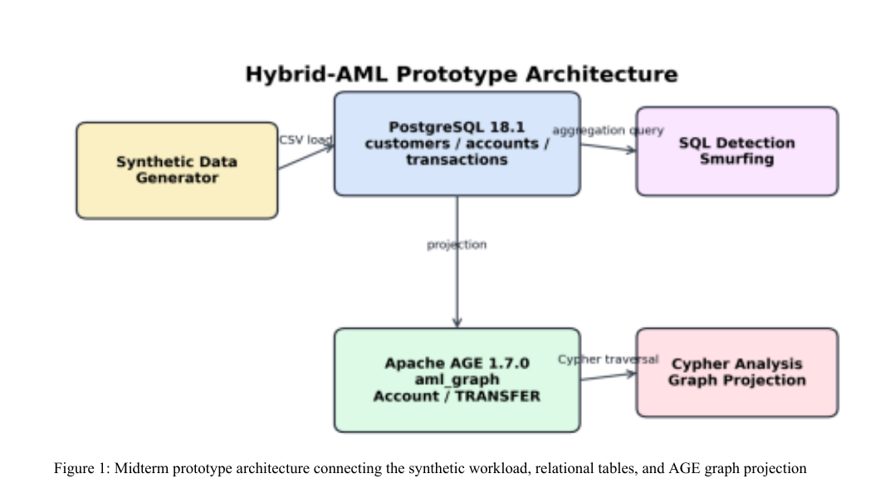
Prototype Architecture
The core prototype flow comes from the midterm Figure 1 and still matches the current demo stack.
Source of truth
Synthetic customers, accounts, and transactions are generated first and loaded into PostgreSQL tables.
Graph projection
AGE then projects Account vertices and TRANSFER edges from the same relational workload for Cypher-based analysis.
Why this slide matters
This architecture slide is about system flow only; the storage and execution details come next in the focus area slides.
Pipeline takeaway: one pipeline produces both relational analysis and graph analysis from the same synthetic workload.
Source: docs/reports/Phase2_MidtermReport_ChanyoungKim_YogitaMutyala.pdf, Figure 1 on page 2; current demo reuses the same architecture with richer queries.
7

Slide 8
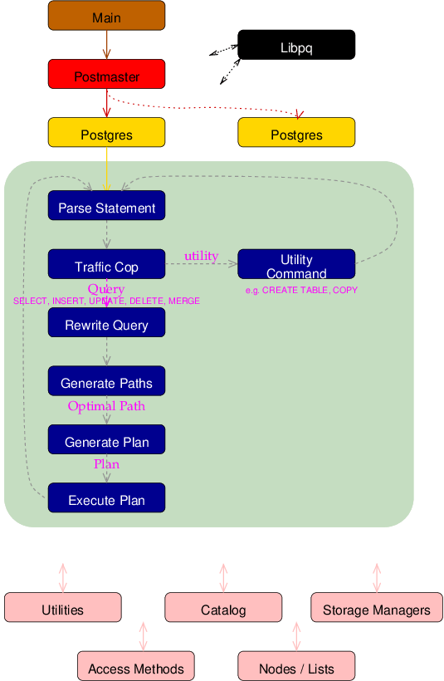
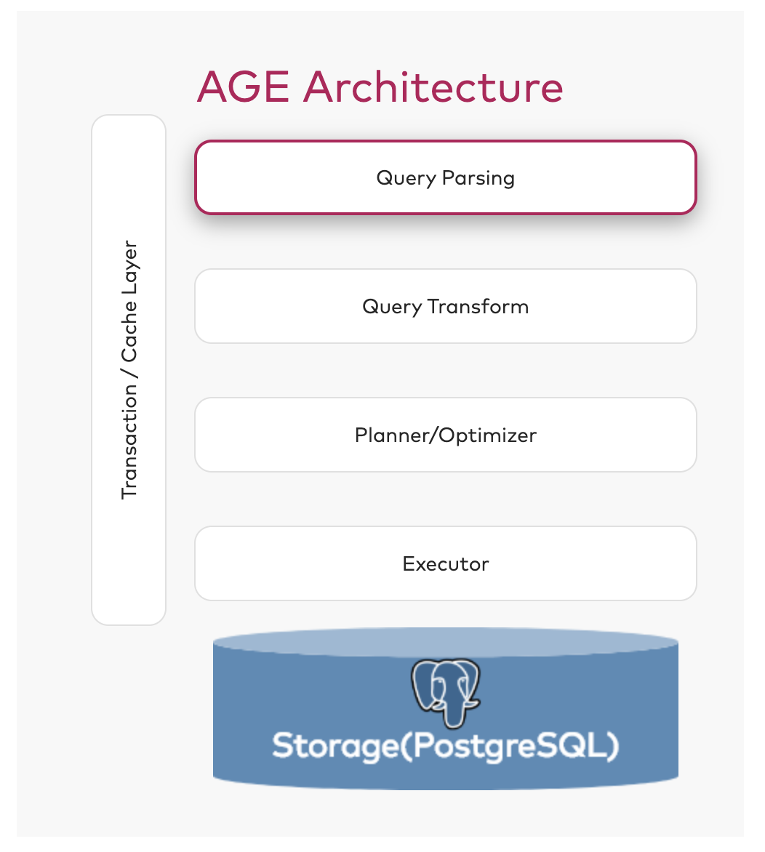
Focus Area 1: Storage Architecture
PostgreSQL System Architecture
APACHE AGE System Architecture
1. Query Parsing
AGE first parses openCypher syntax embedded in the cypher() call and identifies the requested graph operations.
PostgreSQL first parses incoming SQL and converts it into an internal query representation.
2. Query Rewrite / Planning
The parsed Cypher query is transformed into PostgreSQL's internal query tree, usually as a subquery node inside the SQL pipeline
The system rewrites complex queries when needed and chooses the lowest-cost execution plan
3. Execution on Heap Storage
The executor runs the selected plan on heap-organized tables, with indexes pointing to the target heap tuples.
PostgreSQL then builds the execution plan, while AGE adds graph-aware plan nodes for pattern matching, traversal, and property access.
4. MVCC and Cleanup
Concurrency is handled through tuple-version MVCC, and obsolete row versions are later reclaimed by VACUUM.
The executor runs those plan nodes on graph labels stored in PostgreSQL, so AGE ultimately relies on PostgreSQL storage, cache, and ACID transactions.
Difference from other RDBMS
Difference from other Graph DBMS
Unlike MySQL with the InnoDB storage engine, PostgreSQL does not separate the SQL layer from a standalone storage engine. It uses a more unified architecture with tuple-version MVCC and stronger extensibility.
Unlike native graph databases, Apache AGE does not use a separate graph storage engine. It layers graph querying on top of PostgreSQL so relational and graph workloads share one transactional system.
8

Slide 9
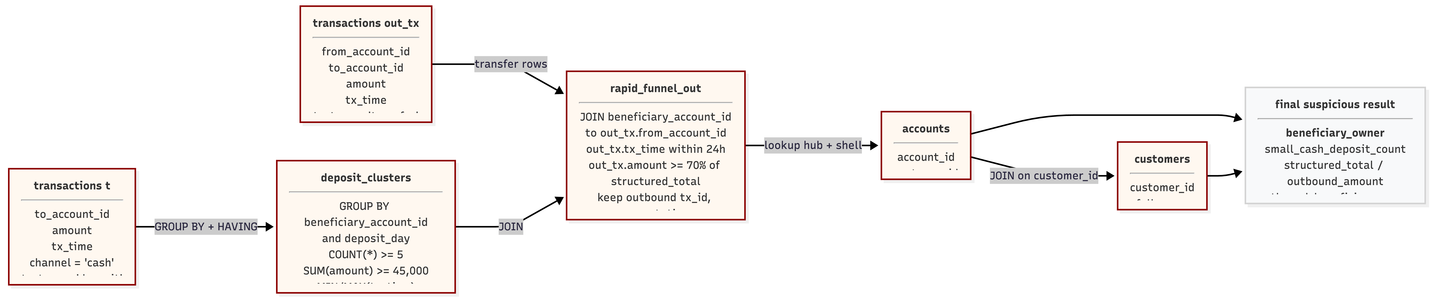
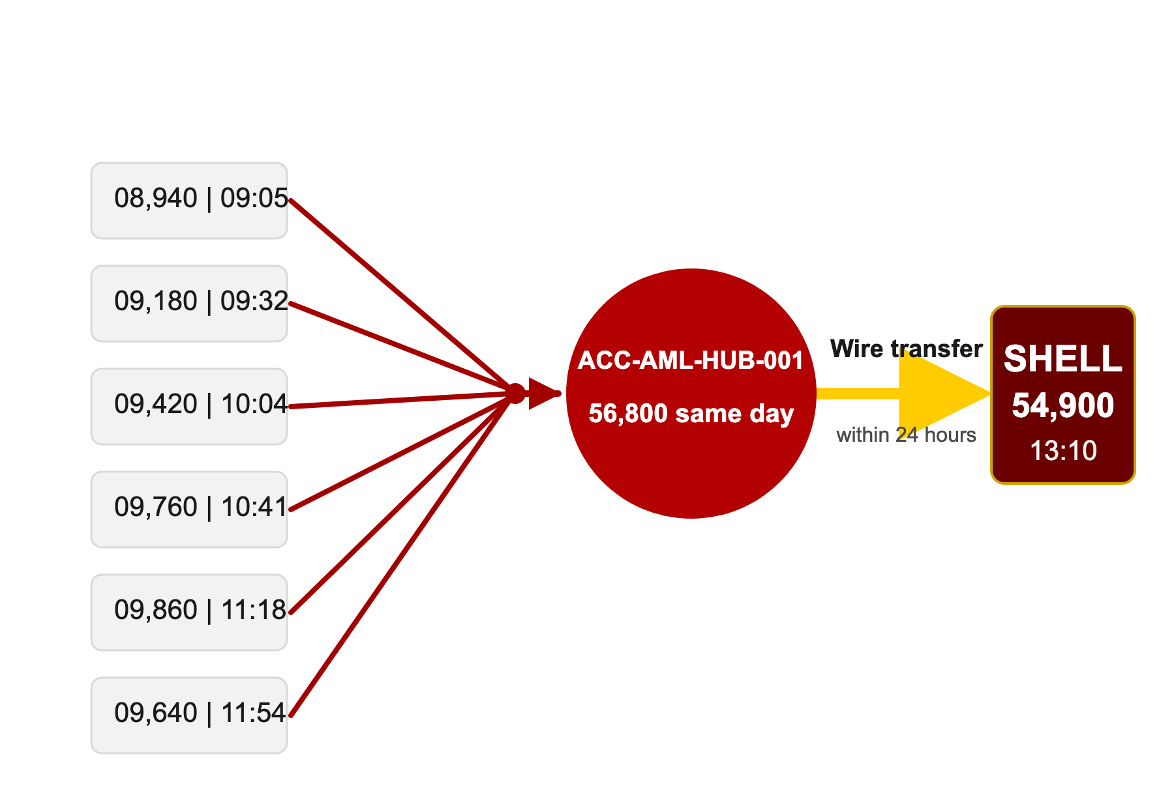
What the application does 1: Smurfing detection
Smurfing Scenario Visual Explanation
SQL Logic
Real-World Example
Several small cash deposits were made into account ACC-AML-HUB-001 on the same day, including $8,940 at 09:05, $9,180 at 09:32, $9,420 at 10:04, $9,760 at 10:41, $9,860 at 11:18, and $9,640 at 11:54. Although each deposit was made in a relatively small amount, together they totaled $56,800 in one day. Shortly afterward, the account sent a wire transfer of $54,900 to SHELL at 13:10. This pattern is suspicious because multiple sub-threshold deposits were quickly consolidated into one account and then transferred out within a short period of time, which is a common sign of smurfing or structuring in money laundering.
9

Slide 10
Query Explanation 1: Smurfing EXPLAIN analysis
PostgreSQL SQL Execution EXPLAIN
APACHE AGE Execution EXPLAIN
1. Seq Scan on aml_graph."TRANSFER"
Filter: agtype tx_type='deposit' AND channel='cash'
cost=0..93.92 rows=105 Buffers=56
deposit edges only
1. Seq Scan on aml_graph."TRANSFER"
Filter: agtype tx_type='deposit' AND channel='cash'
cost=0..93.92 rows=105 Buffers=56
deposit edges only
1. Seq Scan on aml_graph."TRANSFER"
Filter: agtype tx_type='deposit' AND channel='cash'
cost=0..93.92 rows=105 Buffers=56
deposit edges only
1. Seq Scan on aml_graph."TRANSFER"
Filter: agtype tx_type='deposit' AND channel='cash'
cost=0..93.92 rows=105 Buffers=56
deposit edges only
1. Seq Scan on public.transactions
Filter: tx_type='deposit' AND channel='cash'
cost=0..59.44 rows=105 Buffers=31
picks out small cash deposits
1. Seq Scan on public.transactions
Filter: tx_type='deposit' AND channel='cash'
cost=0..59.44 rows=105 Buffers=31
picks out small cash deposits
1. Seq Scan on public.transactions
Filter: tx_type='deposit' AND channel='cash'
cost=0..59.44 rows=105 Buffers=31
picks out small cash deposits
1. Seq Scan on public.transactions
Filter: tx_type='deposit' AND channel='cash'
cost=0..59.44 rows=105 Buffers=31
picks out small cash deposits
2. Index Only Scan on aml_graph."Account"
Account_pkey Cond: id = TRANSFER.start_id
Inner Unique loops=105 Heap Fetches=105
Buffers=210
2. Index Only Scan on aml_graph."Account"
Account_pkey Cond: id = TRANSFER.start_id
Inner Unique loops=105 Heap Fetches=105
Buffers=210
2. Index Only Scan on aml_graph."Account"
Account_pkey Cond: id = TRANSFER.start_id
Inner Unique loops=105 Heap Fetches=105
Buffers=210
2. Index Only Scan on aml_graph."Account"
Account_pkey Cond: id = TRANSFER.start_id
Inner Unique loops=105 Heap Fetches=105
Buffers=210
2. Sort → GroupAggregate on public.transactions
Keys: to_account_id, date_trunc(day, tx_time)
count(*) / sum(amount) / min / max
HAVING count≥5 AND sum≥45,000 rows=9 / 60
2. Sort → GroupAggregate on public.transactions
Keys: to_account_id, date_trunc(day, tx_time)
count(*) / sum(amount) / min / max
HAVING count≥5 AND sum≥45,000 rows=9 / 60
2. Sort → GroupAggregate on public.transactions
Keys: to_account_id, date_trunc(day, tx_time)
count(*) / sum(amount) / min / max
HAVING count≥5 AND sum≥45,000 rows=9 / 60
2. Sort → GroupAggregate on public.transactions
Keys: to_account_id, date_trunc(day, tx_time)
count(*) / sum(amount) / min / max
HAVING count≥5 AND sum≥45,000 rows=9 / 60
3. Sort → GroupAggregate on aml_graph."TRANSFER"
agtype_access_operator extracts amount / tx_time
grouped by Account.account_id, day
HAVING count≥5 AND sum≥45,000 rows=9 Buffers=518
3. Sort → GroupAggregate on aml_graph."TRANSFER"
agtype_access_operator extracts amount / tx_time
grouped by Account.account_id, day
HAVING count≥5 AND sum≥45,000 rows=9 Buffers=518
3. Sort → GroupAggregate on aml_graph."TRANSFER"
agtype_access_operator extracts amount / tx_time
grouped by Account.account_id, day
HAVING count≥5 AND sum≥45,000 rows=9 Buffers=518
3. Sort → GroupAggregate on aml_graph."TRANSFER"
agtype_access_operator extracts amount / tx_time
grouped by Account.account_id, day
HAVING count≥5 AND sum≥45,000 rows=9 Buffers=518
3. Index Scan on public.transactions
idx_transactions_from_account_time
Cond: from_account_id = deposit-beneficiary AND
tx_time within 24h funnel window
Filter: tx_type='transfer' AND amount≥0.70·Σ
3. Index Scan on public.transactions
idx_transactions_from_account_time
Cond: from_account_id = deposit-beneficiary AND
tx_time within 24h funnel window
Filter: tx_type='transfer' AND amount≥0.70·Σ
3. Index Scan on public.transactions
idx_transactions_from_account_time
Cond: from_account_id = deposit-beneficiary AND
tx_time within 24h funnel window
Filter: tx_type='transfer' AND amount≥0.70·Σ
3. Index Scan on public.transactions
idx_transactions_from_account_time
Cond: from_account_id = deposit-beneficiary AND
tx_time within 24h funnel window
Filter: tx_type='transfer' AND amount≥0.70·Σ
4. Hash Join on aml_graph."Account" ⋈ deposit groups
Seq Scan aml_graph."Account" (369 rows, 474 kB)
Hash Cond: Account.account_id = beneficiary_id
4. Hash Join on aml_graph."Account" ⋈ deposit groups
Seq Scan aml_graph."Account" (369 rows, 474 kB)
Hash Cond: Account.account_id = beneficiary_id
4. Hash Join on aml_graph."Account" ⋈ deposit groups
Seq Scan aml_graph."Account" (369 rows, 474 kB)
Hash Cond: Account.account_id = beneficiary_id
4. Hash Join on aml_graph."Account" ⋈ deposit groups
Seq Scan aml_graph."Account" (369 rows, 474 kB)
Hash Cond: Account.account_id = beneficiary_id
5. Index Scan on aml_graph."TRANSFER" (outbound)
TRANSFER_start_id_idx Cond: start_id = Account.id
Nested Loop Filter: time window AND amt≥0.70·Σ
then Index Scan aml_graph."Account" (dst)
5. Index Scan on aml_graph."TRANSFER" (outbound)
TRANSFER_start_id_idx Cond: start_id = Account.id
Nested Loop Filter: time window AND amt≥0.70·Σ
then Index Scan aml_graph."Account" (dst)
5. Index Scan on aml_graph."TRANSFER" (outbound)
TRANSFER_start_id_idx Cond: start_id = Account.id
Nested Loop Filter: time window AND amt≥0.70·Σ
then Index Scan aml_graph."Account" (dst)
4. Nested Loop × 4 on public.accounts & public.customers
accounts_pkey → customers_pkey (Inner Unique)
beneficiary account + customer,
shell account + customer
cost=60.96..69.46 Buffers=169
5. Index Scan on aml_graph."TRANSFER" (outbound)
TRANSFER_start_id_idx Cond: start_id = Account.id
Nested Loop Filter: time window AND amt≥0.70·Σ
then Index Scan aml_graph."Account" (dst)
4. Nested Loop × 4 on public.accounts & public.customers
accounts_pkey → customers_pkey (Inner Unique)
beneficiary account + customer,
shell account + customer
cost=60.96..69.46 Buffers=169
4. Nested Loop × 4 on public.accounts & public.customers
accounts_pkey → customers_pkey (Inner Unique)
beneficiary account + customer,
shell account + customer
cost=60.96..69.46 Buffers=169
4. Nested Loop × 4 on public.accounts & public.customers
accounts_pkey → customers_pkey (Inner Unique)
beneficiary account + customer,
shell account + customer
cost=60.96..69.46 Buffers=169
6. Nested Loop × 3 on public.accounts & public.customers
accounts_pkey → customers_pkey (agtype → text cast
on every edge) for beneficiary and shell sides
loops=9 Buffers=629..683
6. Nested Loop × 3 on public.accounts & public.customers
accounts_pkey → customers_pkey (agtype → text cast
on every edge) for beneficiary and shell sides
loops=9 Buffers=629..683
6. Nested Loop × 3 on public.accounts & public.customers
accounts_pkey → customers_pkey (agtype → text cast
on every edge) for beneficiary and shell sides
loops=9 Buffers=629..683
6. Nested Loop × 3 on public.accounts & public.customers
accounts_pkey → customers_pkey (agtype → text cast
on every edge) for beneficiary and shell sides
loops=9 Buffers=629..683
5. Sort (final)
Sort Key: sum(amount) DESC, out_tx.tx_time
rows=9 Execution Time ≈ 0.99 ms
5. Sort (final)
Sort Key: sum(amount) DESC, out_tx.tx_time
rows=9 Execution Time ≈ 0.99 ms
5. Sort (final)
Sort Key: sum(amount) DESC, out_tx.tx_time
rows=9 Execution Time ≈ 0.99 ms
5. Sort (final)
Sort Key: sum(amount) DESC, out_tx.tx_time
rows=9 Execution Time ≈ 0.99 ms
7. Sort (final)
Sort Key: structured_total DESC, tx_time
rows=9 Execution Time ≈ 5.86 ms
7. Sort (final)
Sort Key: structured_total DESC, tx_time
rows=9 Execution Time ≈ 5.86 ms
7. Sort (final)
Sort Key: structured_total DESC, tx_time
rows=9 Execution Time ≈ 5.86 ms
7. Sort (final)
Sort Key: structured_total DESC, tx_time
rows=9 Execution Time ≈ 5.86 ms
What the database does internally
Seq Scan on public.transactions picks small cash deposits (tx_type='deposit', channel='cash'). Sort → GroupAggregate by beneficiary account + day, keeping clusters ≥ 5 deposits totalling ≥ $45,000. For each cluster, Index Scan on idx_transactions_from_account_time finds an outbound wire within a 24-hour funnel window carrying ≥ 70% of the deposited sum. Four Nested Loop joins with public.accounts + public.customers add customer names (beneficiary + shell). Final Sort by structured_total. Result: 9 hits in ≈ 0.99 ms / 169 shared buffers.
What the database does internally
Same rule on aml_graph."TRANSFER" edges, but every amount/tx_time is unwrapped via agtype_access_operator and cast from agtype → Postgres type on every row. After grouping deposits by beneficiary vertex, a Hash Join back against aml_graph."Account" binds the beneficiary before the outbound TRANSFER lookup, then three more Nested Loop joins with public.accounts + public.customers recover typed PK values. Extra casts + vertex bindings push it to ≈ 5.86 ms / 689 shared buffers
Why it matters: AGE adds graph-layer work before the same result is produced
10

Slide 11
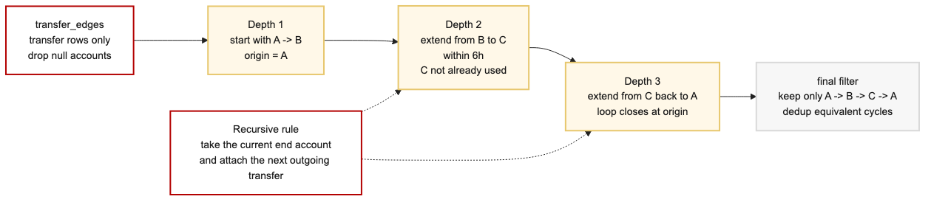
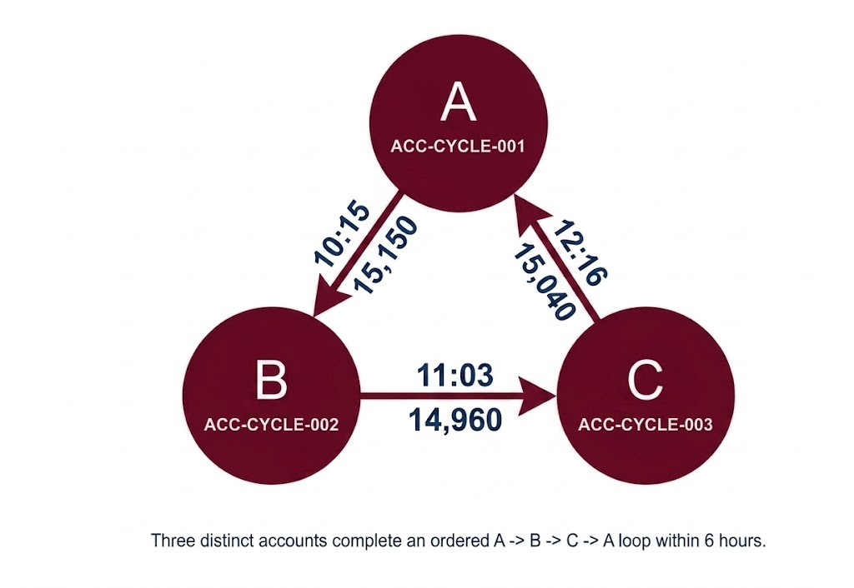
What the application does 2: Circular trading detection
Circular Trading Scenario
Visual Explanation
SQL Logic
Real-World Example
Several transactions take place among three different accounts in a short period of time. First, account A (ACC-CYCLE-001) sends $15,150 to account B (ACC-CYCLE-002) at 10:15. Then, account B sends $14,960 to account C (ACC-CYCLE-003) at 11:03. Finally, account C sends $15,040 back to account A at 12:16. This creates a closed loop of money flow, A → B → C → A, within only a few hours. This pattern is suspicious because the funds circulate among related accounts and return close to the starting point, which may indicate circular trading or layering behavior used to create artificial transaction activity and obscure the true origin of funds.
12

Slide 12
Query Explanation 2: Circular trading EXPLAIN analysis
PostgreSQL SQL Execution EXPLAIN
APACHE AGE Execution EXPLAIN
1. Seq Scan on public.transactions
Filter: tx_type='transfer'
AND from_account_id / to_account_id NOT NULL
rows=792 / Removed 1104 Buffers=31
1. Seq Scan on public.transactions
Filter: tx_type='transfer'
AND from_account_id / to_account_id NOT NULL
rows=792 / Removed 1104 Buffers=31
1. Seq Scan on public.transactions
Filter: tx_type='transfer'
AND from_account_id / to_account_id NOT NULL
rows=792 / Removed 1104 Buffers=31
1. Seq Scan on public.transactions
Filter: tx_type='transfer'
AND from_account_id / to_account_id NOT NULL
rows=792 / Removed 1104 Buffers=31
1. Seq Scan on aml_graph."TRANSFER" (3rd hop)
Filter: agtype tx_type='transfer'
rows=792 / Removed 1104 Buffers=56
1. Seq Scan on aml_graph."TRANSFER" (3rd hop)
Filter: agtype tx_type='transfer'
rows=792 / Removed 1104 Buffers=56
1. Seq Scan on aml_graph."TRANSFER" (3rd hop)
Filter: agtype tx_type='transfer'
rows=792 / Removed 1104 Buffers=56
1. Seq Scan on aml_graph."TRANSFER" (3rd hop)
Filter: agtype tx_type='transfer'
rows=792 / Removed 1104 Buffers=56
2. Hash Join: aml_graph."TRANSFER" ⋈ "Account"
Seq Scan aml_graph."Account" (369 rows, 75 kB)
Hash Cond: TRANSFER.end_id = Account.id
(Account = cycle origin) Buffers=65
2. Hash Join: aml_graph."TRANSFER" ⋈ "Account"
Seq Scan aml_graph."Account" (369 rows, 75 kB)
Hash Cond: TRANSFER.end_id = Account.id
(Account = cycle origin) Buffers=65
2. Hash Join: aml_graph."TRANSFER" ⋈ "Account"
Seq Scan aml_graph."Account" (369 rows, 75 kB)
Hash Cond: TRANSFER.end_id = Account.id
(Account = cycle origin) Buffers=65
2. CTE transfer_edges ← public.transactions
materialised in memory (78 kB)
feeds both anchor and recursive step
2. Hash Join: aml_graph."TRANSFER" ⋈ "Account"
Seq Scan aml_graph."Account" (369 rows, 75 kB)
Hash Cond: TRANSFER.end_id = Account.id
(Account = cycle origin) Buffers=65
2. CTE transfer_edges ← public.transactions
materialised in memory (78 kB)
feeds both anchor and recursive step
2. CTE transfer_edges ← public.transactions
materialised in memory (78 kB)
feeds both anchor and recursive step
2. CTE transfer_edges ← public.transactions
materialised in memory (78 kB)
feeds both anchor and recursive step
3. Index Scan on aml_graph."TRANSFER" (1st hop)
TRANSFER_start_id_idx Cond: start_id = Account.id
Filter: tx_type='transfer'
loops=792 rows≈2 total=1,563 Buffers=4,166
3. Index Scan on aml_graph."TRANSFER" (1st hop)
TRANSFER_start_id_idx Cond: start_id = Account.id
Filter: tx_type='transfer'
loops=792 rows≈2 total=1,563 Buffers=4,166
3. Index Scan on aml_graph."TRANSFER" (1st hop)
TRANSFER_start_id_idx Cond: start_id = Account.id
Filter: tx_type='transfer'
loops=792 rows≈2 total=1,563 Buffers=4,166
3. Index Scan on aml_graph."TRANSFER" (1st hop)
TRANSFER_start_id_idx Cond: start_id = Account.id
Filter: tx_type='transfer'
loops=792 rows≈2 total=1,563 Buffers=4,166
3. Recursive Union (anchor + step)
Anchor: CTE Scan transfer_edges (792 rows)
Recursive step: loops=3 rows≈12 each
Storage Memory: 180 kB
3. Recursive Union (anchor + step)
Anchor: CTE Scan transfer_edges (792 rows)
Recursive step: loops=3 rows≈12 each
Storage Memory: 180 kB
3. Recursive Union (anchor + step)
Anchor: CTE Scan transfer_edges (792 rows)
Recursive step: loops=3 rows≈12 each
Storage Memory: 180 kB
3. Recursive Union (anchor + step)
Anchor: CTE Scan transfer_edges (792 rows)
Recursive step: loops=3 rows≈12 each
Storage Memory: 180 kB
4. Nested Loop: TRANSFER ⋈ aml_graph."Account"
Index Scan Account_pkey Cond: id = TRANSFER.end
Join Filter: origin.account_id < middle.account_id
rows=1,563 → 477 Buffers=7,357
4. Nested Loop: TRANSFER ⋈ aml_graph."Account"
Index Scan Account_pkey Cond: id = TRANSFER.end
Join Filter: origin.account_id < middle.account_id
rows=1,563 → 477 Buffers=7,357
4. Nested Loop: TRANSFER ⋈ aml_graph."Account"
Index Scan Account_pkey Cond: id = TRANSFER.end
Join Filter: origin.account_id < middle.account_id
rows=1,563 → 477 Buffers=7,357
4. Nested Loop: TRANSFER ⋈ aml_graph."Account"
Index Scan Account_pkey Cond: id = TRANSFER.end
Join Filter: origin.account_id < middle.account_id
rows=1,563 → 477 Buffers=7,357
4. Hash Join: paths ⋈ transfer_edges
Hash Cond: paths.current = transactions.from
Join Filter: tx_time ≤ origin+6h,
no repeated account, tx not yet in path
4. Hash Join: paths ⋈ transfer_edges
Hash Cond: paths.current = transactions.from
Join Filter: tx_time ≤ origin+6h,
no repeated account, tx not yet in path
4. Hash Join: paths ⋈ transfer_edges
Hash Cond: paths.current = transactions.from
Join Filter: tx_time ≤ origin+6h,
no repeated account, tx not yet in path
4. Hash Join: paths ⋈ transfer_edges
Hash Cond: paths.current = transactions.from
Join Filter: tx_time ≤ origin+6h,
no repeated account, tx not yet in path
5. Index Scan on aml_graph."TRANSFER" (2nd hop)
TRANSFER_start_id_idx Cond: start_id = middle.id
Filter: tx_type='transfer'
loops=477 rows≈2.43 Buffers=3,234
5. Index Scan on aml_graph."TRANSFER" (2nd hop)
TRANSFER_start_id_idx Cond: start_id = middle.id
Filter: tx_type='transfer'
loops=477 rows≈2.43 Buffers=3,234
5. Index Scan on aml_graph."TRANSFER" (2nd hop)
TRANSFER_start_id_idx Cond: start_id = middle.id
Filter: tx_type='transfer'
loops=477 rows≈2.43 Buffers=3,234
5. Index Scan on aml_graph."TRANSFER" (2nd hop)
TRANSFER_start_id_idx Cond: start_id = middle.id
Filter: tx_type='transfer'
loops=477 rows≈2.43 Buffers=3,234
5. CTE Scan paths (closing filter)
origin<path[2] AND origin<path[3]
depth=3 AND current=origin (closed loop)
rows=9 (819 removed)
5. CTE Scan paths (closing filter)
origin<path[2] AND origin<path[3]
depth=3 AND current=origin (closed loop)
rows=9 (819 removed)
5. CTE Scan paths (closing filter)
origin<path[2] AND origin<path[3]
depth=3 AND current=origin (closed loop)
rows=9 (819 removed)
5. CTE Scan paths (closing filter)
origin<path[2] AND origin<path[3]
depth=3 AND current=origin (closed loop)
rows=9 (819 removed)
6. Nested Loop + _ag_enforce_edge_uniqueness3
hop1.end=hop2.start AND hop2.end=hop3.start
tx_time(hop1) ≤ hop2 ≤ hop3
rows=9 (1,149 removed) Buffers=10,591
6. Nested Loop + _ag_enforce_edge_uniqueness3
hop1.end=hop2.start AND hop2.end=hop3.start
tx_time(hop1) ≤ hop2 ≤ hop3
rows=9 (1,149 removed) Buffers=10,591
6. Nested Loop + _ag_enforce_edge_uniqueness3
hop1.end=hop2.start AND hop2.end=hop3.start
tx_time(hop1) ≤ hop2 ≤ hop3
rows=9 (1,149 removed) Buffers=10,591
6. Nested Loop + _ag_enforce_edge_uniqueness3
hop1.end=hop2.start AND hop2.end=hop3.start
tx_time(hop1) ≤ hop2 ≤ hop3
rows=9 (1,149 removed) Buffers=10,591
6. Sort (final)
Sort Key: first_tx_time rows=9
Execution Time ≈ 1.35 ms
6. Sort (final)
Sort Key: first_tx_time rows=9
Execution Time ≈ 1.35 ms
6. Sort (final)
Sort Key: first_tx_time rows=9
Execution Time ≈ 1.35 ms
6. Sort (final)
Sort Key: first_tx_time rows=9
Execution Time ≈ 1.35 ms
7. Index Scan on aml_graph."Account" + Sort
Account_pkey (third account)
Filter: origin<third AND third≠origin AND middle≠third
rows=9 Execution Time ≈ 6.97 ms
7. Index Scan on aml_graph."Account" + Sort
Account_pkey (third account)
Filter: origin<third AND third≠origin AND middle≠third
rows=9 Execution Time ≈ 6.97 ms
7. Index Scan on aml_graph."Account" + Sort
Account_pkey (third account)
Filter: origin<third AND third≠origin AND middle≠third
rows=9 Execution Time ≈ 6.97 ms
7. Index Scan on aml_graph."Account" + Sort
Account_pkey (third account)
Filter: origin<third AND third≠origin AND middle≠third
rows=9 Execution Time ≈ 6.97 ms
What the database does internally
Filter public.transactions → transfers, materialise as CTE transfer_edges (78 kB). A Recursive Union grows 3-hop paths: anchor reads transfer_edges directly, each recursive step does a Hash Join on another transfer_edges row. Join filter enforces a 6-hour window, no repeated account, and no re-used transaction. A closing CTE scan keeps only A → B → C → A loops, then a final Sort by first_tx_time. Result: 9 cycles in ≈ 1.35 ms / 31 shared buffers.
What the database does internally
Three separate scans of aml_graph."TRANSFER" (one per hop) stitched by Hash Joins + Nested Loops on aml_graph."Account" vertices. Index Scan on TRANSFER_start_id_idx dominates: loops=792 (hop 1), loops=477 (hop 2). Edge uniqueness (_ag_enforce_edge_uniqueness3) and tx_time ordering (hop1 ≤ hop2 ≤ hop3) enforced as Join Filters on top of every agtype property access. Result: > 10,600 shared buffers, ≈ 6.97 ms — about 5× slower than the recursive SQL.
Why it matters: tuned graph narrows traversal, but SQL still executes less work on this dataset.
13

Slide 13
Focus Area 2: Query Execution
How we measured query performance
Smurfing Detection
1. Build shared dataset
369 Accounts, 324 Customers,
1,896 TRANSFER edges (same rows in both stores)
PostgreSQL
Apache Age
0.99 ms
5.86 ms
2. Write equivalent detection queries
Recursive / index-based SQL on public.transactions
Cypher MATCH pattern on aml_graph."TRANSFER"
median exec time
median exec time
Circular Trading Detection
PostgreSQL
Apache Age
3. Warm the buffer cache
Run each query once (discarded)
so we compare warm-cache performance only
1.35 ms
6.97 ms
median exec time
median exec time
4. Run EXPLAIN (ANALYZE, BUFFERS) × 20
20 trials per query per engine
captures plan + actual time + buffers + rows
Why it matters (Exec time performance Analysis)
Every property access on an AGE edge or vertex goes through agtype_access_operator and is then cast from agtype to the underlying Postgres type. That happens on every amount, tx_time, account_id, and tx_id — once per row, per join condition.
The graph layer also forces extra vertex joins the relational plan never needs: a Hash Join on aml_graph."Account" to resolve the beneficiary before the outbound transfer (smurfing), and full TRANSFER + Account re-scans for every hop (cycle detection). _ag_enforce_edge_uniqueness adds a final filter on each edge.
Buffer usage shows the impact clearly: smurfing touches 689 shared buffers on AGE versus 169 on SQL, and circular-trading touches roughly 10,648 buffers on AGE versus only 31 on the recursive SQL plan. The end result is ≈ 6× slower for smurfing and ≈ 5× slower for cycle detection, even though the Cypher is noticeably shorter to write.
5. Aggregate per query
median and trimmed-mean execution time,
planning time, shared-buffer hits, row counts
6. Compare plan & runtime side-by-side
slides 10 & 13 (operator trees)
this slide (timing + why-slow analysis)
11

Slide 14
Evaluation, closing, and future scope
Median planning and execution times summarize the current answer to the research question.
Feasibility
One PostgreSQL stack can support both relational AML analysis and graph-style AML analysis on the same dataset.
Performance takeaway
SQL is faster on the current workload, especially for aggregation-heavy smurfing, because it avoids graph-layer property extraction.
Future scope
Fine-tune the graph further, enlarge the workload, and stress more traversal-heavy AML rules where the graph projection may matter more.
Measured takeaway: one-stack feasibility is proven, SQL is faster on the current workload, and future work is more graph tuning plus larger workloads.
Source: docs/reports/smurfing_sql_explain.txt; docs/reports/smurfing_age_explain.txt; docs/reports/cycle_recursive_explain.txt; docs/reports/cycle_cypher_tuned_explain.txt; 20 warm-cache runs.
14

Slide 15
Appendix A1: Live demo runbook
Use this sequence if the TA or instructor wants the exact classroom run path.
Step
Live action
Expected confirmation
REPRESENTATIVE COMMANDS
1
State the research question and why graph analysis matters in AML.
Audience knows the demo is about one-stack feasibility plus internals.
./scripts/reset_pipeline.sh
docker exec -i -w /workspace apache-age \
2
Run ./scripts/reset_pipeline.sh.
Schema, data load, and AGE projection finish successfully.
psql -U postgres -d hybrid_aml \
< database/queries/smurfing_detection.sql
docker exec -i -w /workspace apache-age \
3
Execute smurfing SQL.
9 detections appear from the relational query path.
< database/queries/smurfing_detection_age.sql
docker exec -i -w /workspace apache-age \
4
Execute smurfing AGE.
The same 9 detections appear from the Cypher path.
< database/queries/circular_trading_recursive.sql
docker exec -i -w /workspace apache-age \
5
Execute circular recursive SQL and tuned Cypher.
Both loop queries return 9 detections.
< database/queries/circular_trading_cypher_tuned.sql
6
Close on EXPLAIN medians and focus areas.
Storage Architecture and Query Execution explain the runtime gap.
Presenter note
If time is tight, run reset first and then show one SQL path plus one tuned Cypher path before returning to the evaluation slide.
Source: README.md; scripts/reset_pipeline.sh; database/queries/.
15

Slide 16
Appendix A2: TA / instructor runnable checklist
This appendix maps each rubric artifact to the repository evidence that satisfies it.
Requirement
Evidence
How satisfied
Application source code
database/, src/, docs/demo/
The repo contains the SQL, Cypher, generation logic, and deck source used in the demo.
Database schema/setup scripts
001_schema.sql, setup_age.sql, load_age_graph*.sql
A reviewer can recreate the relational schema and both graph projections.
Instructions to run
README.md and reset_pipeline.sh
The run order is documented and repeatable from the repo root.
Small dataset
data/synthetic/*.csv
The dataset is compact enough for classroom reruns and labeled enough for correctness checks.
Runnable demo queries
smurfing_detection*.sql and circular_trading*.sql
Each major operation has executable queries and matching EXPLAIN evidence.
Code
Schema
Dataset
Instructions to run
application source
setup scripts
small workload
replay path
Checklist use: this slide is the quick proof that the demo is genuinely runnable without hidden setup steps.
Source: README.md; database/; scripts/reset_pipeline.sh; data/synthetic/.
16

Slide 17
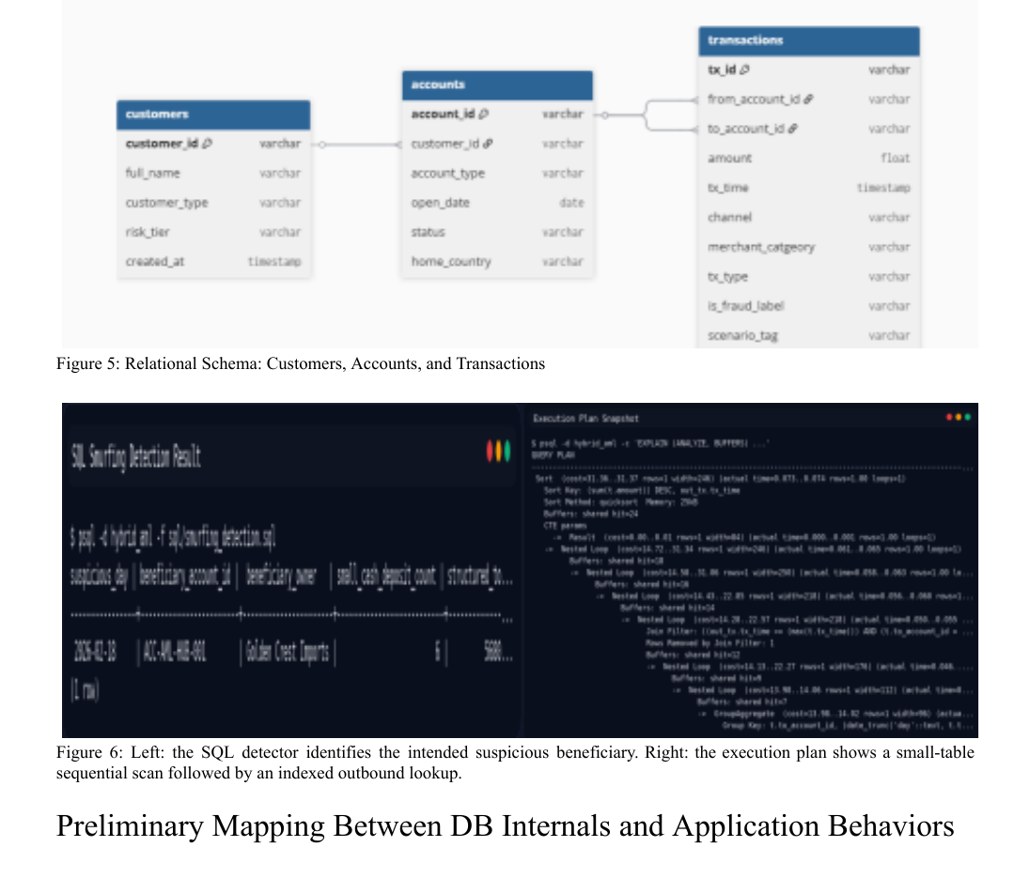
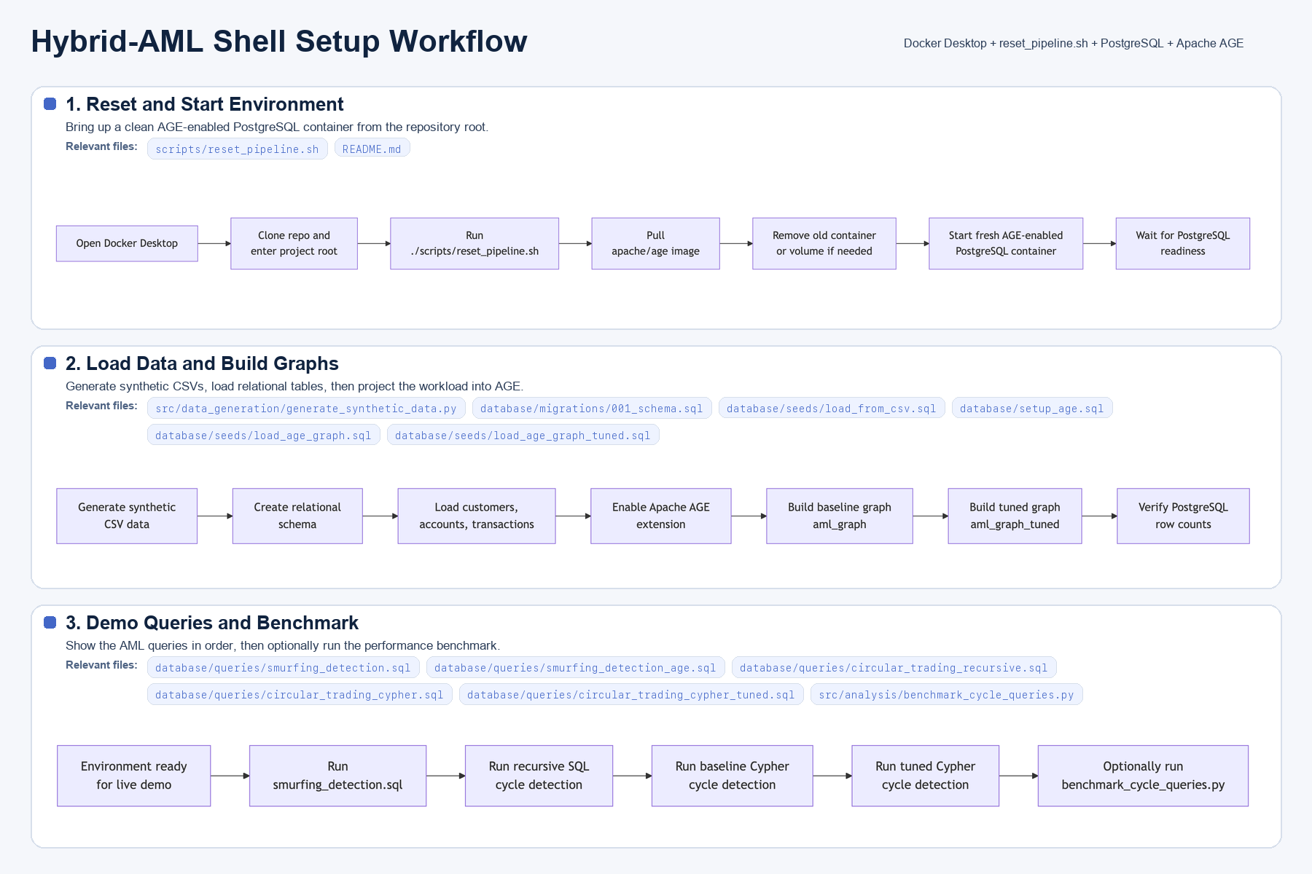
Appendix A3: Backup evidence
Keep the workflow and earlier evidence figures available for Q&A without crowding the main story.
Backup reading: use the workflow image for reproducibility questions and the midterm crop for schema/result backup during Q&A.
0.443 ms
2.503 ms
1.303 ms
2.722 ms
smurf SQL exec
smurf AGE exec
cycle SQL exec
cycle Cypher exec
Source: docs/demo/setting_workflow.png; docs/reports/Phase2_MidtermReport_ChanyoungKim_YogitaMutyala.pdf; 20 warm-cache benchmark runs.
17

