Slide 1
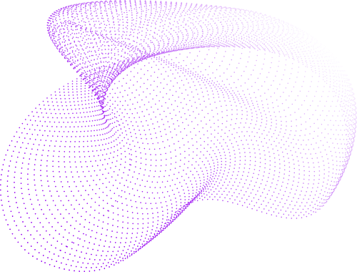
REVIEW - 2
Internship Insights
(Full Stack Development)
Priyansh Khunt
210200107041
@ RKIT Software Pvt. Ltd.

Slide 2
Week - 8
20/2/2025 - 21/2/2025
R&D Project
The primary objectives of this system are:
Secure Token Transmission:
Securely transmit authentication tokens and user-specific data (DTO) from the API to the GUI
Login Flow Confirmation:
Ensure the login API waits for GUI confirmation before finalizing the login process.

Slide 3
Week - 9
24/2/2025 - 28/2/2025
DevExtreme
Rich Data Management: Supports local and remote data sources with CRUD operations.
Advanced Features: Includes sorting, filtering, grouping, pagination, and master-detail views.
Customizable UI: Offers themes, row selection, column customization, and responsive design.
Editing Support: Allows inline, batch, popup, and form-based editing.
Export Options: Enables exporting data to Excel and PDF formats.

Slide 4
Week - 10/11
3/3/2025 - 13/3/2025
Final Demo [Employee Management System]
Authorization & Authentication:
Role-based authentication in an Employee Management system ensures secure access control by assigning users specific roles: User, Editor, and Admin.
User: Can view their profile and general employee information.
Editor: Can view and modify employee records but cannot delete them.
Admin: Has full control, including adding, editing, and deleting employee data

Slide 5



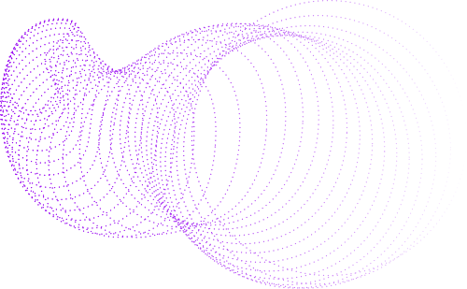
ROLE BASE RIGHTS
 | User | Editor | Admin
View Profile & Attendance
Edit Employee Details
Add New Records
Delete Records
Manage User Roles
What can you do?

Slide 6



ASP .Net framework
For backend as well as forntend base project
Service Stack ORM Lite
Tech
Stack
ServiceStack ORM is a lightweight, fast, and simple .NET ORM.
Dev Extreme
DevExtreme is a feature-rich JavaScript UI framework for modern web applications.
FULL STACK WEB APP

Slide 7
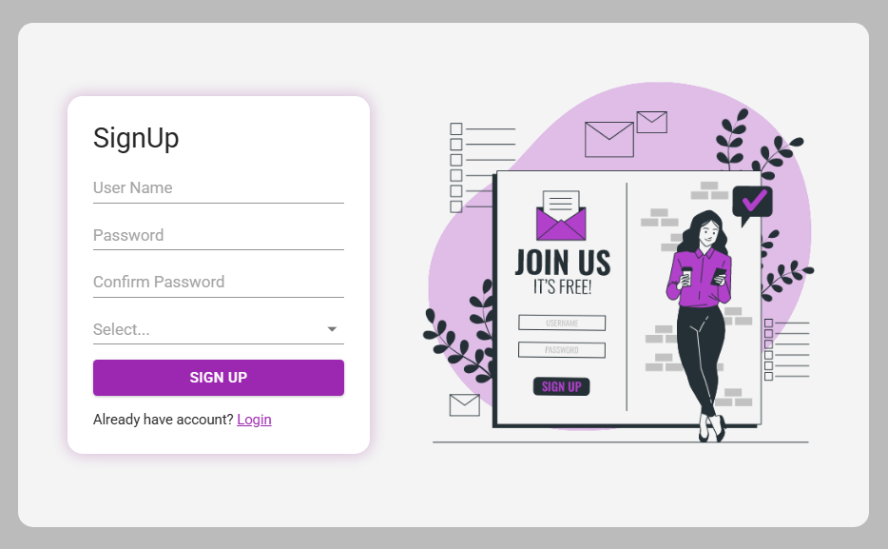
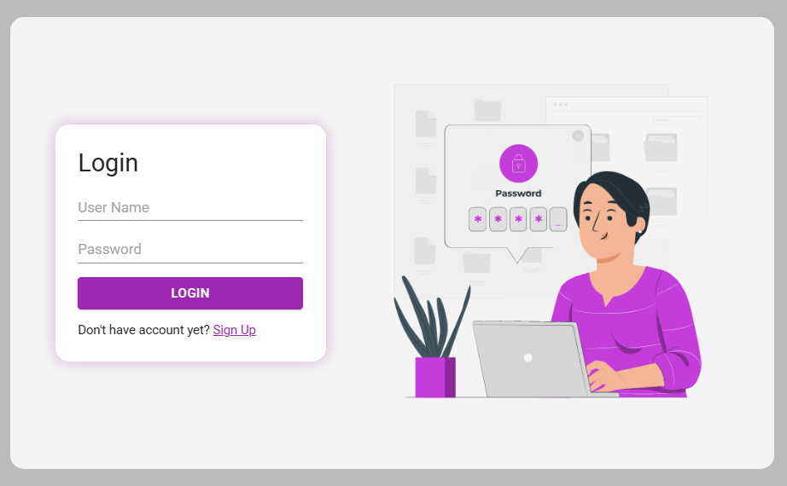
Login / Signup

Slide 8
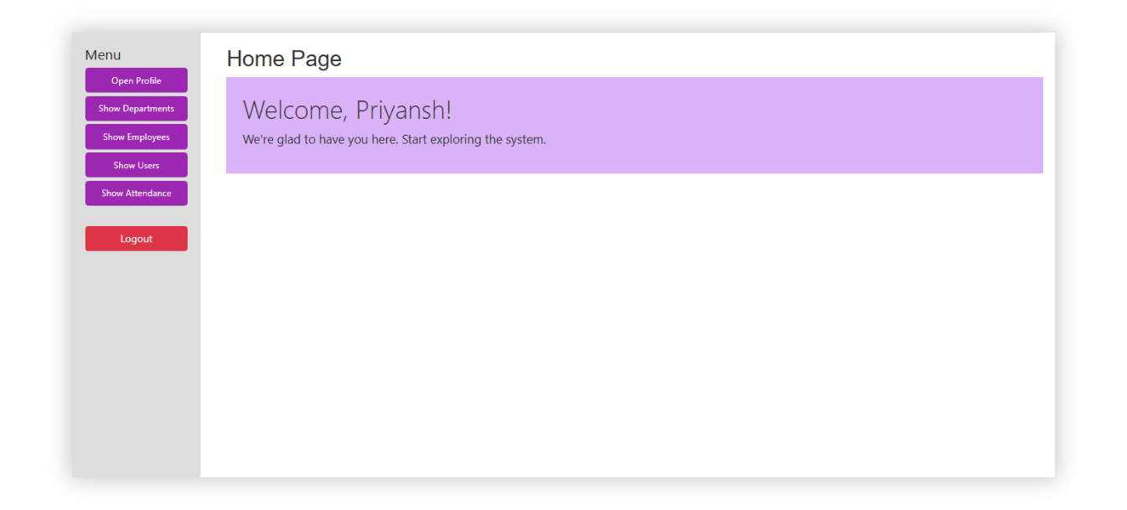
Dashboard

Slide 9
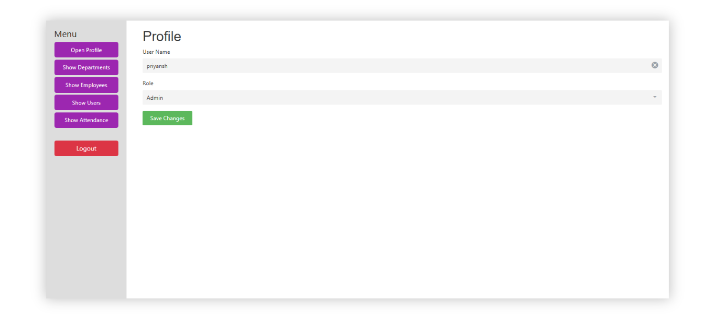
Dashboard: Profile Section

Slide 10
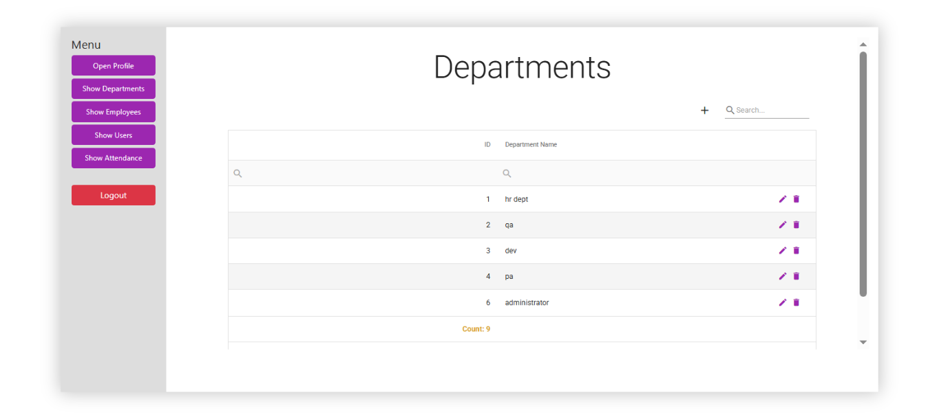
Dashboard: Departments Section

Slide 11
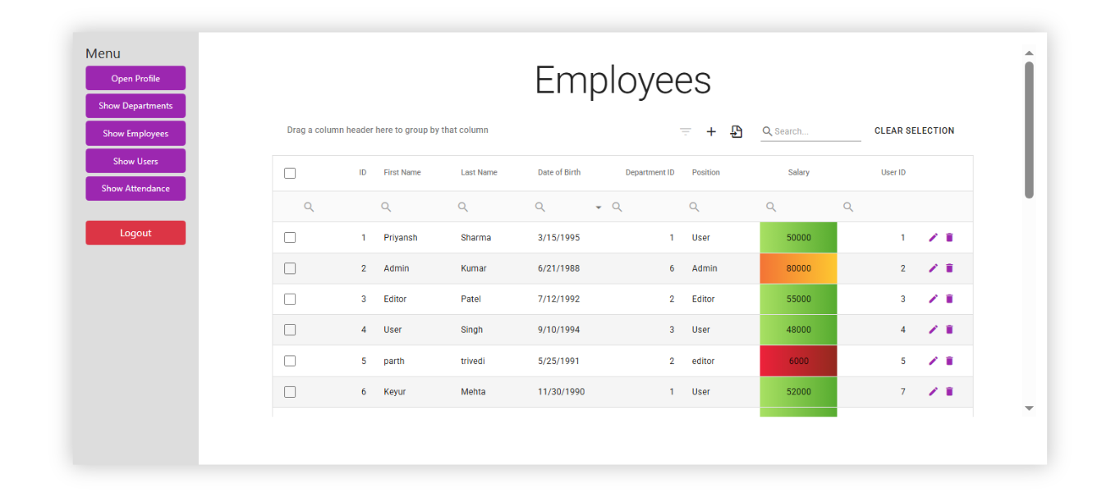
Dashboard: Employees Section

Slide 12
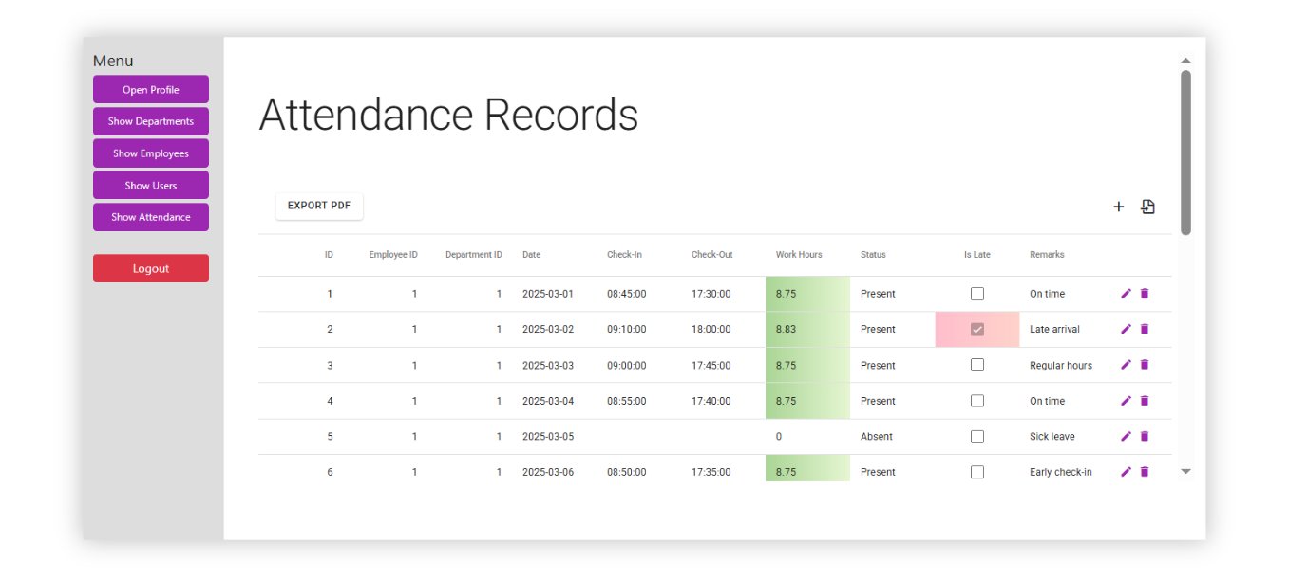
Dashboard: Attendance Section

Slide 13
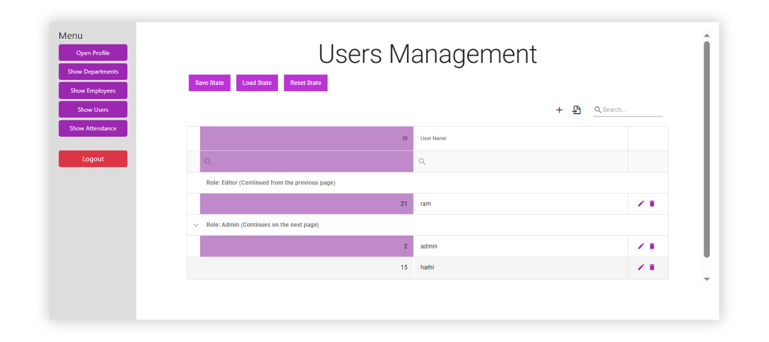
Dashboard: Users Section

Slide 14
THE END
THANK YOU
PRIYANSH KHUNT

