Slide 1
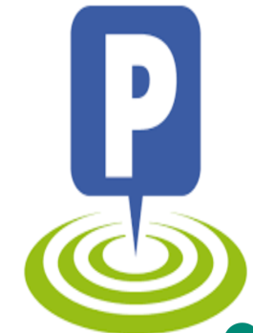
PARK N GO

Slide 2
Agenda
Introduction
Planning
Application screens with explanation
Vision and purpose of an application
Estimate cost and justification for making an investigation
Mobile
Problems Faced

Slide 3
Introduction
Park N Go
Logo:
Team Members:
Khushboo (C0684620)
Sumdeep Kaur (C0730243)
Navneet Kaur (C0728699)

Slide 4
TOOLS USED
ANDROID STUDIO
JAVA
HTML
POWERPOINT

Slide 5

PROJECT SPRINT DETAILS
April 4-April 7
Logo
Launching Screen
Login
Registration
April 8- April 11
Validations
User Profile
Parking Manual
Parking Report
April 12 -April 15
Parking Payment Receipt
Support Contact
Review
April 16 - April 19
Parking Location
Logout
Final Editing

Slide 6
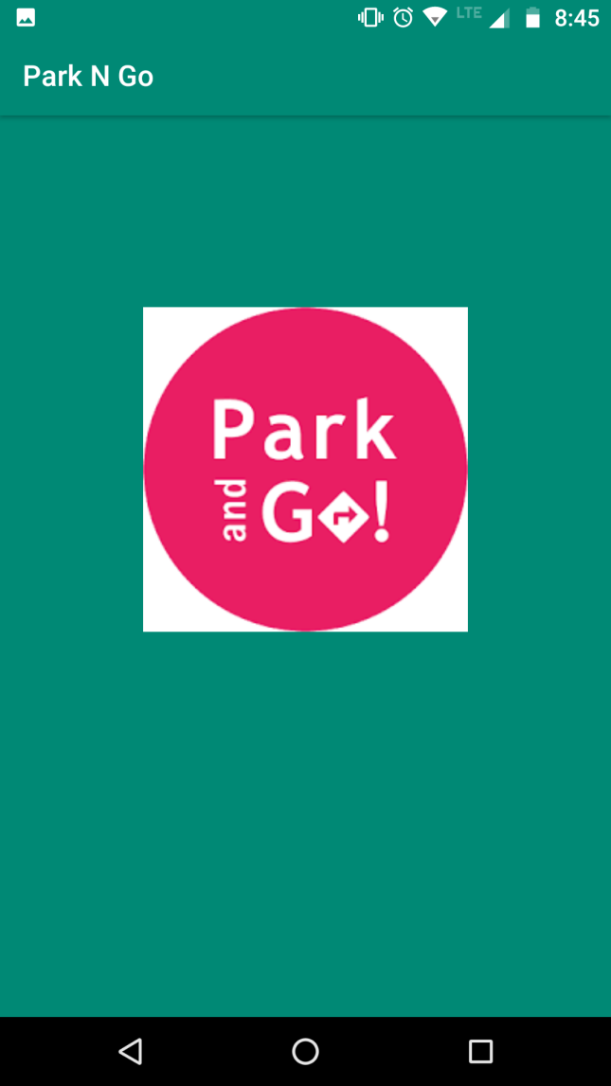
Launching Screen
First screen of the application
Timing for launching screen is 5 seconds
We can set the time according to our need.
We can set the time from AppDelegate.swift file.

Slide 7
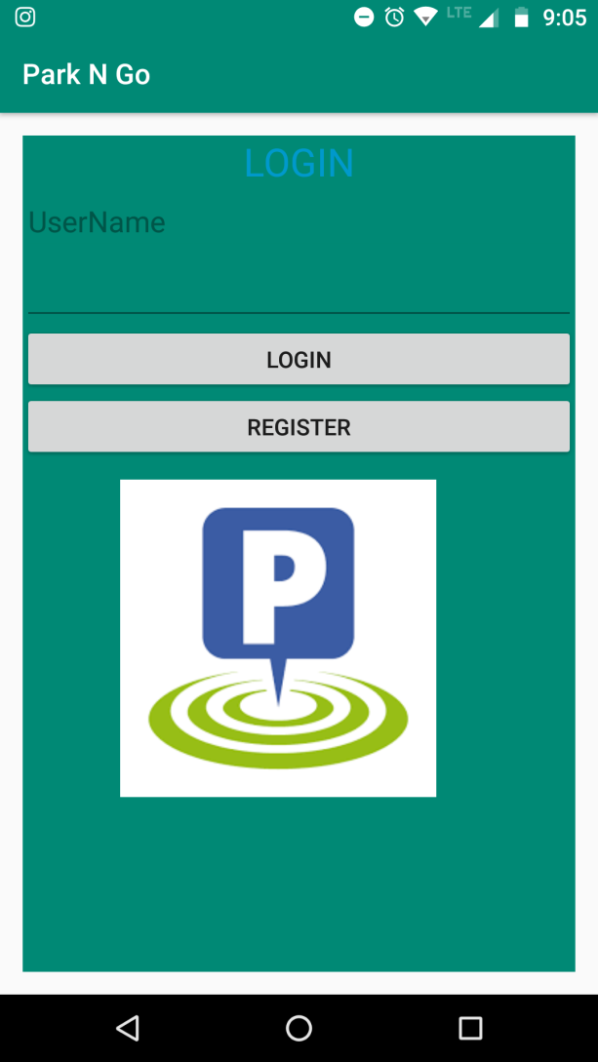
Login Screen
If user wants to use the application he/she must have to login.
In login screen user have to fill email address and password .
User also use remeber me option to save the data.
In remember me we use switch in which it allows tapping the control for on and off.

Slide 8
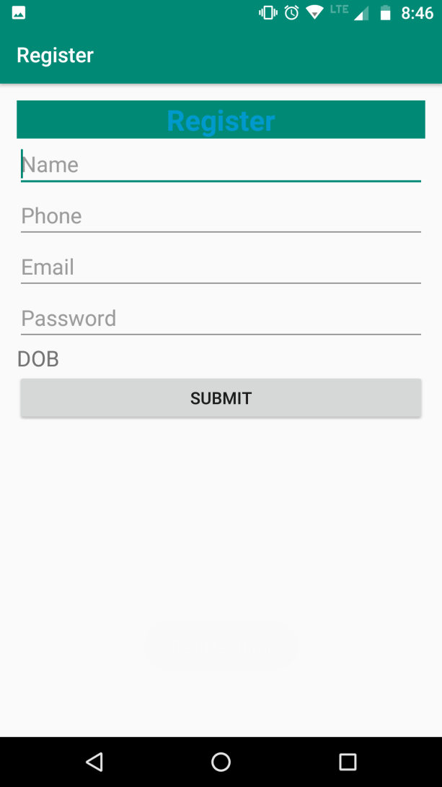
Registration Screen
If user has no account then they need to register first.
In registration form they must have to fill all the required fields.
After filling the data the application will get a confirmation from the user.
After filling the form user will go to menu screen automatically.

Slide 9
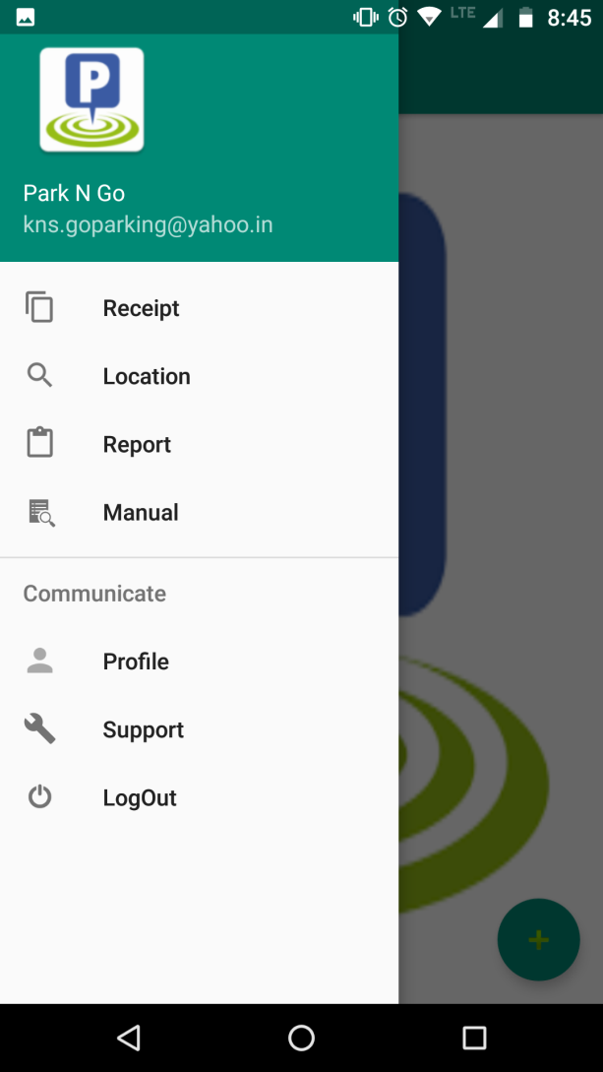
Menu Screen
In menu screen user have all the list of menu which are used in the application.
There are total 7 menus in our screen.
These menus are further linked to another pages.

Slide 10
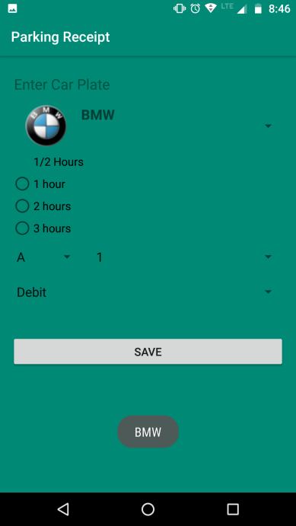
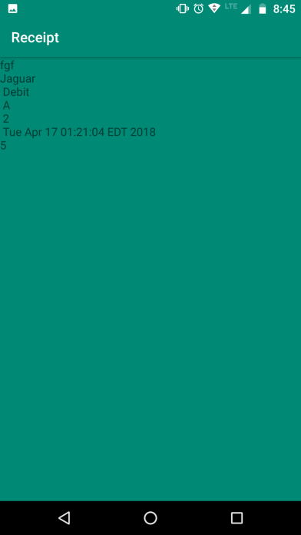
Parking Pay Receipt Screen
For a receipt user have to fill all the required fields of a form.
In this form we use different type of object library like image viewer, stepper,segment control to handle the data.
After add the data user can use the pay option in which alert is shown to check the parking report.

Slide 11
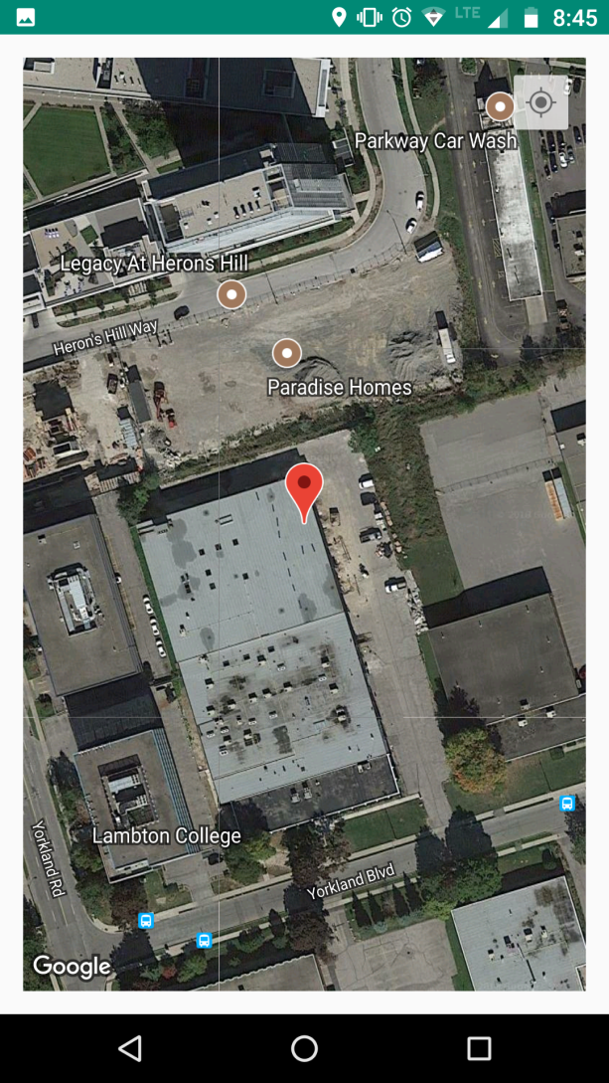
Parking Location Screen
When the user click on parking location screen the application will show the location of the user.

Slide 12
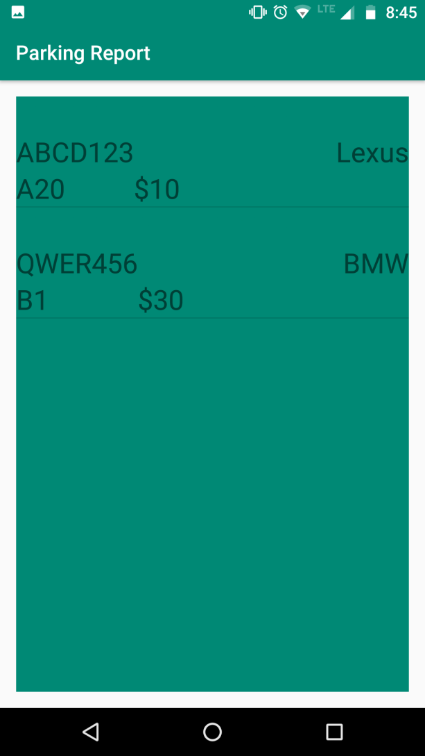
Parking Report Screen
In this screen, all the information which is which the user fill in the receipt will shown as a report.
This report contain all correct information about user.

Slide 13
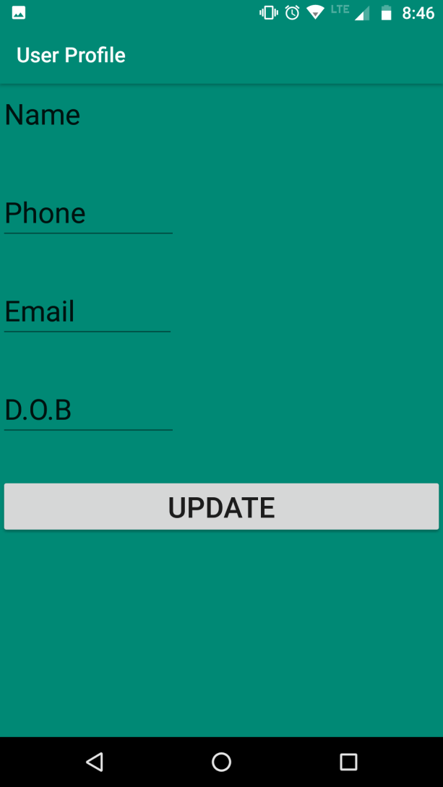
User Profile Screen
In user profile screen, user is able to update the data if they fill wrong data during registration.
In this screen user also save the updated data.

Slide 14
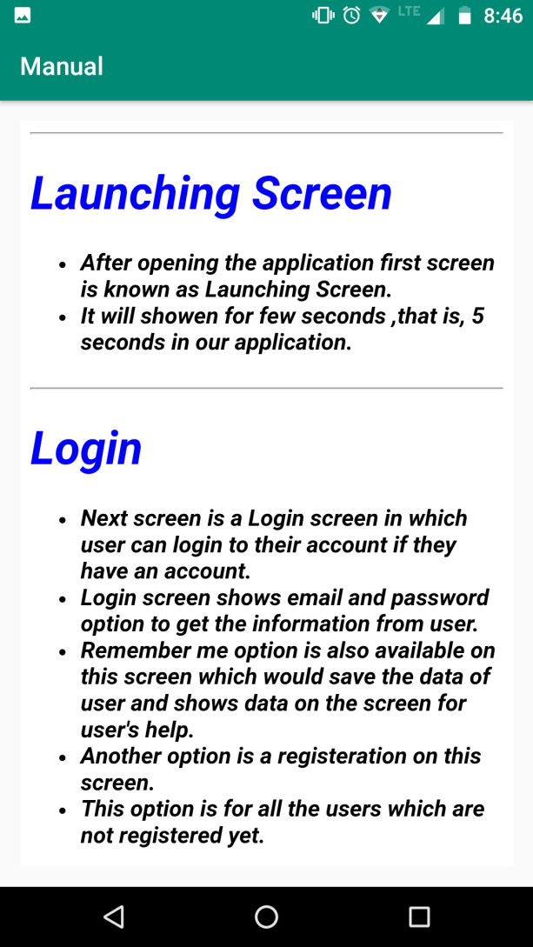
Parking Manual Screen
In a parking Manual Screen, application shows all the guidelines regardingthe use of an application.
The manual is written in html file and this file is accessed in xcode.

Slide 15
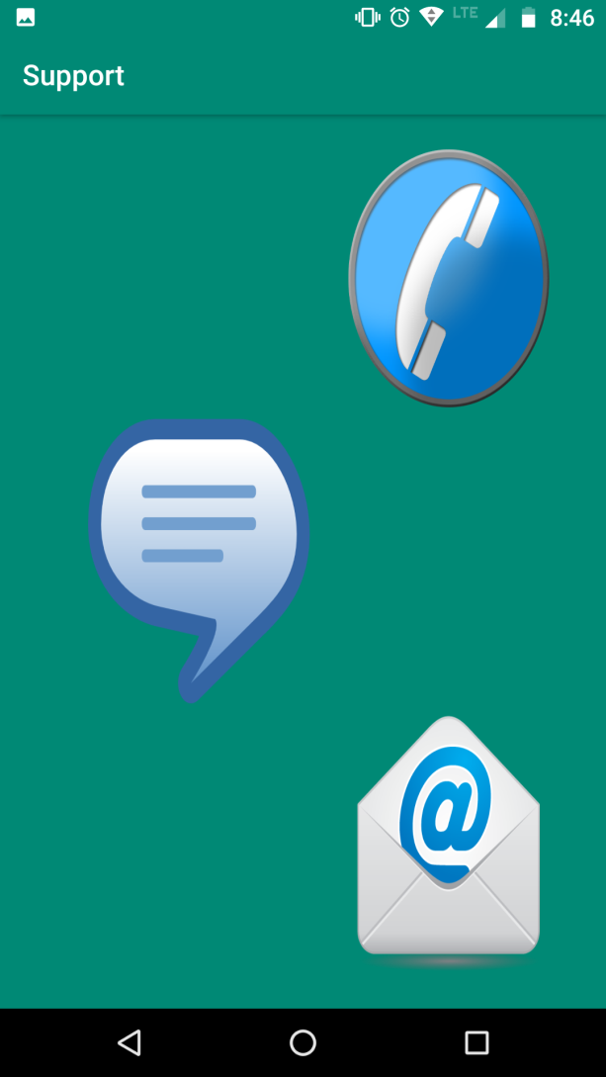
Support Contact Screen
In this screen user use different type of methods for contact ,that is, mail, message and call.
Call uses the contact list and call.
Message is used for text message.
Mail is used for sending an email.

Slide 16
Logout
After clicking the logout button the next screen is login screen.
It means by clicking this button user will not uses the application anymore.

Slide 17
Vision And Mission
Our Vision is to provide a reliable, efficient and cost-effective management service in any vehicular parking situation.
Park N Go enhances quality of life by providing clean and safe parking facilities, based on the pillars of convenience, reliability and hospitality

Slide 18
Scope of Park N Go
Park N Go parking application is useful for buildings, super malls, plaza’s, colleges where a number of cars needs to be park. By using this application user can utilize their time by reserved their parking lots. Parking provides jobs to more than 143,000 people and represents economic activity.

Slide 19
Estimated Cost
The total revenues in the App Store reached $28 billion last year, while developers earned over $20 billion on app sales.
As our application is based on Database/API application. So it cost approximately $12000, that is, $3000 for development, $3000 for designing the application and $4000 for startup.

Slide 20
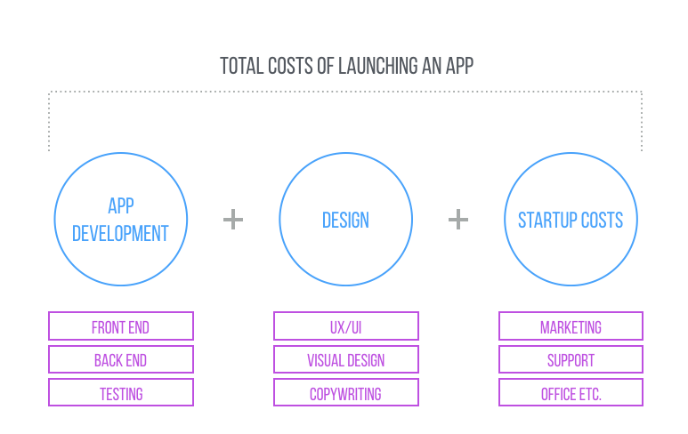
Total Cost of Launching an App

Slide 21
Used Mobile Industry Standards
Application icon graphics and launching screen is used in our application.
All graphics should primarily used all colors and styling.
Additional functions such as register, login, call, text message, email and map all are used in our applications.

Slide 22
Competitor’s Products
A permit for parking who came daily to park their car.
Car share parking
Third Party Authorization
Cancellation and Refund

Slide 23
Legal Requirements
Copyright Ownership
Ownership of mobile App data/Patent
Trade-mark protection
Terms of Use and Privacy
Confidentiality

Slide 24
Training Material
For Customer there are a lot of material like:
Manual to read the information
FAQ's
Audio Clips
Videos
Social media pages for new deals about permit ,that is , on facebook, instagram
Email Alert

Slide 25
Problems Faced
New to android studio.
Fetching data in payment receipt.

Slide 26
Planning
Feb 20 – Feb 23
Feb 24 – Feb 28
March 1 – March 4
March 5 – March 7
Welcome Screen
Login Screen With Validations
Registration
User Profile
Parking Manual
Parking Payment Receipt
Parking Location
Support Contact
Logout
Final Editing
Parking Report

Slide 27
Thank You

