Slide 1
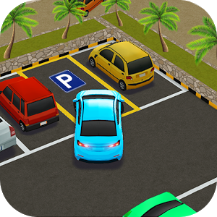
MAD-3115 FINAL PROJECT (W2018)
Cobra Coders Group
LOGO:
TEAM MEMBERS:
RAJESH KUMAR (C0728535)
KHUSHBOO (C0684620)
NAVNEET KAUR (C0730444)

Slide 2
MAD-3115 FINAL PROJECT PLANNING
Feb 20 – Feb 23
Feb 24 – Feb 28
Mar 1 – Mar 4
Mar 5 – Mar 7
Report
Profile
Project Manual
Support
Contact
Logout
Project Setup
Screen Launching
Logo
Login
Registration
Home Screen with Menu Screen
Parking Receipt Payments
Location

Slide 3
THANK YOU

