Slide 1


CE259-PIP SciPy
CE Department
Presentation by:
Hetvi Soni 20CE138
Khushi Tala 20CE142
Archana Vyas 20CE157

Slide 2
CONTENT
What is Scipy
Comparison between Numpy & Scipy
Sub-Packages
Basic Functions
Special Functions
Integration Function
Linear Algebra

Slide 3

What is SciPy?
Scipy is a python library used to solve scientific and mathematical problems
Built on numpy
Allows manipulation and visualizing

Slide 4
Comparison between Numpy & SciPy
﻿﻿﻿Point of Difference | NumPy | ﻿﻿﻿﻿﻿SciPy
Type of operations | Performs basic operations such as sorting, indexing, etc. It is mostly used when working with data science and statistical concepts. | Used for complex operations such as algebraic functions, various numerical algorithms, etc.
Functions | Contains a variety of functions but these are not defined in depth. | Contains detailed versions of the functions like linear algebra that are completely featured.
Arrays | NumPy Arrays are multi-dimensional arrays of objects which are of the same type i.e. homogeneous. | SciPy does not have any such array concepts as it is more functional. It has no constraints of homogeneity.
Base Language of creation and speed | NumPy is written in C and so has a faster computational speed. | SciPy is written in Python and so has a slower execution speed but vast functionality.

Slide 5
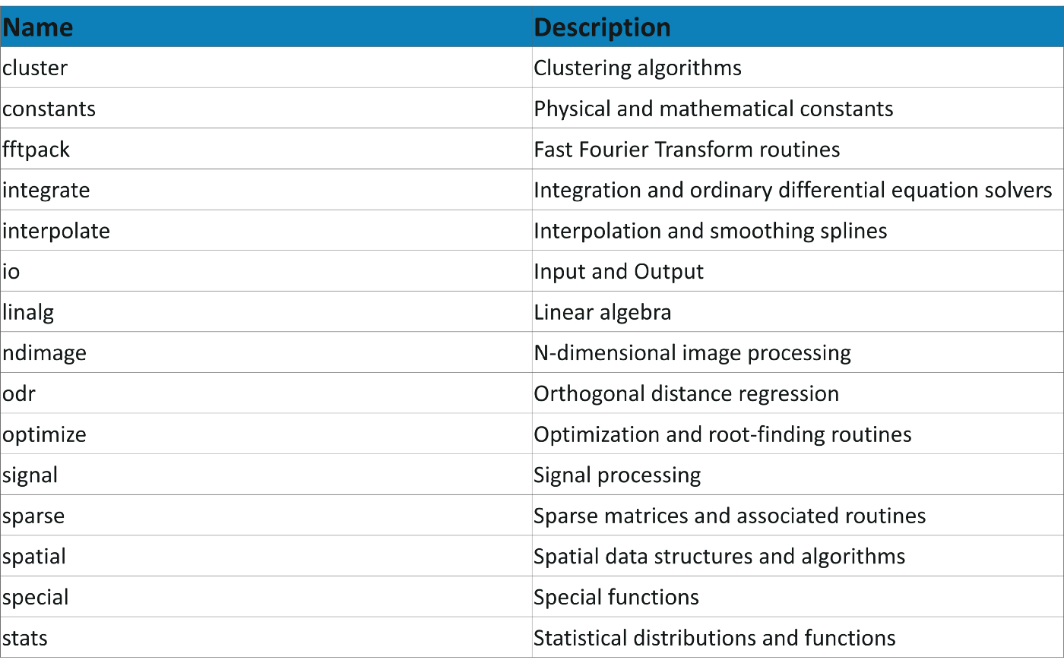
Sub Packages

Slide 6
Basic Functions
help()
info()
source()

Slide 7
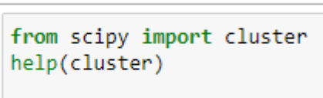
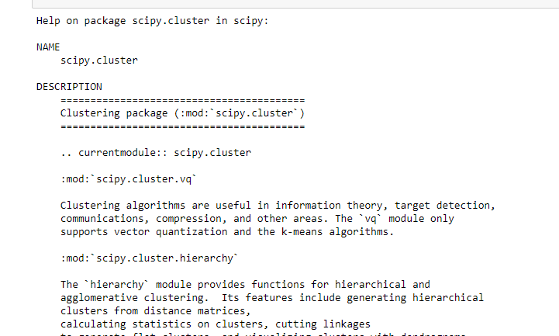
help()
Returns information about any function,keyword,class.

Slide 8
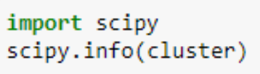
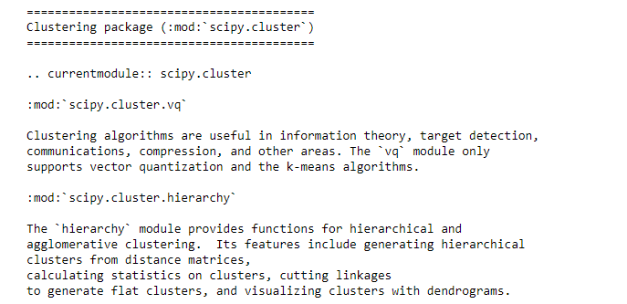
info()
Returns information about any function,keyword,class.

Slide 9

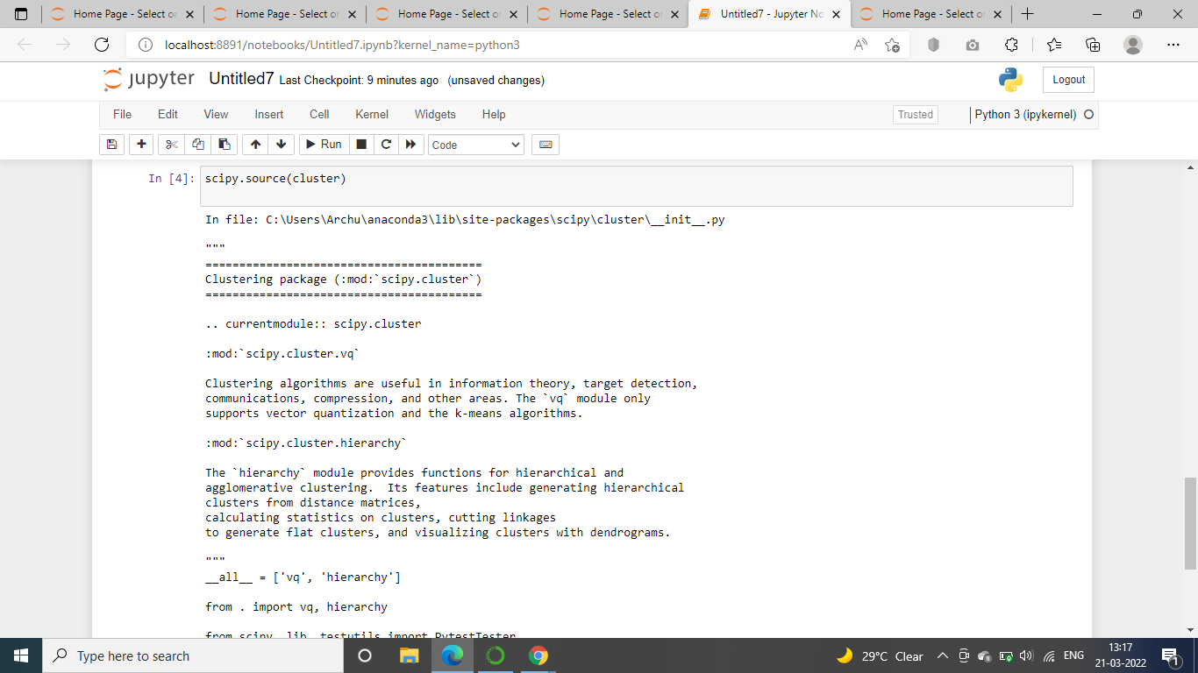
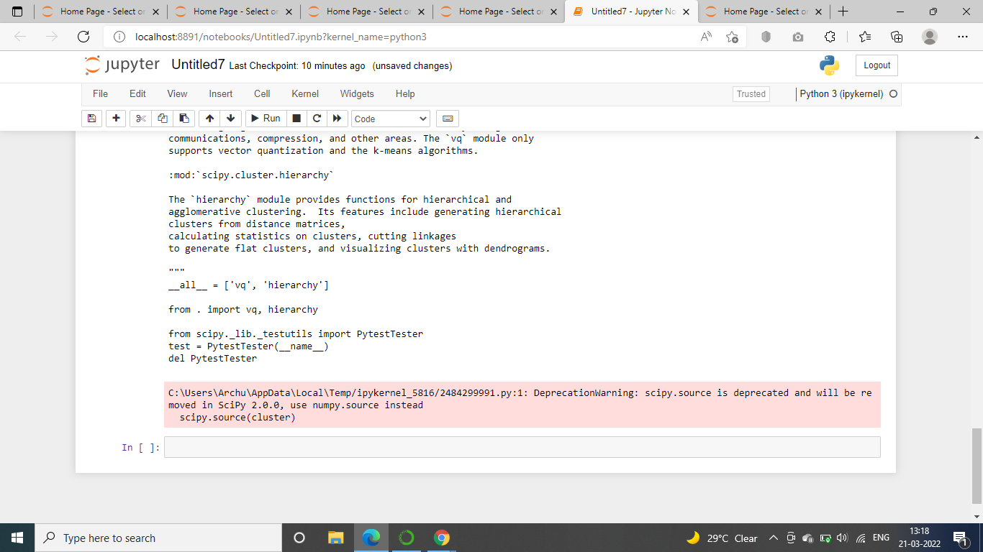
source()
Returns the source code only for objects written in python..

Slide 10
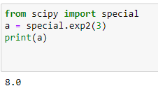
Exponential Function

Slide 11
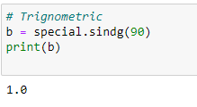
Trigonometric Function

Slide 12
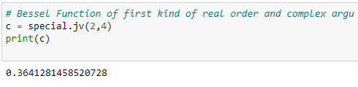
Bessel Function

Slide 13
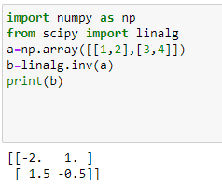
Linear Algebra
Linear Algebra of SciPy is an implementation of BLAS and ATLAS LAPACK libraries.
Performance of Linear Algebra is very fast compared to BLAS and LAPACK.
Linear algebra routine accepts two-dimensional array object and output is also a two-dimensional array.
.
Inverse Matrix

Slide 14
Integration Functions
1. General Integration
2. Double Integration

Slide 15
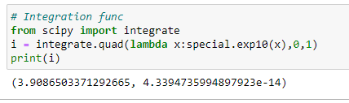
integrate.quad()
We can use the quad() function to find the single integration. The name comes from the fact that integration is sometimes called the quadrature.
Here, f is the function we need to integrate. And a and b are lower and upper limits. We got the output value as a tuple with two values. The first one represents the integral value and the second one is the estimated absolute error.

Slide 16
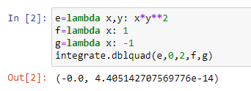
integrate.dblquad()
We can use the dblquad() function to find the double integral of a function.
Here, func is the function we need to integrate. And a and b are lower and upper limits of the variable x. The gfun and hfun are the functions that decide the lower and the upper limits of the y variable.
.

Slide 17
Thanks

