Slide 1
Telecom Churn Case Study

Slide 2
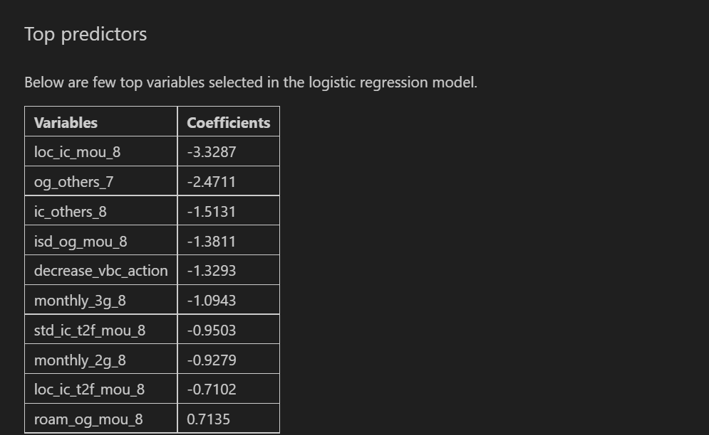
Business Recommendation

Slide 3
Recommendations:
1. Target the customers, whose minutes of usage of the incoming local calls and outgoing ISD calls are less in the action phase (mostly in the month of August).
2. Target the customers, whose outgoing others charge in July and incoming others on August are less.
3. Also, the customers having value based cost in the action phase increased are more likely to churn than the other customers. Hence, these customers may be a good target to provide offer.
4. Cutomers, whose monthly 3G recharge in August is more, are likely to be churned.
5. Customers having decreasing STD incoming minutes of usage for operators T to fixed lines of T for the month of August are more likely to churn.
6. Cutomers decreasing monthly 2g usage for August are most probable to churn.
7. Customers having decreasing incoming minutes of usage for operators T to fixed lines of T for August are more likely to churn.
8. roam_og_mou_8 variables have positive coefficients (0.7135). That means for the customers, whose roaming outgoing minutes of usage is increasing are more likely to churn.

Slide 4
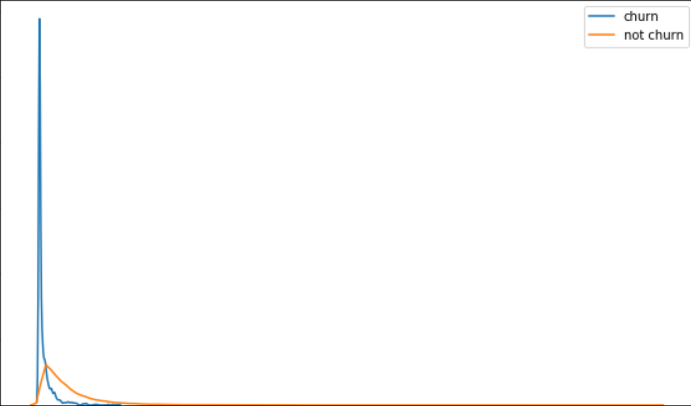
Plots of important predictors for churn and non churn customers

Slide 5
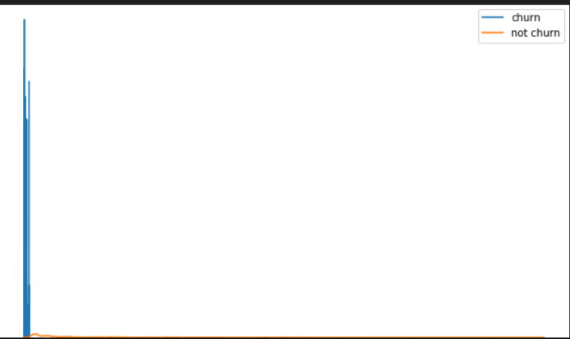
We can see that for the churn customers the minutes of usage for the month of August is mostly populated on the lower side than the non churn customers.

Slide 6
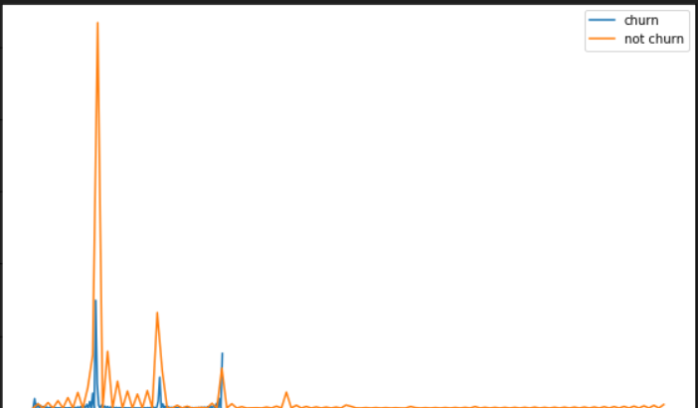
We can see that the ISD outgoing minutes of usage for the month of August for churn customers is densed approximately to zero. On the onther hand for the non churn customers it is little more than the churn customers.

Slide 7
The number of mothly 3g data for August for the churn customers are very much populated aroud 1, whereas of non churn customers it spreaded accross various numbers.
Similarly we can plot each variables, which have higher coefficients, churn distribution.

