Slide 1

CAPSTONE PROJECT - 1 Year: IV & Semester: VIII Alliance School of Advanced Computing Department of CSE-AIML

Slide 2

Title of the Project: Social Media Sentiment Analysis For rural Development Initiatives using Machine Learning
Sl. No | Reg. No | Student Name | Program | Guide Name | Date of Review
1 | 2022BCES07AED093 | K Dinesh Kumar Reddy | CSE-AIML | Dr. Jayabhaduri Radhakrishnan
2 | 2022BCES07AED094 | B Charan Reddy | CSE-AIML
3 | 2022BCES07AED150 | K Harika | CSE-AIML
4 | 2022BCES07AED256 | K Sai Sindhura | CSE-AIML

Slide 3
Agenda
Problem Statement
Existing System
Proposed System
System Architecture
Technology Stack
Key Features
Demo Screenshots
Results
Conclusion & Future Scope

Slide 4
Problem Statement
Rural development programs require continuous public feedback.
Traditional feedback collection methods such as surveys and field reports are slow and limited in reach.
Social media platforms contain large volumes of real-time public opinions.
These opinions are unstructured textual data, making manual analysis difficult.
Policymakers require an automated system to analyze public sentiment efficiently.
Sentiment analysis can help understand citizens' perceptions about government initiatives.

Slide 5
Existing System
Most sentiment analysis systems focus on product reviews or marketing data.
Many tools work only with English language datasets.
Traditional systems provide basic sentiment classification only.
Several systems process data in offline batches instead of real-time analysis.
Visualization tools are often limited and provide minimal insights for decision-making

Slide 6
Proposed System
Develop an AI-based sentiment analysis system for rural development discussions.
Collect social media posts related to government programs and initiatives.
Apply Machine Learning algorithms to classify sentiments.
Perform text preprocessing and feature extraction.
Visualize sentiment trends using an interactive dashboard.
Provide insights to help policy makers understand public opinion.

Slide 7
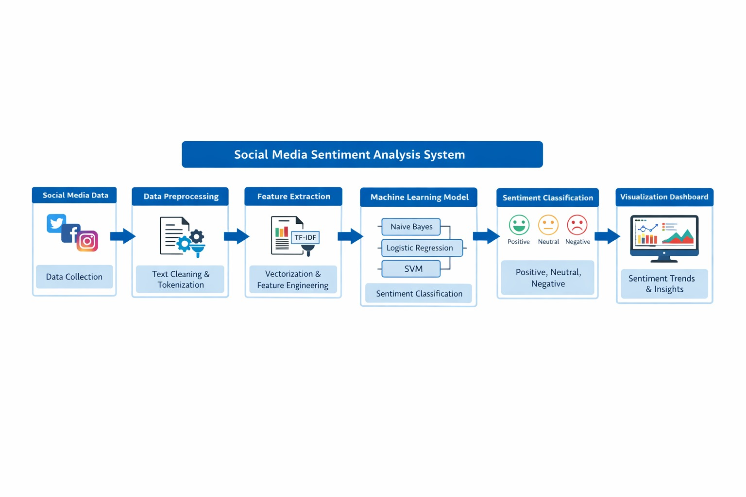
Architecture

Slide 8
Technology Stack
Programming Language
Python
Libraries
Pandas
NumPy
Scikit-learn
Machine Learning Models
Naive Bayes
Logistic Regression
Support Vector Machine
Visualization Tools
Matplotlib
Seaborn
Dashboard
Streamlit
Development Environment
Visual Studio Code

Slide 9
Key Features
Automated sentiment classification of social media posts
Support for analyzing large volumes of text data
Multiple machine learning models for comparison
Interactive visualization dashboard
Sentiment trend monitoring
Provides insights for policy makers and researchers

Slide 10
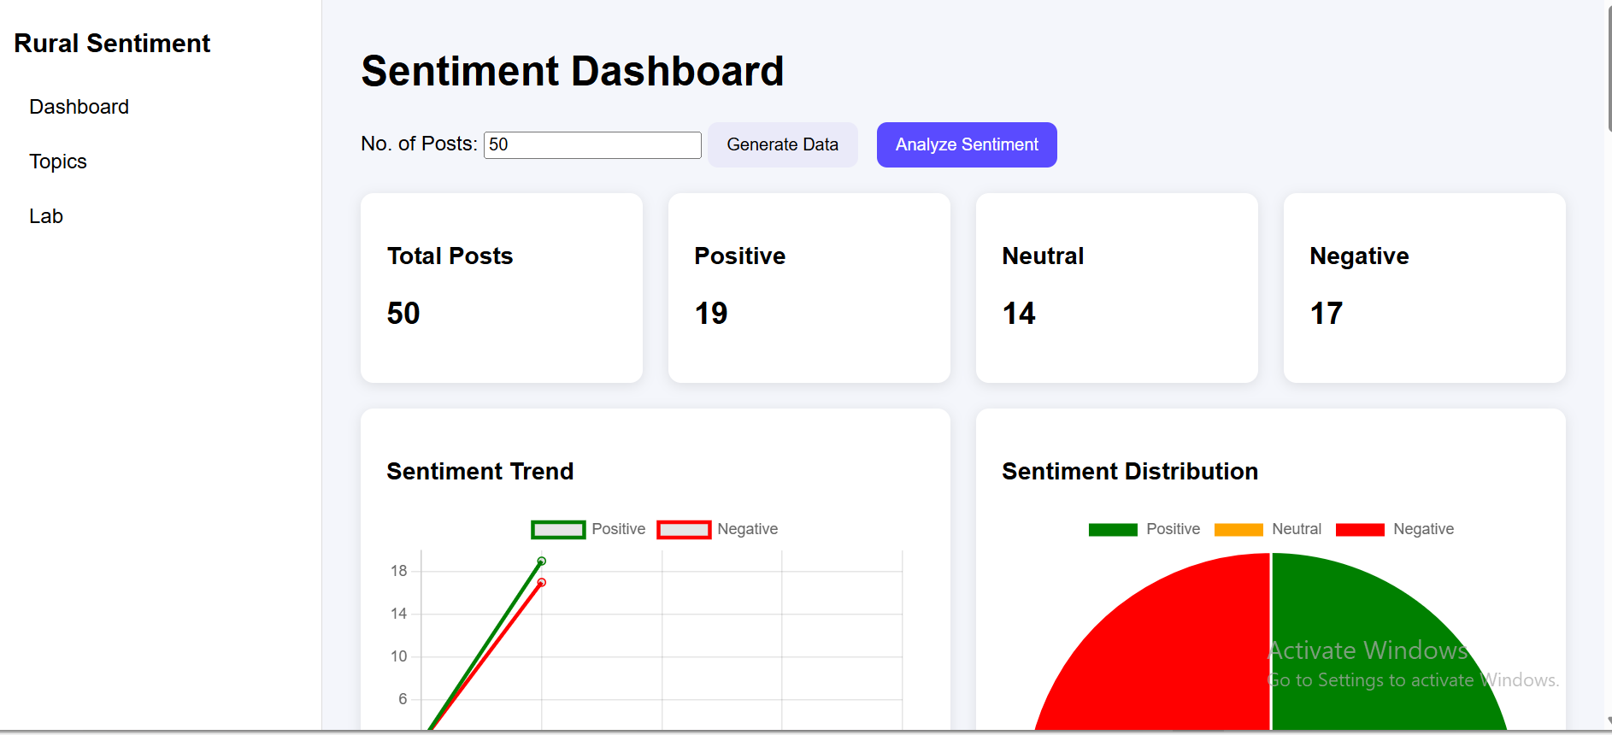
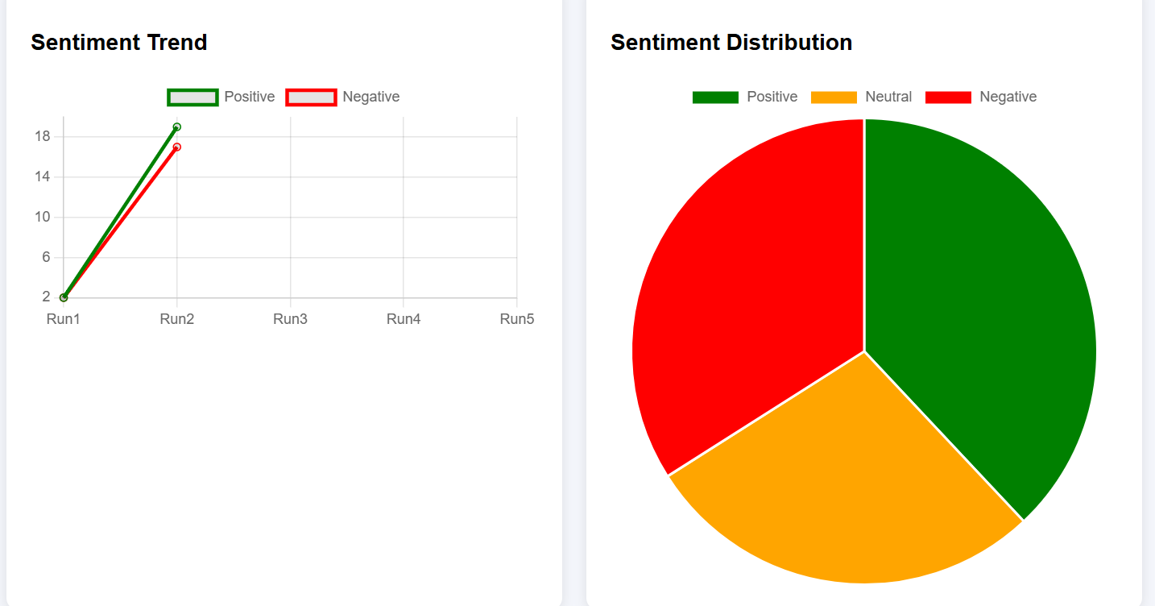
DEMO SCREENSHOTS:

Slide 11
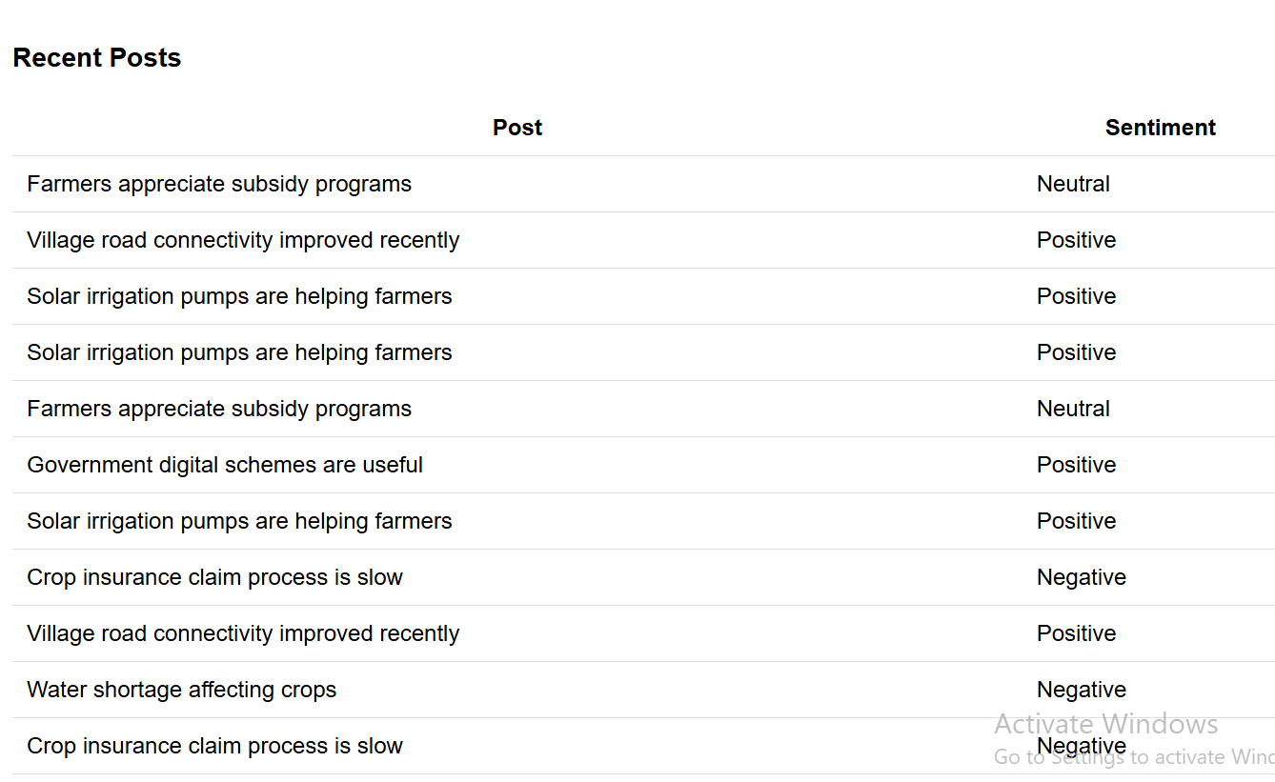
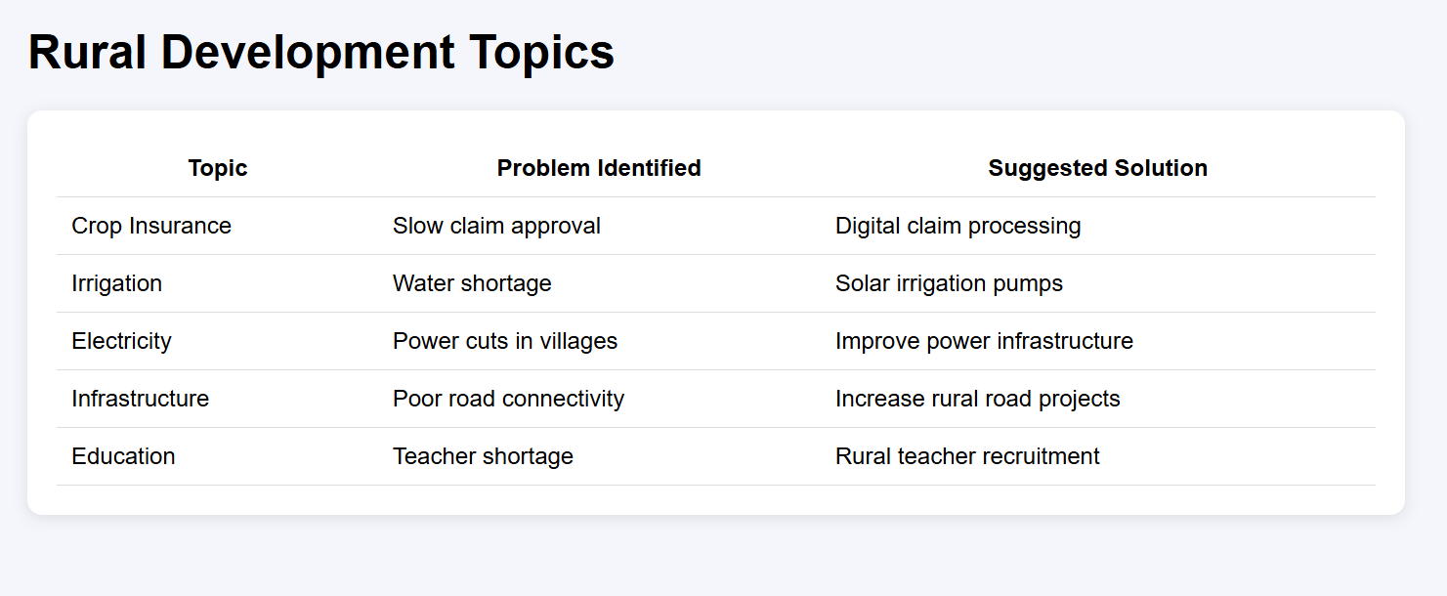

Slide 12
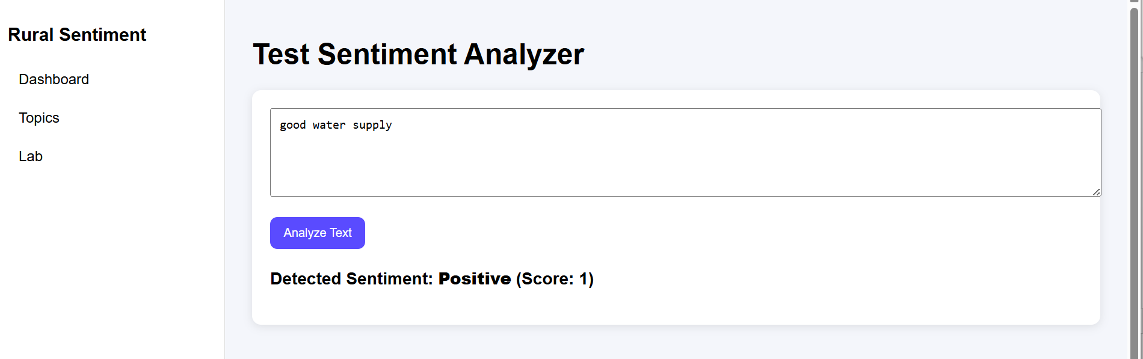

Slide 13
Results
Machine learning models were trained and evaluated.
Sentiment classification achieved good accuracy levels.
Visualization dashboard provides clear insights into public sentiment trends.
Results show that SVM model performs best among tested models.

Slide 14
Conclusion & Future Scope
Developed a sentiment analysis system for rural development discussions.
Machine learning models successfully classify sentiments.
Dashboard provides useful insights for decision makers.
Demonstrates practical application of AI in governance.
Future Scope
Integration with real-time social media APIs
Support for more Indian regional languages
Use of deep learning models for improved accuracy
Cloud deployment for scalability

