Slide 1


Artificial Intelligence and Data Science
24ADI204 Data Science and Visualization
DATA-VIZ HACK-A-BIT (2026-2027)
AIR QUALITY INDEX AND ANALYSIS
Team Number: 09
  Ajayselvakumar K 25BAD004
  Ashwinkumar N 25BAD015
  Harish K 25BAD033
  Logapradeep N D 25BAD050
  Anush Adithiya 25BAD502

Slide 2

Project Walkthrough
01. Project Scope
07. Data Cleaning
13.Key Insights /Results
02.Problem Statement
08. Outlier Handling
14.Dashboard
03. Objectives
09. EDA
15.Demo Video
04. Project Workflow
10. Correlation Analysis
16.Future Enhancements
05. Dataset Overview
11. Feature Engineering
17.Team Contribution
06. Target Variable
12. PCA
18.Conclusion/Reference

Slide 3


Project Scope
  Analyse air quality measurements collected from 26 Indian cities.
  Study major air pollutants and their relationship with the Air Quality Index (AQI).
  Identify pollution patterns across different cities and time periods.
  Clean and preprocess the dataset to improve data quality.
  Apply statistical techniques to identify and handle extreme values.
  Perform exploratory data analysis to understand pollution characteristics.
  Apply feature engineering and Principal Component Analysis (PCA) to prepare data for further analysis.
SDG Alignment
  SDG 3: Good Health and Well-being
  SDG 11: Sustainable Cities and Communities
  SDG 13: Climate Action

Slide 4
Problem Statement
  Air pollution is a major environmental and public health concern in Indian cities. Different pollutants, such as PM2.5, PM10, NO₂, CO and SO₂, contribute to changes in air quality.
  However, analysing large volumes of air-quality data is challenging because of missing values, extreme observations and relationships between multiple pollutants.
Our project focuses on:
  Understanding air pollution levels across Indian cities.
  Identifying the major pollutants associated with AQI.
  Discovering patterns and variations in air quality.
  Preparing reliable data for further pollution analysis and prediction.

Slide 5
Objectives
  Data Understanding: Explore the dataset structure, features, cities and time period.
  Data Cleaning: Identify and handle missing values and duplicate records.
  Outlier Handling: Detect extreme pollutant and AQI values using statistical methods.
  Exploratory Data Analysis: Study pollutant distributions and their relationship with AQI.
  Correlation Analysis: Identify relationships and redundant pollutant features.
  Feature Engineering: Apply transformations, scaling and categorical encoding.
  Dimensionality Reduction: Apply PCA to reduce the number of features while retaining important information.
  Future Prediction: Prepare the processed dataset for developing an AQI prediction model.

Slide 6
Project Workflow
Raw Dataset Collection
↓
Dataset Understanding
↓
Data Quality Analysis
↓
Data Cleaning
↓
Missing Value Treatment
↓
Outlier Detection and Handling
↓
Exploratory Data Analysis
↓
Correlation Analysis
↓
Feature Engineering
↓
Feature Selection
↓
Standardization
↓
Principal Component Analysis
↓
Reduced Dataset
↓
Future AQI Prediction Model
↓
Visualization Dashboard

Slide 7
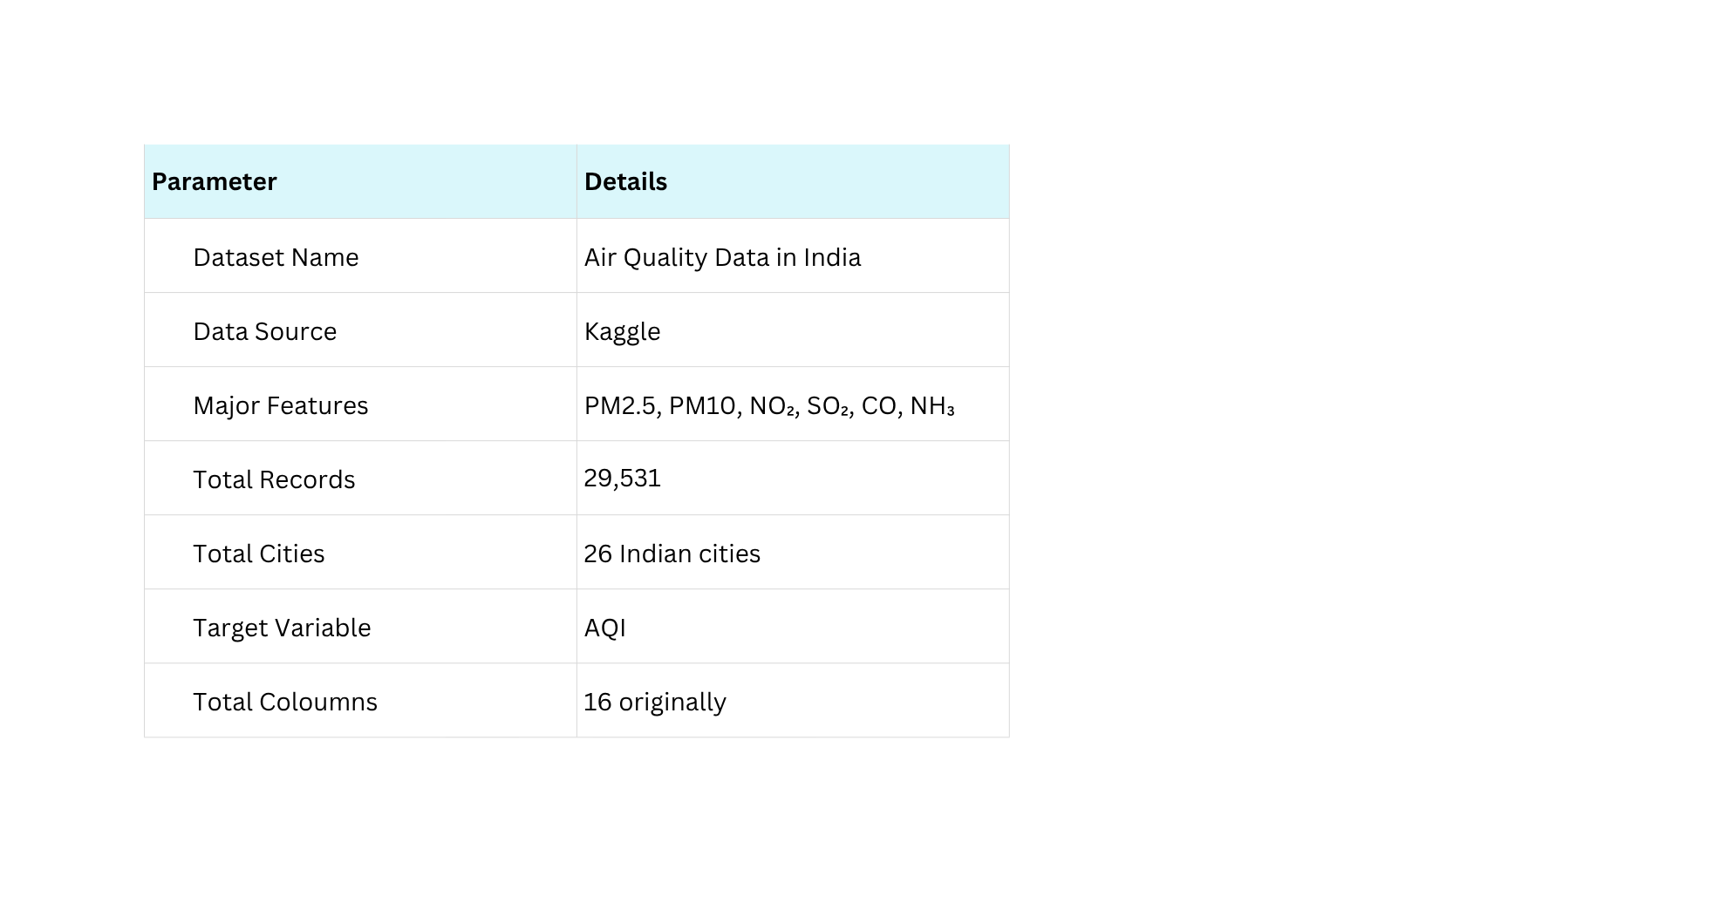
Dataset Overview
Dataset Link:
Kaggle – Air Quality Data in India

Slide 8
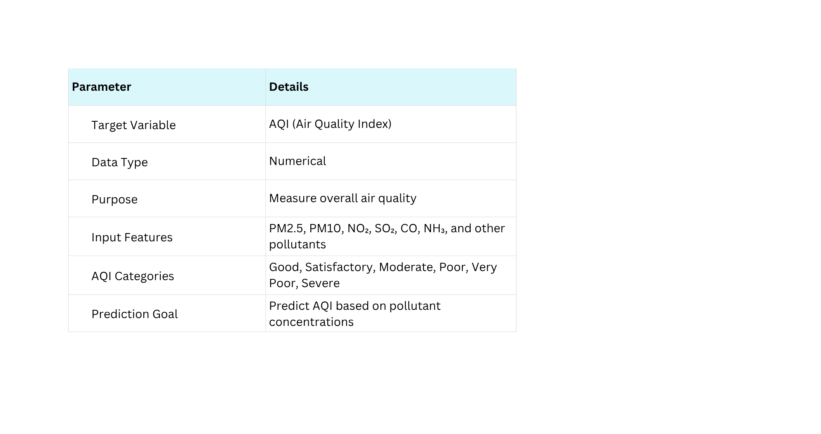
Target Variable
  AQI represents the overall air-quality level based on pollutant measurements.
  It is the main variable considered for understanding and analysing air pollution.
  AQI is a numerical feature that can be used for future prediction.
  AQI_Bucket represents the corresponding air-quality category.

Slide 9
Data Cleaning
Initial Dataset:
  29,531 rows
  16 columns
  88,488 missing values
  0 duplicate records
Cleaning Techniques Applied:
  Created a separate working copy of the original dataset.
  Analysed missing-value percentages for each feature.
  Removed Xylene due to its high missing percentage of 61.32%.
  Applied city-wise median imputation for PM10 and NH3, with an overall median fallback.
  Applied median-based imputation to other numerical pollutant and AQI values.
  Recalculated and validated AQI_Bucket after AQI treatment.
  Verified the final dataset for missing and duplicate records.

Slide 10
Outlier Handling
  Detected outliers in the dataset using IQR (Interquartile Range) and Z-score methods.
  Identified extreme values in pollutants such as Toluene, SO₂, NO, PM10, and NOx.
  Found 543 records with AQI values above 500, with the highest value reaching 2049.
  Applied IQR-based capping to limit extreme AQI values, using an upper limit of 391.
  This process helps reduce the influence of extreme values and improves the reliability of data analysis and visualization.
  Outlier handling was performed carefully to retain useful information while reducing the impact of unusually high values.

Slide 11
Exploratory Data Analysis
  Examined the distribution of AQI values to understand overall air quality conditions.
  Identified variations in pollution levels among the 26 Indian cities.
  Compared PM2.5 and PM10 concentrations to understand their contribution to air pollution.
  Analyzed the distribution of AQI categories, such as Good, Satisfactory, Moderate, Poor, and Severe.
  Used boxplots to identify extreme values in pollutant concentrations.
  Compared average pollutant levels across different AQI categories.
  Observed that pollutant concentrations vary significantly across cities.
  Used visualizations to identify possible relationships between pollutant levels and AQI.
  Summarized the major pollution trends to support further analysis.
  The EDA results provide a foundation for feature engineering and future AQI prediction.

Slide 12
Correlation Analysis
  Studied the strength and direction of relationships between different pollutant features.
  Compared pollutant correlations before and after missing-value imputation.
  Observed that PM10 had a correlation of 0.803 with AQI before imputation.
  Found that NH₃ had a weak correlation with AQI after imputation, with a value of 0.086.
  Used a correlation matrix or heatmap to visualize relationships among pollutant variables.
  Applied a correlation threshold of 0.70 to identify highly correlated features.
  Identified NOx as a highly correlated feature and removed it after reviewing the correlation results.
  Reduced redundant information among features to simplify the dataset.
  Helped identify potentially useful features for future air quality prediction.
  Overall, correlation analysis supported feature selection and preparation for dimensionality reduction using PCA.

Slide 13
Feature Engineering
  Applied log transformation to reduce skewness in pollutant data and improve data distribution.
  Reduced PM2.5 skewness from 1.02 to -0.30 using log transformation.
  Used StandardScaler to bring pollutant features to a common scale.
  Applied one-hot encoding to convert city names into numerical features.
  Used label encoding to convert AQI categories into numerical values.
  Selected and prepared relevant pollutant features for further analysis.
  Transformed the dataset into a suitable format for machine learning algorithms.
  These steps helped improve data quality and prepare the dataset for PCA and future air pollution prediction models.

Slide 14
Dimensionality Reduction
  Applied Principal Component Analysis (PCA) to reduce the number of features in the dataset.
  Selected relevant pollutant features after checking variance and correlation.
  Reduced the number of features while preserving important information.
  The first principal component (PC1) explained 35.56% of the variance.
  The second principal component (PC2) explained 13.23% of the variance.
  The first two components together retained 48.79% of the total variance.
  Nine principal components retained 97.25% of the total variance.
  Dimensionality reduction helps simplify the dataset, reduce complexity, and prepare data for future machine learning models.

Slide 15
Key Insights / Results
  Successfully cleaned the air quality dataset containing 29,531 records from 26 Indian cities.
  Handled missing values and removed duplicate records.
  Identified pollution patterns using exploratory data analysis and visualizations.
  Analyzed relationships between AQI and major pollutants such as PM2.5 and PM10.
  Applied feature engineering techniques to prepare the data for modeling.
  Reduced the dataset to 9 principal components while retaining 97.25% of the variance.
  These results provide a foundation for developing an air quality prediction model in the next phase.

Slide 16
Visualization Dashboard
  Plan to develop an interactive dashboard to visualize air quality data across Indian cities.
  Display AQI levels, PM2.5, PM10, CO, SO₂, and NO₂ concentrations using charts and graphs.
  Use bar charts to compare average AQI across different cities.
  Use line charts to show changes in AQI over time.
  Include filters for selecting cities, dates, and pollutants.
  Use color-coded AQI categories to identify different pollution levels.
  Present key air quality statistics through charts, graphs, and summary indicators.
  Design a simple, user-friendly interface to help users understand pollution patterns.

Slide 17
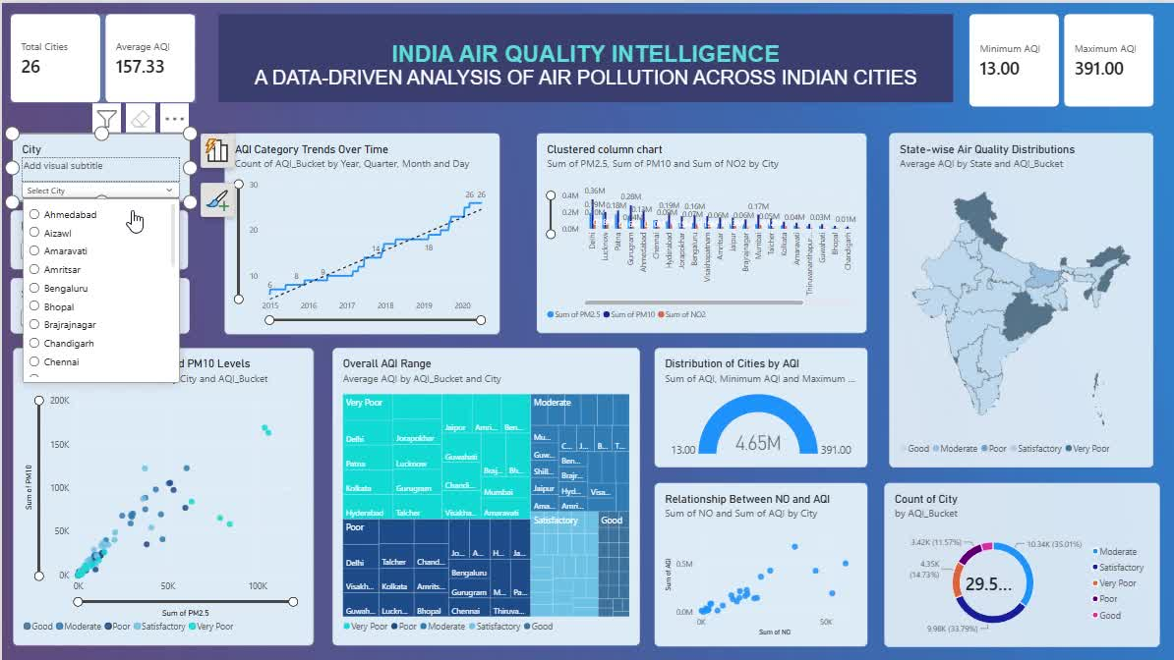
Demo Video

Slide 18
Project Scope
  Analyze air quality data collected from 26 Indian cities.
  Study major pollutants such as PM2.5, PM10, CO, NO₂, SO₂, and NH₃.
  Clean the dataset by handling missing values, duplicate records, and outliers.
  Perform exploratory data analysis (EDA) to identify pollution patterns and trends.
  Analyze relationships between air pollutants and the Air Quality Index (AQI).
  Apply feature engineering and dimensionality reduction using PCA.
  Plan to develop a machine learning model for AQI prediction.
  Design an interactive visualization dashboard for city-wise air quality analysis.
  Support better understanding of pollution levels and help identify highly polluted areas.

Slide 19
Individual Contribution
  Ajayselvakumar K-Dataset collection, understanding, and data preprocessing
  Ashwinkumar N-Data cleaning, Exploratory Data Analysis (EDA), and visualization
  Harish K-Correlation analysis, feature engineering, PCA, and dashboard creation
  Logapradeep N D-Result analysis, documentation, and project evaluation
  Anush Adhithiya-Project coordination, result interpretation, and presentation preparation

Slide 20
Conclusion & References
Conclusion
  Successfully analyzed air quality data from 26 Indian cities using 29,531 records.
  Cleaned the dataset by handling missing values and identifying outliers.
  Performed EDA and visualization to understand pollution patterns and AQI variations.
  Analyzed relationships between major pollutants and AQI.
  Applied feature engineering and PCA, retaining 97.25% of the variance using 9 principal components.
  The analysis provides a foundation for developing an AQI prediction model and an interactive visualization dashboard in the future.
References
  Kaggle – Air Quality Data in India: Dataset (city_day.csv).
  Pandas Documentation – Data cleaning and preprocessing.
  Matplotlib Documentation – Data visualization.
  Seaborn Documentation – Statistical data visualization.

