Slide 1
Regression Problem
Francisco duarte
Florian Heinemann

Slide 2
Objectives:
“[…] build a model that will predict the price of a house based on features provided in the dataset“
“[…] understanding which factors are responsible for higher property value - $650K and above"

Slide 3
Steps taken
Trying to understand all the data points by:
restructuring it with mysql to have a better idea of the shape of the data
visualize it with tableau to prove assumptions and find conclusions for improving the model later

Slide 4
major observations:
Big houses could be cheap and small houses could be expensive.
One of the key features that rose the price was the grade of the house.

Slide 5
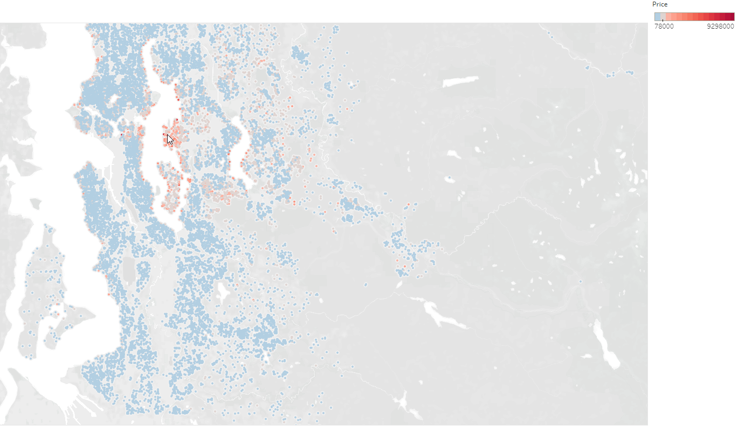
finally location, location, location

Slide 6
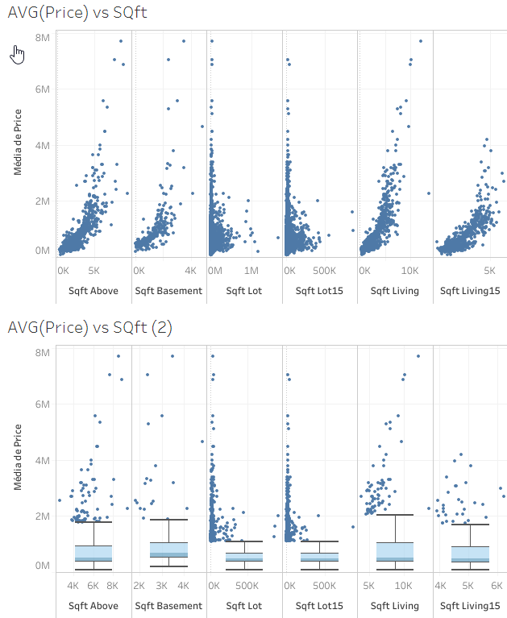

Slide 7
Building the model
What is it predicting?
What is not good about it?
What is good about it?
Improvements for a more reliable version

Slide 8


